Slide 1
Teams A pupil guide

Slide 2
The first time you sign in, use your glowusername@glow.sch.uk
E.g, smithjohn@glow.sch.uk
It is important to remember the @glow.sch.uk part as this is recognised as a school account rather than a personal Teams account.

Slide 3
You will also have to set the time zone to Dublin/Edinburgh/London

Slide 4
Select the tile for your class

Slide 5
You will see these tabs across the top. Posts allows you to chat within your class. Remember to adhere to the policy on comments. Think before you post!

Slide 6
The Files tab contains the files for your class.

Slide 7
Assignments contain tasks that have been assigned to you to complete.

Slide 8
You can click on the tasks to view the information.

Slide 9
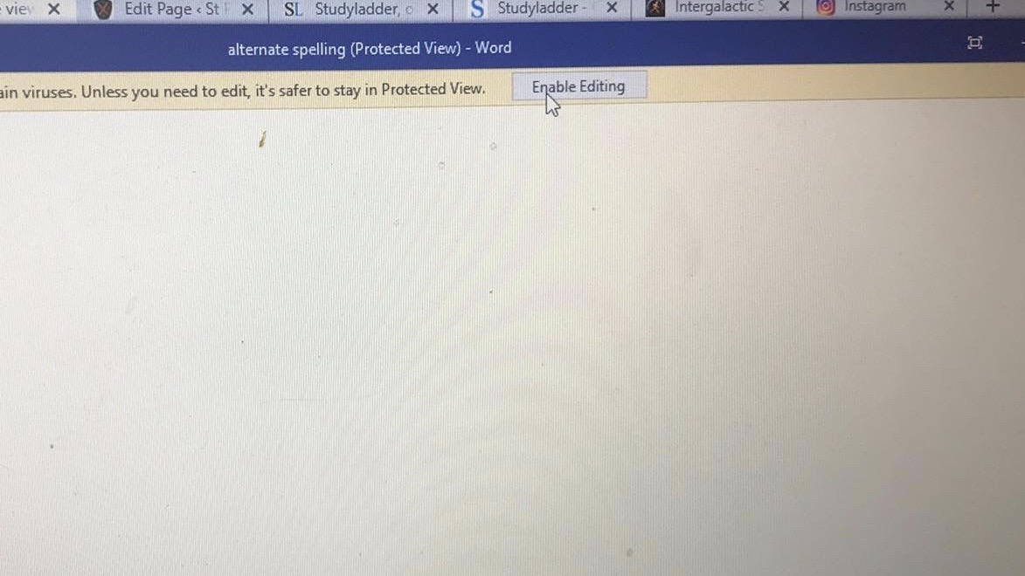
On a desktop you download the document using the 3 dots at right, then enable editing.

Slide 10
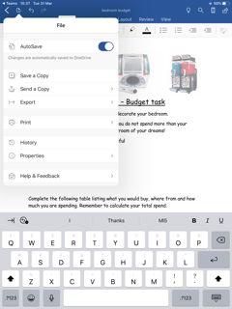
If you are using an Ipad, you save a copy, which allows you to edit and save.

Slide 11
You may have to open a word document to complete the task. Once this is saved to your device use the + Add work function to add the word document.

Slide 12
Once you have added your completed word document, click on the blue Hand in button. This submits the assignment to your teacher to mark.

