Slide 1
Technical
Introduction to our subject areas ☺
DESIGN MANUFACTURE
GRAPHIC COMMUNCATION
PRACTICAL WOODWORK

Slide 2

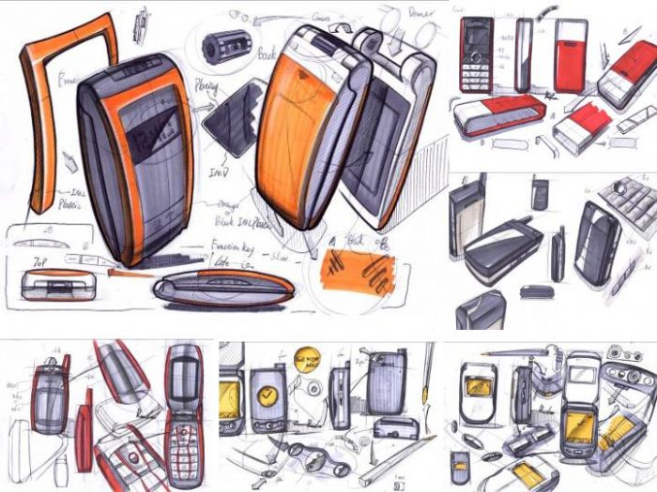
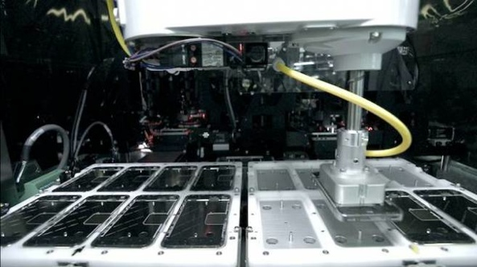

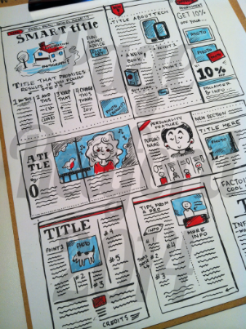
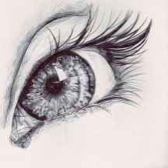

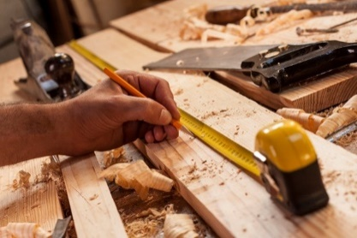
What is Technical?
Design
Manufacture
Graphic communication
Practical Wood

Slide 3




DMG: Creativity is Power
Can you sketch?
Can you draw your ideas on paper?
Can you make card models of your ideas?
Being CREATIVE is WHO we are and WHAT we teach in Technical.

Slide 4

DMG: So what is Creativity?

Slide 5



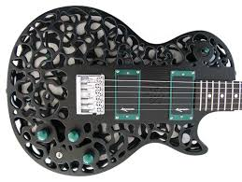
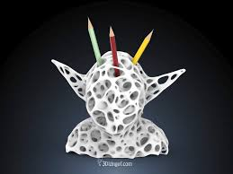
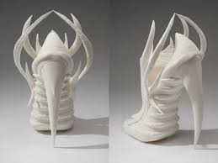
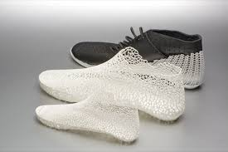
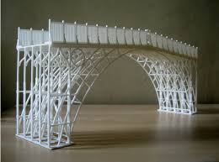
Creativity – What would you create?

Slide 6
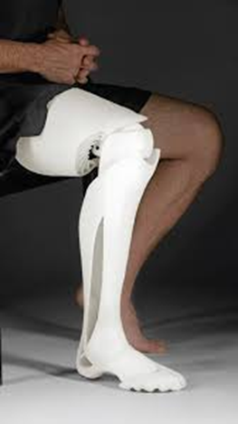
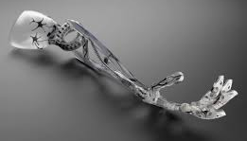
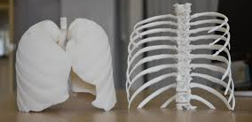
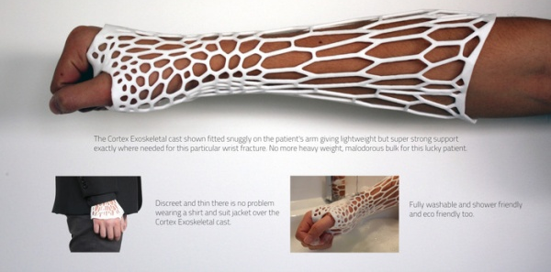
What problems could you solve?

Slide 7


What do all these items have in common though…?
In the Technical department…
We will be working with brand new skills to create various projects
of work that will allow you to learn more about skills for jobs, real life
working and potential career interests.
THEY ALL REQUIRE ACCURACY WITHIN MEASUREMENT AND ON A VERY PRECISE SCALE…WE THEREFORE ABSOLUTELY NEED TO USE MILLIMETERS.
In S1 Technical - You will experience:
1. Working in the Craft Rooms with hand tools and machinery.
2. Using our Technical PC’s with new software to create designs and published work.
3. Using the drawing boards for life as mini architects.

Slide 8
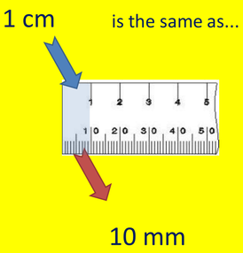
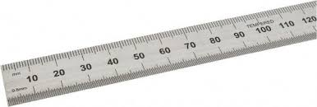
Today’s tasks…
We are going to work through a mini booklet on measurement ☺!
You will then be given an opportunity to use the Steel Rules we use within Technical to complete some tasks ☺!
Your key aim today is being able to identify and use Millimeters ☺!

Slide 9
At home, have a think about possible Careers / Skills you can gain in Technical
Joiner / Shop Fitter / Carpenter / Construction Manager / Site Manager
Prosthetics / CAD Engineer / Product Designer / Interior Designer / Testing
Practical Craft Skills
3D Modelling Skills
CAD-CAM Skills
Mass production / Batch production / Laser Cutter / CNC Router
Discuss the skills for life learning and work that you could gain in the Technical department.
Publishing Skills
Magazine Graphic Designer / Advertisement / Personal Business cards or leaflets
Manual Drawing Skills
Materials and their properties
Freehand Sketching Skills
Interior Designer/ Product Designer / Architect /
Architect / Civil Engineer/ Mechanical Engineer / Project Manager / Builder / Electrician / Quantity Surveyor
Engineer / Construction / Product Designer / Testing and material stresses /

