Slide 1
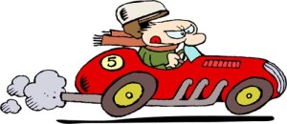
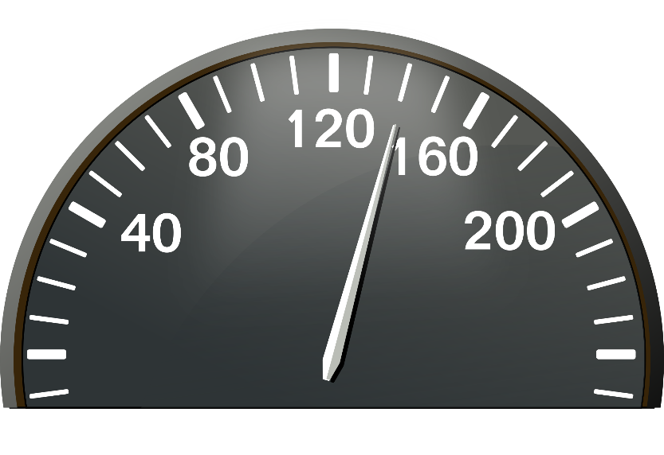
Speeding
JRSO Virtual Assembly

Slide 2
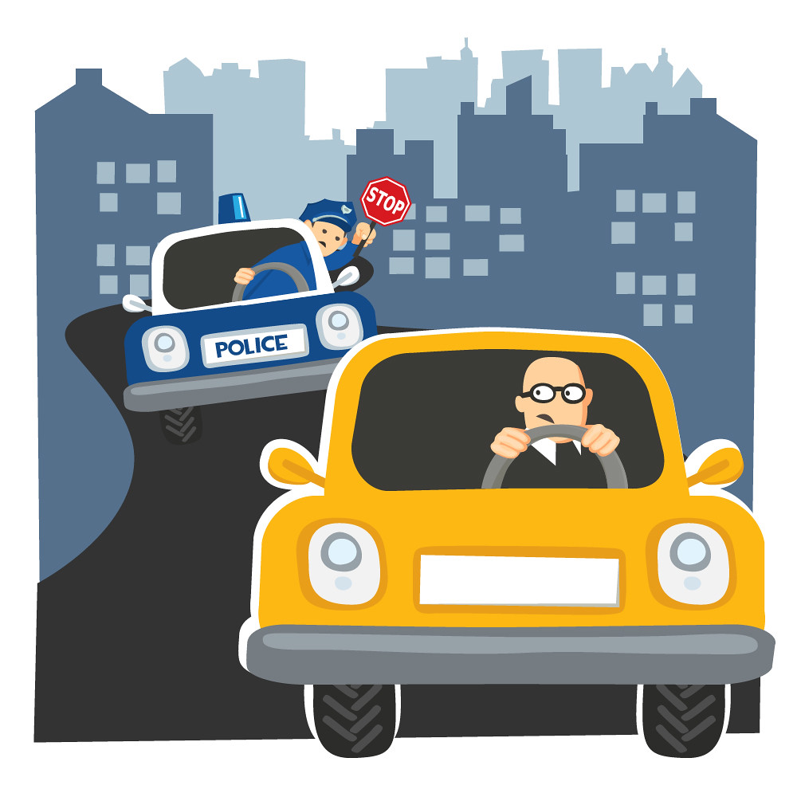
What is speeding?
Speeding is the act of driving a vehicle faster than is legally allowed.
Drivers who speed put themselves, their passengers and other drivers in real danger.

Slide 3
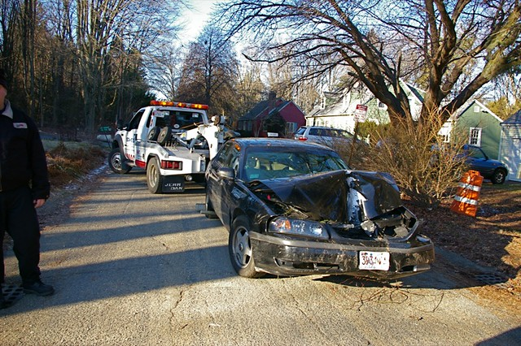
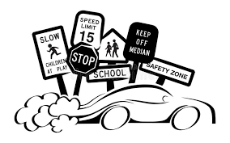
Did you know…
A scary statistic is the number 3 reason for people dying in fatal crashes is because they or someone else was speeding.

Slide 4
Why do drivers speed?
They are in a hurry, impatient or late for somewhere.
They love the thrill and excitement of driving fast.
They feel they know the road well enough to do this
They take drugs or alcohol
Road Rage with other drivers – getting angry behind the wheel and driving in high speed car chases.
Curious or bored
Unaware of speed limits
CAN YOU THINK OF ANY OTHER REASONS? Tell your teacher.

Slide 5
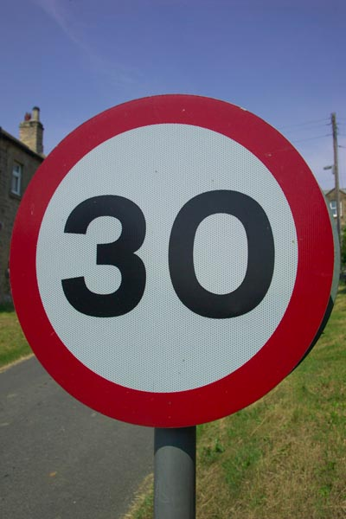
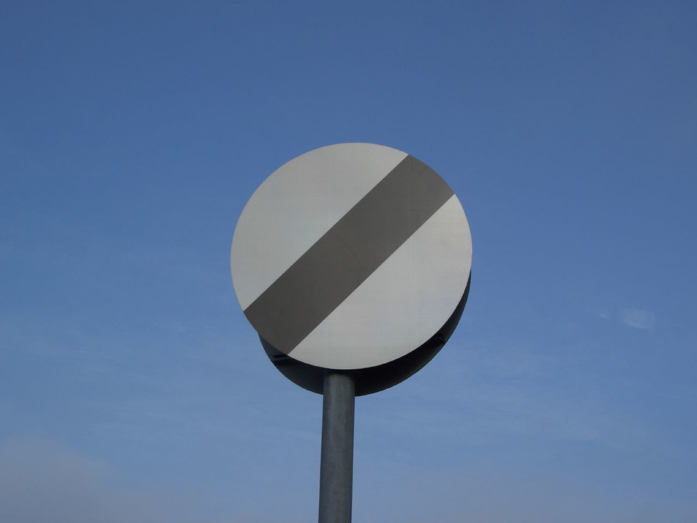
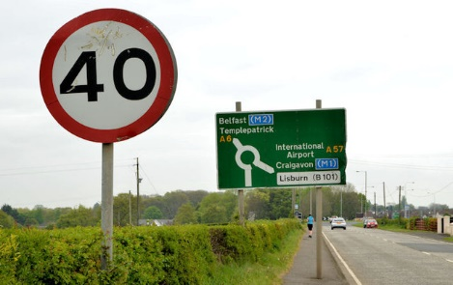
Speed Limits
Circular road signs give orders to road users and must be followed – failing to do so is breaking the law!

Slide 6
Speed Limits
Mostly used in residential areas where traffic speed NEEDS slowed down.
These signs are also used near school areas or where there is a large number of pedestrians like shopping centres and town centres too.

Slide 7
Speed Limits
Can be used when there is not enough street lights.
Sometimes used near housing estates, street lights

Slide 8
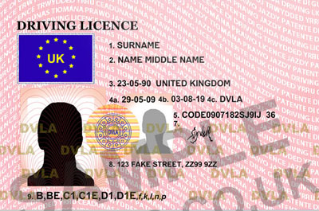
What happens if you speed?
Most speeding offences mean that you can get 3-6 points on your license.
Points are on your license for roughly 4 years.
A driver is only allowed 12 points before they have it taken away.
A new driver who has 6 points within first 2 years can have their license taken away.

Slide 9
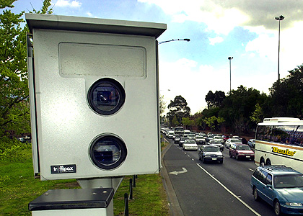
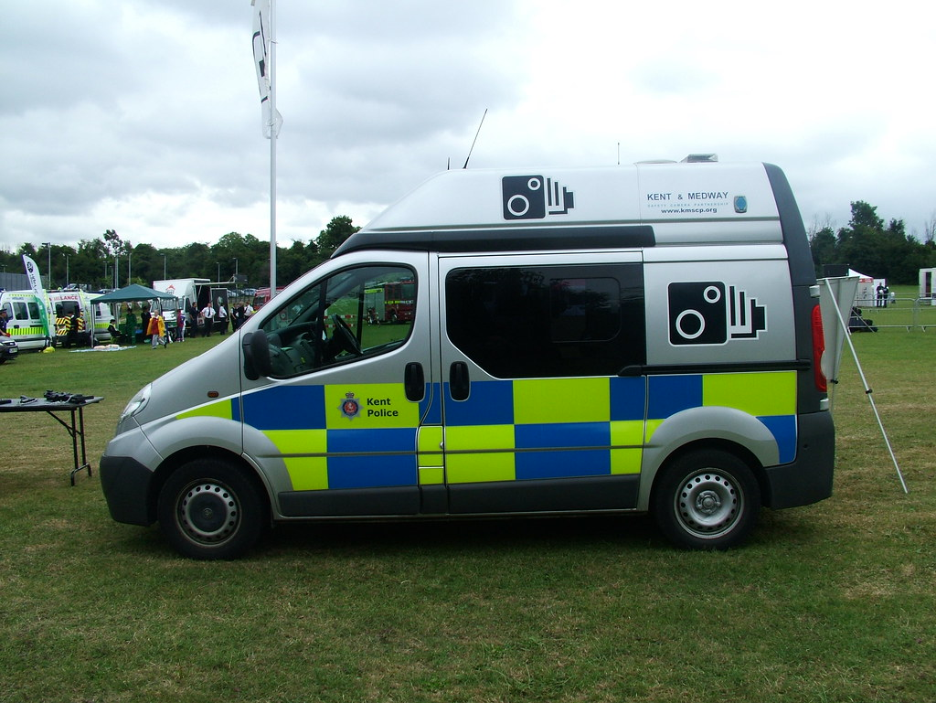
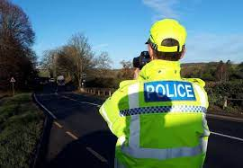
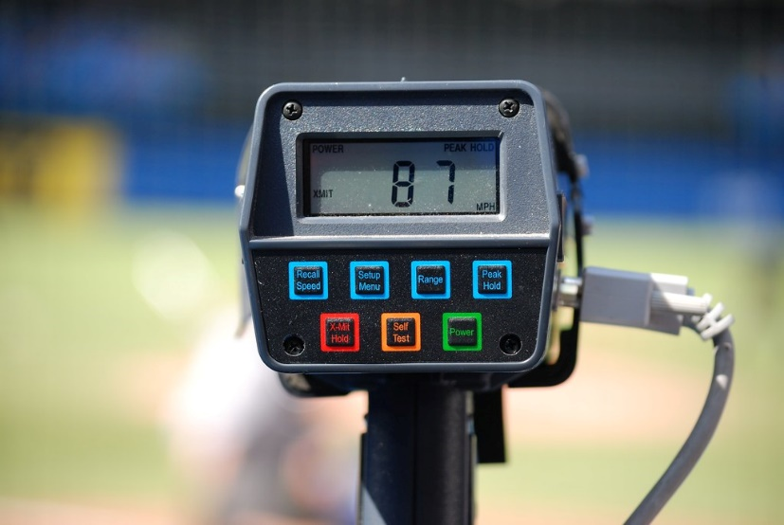
Examples of Speed Cameras …

Slide 10
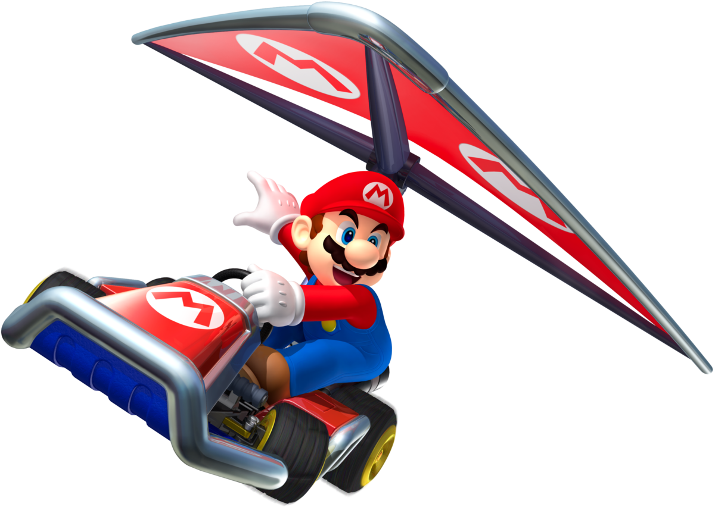
Remember – No Need For Speed!
Observe the speed limits!

Slide 11
Competition Time
Design a Speeding Mascot for 2022.
Your mascot should:
Have a catchy name relating to speed
Be colourful and neatly drawn
Good graphics
Drawn the full size of A5 paper.
Only 1 ENTRY per class to be submitted
Entries due: Friday 18th April 2022

