Slide 1
Kilbowie 2017
We are off to make some lasting memories at Kilbowie.

Slide 2
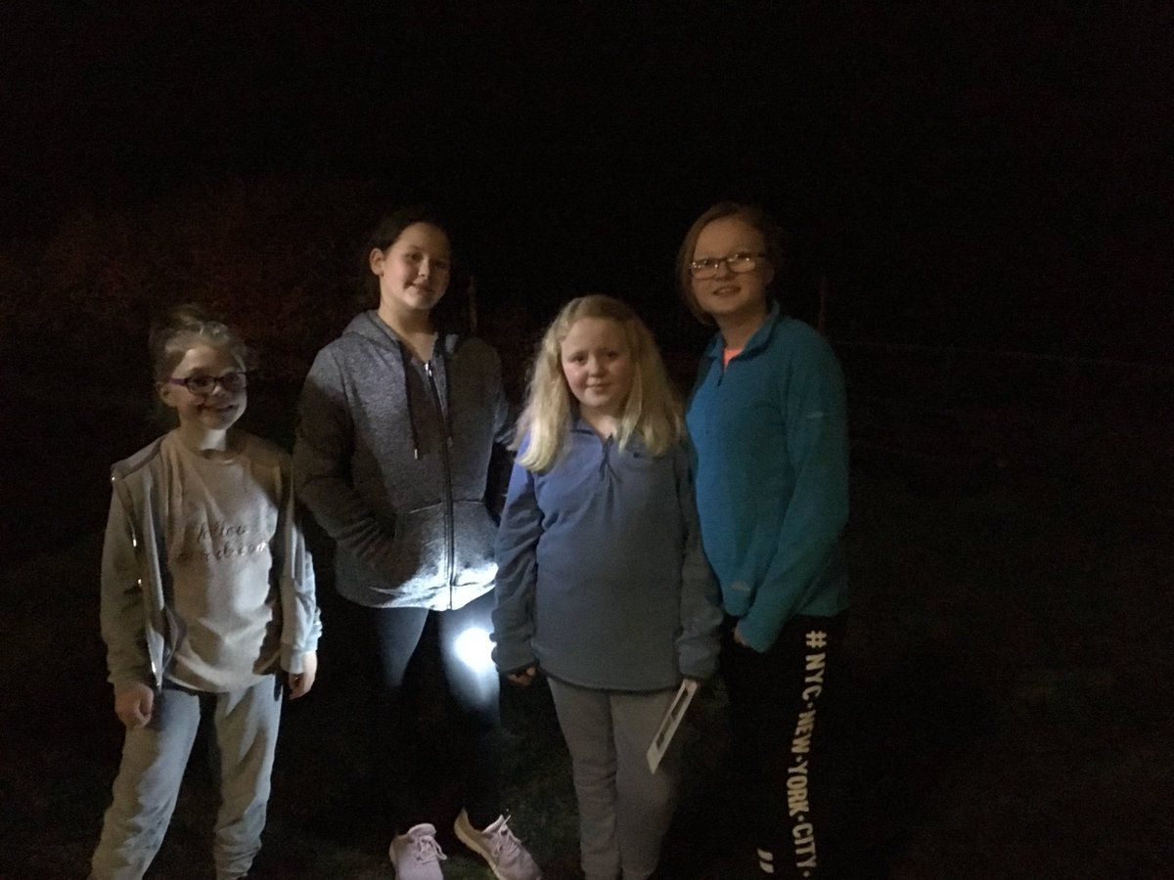
Having fun in the dark!

Slide 3
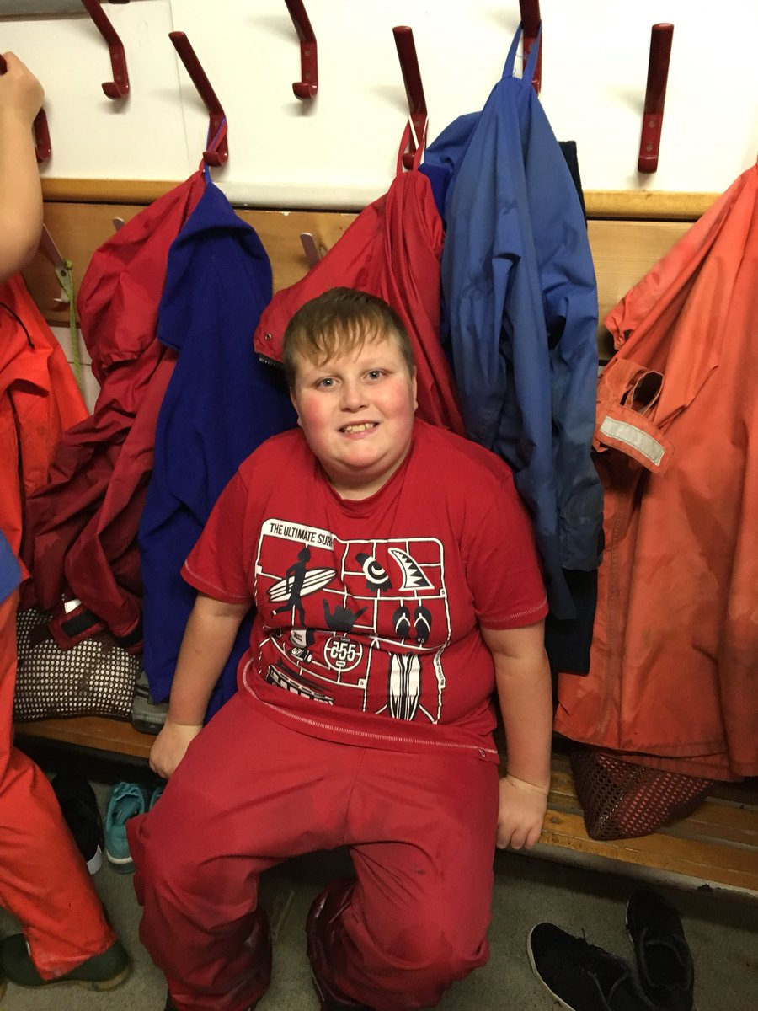
We got to wear special clothing to keep us warm and dry.

Slide 4
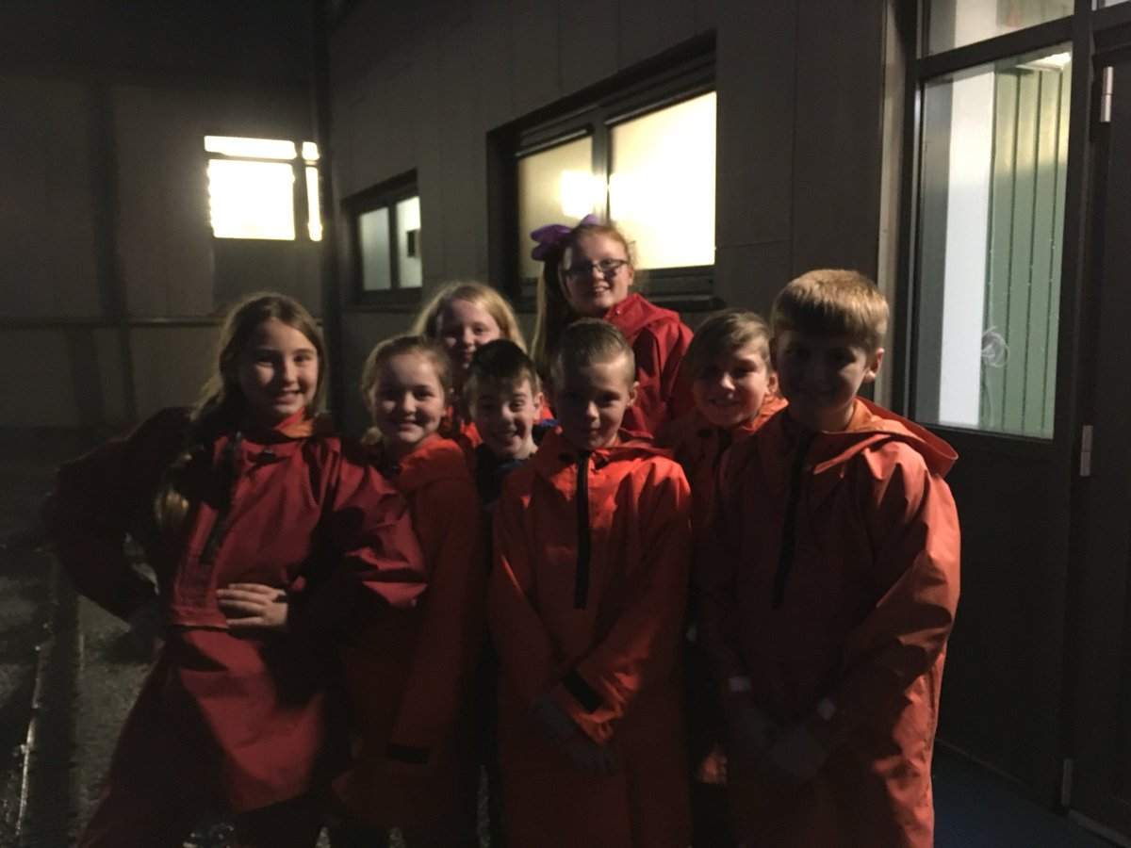
NOTE:
To change images on this slide, select a picture and delete it. Then click the Insert Picture icon
in the placeholder to insert your own image.
The Night Line at Kilbowie

Slide 5
The Night Line at Kilbowie

Slide 6
Knee Deep in Mud and Loving It!

Slide 7
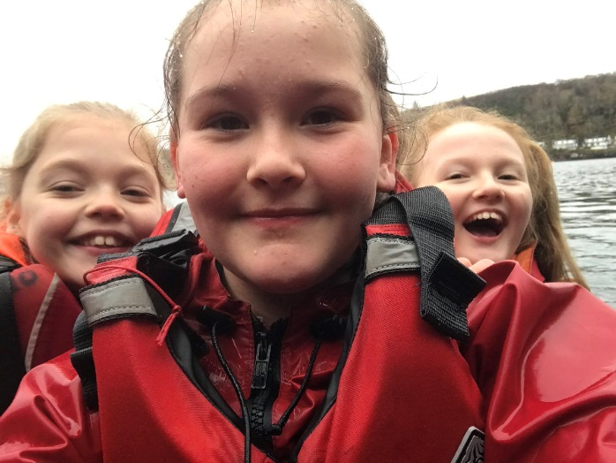
Canoeing and Water Fun at Kilbowie
Full of joy and laughter during the outdoor activities.

Slide 8
The Night Line at Kilbowie

Slide 9
The Night Line at Kilbowie

Slide 10
The Night Line at Kilbowie

Slide 11
Being Put to Work!
NOTE:
To change images on this slide, select a picture and delete it. Then click the Insert Picture icon
in the placeholder to insert your own image.
Spot the difference…

Slide 13
The Night Line at Kilbowie

Slide 17
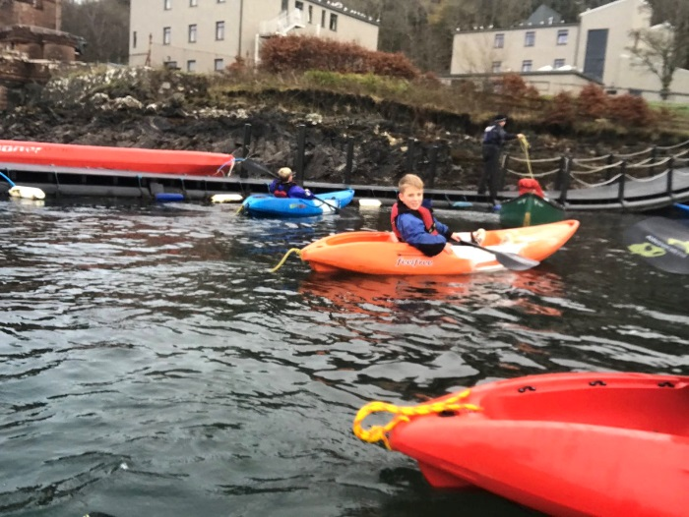
Canoeing and water Fun at Kilbowie
Out on the water having lots of fun!

Slide 19
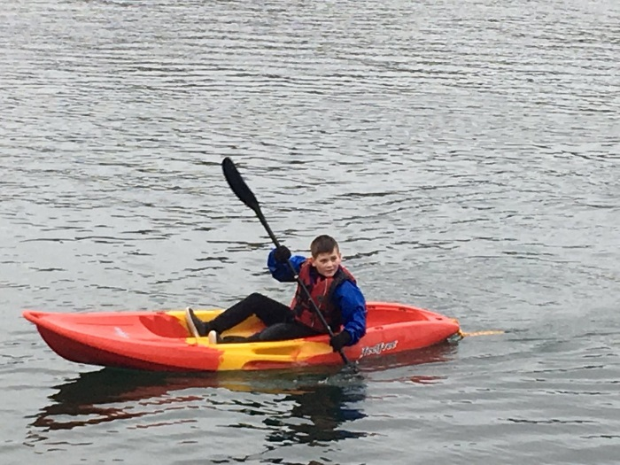
Canoeing and water Fun at Kilbowie
This is super hard work!

Slide 20
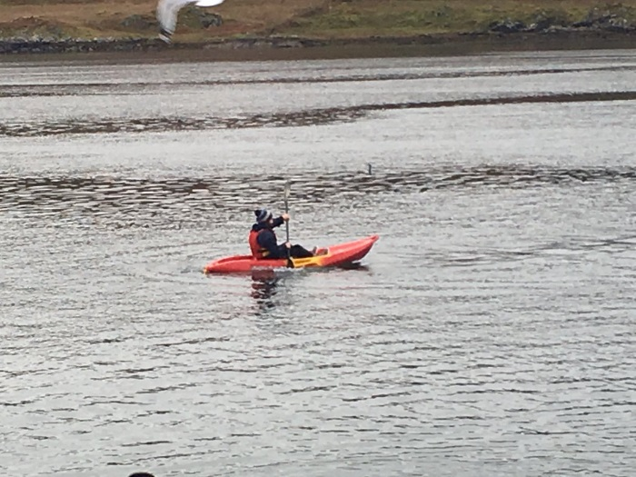
Canoeing and Water Fun at Kilbowie
Out on the water having lots of fun!

Slide 21
The Night Line at Kilbowie

Slide 23
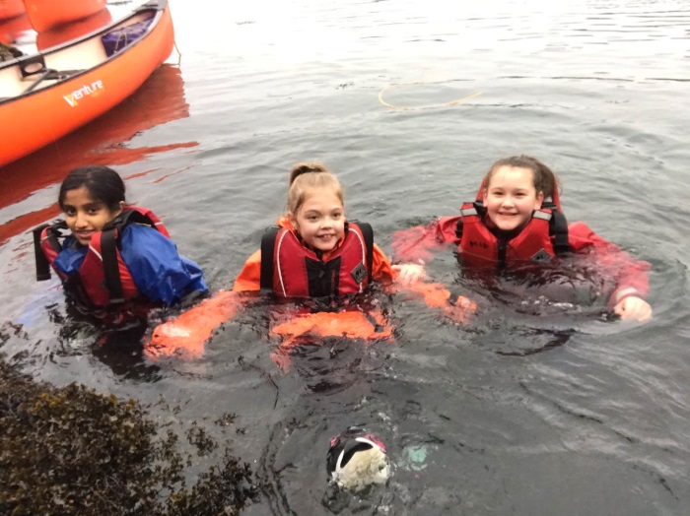
Canoeing and Water Fun at Kilbowie
This water is FREEZING!!!

Slide 26
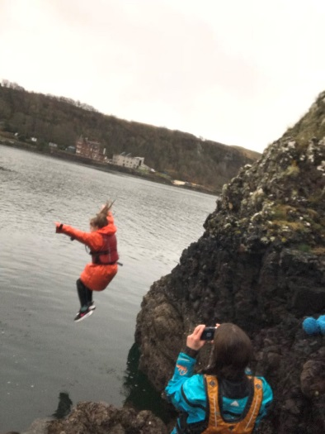
Canoeing and Water Fun at Kilbowie
Jumping off cliffs…a piece of cake!!

Slide 27
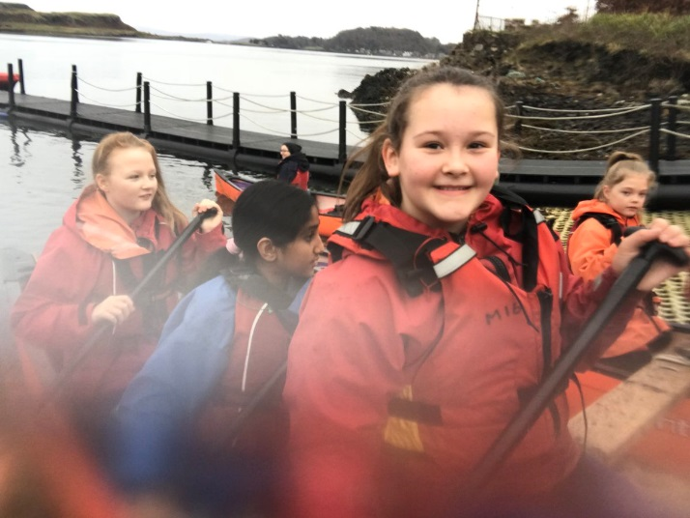
Canoeing and Water Fun at Kilbowie
This is much better than a day in the classroom!

Slide 28
Skiing at Kilbowie
NOTE:
To change images on this slide, select a picture and delete it. Then click the Insert Picture icon
in the placeholder to insert your own image.
We even had the opportunity to go skiing on the slopes. It’s much harder than it tooks!

Slide 29
NOTE:
To change images on this slide, select a picture and delete it. Then click the Insert Picture icon
in the placeholder to insert your own image.
It’s a good job we have this waterproof clothing to wear!
A wee bit of rain does not spoil our fun at Kilbowie!

Slide 30
Getting Ready to go Skiing

Slide 31
Enjoying the Scenery

Slide 32
Getting Ready to go Skiing
Before
After

Slide 33
Group Activities
We got to meet friends from other schools.
Article 15

Slide 34
Group Activities
Making some lasting friendships at kilbowie.

Slide 35
A different Uniform for the Week!

Slide 36
Kilbowie Fun

Slide 37
Exhausted!

Slide 38
A Massive Happy Birthday!

Slide 39
Kilbowie Fun!
Hill Walking
Hill Sliding

Slide 41
Kilbowie

