Slide 1
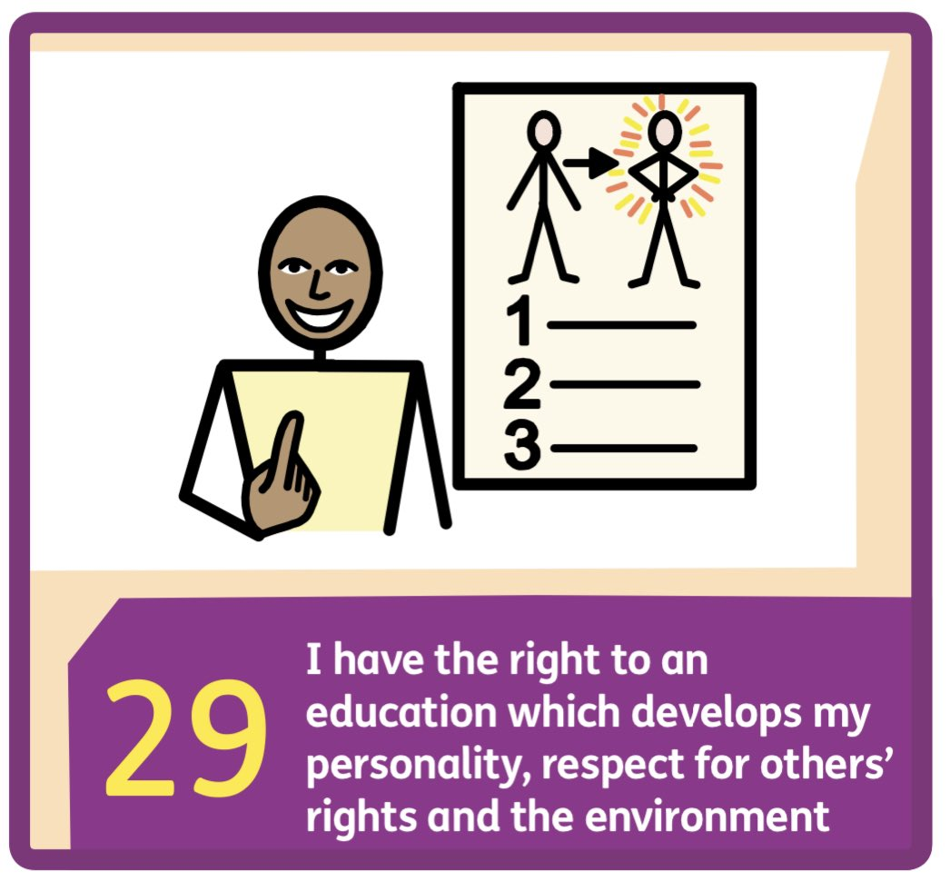
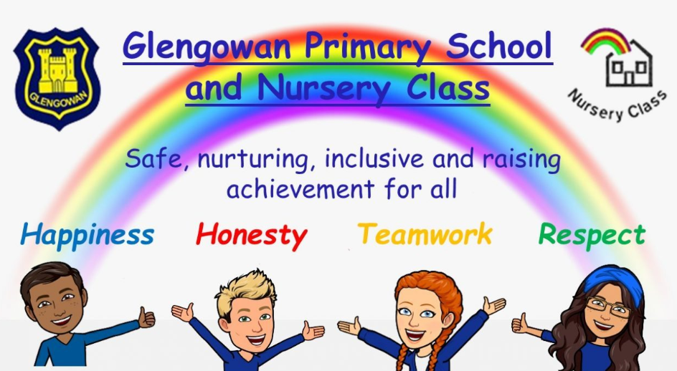



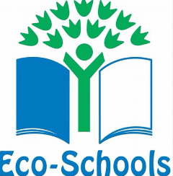


What’s On at Glengowan Primary School & Nursery Class
Week Beginning Monday 24th August 2026
Our UNCRC rights of the fortnight:
Our wellbeing focus is:
Monday 24th August 2026
Breakfast club 8.15am
Home Learning Diaries start today P2-7
Tuesday 25th August 2026
Breakfast club 8.15am
Wednesday 26th August 2026
Breakfast club 8.15am
Parents, please return your child’s annual data check and permissions booklet if you have not already done so. Many thanks.
Thursday 27th August 2026
Breakfast club 8.15am
AM Whole school assembly
Friday 28th August 2026
Breakfast club 8.15am
Brass Lessons
PM FUN31 in class
Lunch Menu: NEW MENU - Week 1
Partnership with Parents – If you would like to speak with us about any aspect of your child's education, please contact us on (01236) 632154 or email enquiries-at-glengowan@northlan.org.uk to arrange an appointment. Many thanks
Our Global Goal of the month is:

