Slide 2
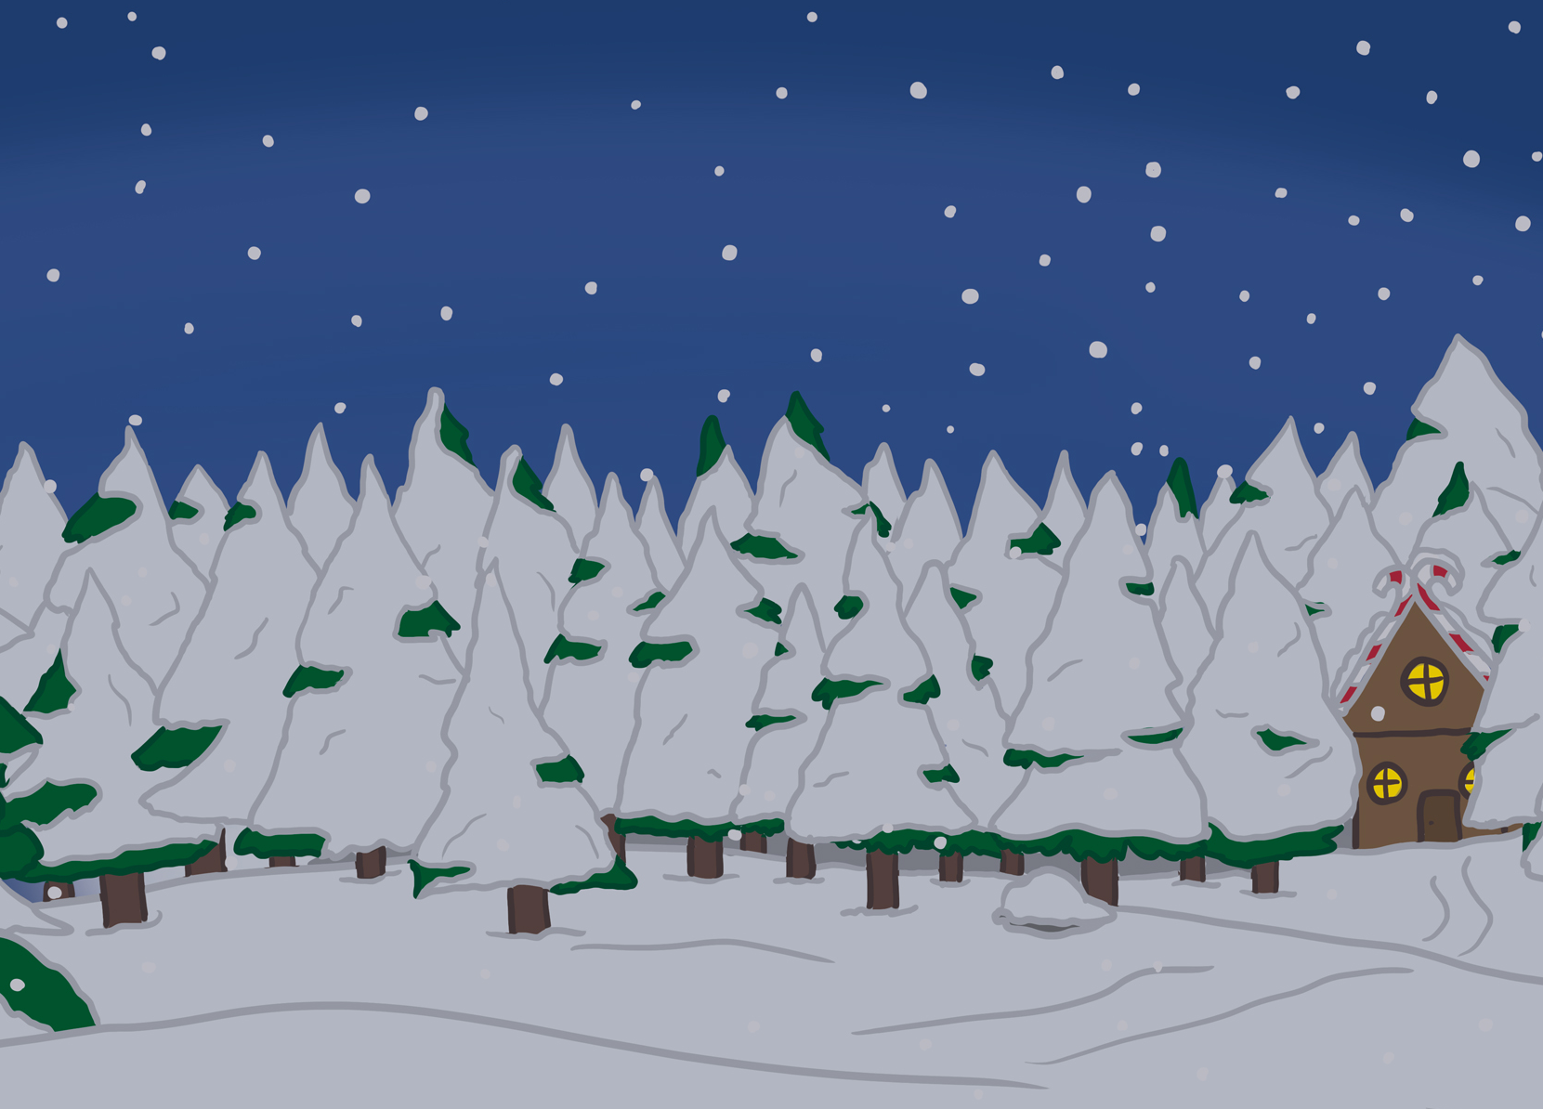
Your Big Bang Question
Can we work together to find a solution to the Chaos at the North Pole?
Teacher’s Toolbelt
Click here to find the Nuts and Bolts of it Adult Information

Slide 3
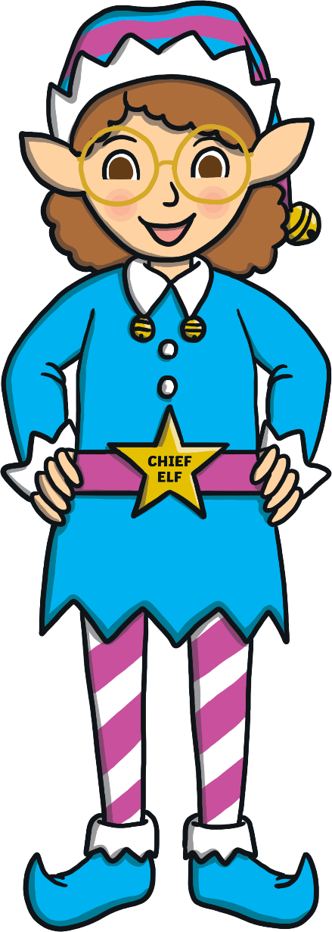
First, can you remember what STEAM stands for?
Chief Elf here!
I need your help to sort out the chaos at the North Pole.
In the next few slides, I will tell you about your class’s challenge and how you can use STEAM to solve it.
S
cience
T
echnology
E
ngineering
A
rt
M
aths

Slide 4
The STEAM Design Cycle
Today, you are going to be Elf Engineers.
When engineers solve a problem, they use a design cycle.

Slide 5
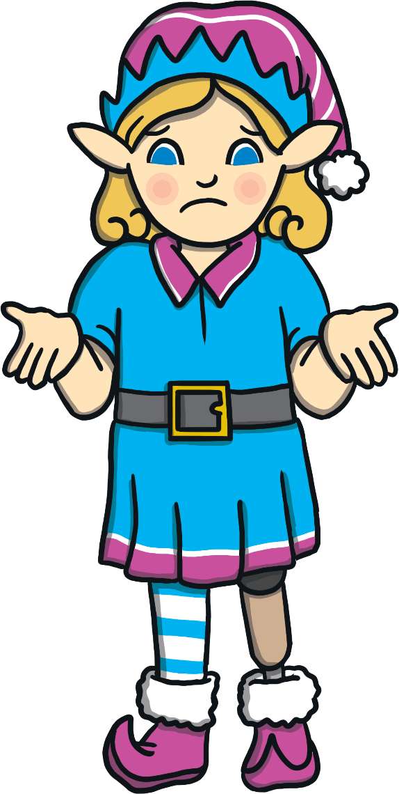
Can you design a sleigh to help the elf win the sleigh race?
I want to win the annual one metre sleigh race but I don’t have a sleigh.
Elf Engineers, here are your design criteria.
‘Elf’ and safety is very important so your elf must stay securely in the sleigh.
Once your elf begins the race, you cannot touch them until they stop travelling.
Your sleigh has to travel at least one metre.
No wheels are allowed.
Can you design a sleigh to help the elf win the sleigh race?

Slide 6
The STEAM Design Cycle

Slide 7
Let’s think about how things slide.
'Click on the Chief Elf to find out about sliding and on Discover It to make a simple model sleigh.
Keep Calm and Ask an Expert

Slide 8
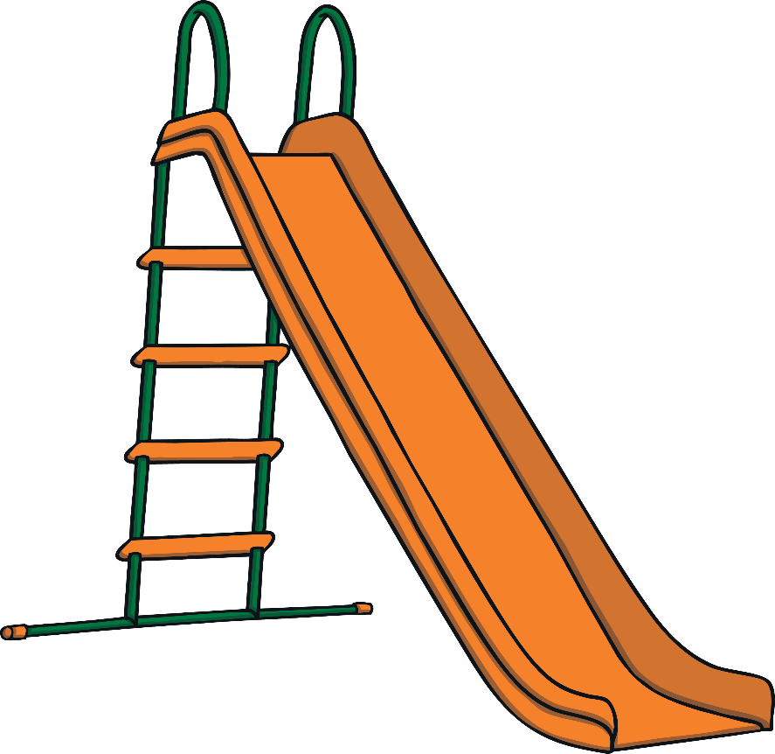
Keep Calm and Ask the Chief Elf
Bobsleds are powered by the pushing force that occurs at the beginning of the race. They can travel between 93 and 125 mph!
Friction is a force that happens when two objects rub together. Friction works against gravity to slow things down. What you wear going down a slide will make you move faster or slower.
Most toboggans have two metal runners underneath a board. The rider sits or lies on the board and slides down the packed snow. Without the runners, friction would slow them down or make the toboggan completely stop.
Keep Calm and Ask an Expert

Slide 9
Let’s Make a Sleigh
You will need:
a cardboard tube;
scissors;
drinking straws;
scissors;
Carefully, cut your cardboard tube in half.
Use the sticky tape to stick straws underneath the cardboard tube.
Place your elf in the tube.
Give your sleigh a push!
an elf!

Slide 10
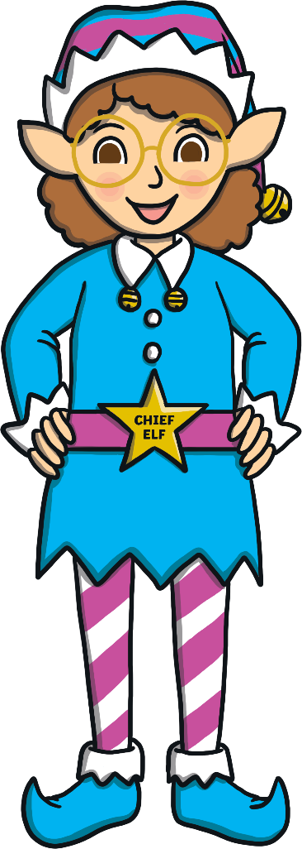
Something to Think About
What happens if you add weight to the sleigh? Does it move slower or faster?
Does the surface you place your sleigh on make a difference?
Does the sleigh move faster if the elf is sitting or lying down?
What would happen if you started the sleigh on a slope?

Slide 11
The STEAM Design Cycle

Slide 12
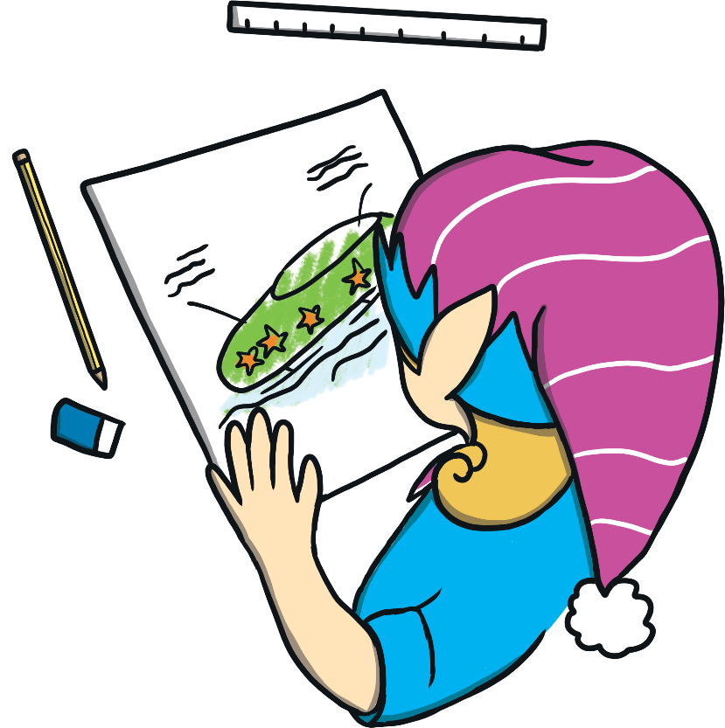
Time to plan your design.
What will you create to help the elf win the sleigh race?
Draw a diagram and make a list of what you need.

Slide 13
The STEAM Design Cycle

Slide 14
Now it’s time to make your design come to life.
Remember what the Chief Elf said:
Elf and safety is very important so your elf must stay securely in the sleigh.
Once your elf begins the race, you cannot touch him until he stops travelling.
The sleigh has to travel at least one metre.
No wheels are allowed.

Slide 15
The STEAM Design Cycle

Slide 16
Try it out!
Did the sleigh travel one metre?
After the initial push, did you need to help the sleigh move?

Slide 17
The STEAM Design Cycle

Slide 18
Can it be improved? Modify and test again.
Can your design be improved?
What doesn’t work?
What works?
What can you change to make it better?

Slide 19
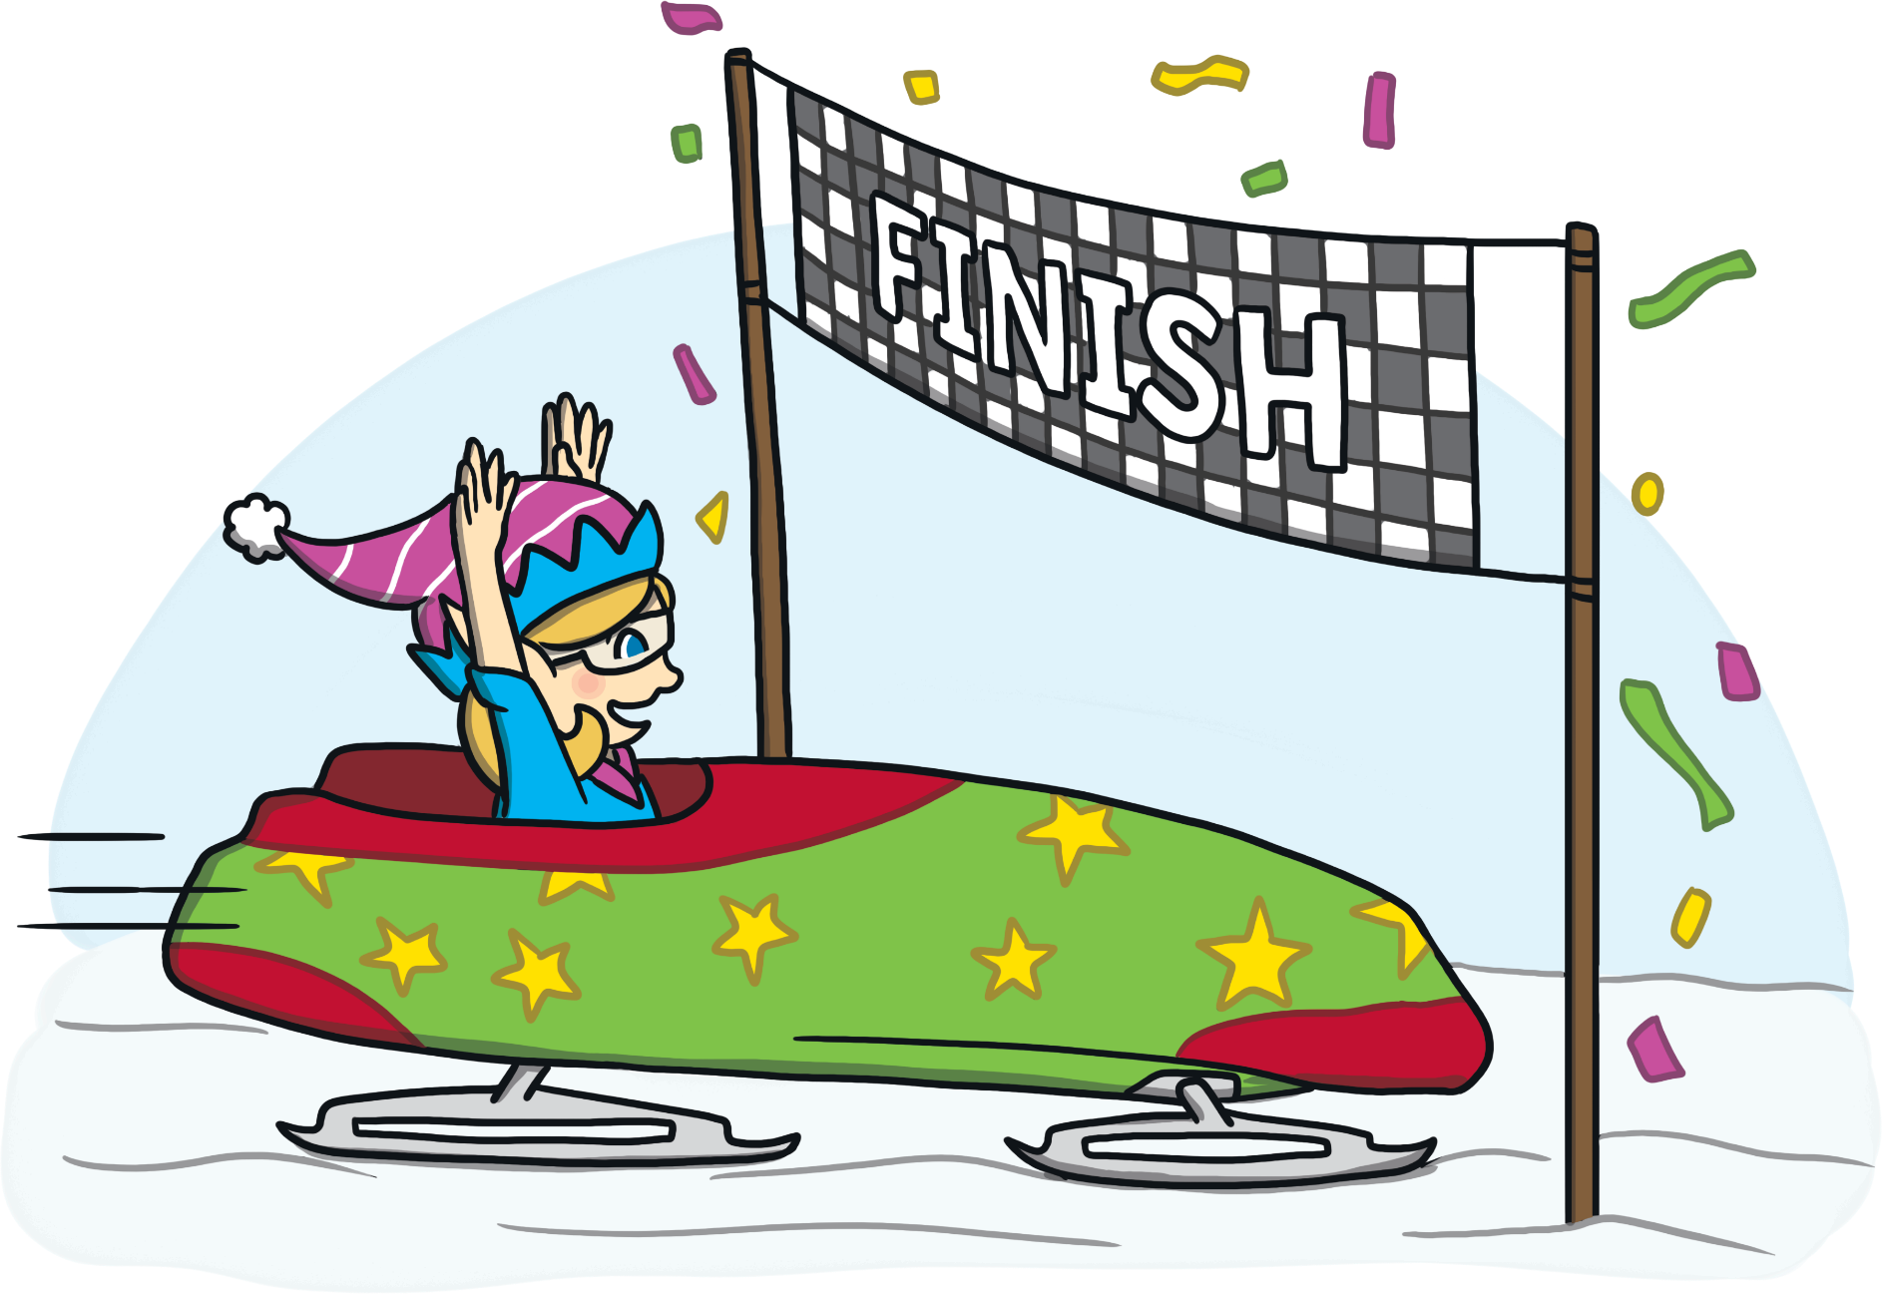
Elf Engineers, thank you for helping me build a sleigh for the race!
Discuss with a partner.
What went well?
What would you do differently next time?
When did you use STEAM?

