Slide 2
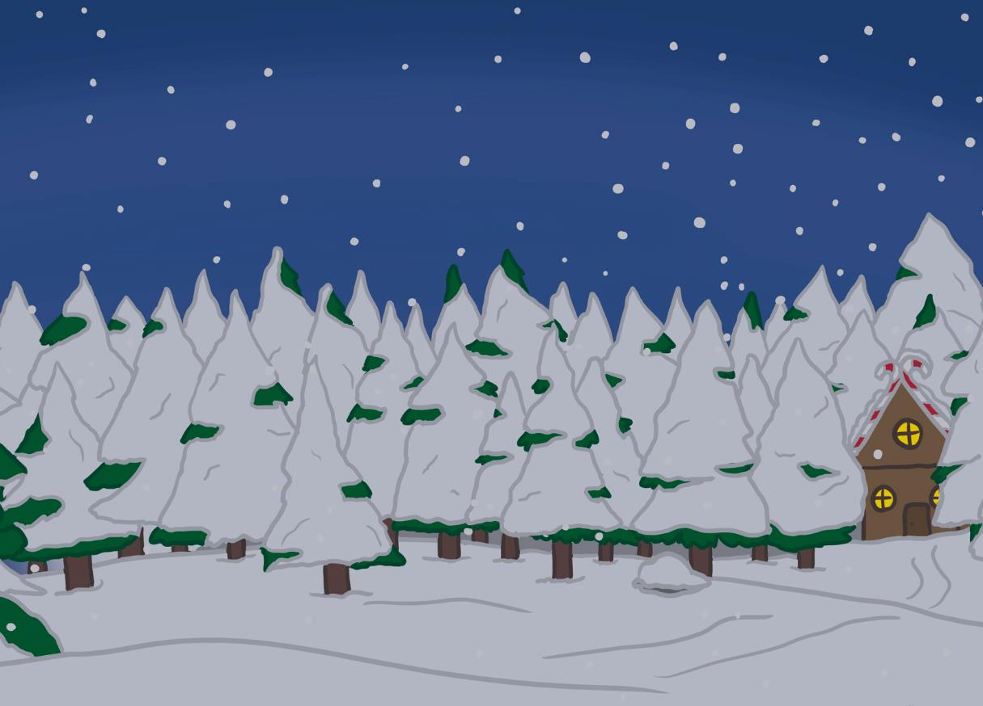
Your Big Bang Question
Can we work together to find a solution to the Chaos at the North Pole?
Teachers’ Toolbelt
Click here to find the Nuts and Bolts of It Adult Information

Slide 3
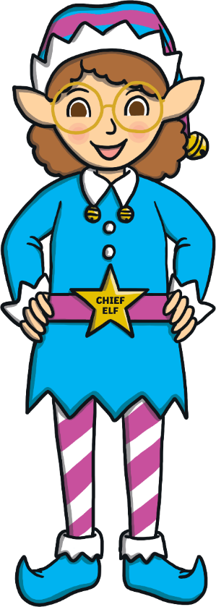
First, can you remember what STEAM stands for?
Chief Elf here!
I need your help to sort out the chaos at the North Pole.
In the next few slides, I will tell you about your class’s challenge and how you can use STEAM to solve it.
S
cience
T
echnology
E
ngineering
A
rt
M
aths

Slide 4
The STEAM Design Cycle
Today, you are going to be Elf Engineers.
When engineers solve a problem, they use a design cycle.

Slide 5
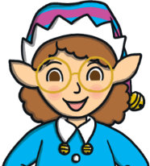
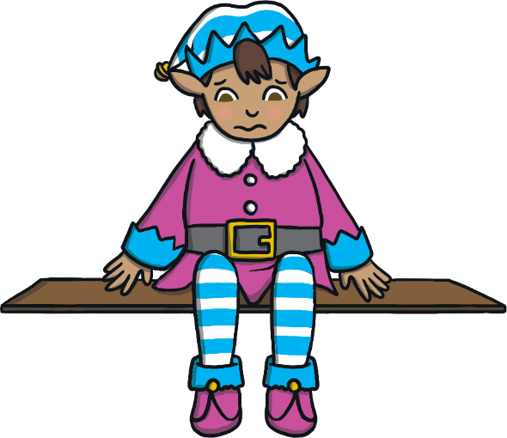
Can you create something to help the elf get down off his shelf?
Elf Engineers, here are your design criteria.
I am stuck on my shelf. I need your help to get down.
‘Elf’ and safety is very important, so your elf must reach the ground safely.
The elf’s shelf is one metre high.
Once your elf leaves his shelf, you cannot touch him until he reaches the ground.
Can you create something to help the elf get down off his shelf?

Slide 6
The STEAM Design Cycle

Slide 7
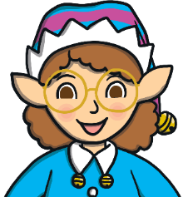
Let’s think about how we get things down from high places.
Click on the Chief Elf to find out about abseiling and zip line and on Discover It to make a simple zip line.
Keep Calm and Ask an Expert

Slide 8
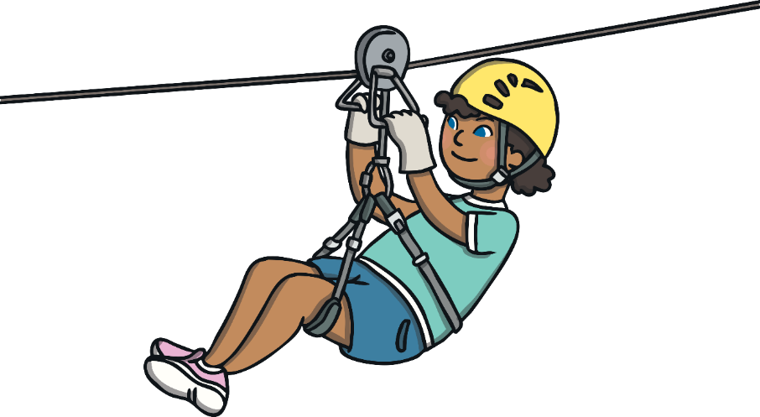
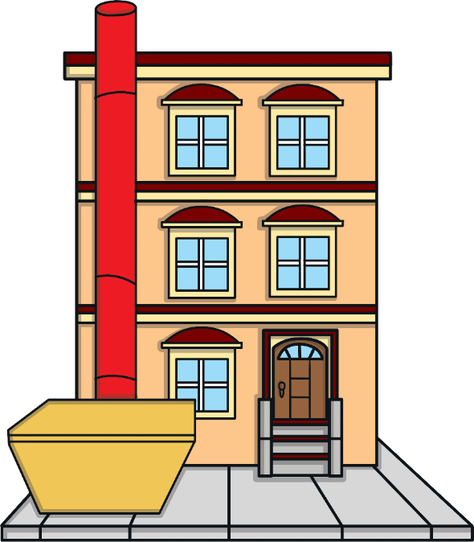
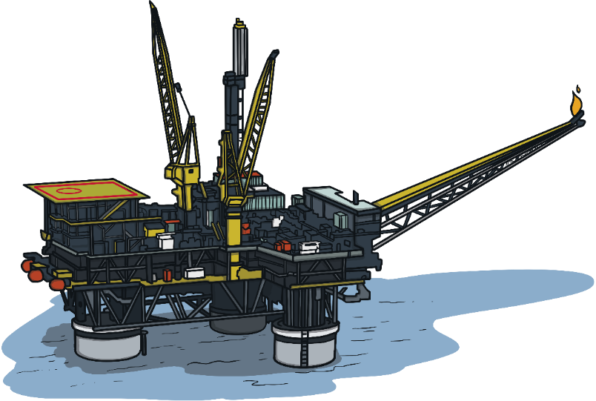
Keep Calm and Ask the Chief Elf
Inspectors abseil down the legs of oil rigs to check they are safe. Abseiling is using a rope to get down from a high point.
Zip lines are a fun way to get from the top of a mountain to the bottom. A zip line starts at a higher point than it ends.
Rubbish chutes are used in building sites to safely remove rubbish from the tops of buildings. Construction workers can put rubbish in the chute and it’s transported safely down into a skip at the bottom.

Slide 9
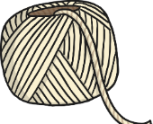
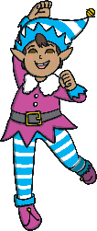
Let’s make a basic zipline.
You will need:
a cardboard tube;
Decorate your cardboard tube to add some festive fun.
Thread your string through the tube.
Hold one end of your string/wool up high and the other on the ground.
Place your elf in or on the tube and let go!
colouring pencils, pens or stickers;
string or wool;
an elf!

Slide 10
Something to Think About
How can you change the speed of the cardboard tube?
What happens if you hold the wool/string too tight?
What happens when you change the angle of the zip line?
What could you wrap the cardboard tube in to make it go faster?

Slide 11
The STEAM Design Cycle

Slide 12
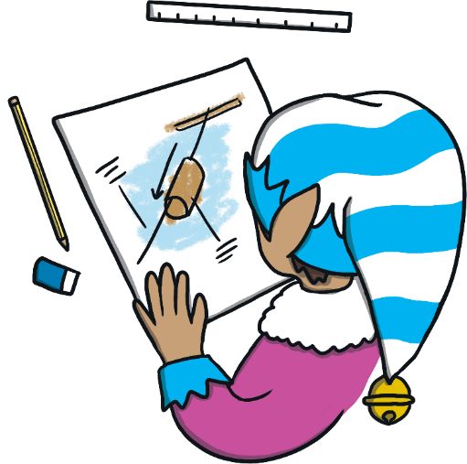
Time to plan your design.
What will you create to help the elf get down from his shelf?
Draw a diagram and make a list of what you need.

Slide 13
The STEAM Design Cycle

Slide 14
Now it’s time to make your design come to life.
Remember what the Chief Elf said:
The elf must reach the ground safely.
The elf’s shelf is one metre high.
Once your elf leaves his shelf, you cannot touch him until he reaches the ground.

Slide 15
The STEAM Design Cycle

Slide 16
Try it out!
Remember, your elf must start one metre off the ground.
Did the elf reach the floor without falling out?
Did you need to help him along the way?

Slide 17
The STEAM Design Cycle

Slide 18
Can it be improved? Modify and test again.
What can you change to make it better?
What works?
What doesn’t work?
Can your design be improved?

Slide 19
Elf Engineers, thank you for helping me get down from my shelf!
Discuss with a partner.
What went well?
What would you do differently next time?
When did you use STEAM?

