Slide 2
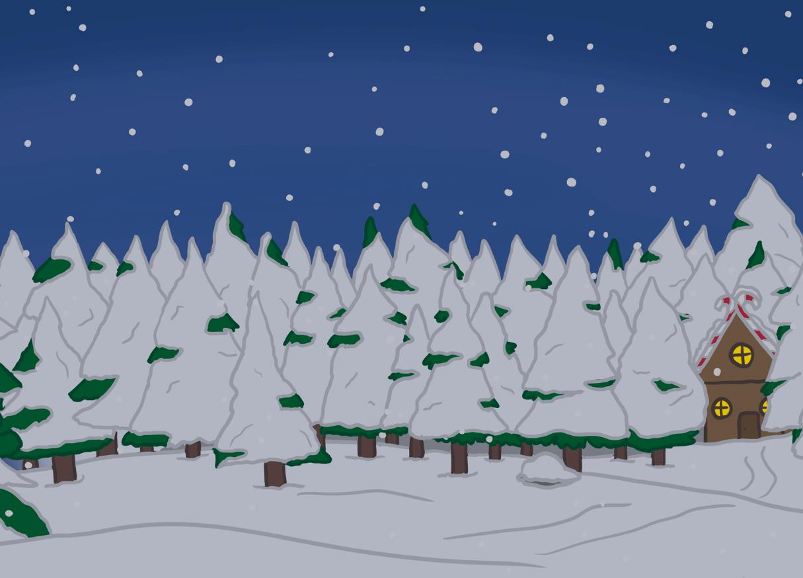
Your Big Bang Question
Can we work together to find a solution to the Chaos at the North Pole?
Teachers’ Toolbelt
Click here to find the Nuts and Bolts of It Adult Information

Slide 3
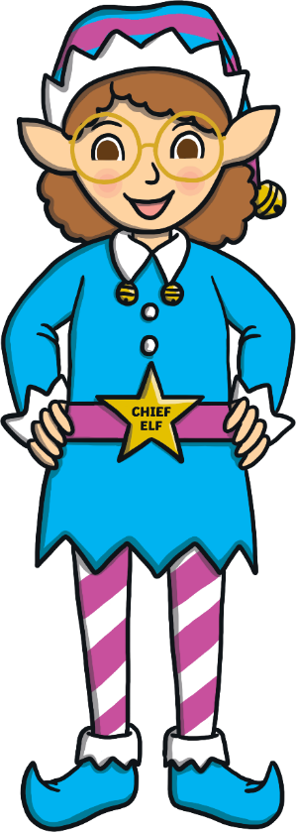
First, can you remember what STEAM stands for?
Chief Elf here!
I need your help to sort out the chaos at the North Pole.
In the next few slides, I will tell you about your class’s challenge and how you can use STEAM to solve it.
S
cience
T
echnology
E
ngineering
A
rt
M
aths

Slide 4
The STEAM Design Cycle
Today, you are going to be Elf Engineers.
When engineers solve a problem they use a design cycle.

Slide 5
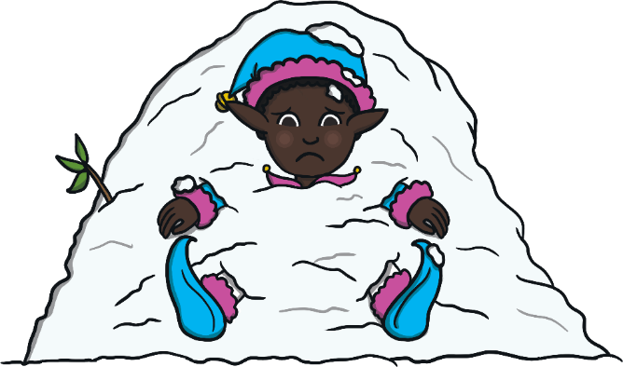
Can you make the elf a shelter to keep them warm and dry?
Elf Engineers, here are your design criteria.
I am caught in a snowstorm and I need your help to build a shelter.
Your shelter must protect the elf from the wind.
Your shelter must keep the elf dry.
Your shelter has to stand on its own.
The shelter needs a doorway for the elf to enter and exit.
Can you make the elf a shelter to keep them warm and dry?

Slide 6
The STEAM Design Cycle

Slide 7
Let’s think about shelters.
Click on the Chief Elf to find out about shelters and on Discover It to make a shelter.
Keep Calm and Ask an Expert

Slide 8
Keep Calm and Ask the Chief Elf
Igloo - In very cold places where there is lots of snow, people build igloos. Snow can be shaped and made into bricks. It does not melt because it is so cold outside. The snow around the igloo keeps it warm inside. Igloos have a small tunnel as a doorway. This helps to keep the heat in and the cold wind out.
Tent - Explorers visiting the North Pole build tents for shelter. Tents have wooden or metal frames and are covered in a waterproof fabric. Tents are often either a dome or triangular prism shape to help rainwater and snow run down. Tents have to be pegged into the ground to stop them blowing over.
Polar bear - During a snowstorm, polar bears dig a hole in the snow and curl into a tight ball to keep warm.

Slide 9
Let’s Make a Shelter
You will need:
two sheets of paper or thin card;
coloured pencils or pens to add some festive fun
a straw;
sticky tape;
a poly pocket;
an elf!

Slide 10
Let’s Make a Shelter
Decorate one sheet of paper.
Carefully, fold the paper in half and place it in the poly pocket.
Next, fold the poly pocket in half.
Use sticky tape to stick the straw along the inside of the fold.
Stick your folded poly pocket onto the paper.
Place your elf in the tent.
Why is the paper being placed in the poly pocket?

Slide 11
Something to Think About
What could you use to block the open ends of the shelter?
What would happen if you folded the paper a different way?
Is there a way to make the base of the shelter more comfortable for the elf?
Is there another way to make the paper waterproof or could you use another material?

Slide 12
The STEAM Design Cycle

Slide 13
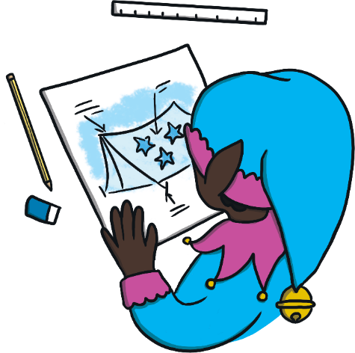
Time to plan your design.
What type of shelter will you make to keep the elf warm and dry?
Draw a diagram and make a list of what you need.

Slide 14
The STEAM Design Cycle

Slide 15
Now it’s time to make your design come to life.
Remember what the Chief Elf said:
Your shelter must protect the elf from wind.
Your shelter must keep the elf dry.
Your shelter has to stand on its own.
The shelter needs a doorway for the elf to enter and exit.

Slide 16
The STEAM Design Cycle

Slide 17
Try it out!
Did the shelter withstand the wind for a 30 seconds?
Did the elf stay dry when the water was sprayed on the shelter?

Slide 18
The STEAM Design Cycle

Slide 19
Can it be improved? Modify and test again.
Can your design be improved?
What can you change to make it better?
What doesn’t work?
What works?

Slide 20
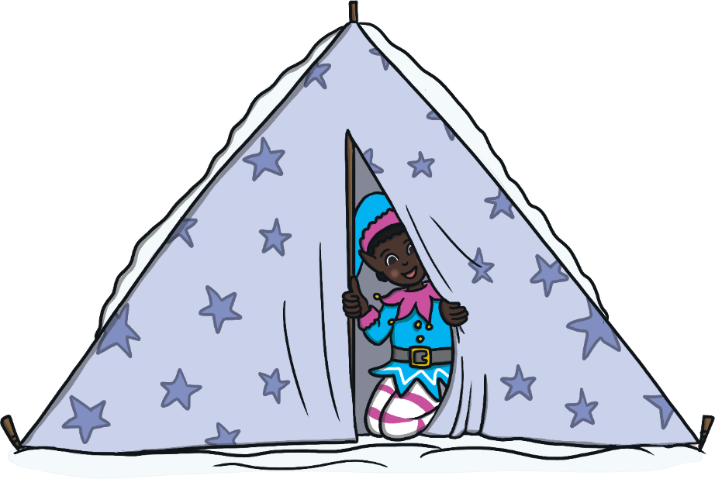
Elf Engineers, thank you for helping me stay dry and warm in the snowstorm!
With a partner, discuss:
What went well?
What would you do differently next time?
When did you use STEAM?

