Slide 2
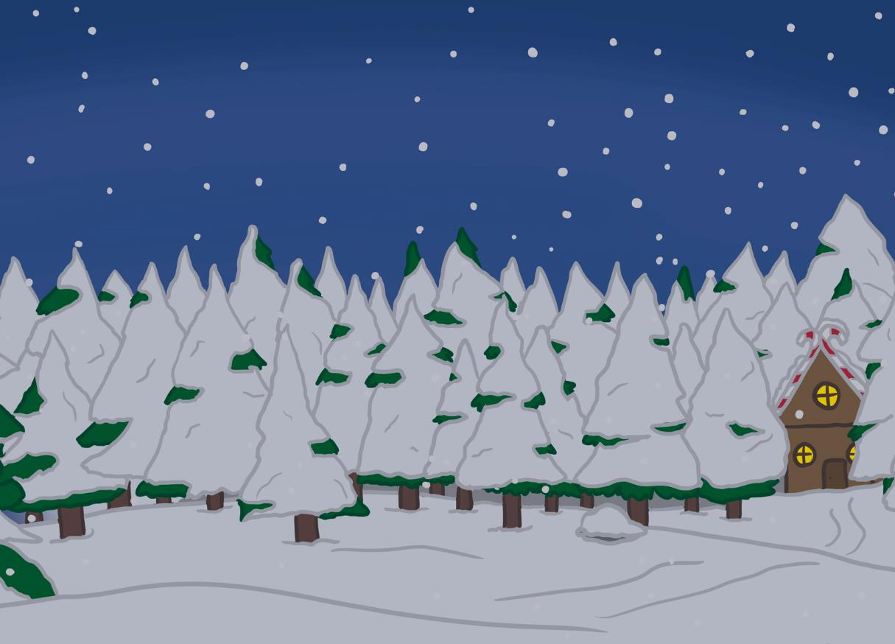
Your Big Bang Question
Can we work together to find a solution to the Chaos at the North Pole?
Teachers’ Toolbelt
Click here to find the Nuts and Bolts of It Adult Information

Slide 3
First, can you remember what STEAM stands for?
Chief Elf here!
I need your help to sort out the chaos at the North Pole.
In the next few slides, I will tell you about your class’s challenge and how you can use STEAM to solve it.
S
cience
T
echnology
E
ngineering
A
rt
M
aths

Slide 4
The STEAM Design Cycle
Today, you are going to be Elf Engineers.
When engineers solve a problem, they use a design cycle.

Slide 5
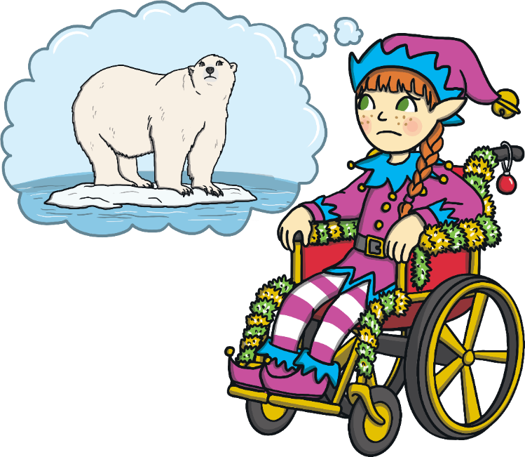
Can you build a boat to help rescue the polar bear?
My polar bear friend is stuck on an iceberg and I need your help to get him back safely.
Elf Engineers, here are your design criteria.
Your boat must float on water.
Your boat must be able to move across the water.
Your boat must be big enough for the polar bear.
Can you build a boat to help rescue the polar bear?

Slide 6
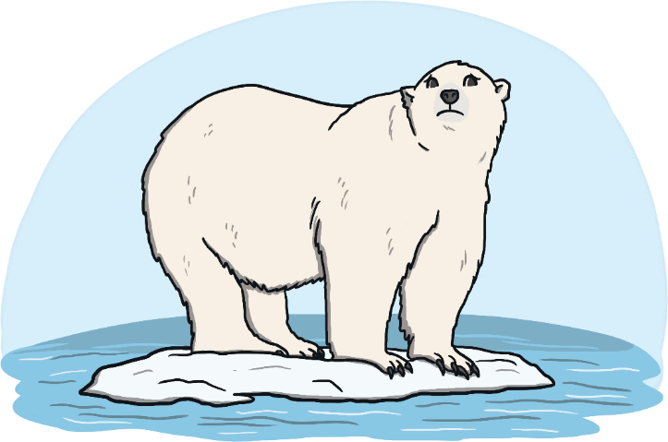
Can you build a boat to help rescue the polar bear?
With a sprinkle of some magic elf dust, the polar bear can shrink to the size of a crayon.

Slide 7
The STEAM Design Cycle

Slide 8
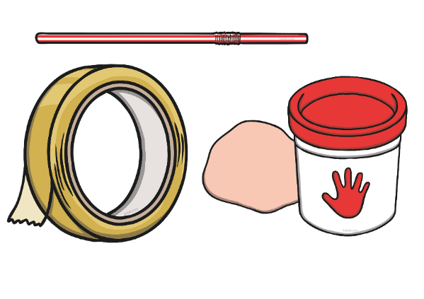
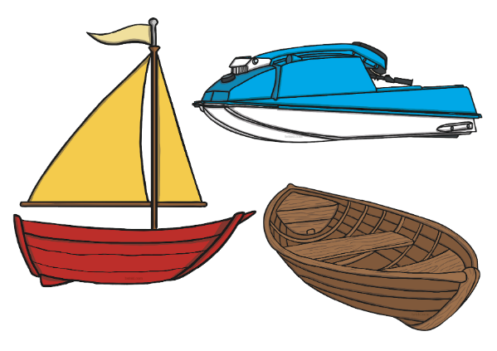
Let’s think about how boats move in water.
Click to Take a Look
Click on the Chief Elf to find out about boats and on ‘Discover It’ to make a simple model boat.
Keep Calm and Ask an Expert

Slide 9
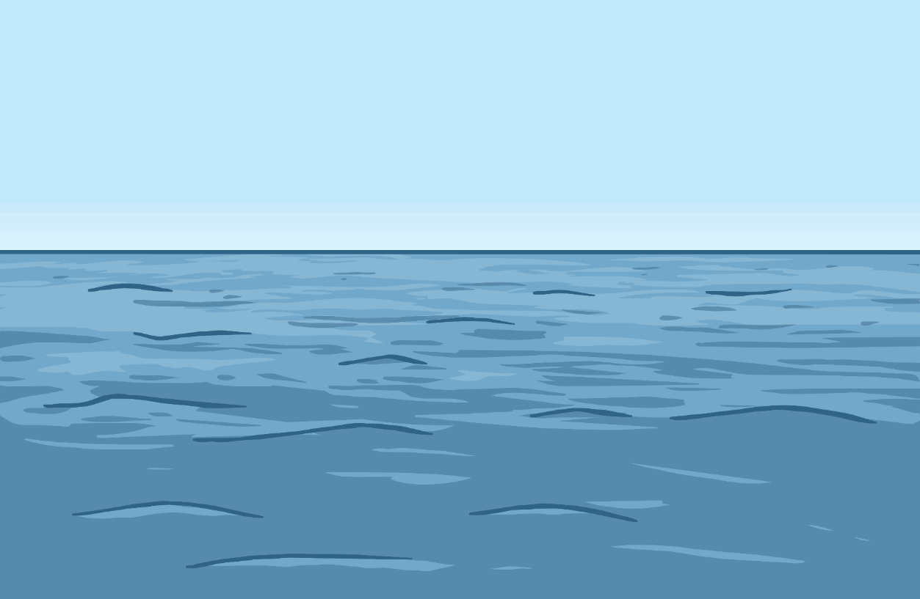
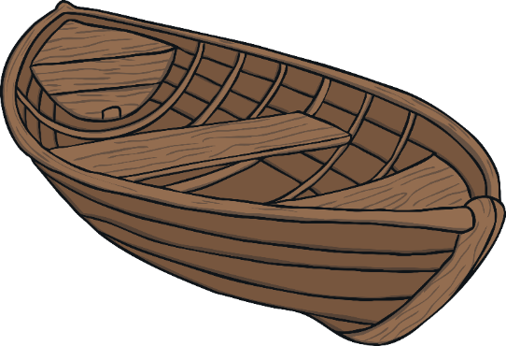
Keep Calm and Ask the Chief Elf
A rowing boat uses oars to paddle through the water.
The wind catches in the sail of a sailing boat to push it along the water.
How do boats move in water?
A speedboat is powered by an engine to make it travel quickly in water.

Slide 10
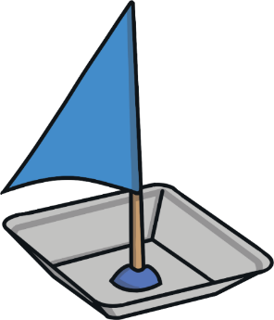
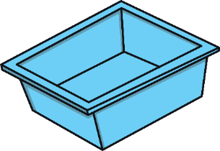
Let’s Make a Boat
You will need:
a plastic container;
a straw;
some playdough;
a sail template on paper;
scissors;
sticky tape.

Slide 11
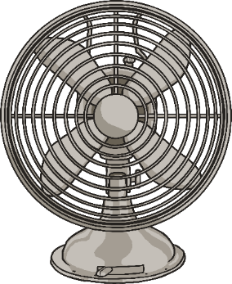
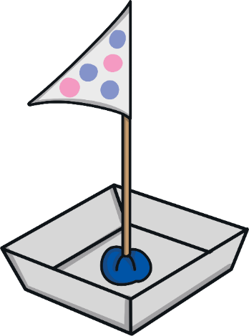
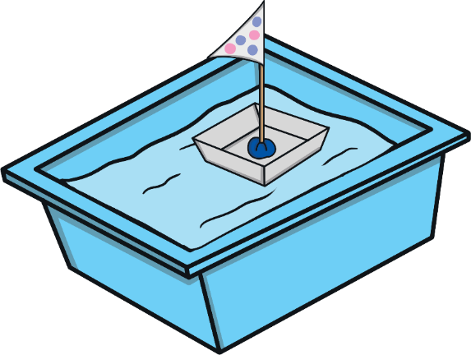
Let’s Make a Boat
Attach the sail to the boat by sticking the playdough inside the container.
5
2
4
3
6
1
Place your boat in water to check it floats.
Use sticky tape to attach the sail onto the straw.
Put the bottom of the straw into a lump of playdough.
Use a fan to make the boat travel along the water.
Decorate and cut out the paper sail.

Slide 12
Something to Think About
What happens when you use a larger sail?
What else could you use as a base for the boat?
Is the amount of playdough you use important?

Slide 13
The STEAM Design Cycle

Slide 14
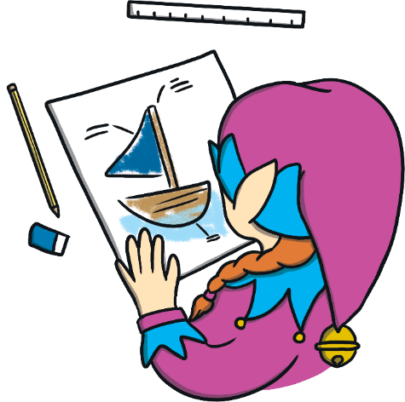
Time to plan your design.
What type of boat will you make to get the polar bear to safety?
Draw a diagram of your boat and label the sail.

Slide 15
The STEAM Design Cycle

Slide 16
Now it’s time to make your design come to life.
Remember what the Chief Elf said:
Your boat must float on water.
Your boat must be able to move across the water.
Your boat must be big enough for the polar bear.

Slide 17
The STEAM Design Cycle

Slide 18
Try it out!
Does your boat float on water?
Does your boat travel across the water?
Is it big enough for the polar bear?

Slide 19
The STEAM Design Cycle

Slide 20
Can it be improved? Modify and test again.
What works?
What can you change to make it better?
What doesn’t work?

Slide 21
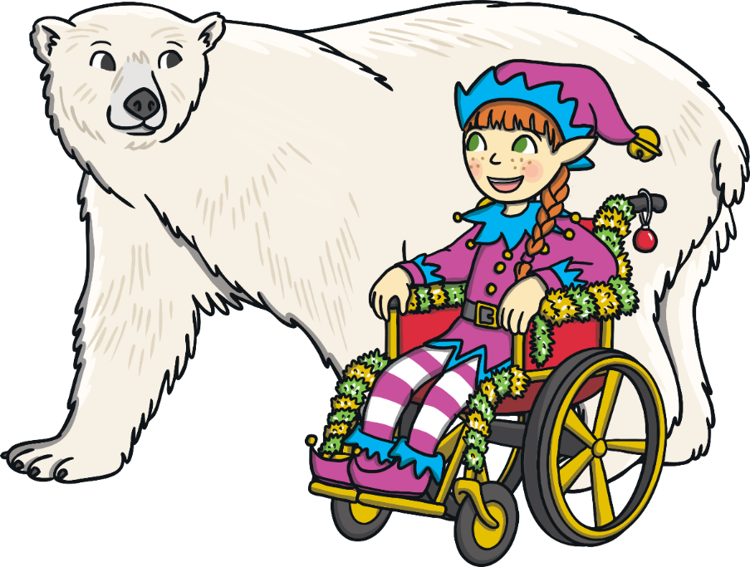
Elf Engineers, thank you for helping my polar bear friend return safely.
Discuss with a partner.
What went well?
What would you do differently next time?
When did you use STEAM?

