Slide 2
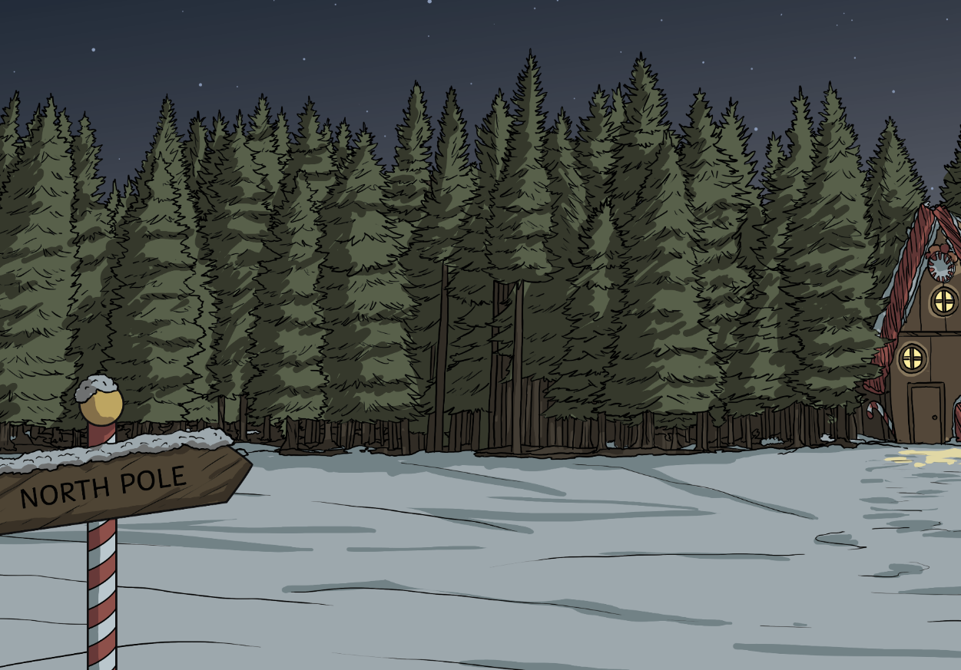
Your Big Bang Question
Can we work together to find a solution to the Chaos at the North Pole?
Teachers’ Toolbelt
Click here to find the Nuts and Bolts of It Adult Information

Slide 3
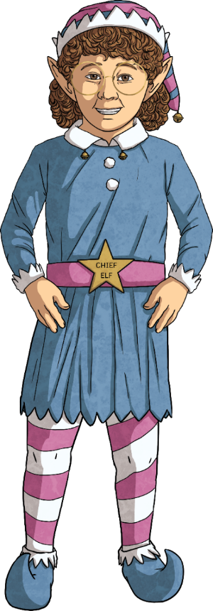
First, can you remember what STEAM stands for?
Chief Elf here!
I need your help to sort out the chaos at the North Pole.
In the next few slides, I will tell you about your class’s challenge and how you can use STEAM to solve it.
S
cience
T
echnology
E
ngineering
A
rt
M
aths

Slide 4
The STEAM Design Cycle
Today, you are going to be Elf Engineers.
When engineers solve a problem, they use a design cycle.

Slide 5
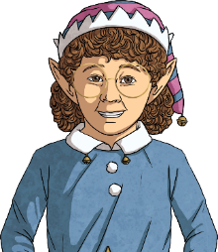
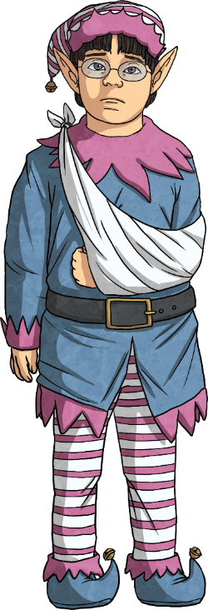
What is the problem and are there criteria the design should meet?
Elf Engineers, here are your design criteria.
I want to win the Annual Twinklelves Snowball Contest but I’ve broken my arm.
‘Elf’ and safety is very important, so you must not shoot your contraption without official testing.
The aim needs to be accurate.
The snowballs need to be able to travel at least two metres.
It must be activated using only one hand, although you are allowed one assistant to hold your contraption down if required.
Can you help by building a contraption to throw snowballs?

Slide 6
The STEAM Design Cycle

Slide 7
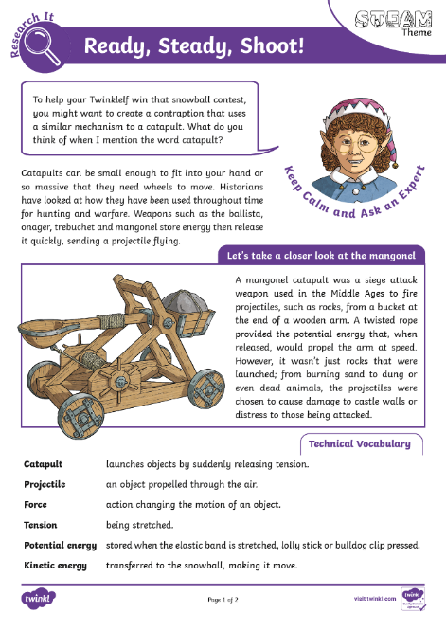
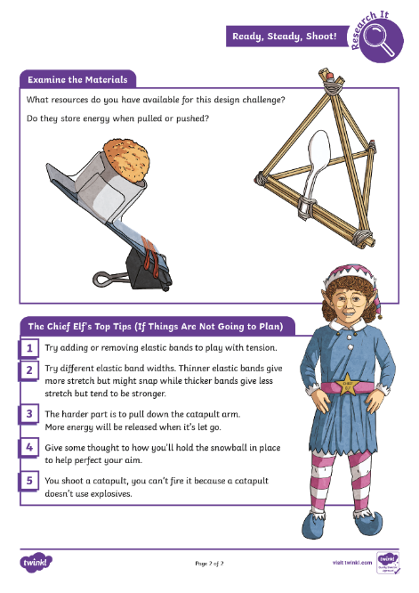
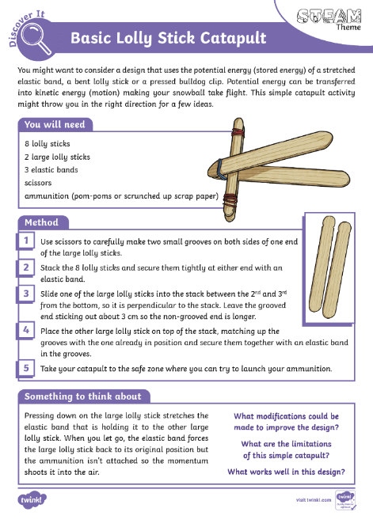
Generate ideas for possible design solutions.
Click on each to open
Keep Calm and Ask an Expert

Slide 8
The STEAM Design Cycle

Slide 9
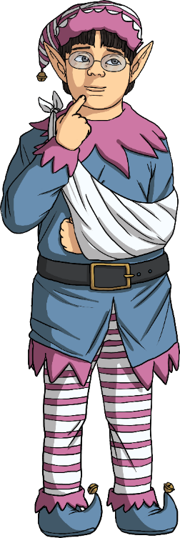
Choose one idea, draw an annotated diagram and make a list of what you need.
An annotated diagram is drawn as accurately as possible. Use a ruler to label specific parts and highlight their function.
Remember the design criteria:
The aim needs to be accurate.
The snowballs need to be able to travel at least two metres.
It must be activated using only one hand, although you are allowed one assistant to hold your contraption down if required.

Slide 10
The STEAM Design Cycle

Slide 11
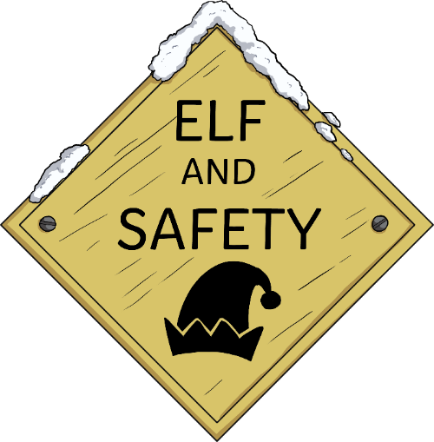
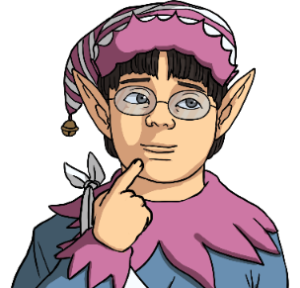
Follow your plan to build your solution.
‘Elf’ and safety is very important, so you must not shoot your contraption without official testing.

Slide 12
The STEAM Design Cycle

Slide 13
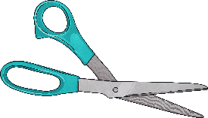
Try it out.
Does it solve the problem and meet the design criteria?
You’ll need to set up a testing zone that recreates the Annual Twinklelves Snowball Contest. To do this you will need the following:
a large sheet of paper
circle drawing compass
sticky tape
a metre stick
desk
As a class decide:
how many target holes are needed;
the different-sized diameters for each target hole;
the points scored for each different size of target hole;
the number of snowballs that will be launched per turn.
snowball substitutes (pom-poms or balls of paper)
scissors

Slide 14
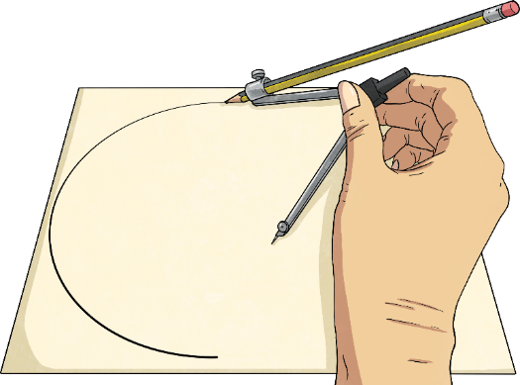
Try it out.
Does it solve the problem and meet the design criteria?
Draw the circles using these specifications.
Carefully push scissors through the paper in the centre of each circle to cut them out.
Around each target hole, write the diameter and the points allocated for a snowball going through it.
Add a festive design.
Tape the sheet to the legs at the narrow end of your desk.
Measure and mark a shooting spot that is 1.5 metres from the sheet for the contraptions to remain in during testing.
Now, test your design!

Slide 15
The STEAM Design Cycle

Slide 16
Can it be improved? Modify and test again.
What works?
What doesn’t work?
What can you change to make it better?
Modify your design and go through testing again.

Slide 17
The STEAM Design Cycle

Slide 18
Show others your solution and ask for feedback.
Hold a Primary 7 Snowball Tournament
to compare the different contraptions.
Celebrate the variety of designs!
How well do they meet the design criteria?
What features do you think are
particularly effective or imaginative?

Slide 19
The STEAM Design Cycle

Slide 20
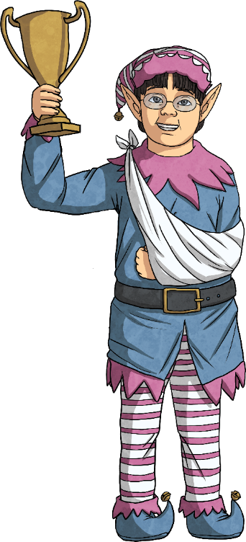
What went well and what could have gone better?
What have you learnt?
Elf engineers, thank you! As a result of your STEAM ideas, not only did I win the contest but I also set a new Twinkelf World Record for the highest score.
Discuss with a partner.
What did you find challenging about this STEAM problem?
What STEAM skills did you use?
Would you do anything differently next time?
What did you enjoy?

