Slide 1
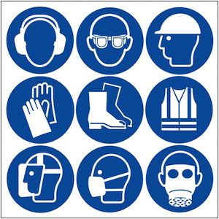
Design Task – Covid 19
One of the most important things we can do in life is help others. With the whole world rushing to combat the spread of Covid 19 how can we use our design and modelling skills to create a gadget or protective gear that will help others.
Stay at home | Protect the NHS | Save lives | Help others

Slide 2
Research
Answer the following questions on the PowerPoint.
What is PPE
What type of PPE is required for NHS staff?
What other workers may need protecting?
What might they require to be protected?
What do we need to do in our everyday lives to help prevent us from contracting coronavirus?
Stay at home | Protect the NHS | Save lives | Help others

Slide 3
Moodboard
Using the internet create a collage of images that displays what products are currently available on the market. Top tip if you remove the image background it looks much better!
Stay at home | Protect the NHS | Save lives | Help others

Slide 4
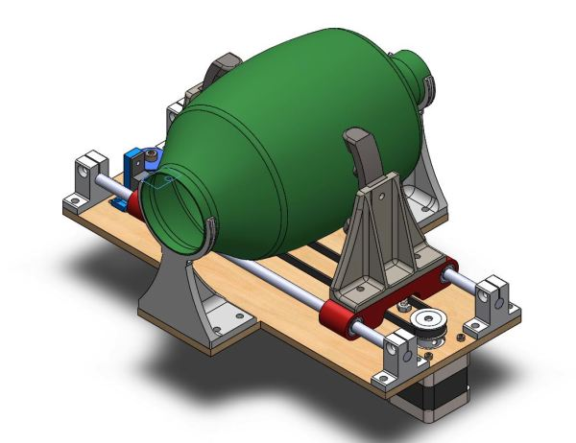
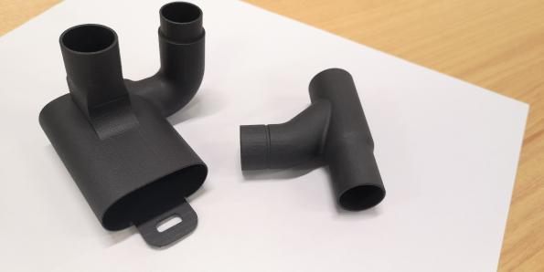
Good news stories from around the world.
Industries are diversifying and people are helping.
Industries and hobbyists are 3D printing ventilators and parts to help meet the global demand.
Answer the following questions.
3D printing is an additive manufacturing process. What is additive manufacturing?
What are the benefits of additive manufacturing?
What are the drawbacks of additive manufacturing?
Stay at home | Protect the NHS | Save lives | Help others

Slide 5
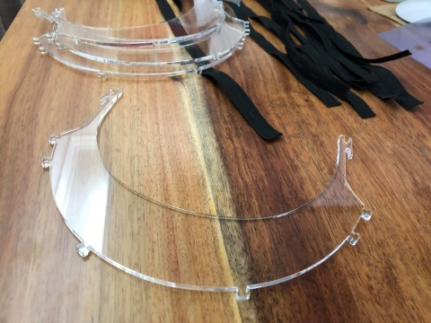
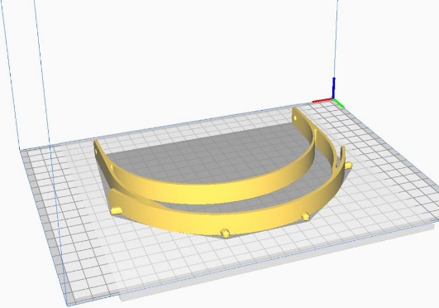
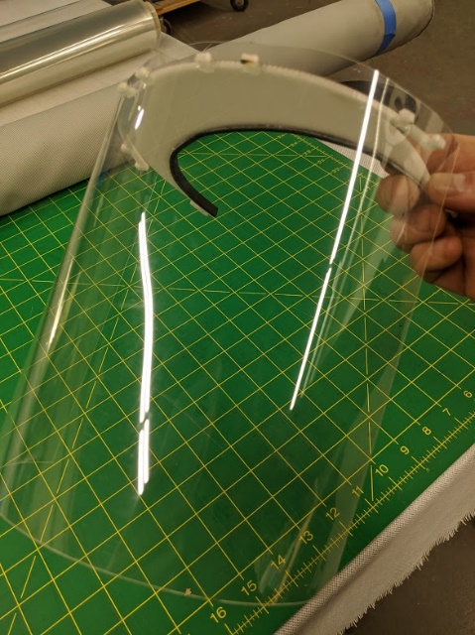
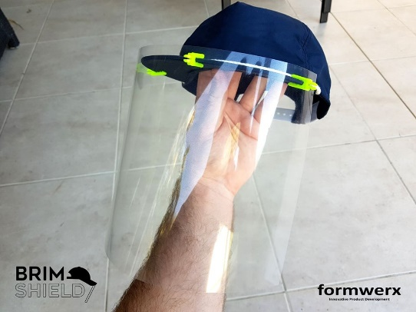
Good news stories from around the world.
Industries are diversifying and people are helping.
Hobbyists are laser cutting and 3D printing full face shields
Answer the following questions.
What is laser cutting?
What are the benefits of laser cutting?
What are the drawbacks of laser cutting?
Stay at home | Protect the NHS | Save lives | Help others

Slide 6
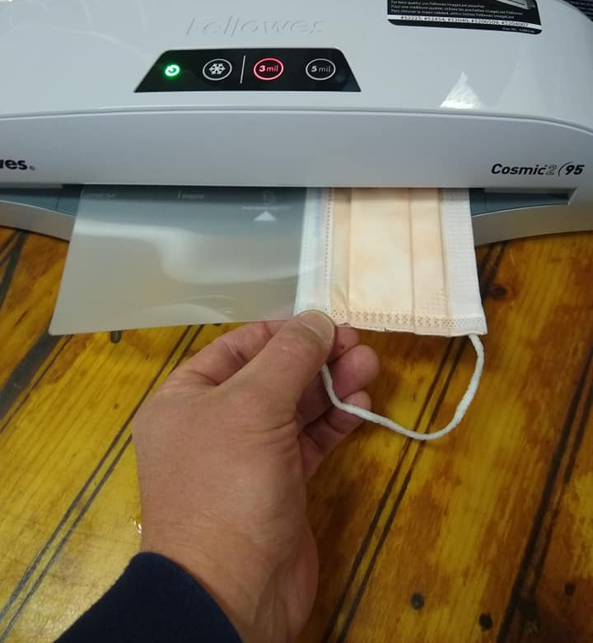
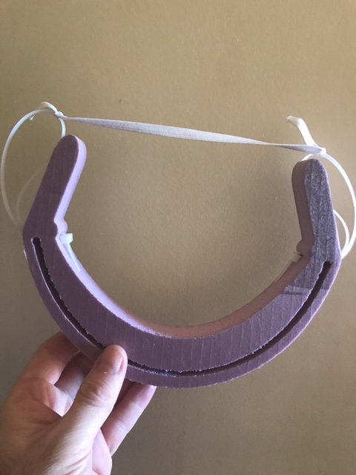
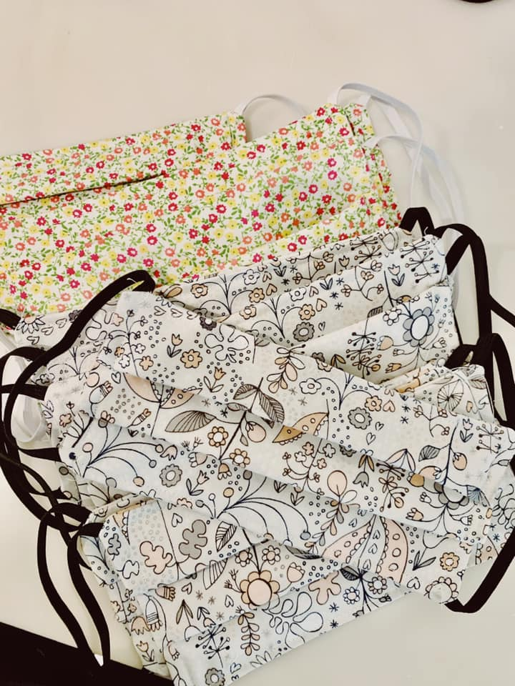
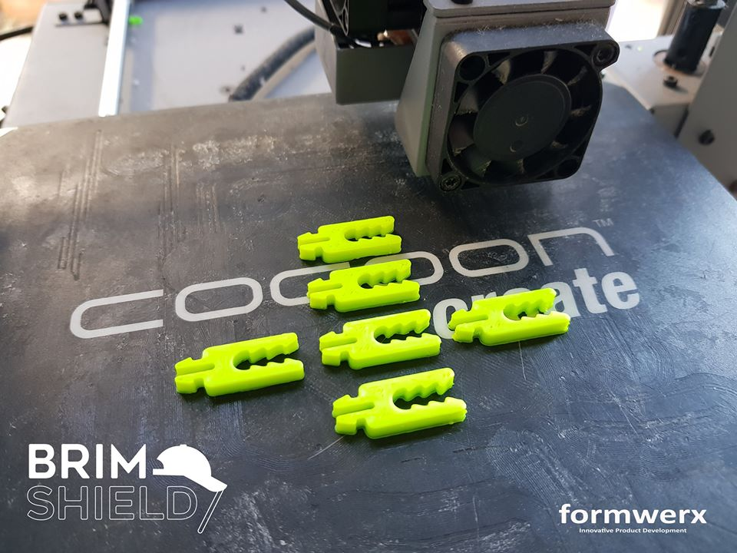
Good news stories from around the world.
Industries are diversifying and people are helping.
Using some foam this person was able to create a reusable headband for a face shield
Someone used a laminating pouch to create a face shield
Left over fabric is being used to crease a simple face mask.
This hacker has 3D printed clips to turn a standard baseball cap into a full face shield.
Stay at home | Protect the NHS | Save lives | Help others

Slide 7
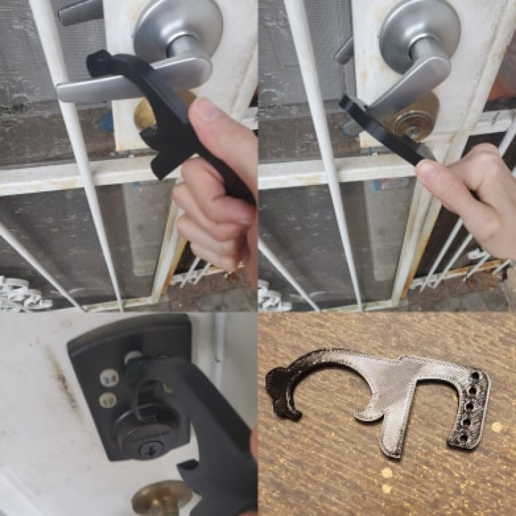
Good news stories from around the world.
Good or bad design you decide?
What do you think about this product?
Do you think it protects the user?
Does it significantly stop spreading?
What happens once you use it?
What are your thoughts?
What does this do that the others don’t?
Is acrylic suitable?
Stay at home | Protect the NHS | Save lives | Help others

Slide 8
Idea Generation
Sketch 6 different ideas for products that could be used to combat Covid-19. You may use the previous examples to help with your design.
Upload a photo of your six ideas here.
Stay at home | Protect the NHS | Save lives | Help others

Slide 9
Development 1 Ergonomics
Watch this video https://www.youtube.com/watch?v=PZWSc5EWDoA many factors are changed to make the user more comfortable. How can you change your design so that it is easier and more comfortable for the user to use?
Upload a photo of your ideas here.
Stay at home | Protect the NHS | Save lives | Help others

Slide 10
Development 2 Sizes
Sketch your idea complete with sizes and upload a photo of it on this page. Remember to use MM
Stay at home | Protect the NHS | Save lives | Help others

Slide 11
Test modelling
Create a full scale prototype of your design using household materials for example card, paper, plastic bottles or old fabrics. Be safe! Take lots of photos of the process
Upload photos of the process here.
Stay at home | Protect the NHS | Save lives | Help others

Slide 12
Promotional Poster
Using any app or by hand create a promotional poster for your product.
Upload your poster here
Stay at home | Protect the NHS | Save lives | Help others

Slide 13
Evaluation
Answer the following questions on the PowerPoint.
Did your product work?
What materials will you use and why?
What are the strengths?
What parts need further development?
If you were to design the product again what would you change?
Discuss your product (75 words)
Stay at home | Protect the NHS | Save lives | Help others

