Slide 1
Architectural unit
Level 4 Graphic Communication

Slide 2
Building drawings
A number of different drawings are required to be completed and submitted to the local authorities when developers want to build new buildings.
This group of drawings is called a Project Set.

Slide 3
Project Set
Elevations, sketches and sectional drawings are required to view the actual building.
Schematic diagrams are used by tradesmen to install any electrical circuit work or plumbing and heating.
Schematic diagrams use British Standards symbols covered in these slides.

Slide 4
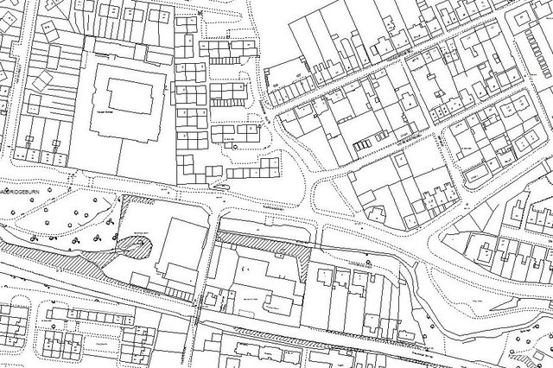
Location Plans
This type of drawing shows the position of the new building in its surrounding area.
It is as if you are looking at the building from an aeroplane above.
It is normally drawn to a scale of 1:1250.

Slide 5
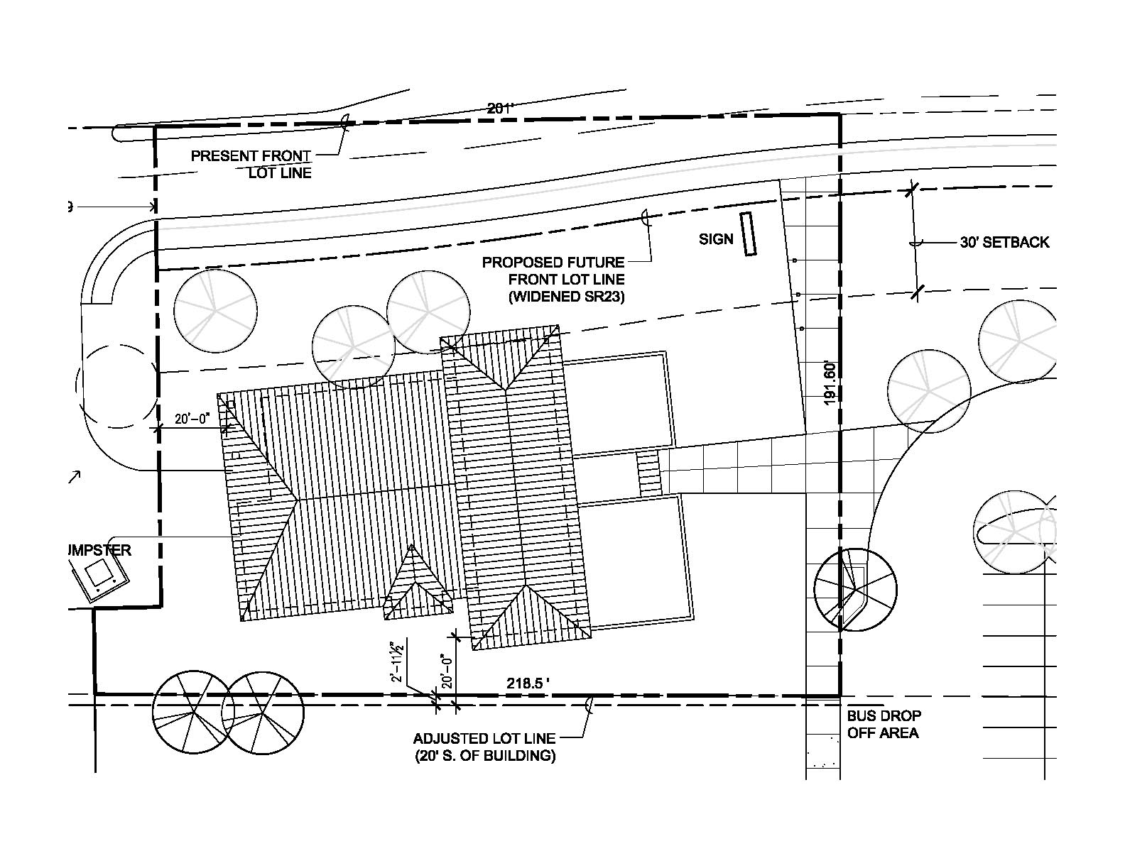
Site Plans
This type of drawing shows the building from closer in than a Location Plan.
It is like a bird is looking down at it.
It shows the building in its immediate surrounding area.
It is normally drawn at a scale of 1:200.

Slide 6
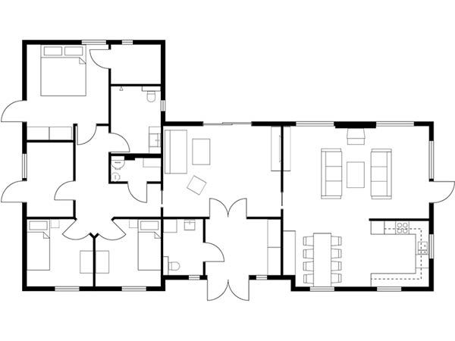
Floor Plans
This type of drawing shows the internal layout of a building including the materials used in the walls.
Any electrical appliances fitted will also be drawn like, radiators, electrical sockets and switches.
This type of drawing is normally drawn at a scale of 1:50.

Slide 7
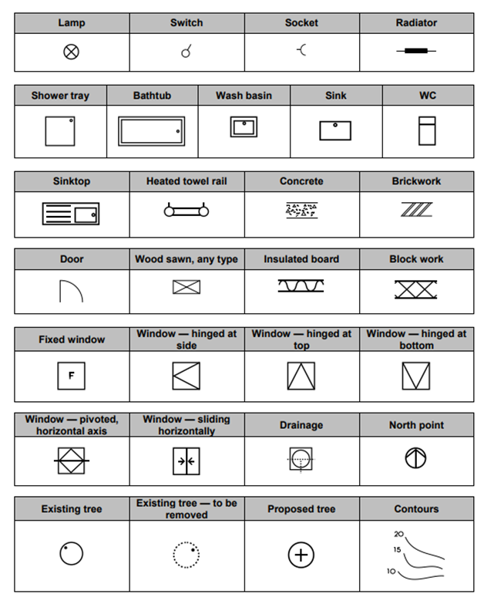
Building Symbols
Engineers need to use symbols to show the different materials used in building a house.
This is law as when submitting planning permission a company must be able to prove the quality of the houses or buildings they want to build.
These symbols are drawn to British Standards so they are the same throughout.

Slide 8
Brief
The tryst sports centre is next on the list for a re vamp.
The council are looking for the exterior to reflect the interior more.
They are wanting young architects in the making to design a building which will be modern and inviting to come into from the exterior and from the interior to be easy to navigate around and feel open.
They are looking for the interior to have:
Swimming pool
Changing areas/toilets
cafe/kitchen
Courts (badmington, squash etc..)
Gym
Soft play

Slide 9
Signage
They are looking for new and modern signage to go with the new exterior of the building.
They want it to reflect the modern design of the building but also to reflect sports.
Try and look at ways you can use font and/or images to create a new logo / signage for the front of the building.

Slide 10
YOUR TASK
Create 4 different ideas of what the front of your sports centre could look like.
Make sure you make use of the pictorials you have just learned about:
1 point perspective
2 point perspective
Isometric
oblique
Think about the shape of the building and where the name of centre will be located?
Think about material choices? Try and render the sketches to symbolise the material choices.

Slide 11
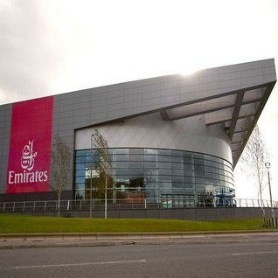
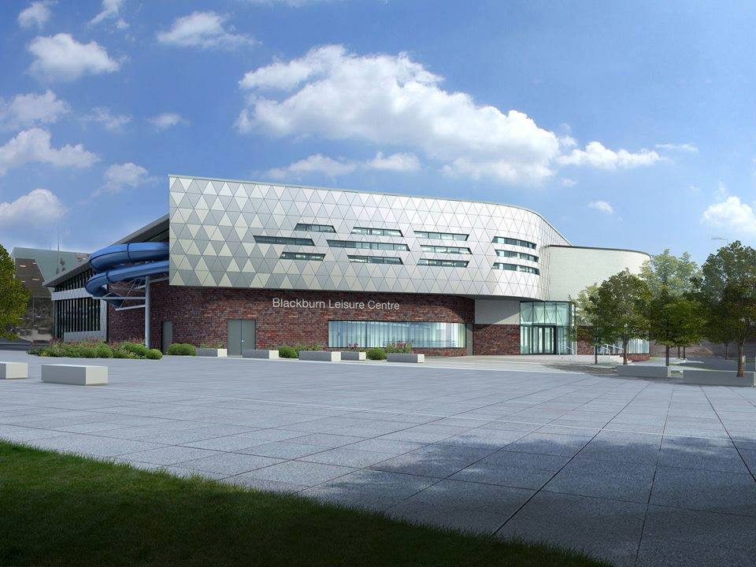
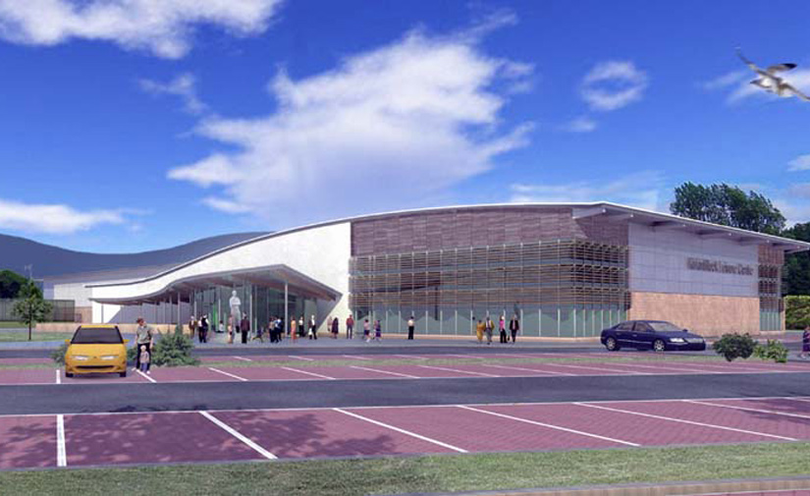
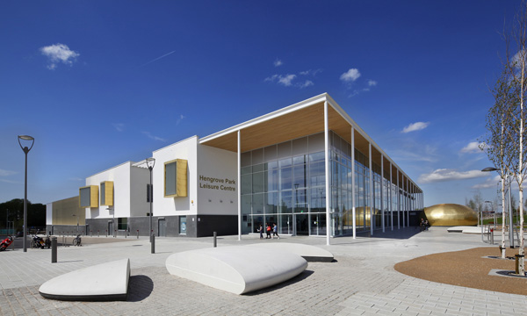
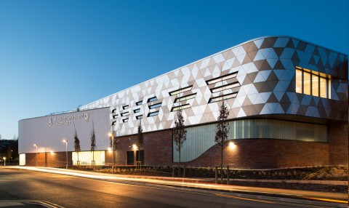
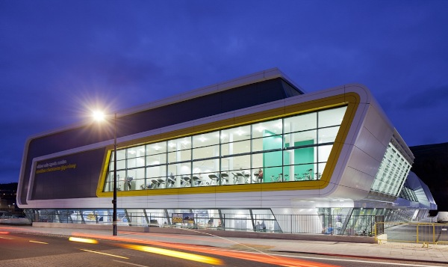

Slide 12
Exterior task
Now think about the exterior of your building
What do you think it will look like?
Will it be modern in design or old fashioned?
Will it be made of concrete? Wood? Glass? Or a mixture.
Create a 2 point perspective sketch of the exterior of your building
Render in the exterior to show the material used.

Slide 13
Interior task
You now have to create a floor plan to suit the shape of your building.
Think about location of doors – entrances, fire exits
Think about where changing rooms and toilets will be
Think about the café area – where will this be located? What will it have in it?
Where will the swimming pool area be? Changing areas? Showers?
Where will the courts be? How many will there be?
Once you have sketched this out, you can then create a floor plan manually.
Leave an area for your key for your symbols.

Slide 14
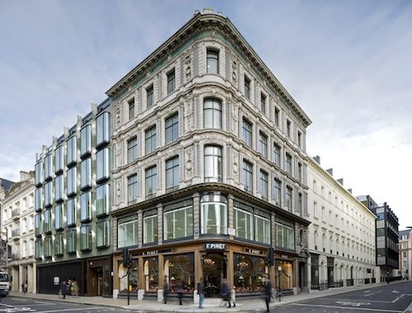

Slide 15
