Slide 1
S2 Desktop Publishing
Graphic communication
Greenfauld’s High School

Slide 2
What is Desktop Publishing (DTP)
Desktop publishing (DTP) is the process of designing newspapers, magazines, books, leaflets, booklets and reports etc on a computer.
The industry that produces these items is the publishing Industry.
Designing the structure and format of the publication and layout of each page is the job of the graphic designer, while the process of creating the publication on paper is printing.
DTP provides a number of benefits to publishers and graphic designers:
Text and graphics can be imported from a variety of sources and locations around the world.
Text and graphics can be positioned accurately using grid and snap, scale, rotate and crop functions.
The proposed layout can be sent electronically to the editor or client for approval prior to printing.
Modifications can be made easily.
Once approved, the final layout can be sent for printing electronically with little or no time wasted in pre-production.

Slide 3
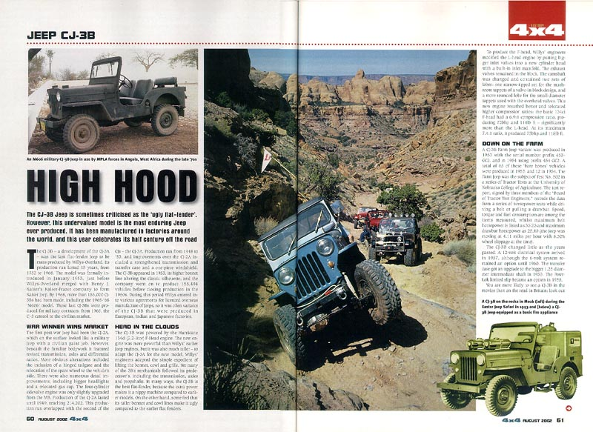
Desk Top Publishing Features
Header; this will appears on every page in this section of the publication
White Space; Areas on a piece which are free of type, graphics and photos, it is simply an uncluttered area. White space is important in good design
Heading; this is the main title on the page. Its usually short but eye catching.
Rule; this is a straight line which has been included to neaten up the structure of the page or separate different areas in an article.
Drop Cap: the first letter of the first word of the Column is enlarged
Image; a picture which has been included in the publication
Sub Heading; gives more info on the article or can be used to divide the article up into different sections.
Caption; this gives additional information about the image or photograph.
Columns; the area of body text. These vertical columns are restricted in width to make the text easier to read.
Cropped Image; this is where a background or part of an image has been removed to create a more interesting shape.
Gutter; this is the narrow space that separates the columns.
Footer/Folio; these are placed on the bottom of each page in the publication. The folio is the page number, while the footer can contain information like a web address, issue number etc.

Slide 4
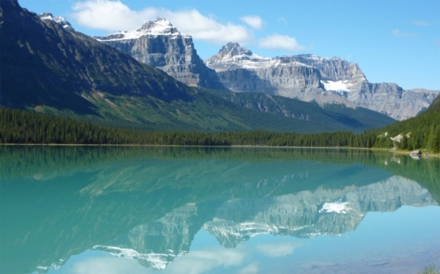
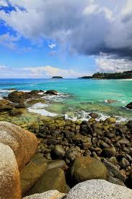
DTP Features
Page Orientation
Orientation is the direction or rotation at which the page lies when text and graphics are added. The two types of page orientation are Landscape and Portrait.
Colour Fills
Colour fills provide background colours, textures and fill effects to enhance publication
Solid Fill
Gradient Fill
Textured Fill
Landscape
Fonts and text size
The heading should be the most visible piece of text on any page, followed by the sub heading then the main body text.
You can make a heading stand out by using some of the following techniques:
By increasing the size of text,
Through colour choice
Making it bold
Through the font selection
Some examples have been shown opposite:
Portrait
Margins
This is the name given to the white space around the outer edge of the publication.
Margin
Row
Column
Gutter

Slide 5
DTP Features
Text along a path
The free flowing text is restricted by flowing a path such as a circle, wave or other shape.
Before Cropping
Cropped images
Many photos or images may contain a lot of unwanted background. We can remove this unwanted area by using the crop tool.
This will reduce the background area and allow the main focus of the image to be more visible.
Text wrap
Cropped images can create a variety of shapes that don’t naturally sit well with a column of text.
Using the text wrap function allows the body text to follow the irregular contours of an image.
Crop tool
After Cropping
Sometimes, a graphic designer would want the background to be removed completely. This can be done easily by using Serifs ‘Cut out Studio’ or Photoshop’s ‘Magic Wand’ tool. This tool allows you to remove large areas of the background by following the contours of the main image.
Before
After background has been removed

Slide 6
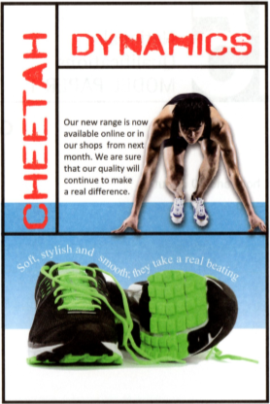
DTP Features
Alignment
Alignment can be applied in two ways.
Text Alignment The alignment of text within
a text box. This can be left, centre, right or
justified.
Reverse
The technique of printing white or light coloured text on a black or dark background for emphasis.
This is Left alignment
Drop Shadow
This gives the effect of a shadow behind text or a shape. The shadow can be altered to appear anywhere around the selected element and any distance from the element.
This is Right alignment
This is Centre alignment
This is Justified text
Rule
Horizontal or vertical lines used in design for separating sections or provides graphic elements for decoration.

Slide 7
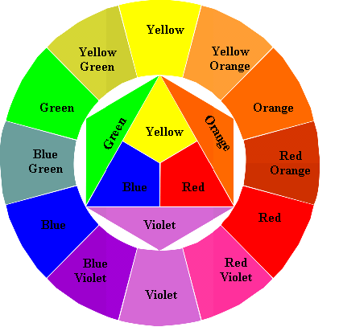
Colour Wheel
The use of colour is an important part in illustration and graphic design. Colour is used to create certain moods or feelings as well as helping to make an image look more realistic.
In S1, you would have completed a copy of the colour wheel. Here is a small refresher of what else was covered:
Primary colours (Red, Blue and Yellow) are the three main colours which when mixed together can produce any other colour.
Secondary colours (Violet, Orange and Green) are created when two primary colours are mixed together in equal quantities. (e.g., yellow and blue make green)
Tertiary colours are made when a primary colour is mixed with a secondary colour in equal quantities, e.g., red-orange or blue-violet.

Slide 8
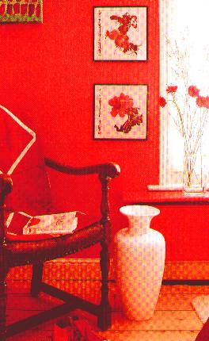
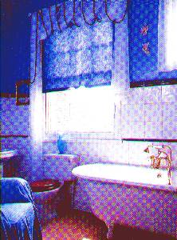
Colour Effects
Skoosh!
There are many different effects and moods that can be achieved by using carefully selected colour combinations.
Harmony is created when colours close to each other on the outside of the colour wheel are used together. Harmony is easy on the eye and can be used to create a relaxed and elegant ambiance (e.g. blue and blue-green).
Contrast is created when colours far apart on the colour wheel are used together. Contrast is vibrant, eye catching, bold and exciting (e.g. blue and orange)
Skoosh!
Warm colours such as reds, orange and yellows all give a sense of heat and warmth. They are also known as advancing colours as they appear closer to the viewer than other colours.
Cool colours such as blues, greens and violets do the exact opposite. They give a feeling of being cold and are also known as receding colours as they appear more distant and further away.
When WHITE is added to a colour,
it is called a TINT of that colour.
When BLACK is added to a colour,
it is called a SHADE of that colour.
+
+
=
=
e.g.

Slide 9
Your Task

Slide 10
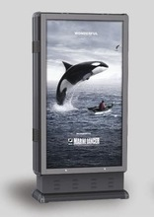
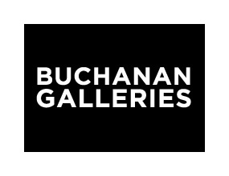
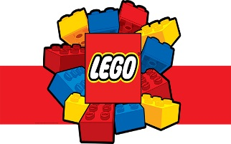
Brief
The Lego store in Buchanan Galleries are hosting a challenge to build the biggest Lego structure for the Guinness book of records. The advert will be shown on the rotating billboards throughout the centre so it needs to be eye catching, as it will be on display for 10 secs each rotation.
900mm
Event Details
Location: Lego Store, Buchanan Galleries
Date: Saturday 29th July 2020
Time: Starts at 10am
1400mm

Slide 11
Preliminary Sketches
Before a graphic designer would start on a publication, they would produce a range of preliminary sketches to help them create and develop their ideas. The different type of sketches are shown below:
Thumbnails
Thumbnail sketches are quick, first drafts of possible DTP layouts. The main focus is to help plan out the structure of the publication, e.g., how many columns, position of titles and images etc. Other design elements and principles can be considered at this stage, e.g., shape, colour and contrast.
Working Roughs
At this stage, a graphic designer would develop a small number of the thumbnails, spending more time on each layout and ensuring more detail in included. The working roughs would be larger than the thumbnails to allow more information to be recorded, e.g., possible headings, subheadings, fonts captions etc.

Slide 12
Preliminary Sketches
Taking into account the information you have just been shown, you are now going to produce your thumbnails of your advert for the poster.
Think about:
Location of your header
Information that must be on the poster
Images that you want to include (must include your Lego figure)
Remember these are ROUGH SKETCHES with not much detail at this stage!! Use LINES for where text is going and a BOX with a cross for images.

Slide 13
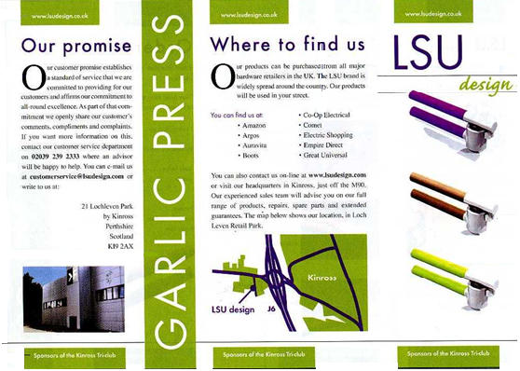
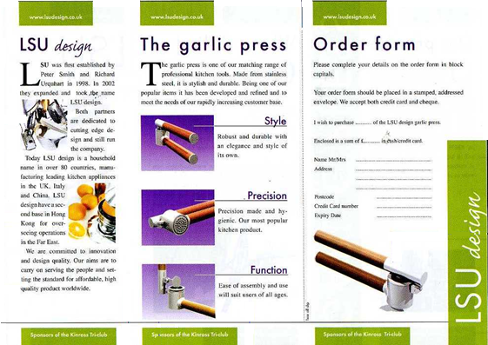
Preliminary Sketches
Presentation visuals
The presentation visual is an actual size, manually produced mock up of the intended document. It gives the designer a preliminary version to discuss with their clients. It also helps to firm up the structure prior to it being created on DTP software.
They should contain dimensional information relating to some of the main features within the publication., for example, the margin size and column breadths as well as the position of headers and footers.
Other features like titles, font styles and exact images should also be decided at this stage.
The presentation visuals above show the sizes and details to be included on the final document.
The final presentations should closely reflect what is shown in the presentation visuals. Some of the images have changed positions slightly, this may have resulted from the discussion between the designer and the client.

Slide 14
Visual
Now you are going to produce a scaled manual visual of what the poster on A4 of what it will finally look like prior to producing it on the computer.
Think about size of font, size of images, size of columns etc..
Think about colours, gradients etc.. that you want to apply.

