Slide 1
Desk top Publishing Homework
Second Year
Technical Department

Slide 2
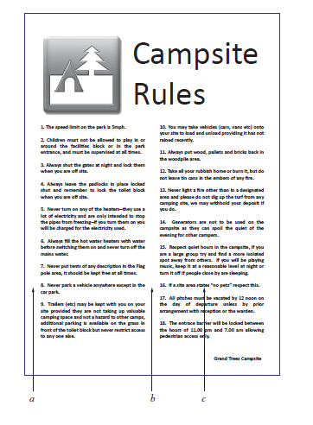
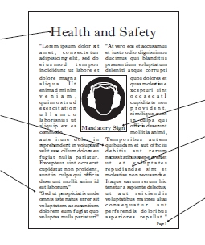
Homework 1
1. A desktop published document is shown below. State the DTP features indicated.
2. A desktop published document is shown below. State the DTP features indicated.
a
b
c
d
e
f
a b c
a) …………………………………………………..………
……………………………………………………………
……………………………………………………………
……………………………………………………………
……………………………………………………………
……………………………………………………………
...................................................................
...................................................................
...................................................................
State the page orientation of the document shown above. …………………………………………………………………

Slide 3
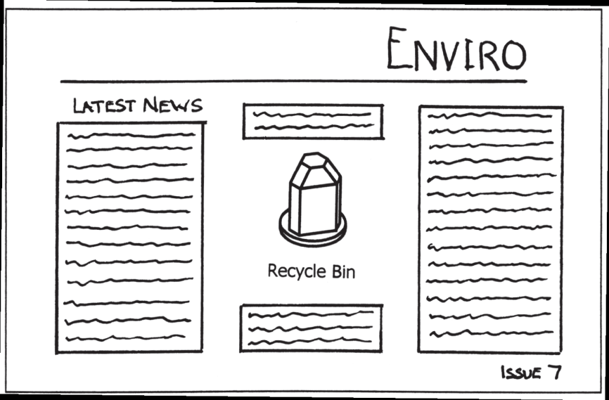
Homework 2
1. There are three stages in planning a DTP document prior to the production of the final electronic version. Research is the first stage.
State two further stages in planning a DTP document.
Stage ...................................................................
Stage ...................................................................
(i)
(ii)
(vi)
Part of the planning stage is shown above.
(b) State the page orientation used in the document above.
.............................................................................................................................
(c) State the DTP term for the deliberately created clear area to the left of the word “ENVIRO”.
.............................................................................................................................
(d) State the DTP term for each of the features (i) to (vi).
(i) ......................................................... (ii) .........................................................
(iii) ....................................................... (iv) ........................................................
(v) ......................................................... (vi) ........................................................
(v)
(iv)
(iii)

Slide 4
Homework 3
Question 1
Listed below are some colours you would find in a colour wheel.
Blue Orange Yellow-Orange Green Blue-Green Red
State, from the list of colours;
A primary colour.
………………………………………………………………………………………………………………………
A secondary colour.
………………………………………………………………………………………………………………………
A tertiary colour.
………………………………………………………………………………………………………………………
An advancing colour.
………………………………………………………………………………………………………………………
(iii) To contrast with orange…………………………………………………………………
Question 3
A toy company has decided to introduce a new colour scheme for its packaging.
A tint of Green was suggested.
State what is added to green to make it a tint.
………………………………………………………………………………………………………………………
State a tertiary colour that contrasts with green.
………………………………………………………………………………………………………………………
State how a tertiary colour is created.
………………………………………………………………………………………………………………………
Question 2
Question 4
(a) State what must be added to a secondary colour in order to make a tertiary colour.
………………………………………………………………………………………………………………………
State two secondary colours
…………………………………………………… and ………………………………………………………
State an appropriate colour to use in the following situations.
(i) To represent something that is warm…………………………………………
(ii) To harmonise with orange……………………………………………………………..
Colour can be used for many different reasons.
State what is added to red to make it a shade.
………………………………………………………………………………………………………………………
State two tertiary colours that contain blue.
……………………………………………….. and ……………………………………………………………

