Slide 1
Architecture unit
S2 Technical Department

Slide 2
What this unit involves….
You will learn about different types of architectural drawings that get used when constructing a new build.
You will learn about the signs and symbols that get used throughout the world
You will learn about scale
You will create your own design to a brief and create a floor plan.

Slide 3
Drawing Scales
Drawing Scales
Every technical drawing needs to be drawn in an accurate proportion, also known as scale, which is given in ratio format. It is crucial that you aware of the following scales within the Graphics course.
Full Size - 1:1
Reduction Scales - 1:2, 1:5, 1:10, 1:20, 1:50, 1:100, 1:200, 1:500 & 1:1000
Enlargement Scales - 2:1, 5:1, 10:1, 20:1 & 50:1
Reduction (1:2) Full Size (1:1) Enlargement (2:1)

Slide 4
Different types of architectural drawings…
Construction projects require several types of specialised drawings. These collection of drawings are known as a Project Set, it includes the following drawings:-
• Location Plans
• Site Plans
• Floor Plans
• Elevations
• Sectional Views
• Rendered Illustrations
Any building drawing created must be in accordance to British Standards BSI, this allows allow interested parties able to read and understand the drawing, whether it be an architect, contractor and planning department etc.

Slide 5
Location Plan
SCALE 1:1250
The location plan shows the geographical location of the construction site. An entirely new development for housing will require a location plan to show it’s location with regards to the surrounding area.
Example of Location Plan
Key Details of Location Plan
• Shows all neighbouring buildings and plot boundaries.
• Shows street names and house numbers.
• Shows roads, pavements, footpaths, parks and fields.
• Shows the position of North.
• Shows the scale of the drawing which is 1:1250

Slide 6
Site plan
SCALE 1:200
Site plans show a larger view of the plot highlighted in the location plan. The builder needs to show exactly where on the plot the building is to be constructed. The site plan allows the builder to mark out the site before digging trenches for foundations and drains.
Key Details of Site Plan
• Boundaries of the plot.
• The position of the building within the plot.
• Access paths.
• Drainage information for the removal of
waste: pipe runs, manholes and main
sewer location.
• Contour lines to indicate the direction and
gradient of any sloping ground.
• Existing trees and positions of any new
trees that are required.
• A North direction arrow.
• The scale of the drawing which is 1:200

Slide 7
Floor Plan
SCALE 1:50
The floor plan is an internal view of the house from above. It gives information to all trades and customer to show position of windows, doors, room dimensions etc. For instance Floor plans often form the part of the promotional pack that customers get when they view a new house.
Key Details of Floor Plan
• The layout & dimensions of rooms
inside the building.
• Position & dimensions of doors and
windows.
• Layout of kitchen and bathroom
fixtures and fittings.
• Lights, light switches, electrical
sockets, electric cables and fuse
boxes.
• The layout of water pipes (internal
plumbing)
• The scale of the drawing which is
1:50.

Slide 8
Rendered Illustrations
Rendered illustrations are mainly used for promotional purposes, the marketing team might use such illustrations on their development leaflets, websites etc to help advertise and give a realism to the project.
To maximize the impact and realism of illustrations, these may be fully rendered and shown in mature surroundings; trees and shrubs are often included. The drawings can be computer generated or manually created either in 2D or 3D.
Key details of Promotional Illustrations
• External views of the building.
• Coloured and rendered views that are easily understood and
appeal to customer.
• Simplified floor plans enabling the consumer to determine
which size of house will best suit their family’s needs.
• A new property in pleasant, mature surroundings.
• Text that explains the benefits of a particular property but does
not get bogged down in technical details.
• Prices.

Slide 9
Your Brief
A new restaurant is opening up in Cumbernauld.
The owners are looking for you to create a floor plan detailing possible layout ideas of how the restaurant could look.
You are given a specification of things that must be included and a rendered illustration of what the outside will look like. A location and site plan is also included to help you with the location of certain features like drainage, toilets etc..

Slide 10
Specification
Your floor plan must include:
  Entrance/exit
  Toilets (male, female, disabled)
  Tables/chairs/booths
  Kitchen
  Office/staff room
  Bar

Slide 11
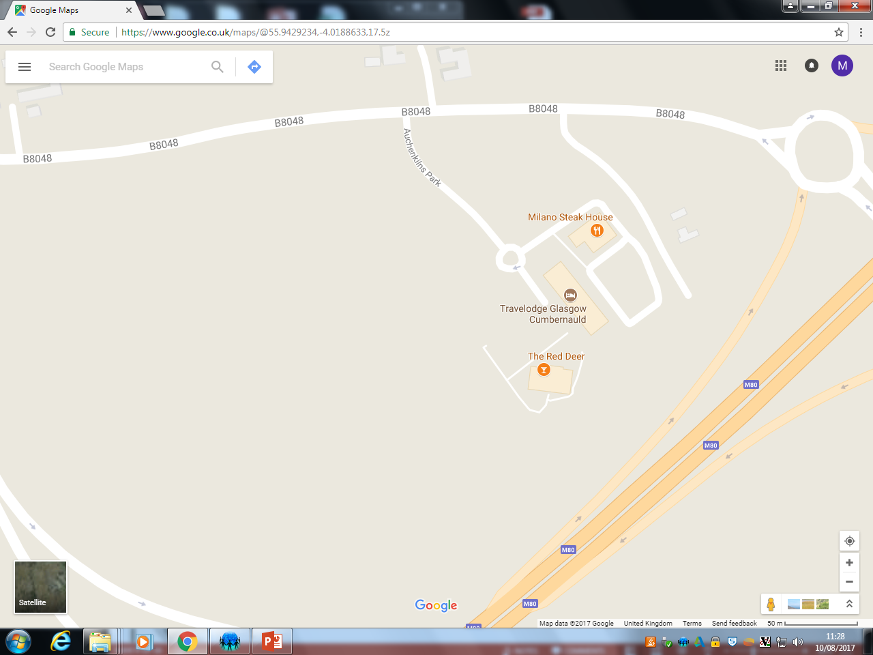
Location Plan

Slide 12
Site plan
Car park
Restaurant

Slide 13
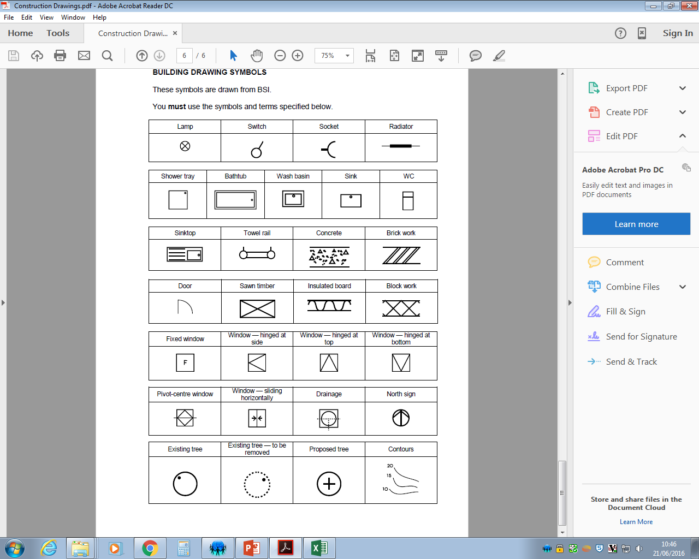

Slide 14
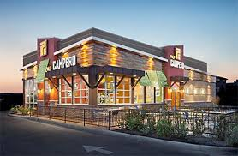
Rendered Illustration
The outside look of the restaurant is modern with a twist from the environment being clad in timber.

Slide 15
The floor plan shape given to you on the worksheet.
Outline of the floor plan for the restaurant.
Think about windows, doors, kitchen, bar, any raised parts? Toilets etc…
You may need to create your own signs and symbols for some of your creations
Is this a revolving door? Sliding doors?
Main
entrance

Slide 16
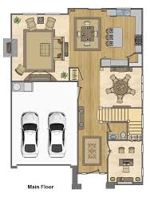
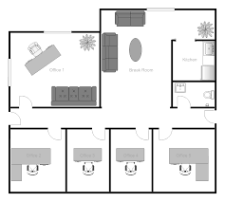
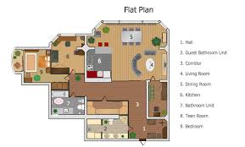
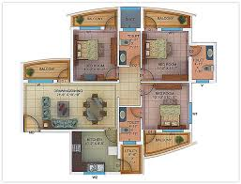
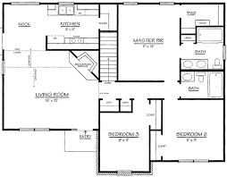
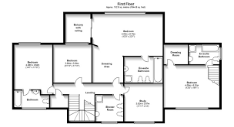
GOOD LUCK!!

