Slide 1
Design and manufacture
N5 revision

Slide 3
specifications

Slide 4
Design factors
Materials, function, aesthetics, ergonomics

Slide 5
Materials

Slide 6
Function

Slide 7
Aesthetics

Slide 8
ergonomics

Slide 9
Ergonomics

Slide 10
Commercial manufacturing processes
Plastics

Slide 11
Identifying Features?

Slide 12
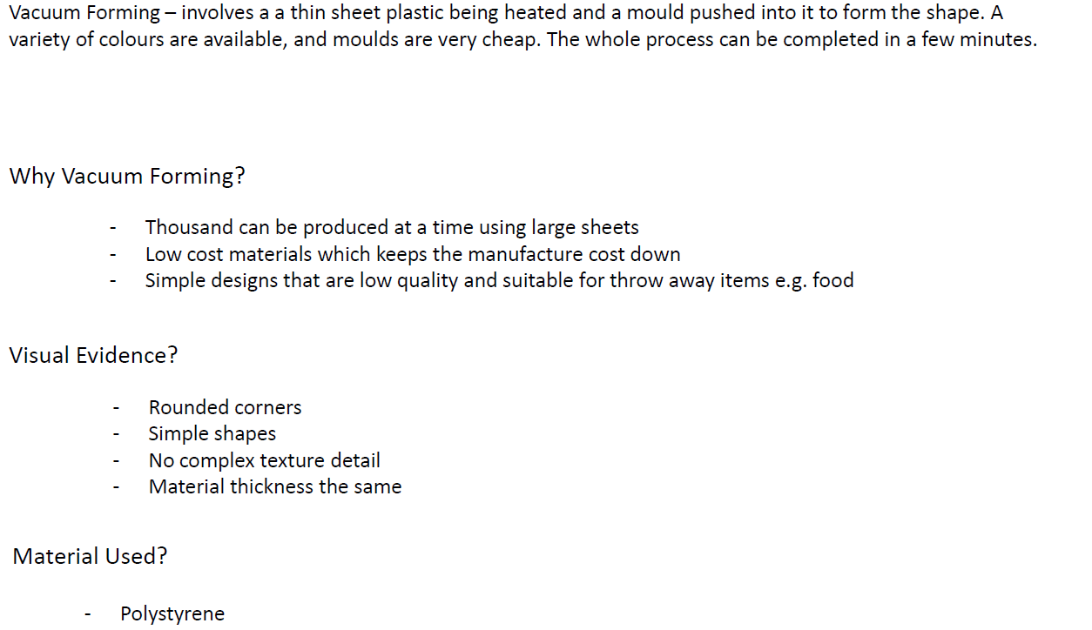
Identifying Features?

Slide 14
Evaluation strategies
N5 design and manufacture

Slide 15
Strategies
Why do we use them?
They are used to help gain results of a product that will need testing
a new product that is going out in the market will be tested to see if it will be a success

Slide 16
Types of strategies
Questionnaires/surveys
User Trials
Observations
Product Comparisons
Internet Research

Slide 17
Questionnaires/surveys
Types of questions
Closed questions:
Usually yes, no answers
Open questions:
This encourages people to give opinion or point of view
Rating questions:
Helps people express an opinion, usually asked to give ratings from a scale.
Structured Questions:
Very particular answers and a lot of information is required. Prevents people going off on tangents

Slide 18
User trials/observations
USER TRIAL
This is when you get people to actually test the product to a set of questions you wish them to answer.
Allows designers to generate improvements to a product and changes that a designer or manufacturer may not otherwise consider.
A user trial could be used to determine the products function, ergonomics and ease of use.
OBSERVATION
This is when you would ask someone to use the product for ‘x’ amount of time and you would record through observing how easy or hard they found aspects.
You would have a series of areas you would be looking for in particular for results.

Slide 19
PRODUCT COMPARISON
This is when you compare your product and its functions or aesthetics or other aspects to other products on the market that do the same job.
If a designer wants to see if the product is good value for money then a product comparison would be carried out.

