Slide 1
Design and Technology
S1 Sketching and Rendering

Slide 2
Control and Proportion
Using only a pencil divide your page into 2 halves with a horizontal line. Fill the top section equally spaced horizontal lines and fill the bottom section with equally spaced vertical lines.

Slide 3
Control and Proportion
Using your measuring skills on a piece of A4 paper draw a rectangle 160mm x 100mm using a ruler and a pencil. Then only using a pencil divide the box into 2 halves with a vertical line. Divide one of the halves into 2 with a horizontal line, repeat this until all the space is filled.
160
1
2
100
4
3

Slide 4
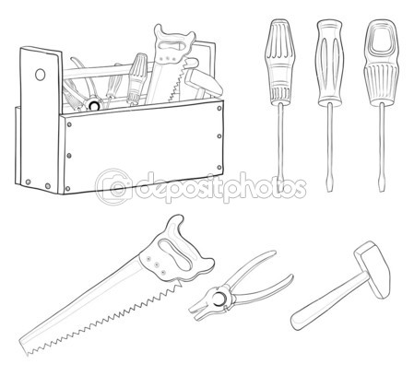
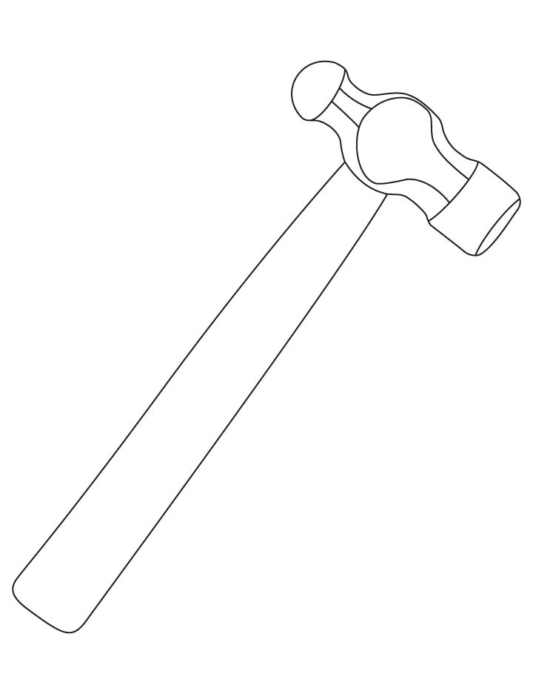

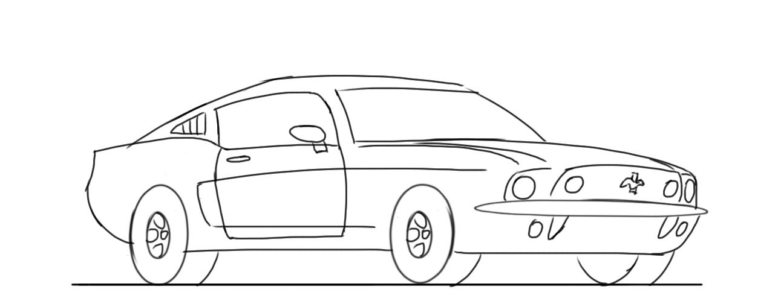
Control and Proportion
sketch the objects shown. Be aware of the sizes of the different parts so that the objects do not look out of proportion.

Slide 5
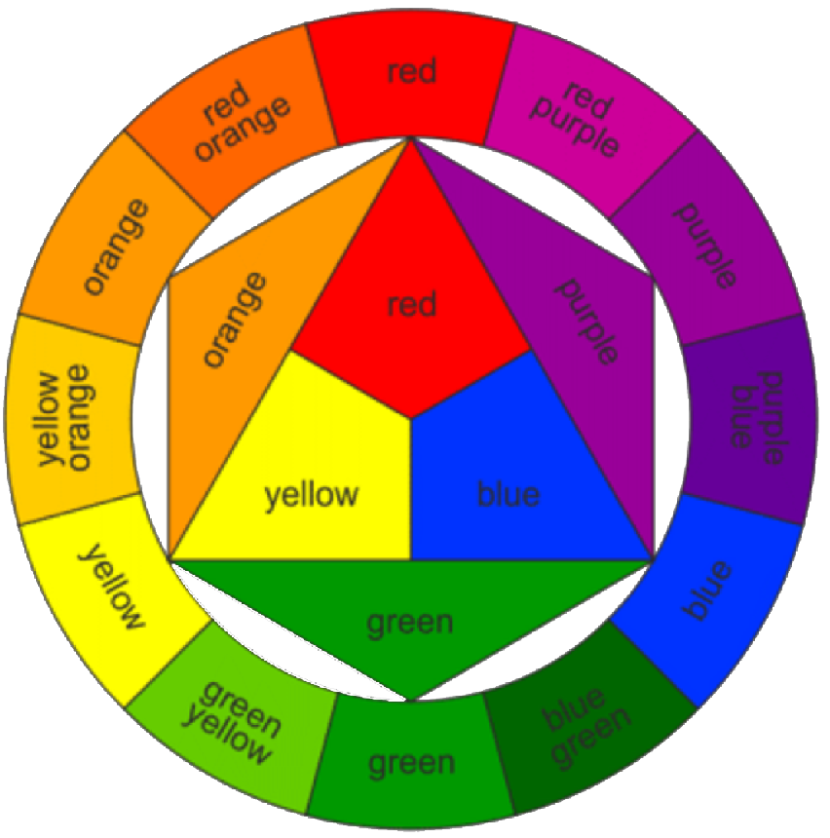
Colour
When communicating an idea graphically, colour can be used to help improve your presentation.
The colour wheel below shows how colours relate and interact with each other. It revolves around three PRIMARY colours.
If you add 2 PRIMARY colours together you get a
SECONDARY colour.
The outside of the colour wheel is made up of PRIMARY, SECONDARY and TERTIARY colours.
A TERTIARY colour is made by mixing a PRIMARY colour and a SECONDARY colour.
Tertiary colours
Yellow-orange, red-orange, red-violet, blue-violet, blue-green, yellow-green

Slide 6
Effects with Colour
By using colours from the colour wheel that are close together or far apart, different effects and moods can be created
Colours that are close together on the wheel are said to be in
HARMONY, this means they blend well together.
Colours that are far apart or opposite on the wheel are said to
CONTRAST, this means they make each other stand out as bolder colours.

Slide 7
Homework 1
Complete the colour wheel by adding the PRIMARY colours first, then the SECONDARY colours then final the outside of the colour wheel with the TERTIARY colours.
Y
G
O
G
Y
O
B
R
B
R
V
V

Slide 8
Effects with Colour
Using a compass, draw two circles like the ones below. The smaller circle has a diameter of Ø20 and the larger circle has a diameter of Ø40.
Colour the two circles below using contrasting colours.
What is the effect on the inner circle?
Ø40
Ø20
Draw 5 more circles using the same sizes. Have 3 sets of harmonising colours and 3 sets of contrasting colours.

Slide 9
Colour Questions
Copy the following questions into your jotter. Lay your answers out like below:
For e.g. what colour is grass…you would draw a small box and shade the box green
What are the 3 primary colours?
What are the 3 secondary colours?
What are warm colours?
What are cool colours?
Show 2 harmonising colours
Show 2 contrasting colours

Slide 10
Tonal scales – Exercise 1
Using the worksheet, trace the 5 boxes into your jotter. Divide the boxes into 5 equal divisions and produce a tonal scale of 1 to 5 for each type of pencil indicated.
Follow the method demonstrated by the teacher, remember to start with a very light tone and always keep your pencil moving in the same direction.
2H
2B
RED
YELLOW
BLUE

Slide 11
Tonal scales – Exercise 2
On a new page in your jotter, using the worksheet trace the 4 shapes below. Render SHAPE 1 - 3 using the tonal scale technique demonstrated by the teacher. There is a curved surface on object 3 for you to deal with for the first time. How will you handle it ?
Remember to check the direction of the light.
Light
Light
Light
Light
1
4
3
2

Slide 12
Tonal scales – Homework 2
Using the tonal scale technique, render SHAPE 4. Remember to check the direction of the light.
Light
SHAPE 4

Slide 13
Impact using Thick and thin lines
Using thick and thin lines makes an object more visually interesting and also makes it look more realistic. Look at both the filing cabinets shown below.
Before
After

Slide 14
Impact using Thick and thin lines – Exercise 1
In your jotter, trace the objects that are on your worksheet and by using the methods shown by the teacher, complete the thick and thin lines and render them using the tonal scale technique.

