Slide 1
S1 Orthographic Sketching

Slide 2
INTRODUCTION
Orthographic drawing is a way of drawing a three dimensional object. Normally the object is drawn as three separate, related views - Front View, Side View and Plan View.

Slide 3
BLOCK 1
4
Draw the Front View, Top View and End Views of the block.
The block has a length of 10 squares, a height of 6 squares and a thickness of 4 squares.
10
6
6
2

Slide 4
BLOCK 1 – ANSWERS

Slide 5
3
Block 2
Draw the Front View, Top View and End Views of the block.
The block has a length of 10 squares, a height of 6 squares and a thickness of 4 squares.
3
3
6
10
4

Slide 6
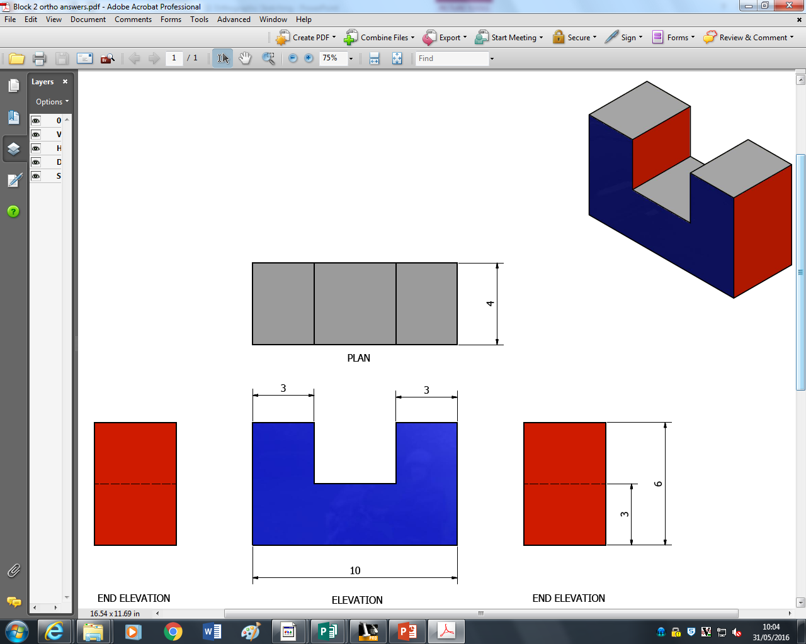
BLOCK 2 - ANSWERS

Slide 7
Block 3- HOMEWORK
10
Draw the Front View, Top View and End Views of the block.
The block has a length of 10 squares, a height of 6 squares and a thickness of 4 squares.
6
3
4
3

Slide 8
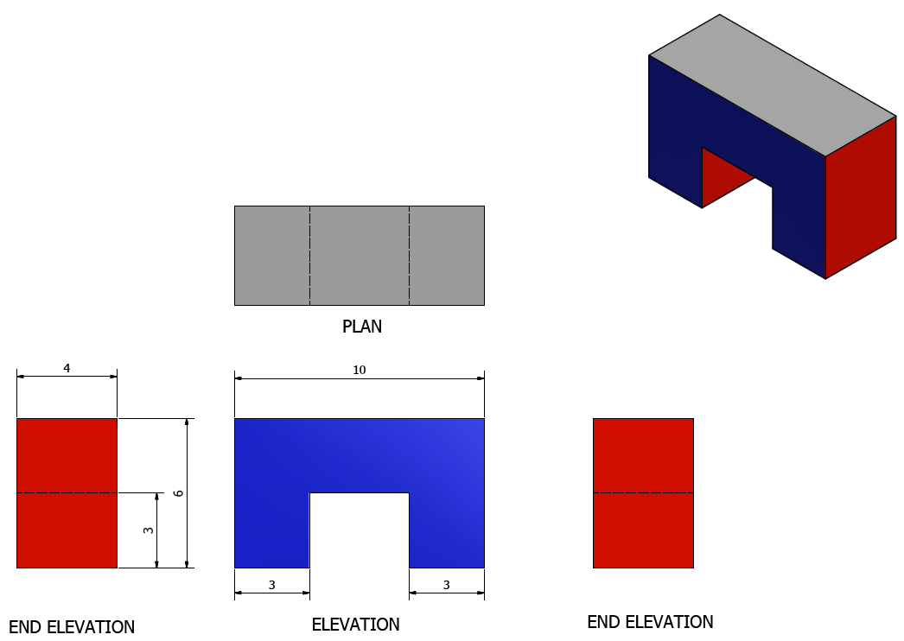
BLOCK 3 - ANSWERS

Slide 9
2
BLOCK 4
Draw the Front View, Top View and End Views of the block.
The block has a length of 10 squares, a height of 6 squares and a thickness of 4 squares.
2
7
10
4

Slide 10
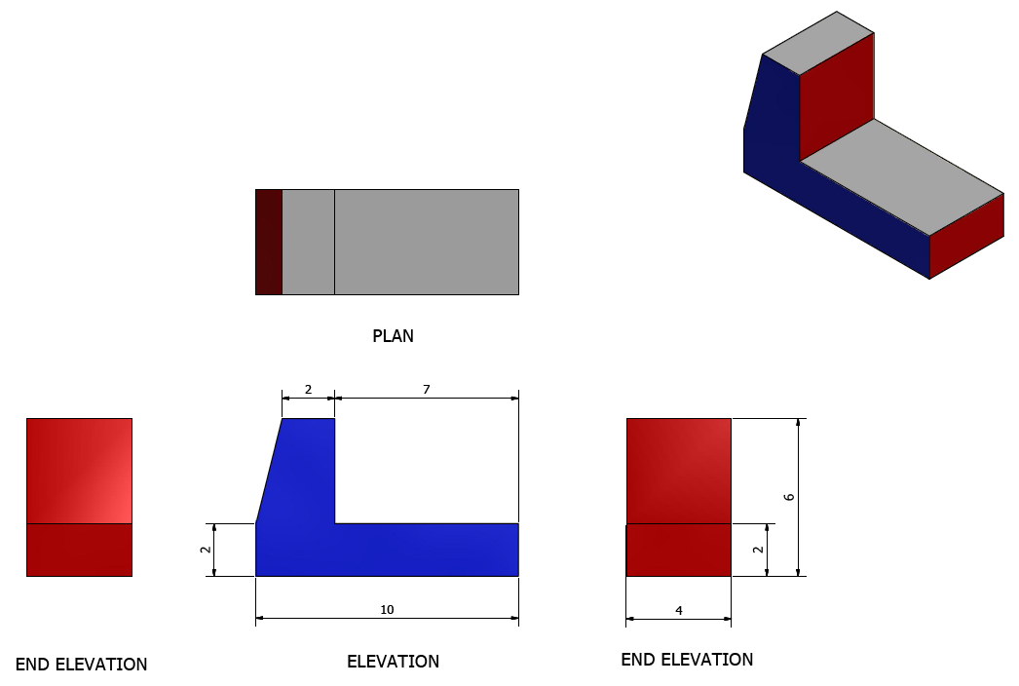
BLOCK 4 - ANSWERS

Slide 11
BLOCK 5
1
10
Draw the Front View, Top View and End Views of the block.
The block has a length of 10 squares, a height of 6 squares and a thickness of 4 squares.
1
6
4

Slide 12
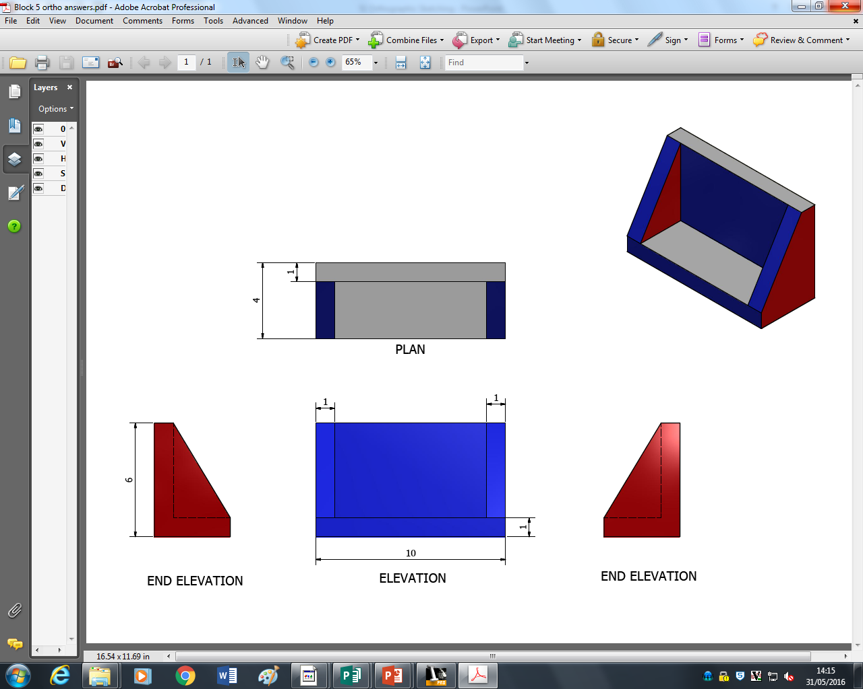
BLOCK 5 HOMEWORK - ANSWERS

Slide 13
BLOCK 6 – HOMEWORK
6
Draw the Front View, Top View and End Views of the block.
The block has a length of 10 squares, a height of 6 squares and a thickness of 4 squares.
2
4
2
4
4
4

Slide 14
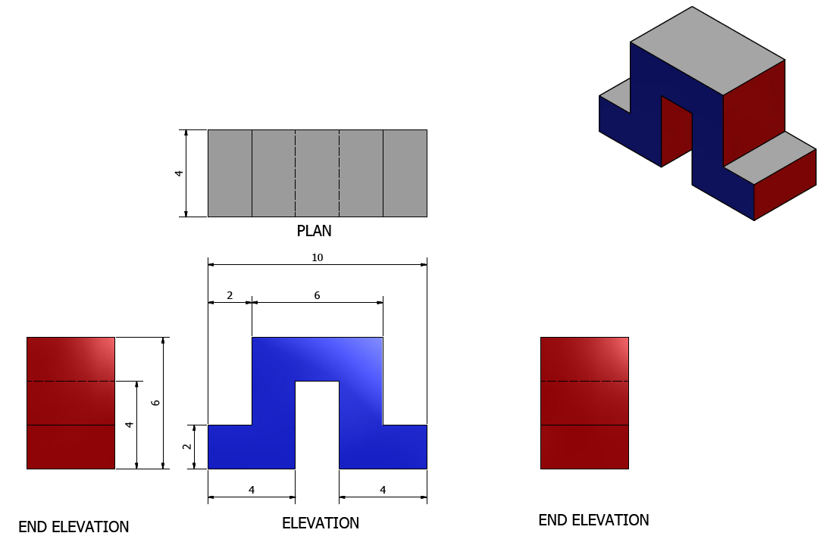
BLOCK 6 HOMEWORK – ANSWERS

Slide 15
BLOCK 7
10
Draw the Front View, Top View and End Views of the block.
The block has a length of 10 squares, a height of 6 squares and a thickness of 4 squares.
3
4
2
4
1

Slide 16
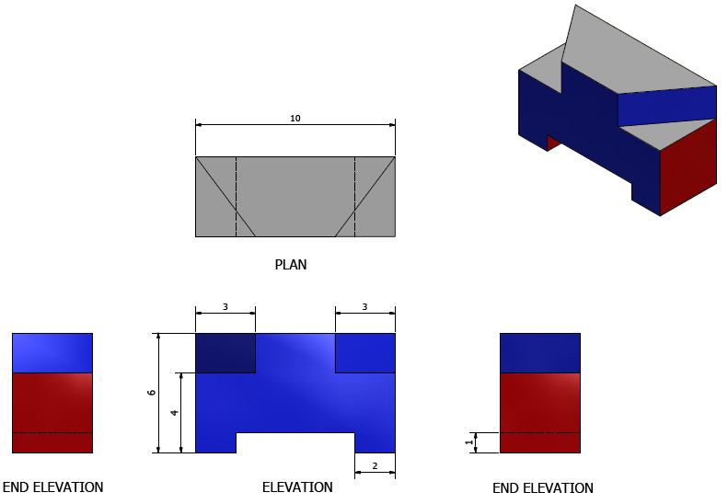
BLOCK 7 - ANSWERS

