Slide 1
Alessi Design
..an artistic and poetic discipline

Slide 2
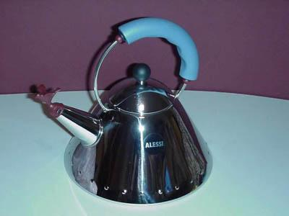
Alessi
Alessi
Ettore Sottsass
Stefano Giovannoni
Guido Venturini
Click Mouse button on arrow to Operate
Michael Graves
Philipe Starck
Aldo Rossi
Alesandro Mendini
King Kong
Family Follows Fiction

Slide 3
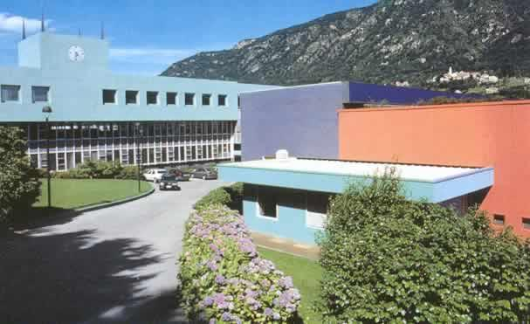
Alessi
The ‘Dream Factory’ in Crusinallo Milan

Slide 4
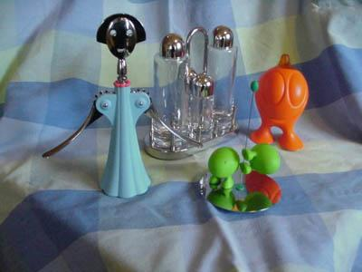
Introducing Alessi Maestri
and the products they create

Slide 5
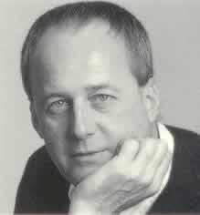
Alberto Alessi
Alberto Alessi runs the factory in the Italian Alps in the town of Crusinallo NW of Milan
It was founded in 1921 by Giovanni Alessi grandfather of Alberto, a craftsman/small businessman
Alessi business was highly innovative from the start and quickly developed into one of the ‘Factories of Italian Design’

Slide 6
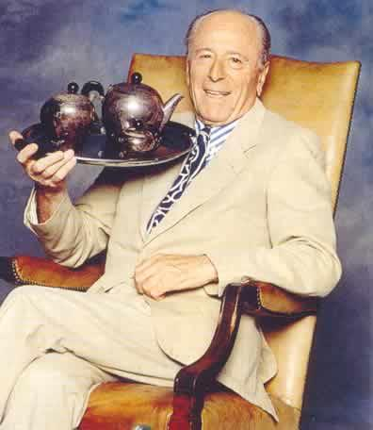
Carlo Alessi
Carlo Alessi, Alberto’s father trained as an industrial designer in Novara and joined the company designing and producing products from the mid-thirties to 1945
Seen with the classic ‘Bombe’ tea and coffee set which is still in production today and the most successful tea and coffee set sold by Alessi

Slide 7
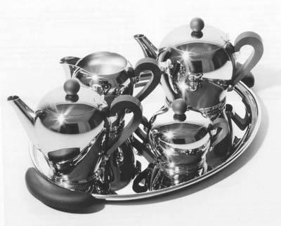
Alessi
‘The ‘Bombe’ tea and coffee set designed by Carlo Alessi in 1945. The Bombe is emblematic of the company’s development from a craftsman base into an industrial producer.
Originally made from chrome plated brass, the Bombe is now made in electroplated stainless steel

Slide 8
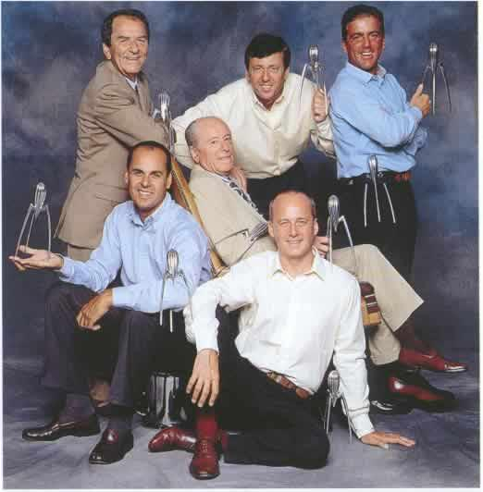
Alessi
Members of the Alessi family holding one of the most famous ‘mystery objects’ , Phillipe Starck’s Juicy Salif
The company was founded in 1921 by Giovanni Alessi and the first factory opened in Omegna, north of lake Orta
Michele
Ettore
Stefano
Carlo
Alessio
Alberto

Slide 9
Alessi
The company moved to Crusinallo in 1928 where it remains today as a world leader in classic hotel and restaurant lines together with beautiful household products
The transition from early mechanical production line to ‘research and development workshop operating in the applied arts’ was the dream of Alberto
Michele
Ettore
Stefano
Carlo
Alessio
Alberto

Slide 10
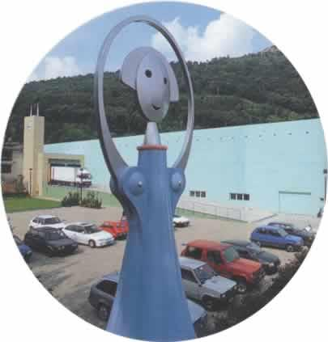
Alessi
The factory in the Italian Alps in the town of Crusinallo NW of Milan is ‘guarded’ by a giant reproduction of Anna G, the character created by Alessandro Mendini
Here Alessi think of design as an ‘artistic and poetic discipline’

Slide 11
Alessi
Alessi
Ettore Sottsass
Stefano Giovannoni
Guido Venturini
Click Mouse button on arrow to Operate
Michael Graves
Philipe Starck
Aldo Rossi
Alesandro Mendini
King Kong
Family Follows Fiction

Slide 12
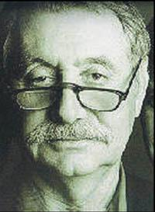
Ettore Sottsass
Alessi’s first Maestro
Born in Innsbruck in 1917
Studied architecture in Turin in 1939
Formed his own studio in Milan in 1947
Made important designs for Olivetti
One of the founders of Memphis 1981
An Alessi maestro

Slide 13
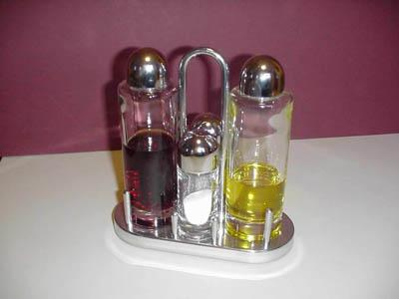
Ettore Sottsass
Alessi Maestro
Sottsass designed this classic condiment set for Alessi in 1978
Distinctive in the choice of materials and proportion

Slide 14
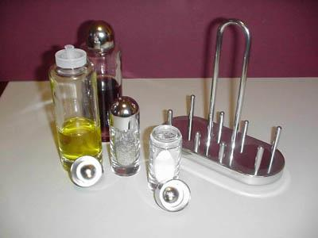
Ettore Sottsass
Alessi Maestro
The glass containers are fitted with plastic inserts and chrome tops
Highly polished chrome base with simple positioning pegs

Slide 15
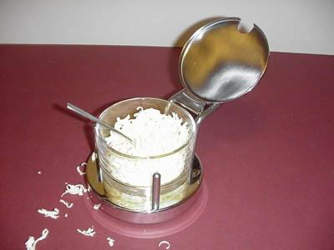
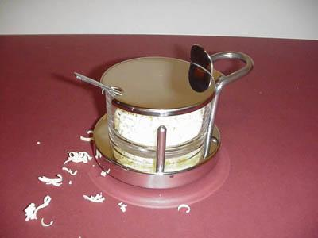
Ettore Sottsass
Alessi Maestro
The cheese container has been added to compliment Sottsass’ condiment set
A rim around the base of the glass container allows it to rotate freely on the base

Slide 16
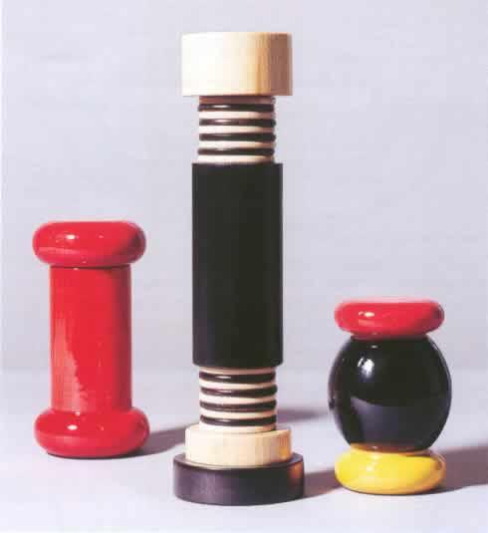
Ettore Sottsass
Alessi Maestro
A collection of tableware designed by Sotsass includes the red,yellow and black aniline coloured beech-wood salt grinder
The red chilli mill and Maple –wood pepper mill part of Sottsass’ ‘Twergi’ range of products

Slide 17
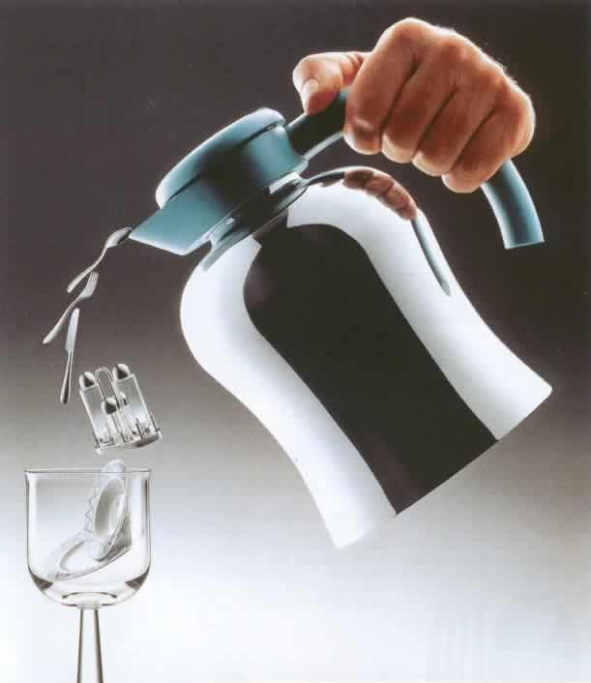
Ettore Sottsass
Alessi Maestro
A collection of products designed by Sottsass who wishes to build up a complete family of objects for the table and the kitchen

Slide 18
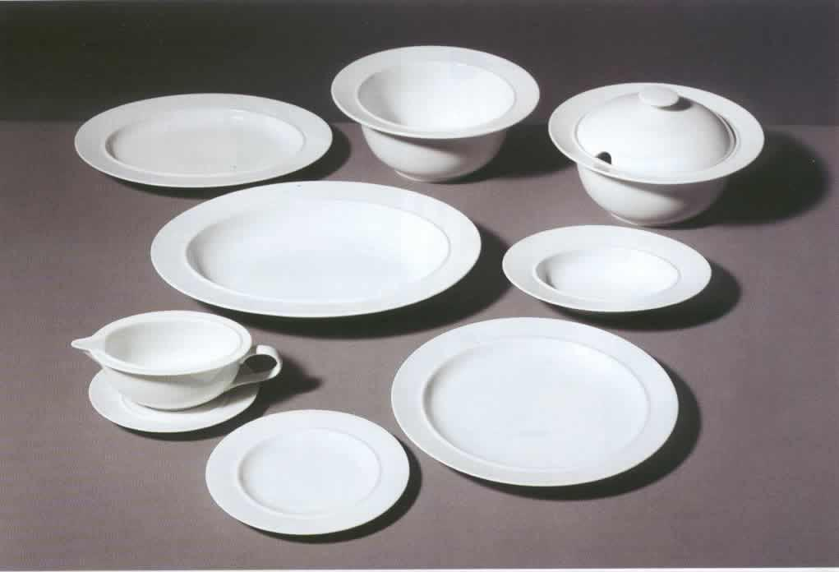
Ettore Sottsass
Alessi Maestro
‘Preparing a beautiful table for eating with the family or for eating with friends… is a practiced custom and a way of showing awareness, respect and care about that ‘basic’ event of having food’
Ettore Sottsass
A classic collection of tableware designed by Sottsass
‘La Bella Tavola’

Slide 19
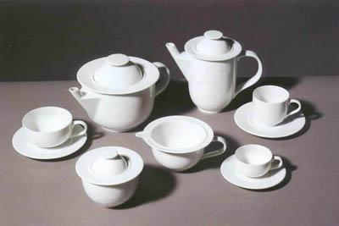
Ettore Sottsass
Alessi Maestro
Generously rounded tableware designed by Sottsass
‘La Bella Tavola’
Beautiful, simple and clean lines of the white porcelain designed for the ‘beautiful table’

Slide 20
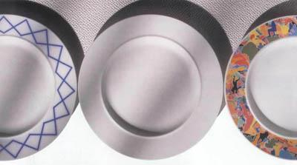
Ettore Sottsass
Alessi Maestro
‘La Bella Tavola’
Appeared in pure white or a version with subtle classic overlapping blue lines
Alighiero Boetti, one of Italy's most original contemporary artists decorated the broad spaces on the ornamental edges with this unique elaborate decoration.

Slide 21
Alessi
Alessi
Ettore Sottsass
Stefano Giovannoni
Guido Venturini
Click Mouse button on arrow to Operate
Michael Graves
Philipe Starck
Aldo Rossi
Alesandro Mendini
King Kong
Family Follows Fiction

Slide 22
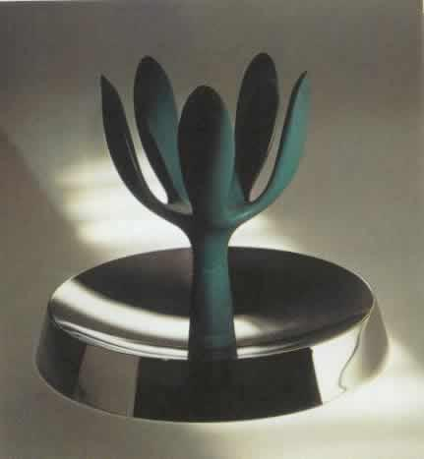
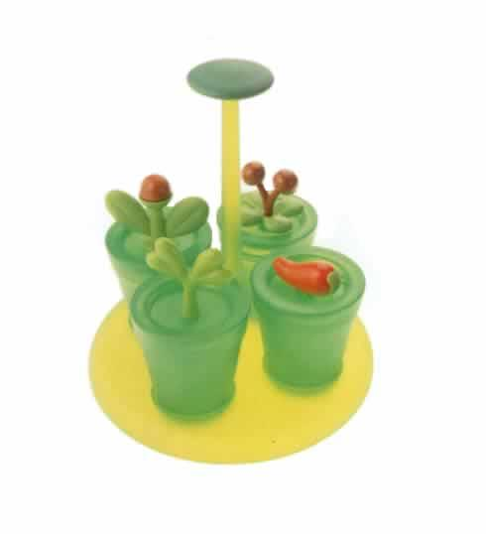
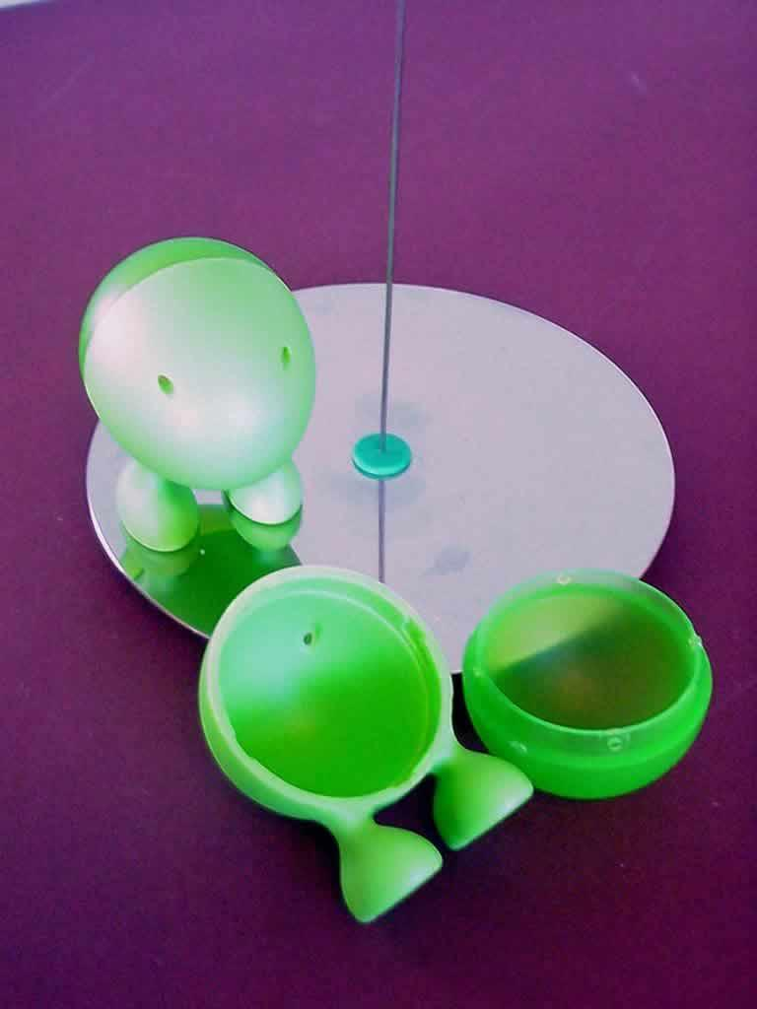
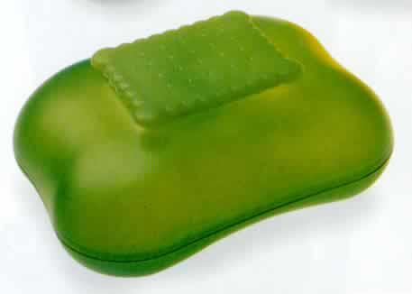
Stefano Giovannoni
Alessi Maestro
Fruit Mama
Merdolino
Happy Spices
Mary biscuit
Lilliput

Slide 23
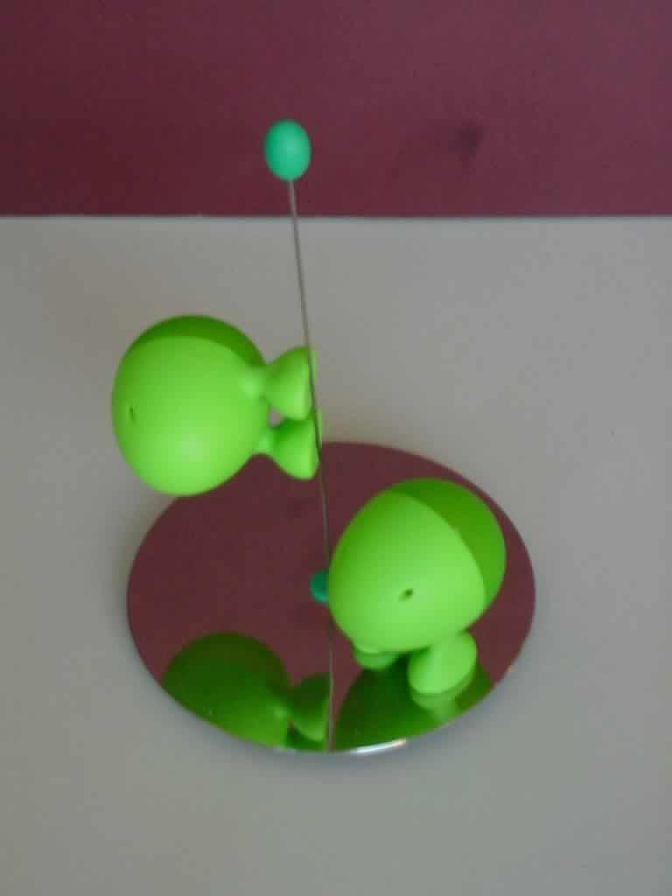
Stefano Giovannoni
Alessi Maestro
A simple ‘fun’ product named ‘Lilliput’ designed for Alessi by Giovanoni.
The salt and pepper pots have magnets on the feet securing the pots to the base or stem

Slide 24
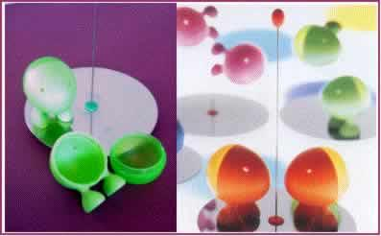
Stefano Giovannoni
Alessi Maestro
The face of the salt and pepper pot twists off easily for re-filling
Standing on the stainless steel base-plate ‘Lilliput’ is available in a range of colours

Slide 25
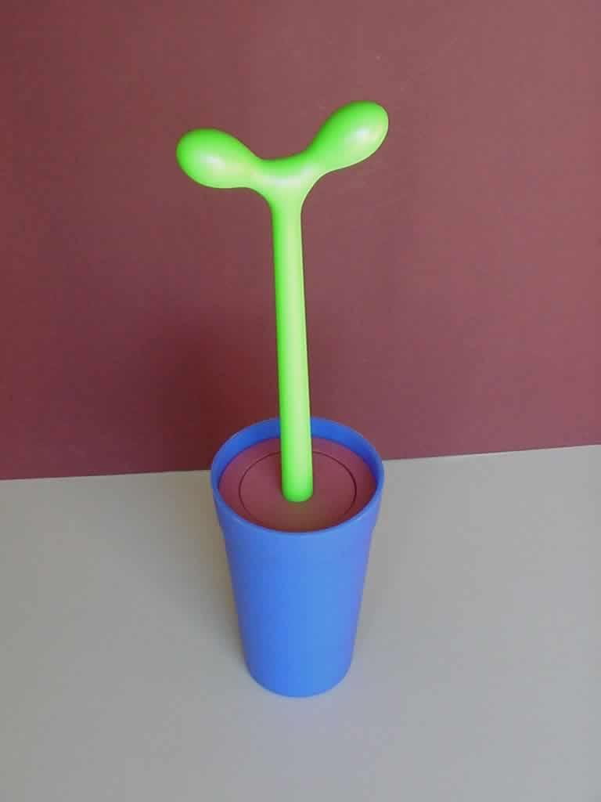
Stefano Giovannoni
Alessi Maestro
Stefano Giovannoni designed the ‘Merdolino’ toilet brush to look like a cactus growing out of the pot
Giovannoni takes a ‘taboo’ object and creates ‘fun’ in a new form

Slide 26
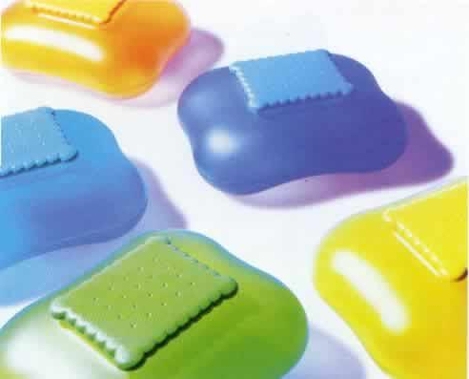
Stefano Giovannoni
Alessi Maestro
Made in acrylic and thermoplastic rubber
These biscuit boxes that look like plastic pillows are part of the ‘Family Follows Fiction’ collection
The Mary biscuit boxes designed in 1995 with sweet, soft, flowing design language

Slide 27
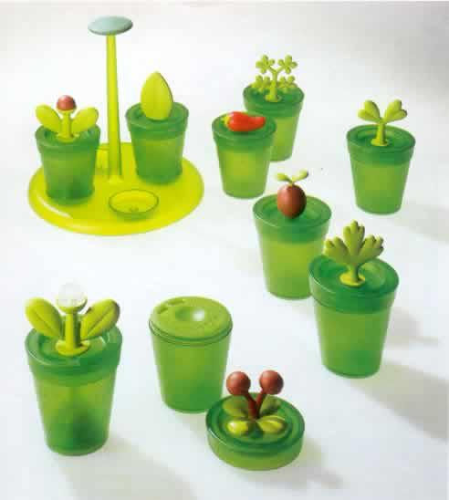
Stefano Giovannoni
Alessi Maestro
Stefano Giovannoni designed ‘Happy Spices’ family of tableware in 1997
These amusing containers have rather quaint plants apparently growing out of them
The set comprises little jars and dispensers for spices, salt and pepper
Made in acrylic, polythene and polyamide

Slide 28
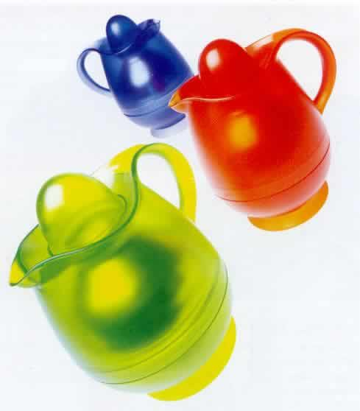
Stefano Giovannoni
Alessi Maestro
The ‘Alibaba’ jug with vacuum flask designed in 1998 to evoke a feeling of the oriental fairytale
These amusing containers having the feeling of earthenware pots are made in PMMA

Slide 29
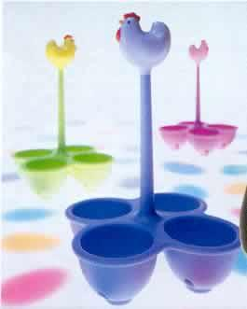
Stefano Giovannoni
Alessi Maestro
Giovannoni named his egg boiling baskets ‘Coccodandy’ as if the chickens have some air of superiority about them
Designed in 1998 they make the rather humble and simple operation of boiling an egg a playful and gregarious activity

Slide 30
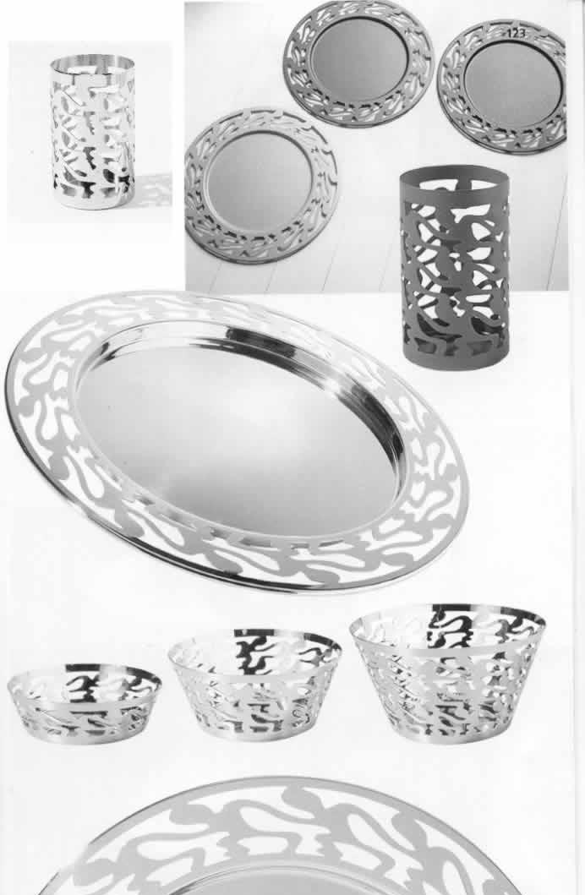
Stefano Giovannoni
Alessi Maestro
‘Ethno’ 2000 was conceived to be the new pop icon of the twenty-first century
Giovannoni designs for his ‘Ethno’ series ‘with products made in finely decorated stainless steel

Slide 31
Alessi
Alessi
Ettore Sottsass
Stefano Giovannoni
Guido Venturini
Click Mouse button on arrow to Operate
Michael Graves
Philipe Starck
Aldo Rossi
Alesandro Mendini
King Kong
Family Follows Fiction

Slide 32
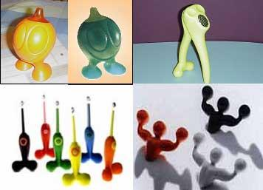
Guido Venturini
Alessi Maestro
Gino Zucchino
Nonno di Antonio
Firebird
Antonio

Slide 33
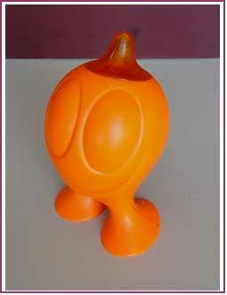
Guido Venturini
Alessi Maestro
The face of Gino Zucchino Venturini’s friendly sugar shaker
A fun item of tableware that simply asks to be picked up
At Alessi the character has become so popular that it has turned into a kind of garden gnome

Slide 34
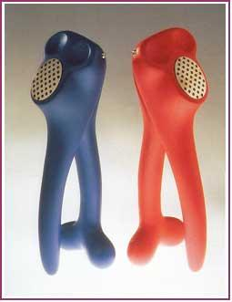
Guido Venturini
Alessi Maestro
‘Noni di Antonio’ is Venturini’s garlic crusher made with thermoplastic resin
Simplicity of shape combined with the unusual
Designed in 1997

Slide 35
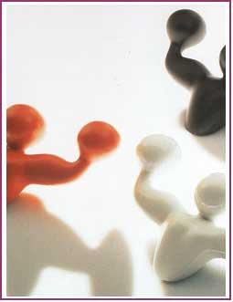
Guido Venturini
Alessi Maestro
A ‘fun’ element combined with a feeling of strength the coat hook is joined with the toilet roll holder, towel rail, soap dish and toothbrush holder
Antonio is Venturini’s strong man coat hook designed in 1996 and now part of a set of bathroom fitments

Slide 36
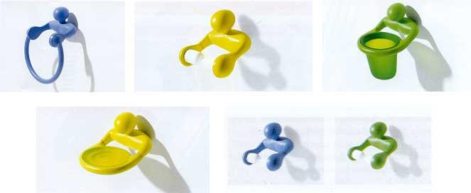
Guido Venturini
Alessi Maestro
Antonio A
Antonio D
‘Antonio’ Family
Antonio S
Antonio C

Slide 37
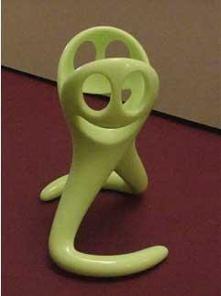
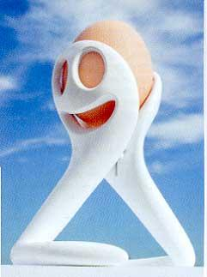
Guido Venturini
Alessi Maestro
‘Mangiauovo’ Venturini’s egg boiler was designed from a concept by Genoese inventors Terrile and Marinelli
A practical idea for placing and fishing eggs from hot water and eating from the same product

Slide 38
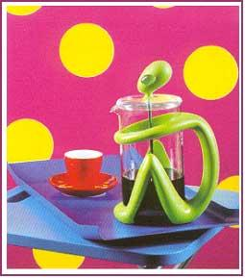
Guido Venturini
Alessi Maestro
‘Inka’ press coffee maker designed in 2000 here Venturini uses plastic in a most innovative way
A person sitting patiently allowing the caffeine blitz to become a pleasurable and quality experience

Slide 39
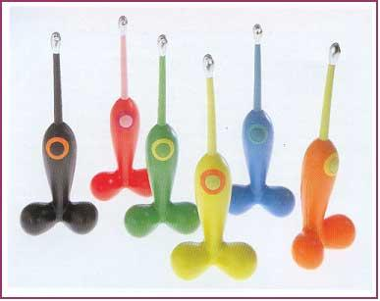
Guido Venturini
Alessi Maestro
Venturini designed the ‘Firebird’ electronic gas lighter in 1993 the most explicit and ‘courageous’ of Alessi products
The iconic reference to the ‘erotic code’ designed to put a spark into anyone’s cooking

Slide 40
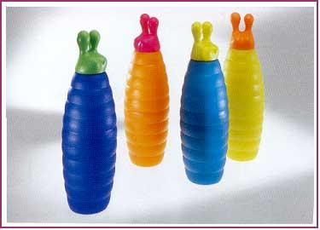
Guido Venturini
Alessi Maestro
The ‘Fred Worm’ jug with vacuum glass was designed in 1997 another example of Venturini’s creative exploration of plastic products

Slide 41
Alessi
Alessi
Ettore Sottsass
Stefano Giovannoni
Guido Venturini
Click Mouse button on arrow to Operate
Michael Graves
Philipe Starck
Aldo Rossi
Alesandro Mendini
King Kong
Family Follows Fiction

Slide 42
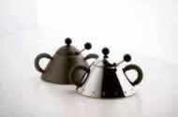
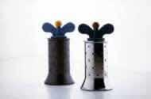
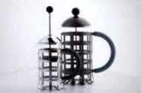
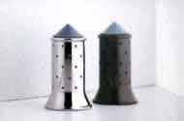
Michael Graves
Alessi Maestro
Sugar bowls
Pepper mills
Cafetiere
Salt pots

Slide 43
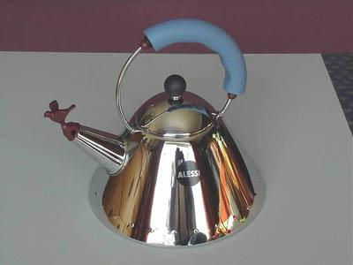
Michael Graves
Alessi Maestro
Michael Graves’ singing kettle added to the already famous series of Alessi kettles
Kettle with bird was produced in1985
The raised ‘rivet like’ dots around the base are a reminder of past metalworking techniques

Slide 44
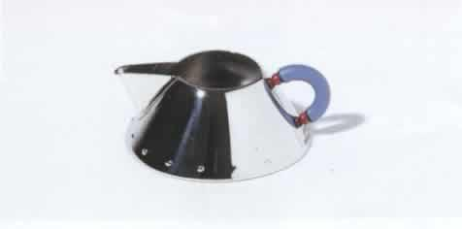
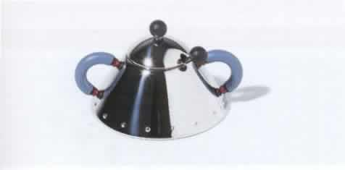
Michael Graves
Alessi Maestro
Michael Graves’ designs for the sugar bowl and milk jug that form a set with the singing kettle
The raised ‘rivet like’ dots again in evidence around the base

Slide 45
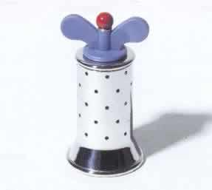
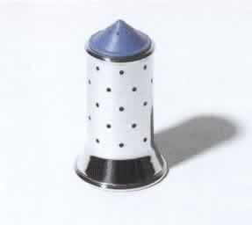
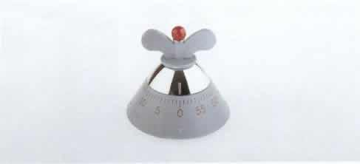
Michael Graves
Alessi Maestro
The Pepper Mill (1988), the Salt Castor (1990) and the kitchen timer (1992) are the continuing series of Graves’ family of products
The set has an almost playful appeal and is again characterised by the rivets and polyamide plastic components

Slide 46
Michael Graves
Alessi Maestro
The open construction of stainless steel loops with the rivet pattern that is so distinctively Graves’ style
Large easy grip polyamide handles are another distinctive feature of his work

Slide 47
Michael Graves
Alessi Maestro
A round tray with polyamide handles (1990) and the pierced steel basket (1994) with feet made from pear wood
Continuing the theme of large easy to grip handles in these two products

Slide 48
Michael Graves
Alessi Maestro
The Pitcher (1991), the Champagne cap (1995), the Corkscrew (1995) and the Butter dish (1990) by Michael Graves
Unmistakably Michael Graves; products with enchanting simplicity demonstrates his ability to design products in tune with the general public
Pitcher
Corkscrew
Champagne cap
Butter dish

Slide 49
Alessi
Alessi
Ettore Sottsass
Stefano Giovannoni
Guido Venturini
Click Mouse button on arrow to Operate
Michael Graves
Philipe Starck
Aldo Rossi
Alesandro Mendini
King Kong
Family Follows Fiction

Slide 50
Philipe Starck
Alessi Maestro
Starck hanging around with his ‘Faitoo’ range of kitchenware
Does design and artistic brilliance border on the insane?

Slide 51
Philipe Starck
Alessi Maestro
Philipe Starck’s most famous Alessi product the ‘Juicy Salif’ lemon squeezer
A 24 carat gold plated version has been produced as a limited edition for the tenth anniversary of ‘Juicy Salif’
The lemon squeezer is made in cast Aluminium and finished polished or coated black
Juicy Salif 1990

Slide 52
Philipe Starck
Alessi Maestro
Said to be inspired by Starck’s fascination with aeroplanes the bowl clearly resembles an aeroplane nose cone with wing like feet
‘Max le Chinois’ is a colander made from stainless steel and cast brass feet
This product bears many of the Starck hallmarks

Slide 53
Philipe Starck
Alessi Maestro
The ‘Hot Bertaa’ kettle has a handle and spout skewered through the body
Produced by Alessi from 1990-1997 the kettle has an almost sacred like appearance shrouded in mystery
Starck penned a Latin inscription around the base in his preliminary sketches however it appears that maybe he pushed the boundaries a little too far with this project

Slide 54
Philipe Starck
Alessi Maestro
The table centres clearly exemplifying Starck’s more recent work for Alessi
1996
A table centre piece called ‘Les ministres’ supported by translucent resin ‘attendants’

Slide 55
Philipe Starck
Alessi Maestro
The ‘Joe Cactus’ ash tray designed by the Starck and Patricia company in 1990 is one of these products
The design company Starck and Patricia was acquired by Alessi in 1996 with many of their products being added to the Alessi catalogue

Slide 56
Philipe Starck
Alessi Maestro
The Starck and Patricia design company was also responsible for the design of these cast aluminium lampshade
‘O’Kelvin’ was designed in 1997

Slide 57
Philipe Starck
Alessi Maestro
The fly swatter is called ‘DR Skud’ and reveals a human face when moved
Designed by Starck in 1998

Slide 58
Philipe Starck
Alessi Maestro
Designed by Starck in 1998 a range of kitchen containers with lids and bowls with feet
The ‘Boaat’ range of kitchenware was inspired by Japanese cuisine

Slide 59
Alessi
Alessi
Ettore Sottsass
Stefano Giovannoni
Guido Venturini
Click Mouse button on arrow to Operate
Michael Graves
Philipe Starck
Aldo Rossi
Alesandro Mendini
King Kong
Family Follows Fiction

Slide 60
Aldo Rossi
Alessi Maestro
momento
La conica
Coffee Maker
La cupola
Il conico

Slide 61
Aldo Rossi
Alessi Maestro
La Cupola was part of Rossi’s dream to create a new Moka to sell to the masses at a minimum cost
La Cupola the cast aluminium Espresso coffee maker was designed in 1990

Slide 62
Aldo Rossi
Alessi Maestro
‘La Conica’ designed by Rossi between 1980 and 1983 was his contribution to Alessi’s ‘Tea & Coffee Piazza’ project
In doing so he had to translate a solid silver object into a mass-produced stainless steel product

Slide 63
Aldo Rossi
Alessi Maestro
‘Il conico’ the perfectly conical kettle has become one of the world renowned Alessi kettles
Rossi’s second design for Alessi Il conico was designed in 1986

Slide 64
Alessi
Alessi
Ettore Sottsass
Stefano Giovannoni
Guido Venturini
Click Mouse button on arrow to Operate
Michael Graves
Philipe Starck
Aldo Rossi
Alesandro Mendini
King Kong
Family Follows Fiction

Slide 65
Alesandro Mendini
Alessi Maestro
Vaso Viso
How many colours
Tea & coffee Piazza
Anna Candle
Anna G

Slide 66
Alesandro Mendini
Alessi Maestro
Made in chrome plated zamak and polyamide Anna G became the model for a whole family of Alessi products the build quality of this product ensures that it is a pleasure to use
Probably the most iconic symbol of Alessi design is the corkscrew ‘Anna G’ designed in 1994 it has become one of the Alessi bestsellers

Slide 67
Alesandro Mendini
Alessi Maestro
The porcelain dinner services designed by Mendini began production in 1996
‘How Much White’ was the first followed by ‘How Many Stars’ and the pointillist decorated ‘Proust’
How Many Stars
Proust

Slide 68
Alesandro Mendini
Alessi Maestro
The porcelain dinner services designed by Mendini was decorated by Nicola De Maria in 1996 and included polychrome triangles in the style ‘How Many Colours’
How Many Colours

Slide 69
Alesandro Mendini
Alessi Maestro
The pepper mill ‘Anna Pepper’, also modelled from Anna G, was also made from the same materials
Anna Pepper

Slide 70
Alesandro Mendini
Alessi Maestro
The bottle stopper ‘Anna Stop1’, modelled from Anna G, was made from thermoplastic resin and chrome plate
‘Anna Stop 1 & 2’ were designed by Mendini in 1998 and they simply add to the sense of fun when using the products
Anna Stop 1
Anna Stop 2

Slide 71
Alesandro Mendini
Alessi Maestro
Anna Light
The timer, cheese grater, light and pendant are from the ‘Anna G’ family designed from 1998 to 2001
Anna Time
Anna Face
Anna Cheese

Slide 72
Alessi
Alessi
Ettore Sottsass
Stefano Giovannoni
Guido Venturini
Click Mouse button on arrow to Operate
Michael Graves
Philipe Starck
Aldo Rossi
Alesandro Mendini
King Kong
Family Follows Fiction

Slide 73
King Kong
Girotondo
Giovannoni and Venturini
Giovannoni and Venturini combined their talents to produce the ‘Girotondo’ series of products
Some items from the collection The simple figure cut-out is meant to appeal to the child in all of us.

Slide 74
King Kong
Girotondo
Giovannoni and Venturini
Among a series of drawings brought to him Alberto Alessi noticed a plain tray with a perforated pattern
This was the tray that initiated the ‘Girotondo’ series and is now Alessi’s best selling tray

Slide 75
King Kong
Girotondo
Giovannoni and Venturini
The metal fruit bowl is finished in stainless steel or a range of coloured paints
‘Girotondo’ the name of the series being the Italian version of ‘Ring-a-Ring-a-Roses’

Slide 76
King Kong
Girotondo
Giovannoni and Venturini
Giovannoni and Venturini developed ‘King Kong’ at the right time for the market and for the Alessi catalogue
‘Girotondo’ is being incorporated into even the most traditional of Alessi products

Slide 77
King Kong
Girotondo
Giovannoni and Venturini
Giovannoni and Venturini borrowed Ettore Sottsass’ classic condiment set to include in the series
‘Girotondo’ cut-out man is incorporated into the base of the condiment set designed by Sottsass

Slide 78
King Kong
Girotondo
Giovannoni and Venturini
The simple kitchen timers are functional yet a very elegant kitchen accessory
Here the cut-out man is placed around the base of egg cups

Slide 79
King Kong
Girotondo
Giovannoni and Venturini
The little ‘King Kong’ men and women manifested themselves in a whole range of Alessi jewellery in 1998
A selection of brooches, bracelets, earrings, chokers and pendants from the jewellery range

Slide 80
King Kong
Girotondo
Giovannoni and Venturini
The Wastepaper basket was designed for the Girotondo series in 1998

Slide 81
Alessi
Alessi
Ettore Sottsass
Stefano Giovannoni
Guido Venturini
Click Mouse button on arrow to Operate
Michael Graves
Philipe Starck
Aldo Rossi
Alesandro Mendini
King Kong
Family Follows Fiction

Slide 82
Family Follows Fiction
Just some of the hilariously funny and fantasy inspired family
Gianni, a little man holding on tight
Te o
Egidio, the little man has lost something
Diabolix
Carlo,a little ghost on the top of a bottle
Luca, a little monster eating a napkin
Folpo

Slide 83
Family Follows Fiction
The original design was produced by the British designer Christopher Dresser in 1864
The design for this coloured resin sugar bowl is over a hundred years old. Alessi re-produced it in 1993

Slide 84
Family Follows Fiction
Diabolix’ the creation of Biagio Cisotti is one of the most popular of the FFF series of products
Designed in 1994 these funny little devil like bottle openers not only capture the aesthetic qualities of FFF but they also function very efficiently

Slide 85
Family Follows Fiction
‘Te o’ sits quite comfortably on the edge of the cup or mug whilst the tea is being strained
The delightful form of ‘Te o’ the tea strainer was designed by Stefano Pirovano in 2000

Slide 86
Family Follows Fiction
Named,’Carlo, a little ghost on top of a bottle’ this design for a pair of pressure caps was produced in 1994
‘Carlo’ was designed for the Alessi metaproject by Mattia Di Rosa

Slide 87
Family Follows Fiction
Mattia Di Rosa designed the incredibly funny ‘Gianni, a little man holding on tight’ in 1994
The glass kitchen storage jar has a polypropylene top with an airtight seal

Slide 88
Family Follows Fiction
‘Folopo’ is a glass mixer and measuring container designed for FFF by Marta Sansoni in 1998
The octopus like products have mixing handles incorporated into the top of the container

Slide 89
Family Follows Fiction
‘Luca, a little monster eating a napkin’ produced in 1994 by Mattia Di Rosa
This ‘little monster’ has become one of Alessi’s best sellers

Slide 90
Family Follows Fiction
Another design my Mattia Di Rossa ‘Egido’ came into being in 1994 as a plastic pressure cap
The pressure cap, sold in pairs, is also called ‘the little man has lost something’

Slide 91
Alessi Books
1
2
1 Alessi - Michael Collins – Carlton Books Limited – ISBN - 1-85868-737-3
2 Aslessi Art and Poetry – Fay Sweet – Thames & Hudson – ISBN 0-500-01857-X

Slide 92
Alessi Books
3
4
3 Alessi is More – 2002 – 2003 Catalogue
4 The Dream Factory – Alberto Alessi – Electra Alessi

Slide 93
Alessi – The dream Factory
Acknowledgements
I would like to thank Alberto Alessi and Gloria Barcellini for their assistance in producing this educational resource; particularly for allowing the use of Alessi images and information on ‘The Dream Factory’, and of course the Maestri for their invaluable contribution to Post-modern design

Slide 94
Alessi
Alessi
Ettore Sottsass
Stefano Giovannoni
Guido Venturini
Click Mouse button on arrow to Operate
Michael Graves
Philipe Starck
Aldo Rossi
Alesandro Mendini
King Kong
Family Follows Fiction

