Slide 1
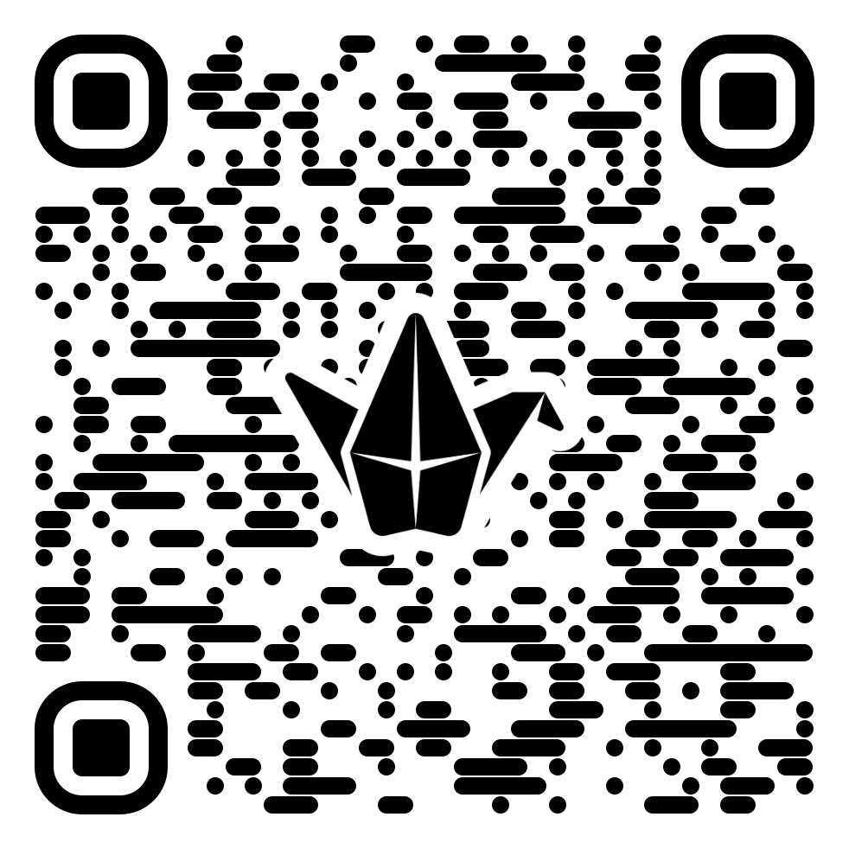
Skills Padlet- Course Information
Pathways Diagram 2026/2027
Construction & Engineering | L4 Auto Mechanic | L5 Construction | L5 Engineering | L6 Engineering Design Challenge | FA Civil Engineering | HNC CADD | HNC Architectural Technology | Winter Leavers Programme
Health & Social Care | L4 Healthcare | L4 Early Years & Childcare | L5 Healthcare | L5 Early Years & Childcare | L6 Public Health | FA Children & Young People | FA Healthcare
Business Services | L6 Intro to Scots Law | L6 Cyber Security | L6 Criminology | HNC Business Skills | HNC Cyber Security | HNC Social Science
Tourism & Creative | L4 Hospitality | L4 Hairdressing | L4 Beauty | L5 Hairdressing | L5 Beauty | L5 Make Up Artistry | FA Hospitality | FA Creative & Digital Media
Please use the QR code below to access the Padlet containing full information on all our courses and entry requirements. If you would like to make a referral to one of the courses, please speak to your pupil support teacher and use the link in the Padlet

Slide 2



Skills Pathways Offer 2026/2027 Industry Recognised Awards and Qualifications

