Slide 1
Short Stories

Slide 2
Short Story Unit
You will:
Read short stories.
Take notes on them and do group/solo activities.
Create your own short story.

Slide 3
Key Skills
You will:
Show an understanding of the short story form.
Discuss setting; theme; characterisation; plot; and point of view.

Slide 4
Learning Intention
An introduction to the short story genre.
Success Criteria
Identify key features of a short story

Slide 5
Success Criteria
I can:
Identify key features of a short story

Slide 6
Starter Task
Task: How would you describe a short story to someone?

Slide 7
Basic Information
A short story has the following characteristics:
It has a limited length.
It is very condensed; only vital details are revealed.
The setting is limited, as is the number of characters.
There can be a message or moral that offers the reader insight into life

Slide 8
In the 1920s, Ernest Hemingway’s colleagues bet him that he couldn’t write a complete story in just six words. They paid up. Hemingway is said to have considered it his best work.

Slide 9
For sale: baby shoes, never worn.
—Ernest Hemingway

Slide 10
The Scarlatti Tilt
‘It’s very hard to live in a studio apartment in San Jose with a man who’s learning to play the violin.’ That’s what she told the police when she handed them the empty revolver.
— Richard Brautigan
Notes:
The Scarlatti Tilt succeeds precisely because it cares not for restrictive rules on length, tone, or style of composition.

Slide 11
How would you continue this story?
The Scarlatti Tilt
‘It’s very hard to live in a studio apartment in San Jose with a man who’s learning to play the violin.’ That’s what she told the police when she handed them the empty revolver.

Slide 12
Reading – Richard Brautigan
Richard Brautigan (1935-1984) was a novelist, poet and short story writer in the 1960's and 70's. Depending on who you talk to, his work was beautiful or depressing, funny or tragic, and perhaps both at the same time.

Slide 13
Basic Information
A short story has the following characteristics:
It has a limited length.
It is very condensed; only vital details are revealed.
The setting is limited, as is the number of characters.
There can be a message or moral that offers the reader insight into life

Slide 14
Reading – Pacific Radio Fire is a good story but you could choose any short story for this!
First Thought Questions
As you read through the story for the first time, think about the answers to these questions.
Who is the main character in the story?
Who is he speaking about?
Why has the speaker come to this place?
What does the ending mean?
Notes:
Pacific radio fire from Nathan chapman

Slide 15
Writing task - character sketch:
What does each character look like? Include as many details as possible.
What does each character’s voice sound like? Think of three adjectives to describe their voice (e.g. croaky, gruff), then think of three expressions they like to use.
What does the character like to eat for breakfast? What would he choose for his last meal?
Think of a smell that is important to the character. Why is this smell important to him? What memory does it bring to his mind?
What does your character want more than anything in the world? Why? What would he do to get it?

Slide 16
A quick writing task to finish!

Slide 17
Choose a number between 1 and 5. This corresponds to a new character.
Choose a letter between A and E. This corresponds to a setting.
Your task is to write the first couple of paragraphs of a short story that brings both characters together in the setting.

Slide 18
A few hints
Have your character thinking, saying or doing something as quickly as possible, preferably in the first sentence.
Do not explain how or why they are there: that is the kind of information a story writer would tease out as the story progresses. Show don’t tell!
Write in any way you like: first, second or third person, past or present tense.
Don’t finish the story (yet!): don’t get the character out of the situation, don’t come to any conclusions. Leave us with questions – which you might want to answer when you write the rest of the story in your own time.

Slide 19
A taxi driver
A washed-up pop singer
A person in a bathing costume
A clown
A nurse
Sitting cross-legged on a train station platform
In a wardrobe
Precariously balanced on a plank of wood
Hanging by their fingertips from the roof of a building
Stretched out on a park bench

Slide 20
Lesson 2
Characterisation

Slide 21
Short Stories

Slide 22
Learning Intention
We are learning how to create fictional characters through action and description.

Slide 23
Stimulus Exercise: Creating Character Through Action and Description 1

Slide 24
The importance of description
Description can be used very effectively in short stories and in personal writing, bringing scenes and people to life.
However, description just for description’s sake is clumsy and often pointless.
It should be used carefully to convey tone or mood, or to say something meaningful about a character. If it isn't really relevant that a character is blonde haired and blue eyed, there is no need to write 'Samantha was blonde-haired and blue-eyed'!

Slide 25
On your own, choose a number between 1 and 6. Your task is to write the opening of a short story in which a person is shopping.
You will be shown a photograph.
Your character must capture the essence of the photograph in its tone, word choice, imagery and characterisation.

Slide 26
The photograph may suggest to you:
what kind of person you are describing
what they look like
how they are built
what they sound like
what clothes they wear
what kind of shop they would be found in
what kinds of things they would buy
how they would treat their fellow shoppers
how they would treat staff.

Slide 27
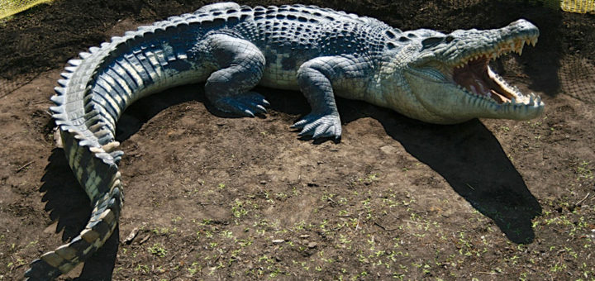
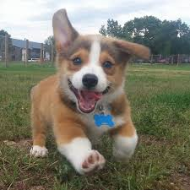
2
1
Notes:
Change images

Slide 28
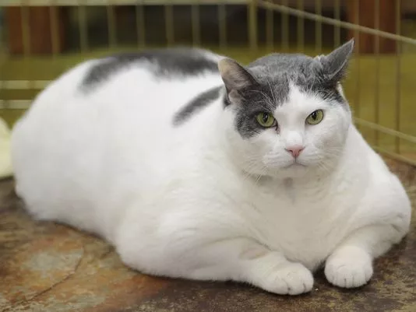
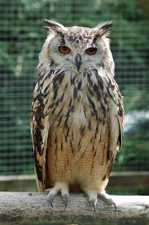
3
4

Slide 29
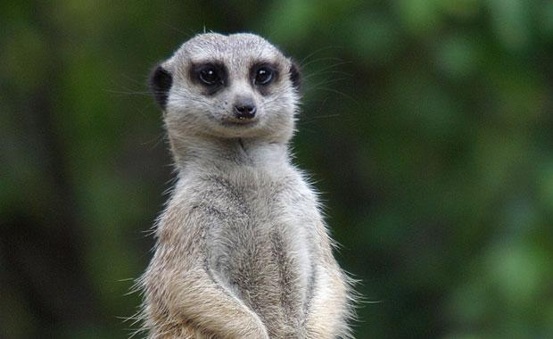
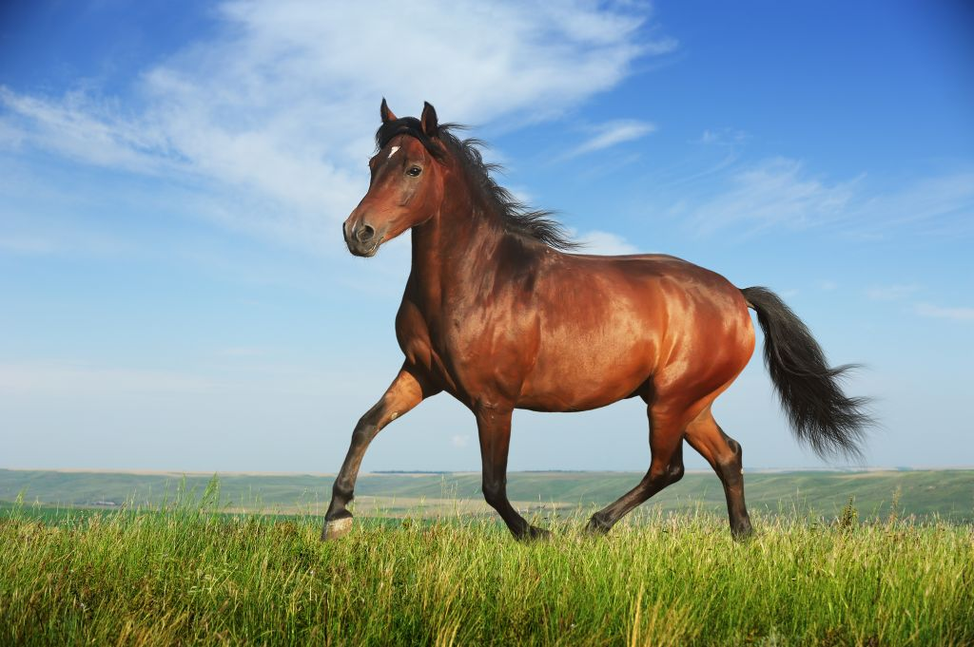
5
6

Slide 30
Stimulus Exercise 2: Creating Character Through Action and Description

Slide 31
This is an exercise to develop your descriptive skills.
Imagine a middle-aged woman standing at a bus stop.
Working in pairs, write a description of her waiting in four sentences only. You must not describe her face, although you can describe her clothes. You cannot describe her thoughts – only the physical description as if you are watching her from the other side of the road.
She is:
going to see her son in prison or
starting a course at college for the first time or
going to buy a new dress for her son’s wedding or
looking for her husband in a local pub or
going to see her sister in hospital.
In your description, try to indicate how she feels, through her posture, what she does as she waits, what she’s wearing and how she’s wearing it, etc.

Slide 32
Now, on your own, try a different waiting description from the list for the same woman.
This time, try to picture who is watching her and bring out the watcher’s personality.
Here, you will create two characters: the woman and the narrator.
You are not limited to three sentences this time!

Slide 33
Stimulus Exercise 3: Which Voice? The First Person

Slide 34
Different perspectives
Talking It Over, Julian Barnes
Stuart and Oliver are friends, but tensions erupt when Oliver falls in love with Stuart’s wife, Gillian. The novel is told in the three voices of the characters. Here, they describe the same incident. What do the three versions tell you about what happened and how they feel about it?
Oliver:
‘It was about that time that the accident occurred. Stuart was, as I recall, giving me a light, and we stood up for some reason, when an unfortunate clash of heads occurred, which quite stunned us both. Luckily he had his lenses in; otherwise he might have broken his glasses.’
Stuart:
‘This is a Glasgow kiss,’ I said, and butted him in the face. He fell over, and at first was sort of half-laughing, as if I must have been going to show him something else but had slipped.’
Gillian:
‘Oliver needed five stitches in his cheek… He said the expression of violence on Stuart’s face had to be seen to be believed.’

Slide 35
Adopting a different perspective
‘I’d advise not using first person if you are too close to the voice or character of your story. Successful first-person point of view exists in the distance between the writer and the voice… The voice is not only your guiding light through the jungle of plot, it is a device you consciously manipulate. You need to hear it clearly, objectively, from a distance.’
The Writer’s Idea Book, Jack Heffron
Think about an event that you attended which had an effect on you or which you remember: a wedding, a party, a family get-together or a first date. In the first person, write an account of that event from the point of view of someone else involved. If possible this person should be different from you: if you are a woman, try to choose a man: if you are young, try an old person.

Slide 36
More in the first person
Choose a number between 1 and 6. This will provide you with the first sentence of a piece of writing in the first person; in fact, the first word of every sentence is 'I'. You might use this as a line of dialogue or as the opening statement of a monologue.
Continue the writing until we get a sense of character. It might be fiction or personal. You do not have to finish this piece – but, of course, you can if you want to!

Slide 37
'I was always a quiet child and seemed afraid of everything around me.'
'I can’t tell you how profoundly that day affected me.'
'I know I shouldn’t say it, but I really can’t stand my brother.'
'I steal.'
'I am destined to be a star, you know.'
'I reckon my life would be a lot better if I were a house cat.'

Slide 38
Lesson 3
Looking at the short story ‘The Pedestrian’

Slide 39
Ray Bradbury’s ‘The Pedestrian’

Slide 40
Learning Intention
An introduction to ‘The Pedestrian’ by Ray Bradbury
Success Criteria
I can:
Identify how to create imagery in a short story

Slide 41
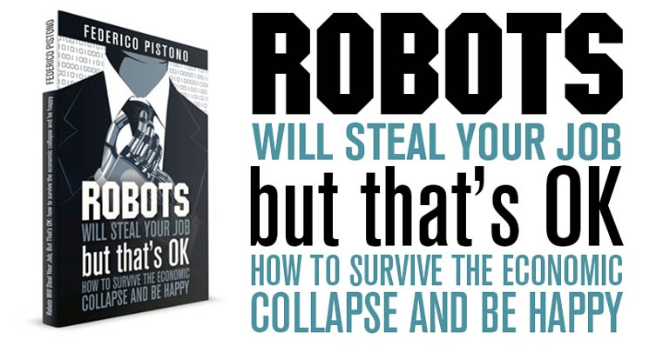
If you like this…

Slide 42
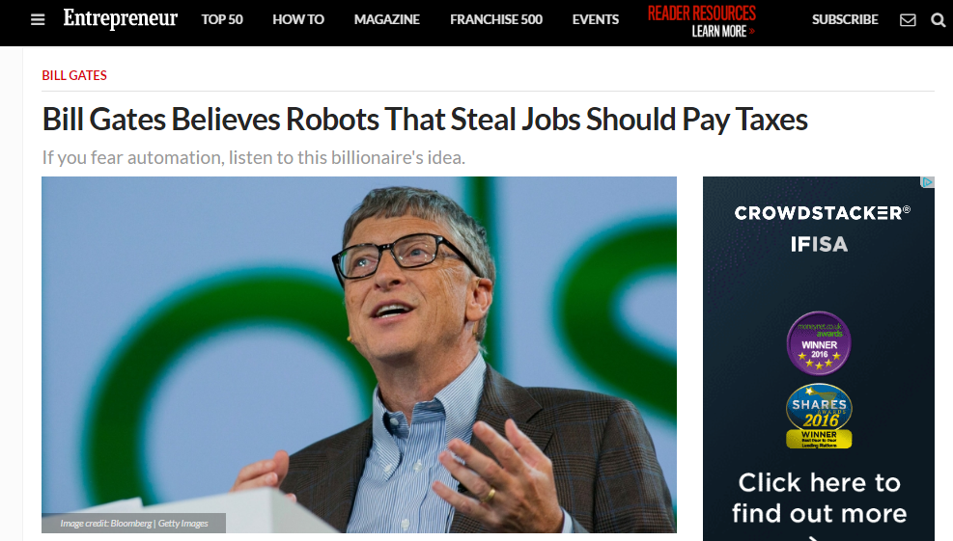
Or are interested in this…

Slide 43
Technology Used | Mon | Tue | Wed | Thurs | Fri | Sat | Sun | Total
TV
Mobile Phone
Laptop
Digital Radio
e-reader (Kindle, Kobo etc)
Music
Gaming
Total per day
 |  |  |  |  |  |  | Total hrs

Slide 44
Let’s Read
Ray Bradbury was a science fiction writer.
The Pedestrian was written in 1951, but is set in an imagined future in 2053.
As you read think about these questions, which you’ll be discussing:
What happens in this story?
What kind of world does the pedestrian (Leonard Mead) live in? Is it different to our society? Is it the same in any way?
Definition of dystopia
An imaginary place where people lead dehumanized and often fearful lives

Slide 45
Consider…
What do you think are the main themes of the short story?
How well do you think Ray Bradbury has presented the future world in the short story? Give reasons for your answer.
What points is Ray Bradbury making about our future society? Consider the following:
Television
The police car
The packs of dogs
The empty streets
The “Psychiatric Centre for Research on Regressive Tendencies”
What comparisons can be made between this future society and our own?
What images do you find most interesting in the short story? Why?
Notes:
The

Slide 46
Q. What do you think are the main themes of the short story?
One of the most important themes of the story is that we need to be wary of technology. Bradbury’s message is that technology, while designed to make our lives easier, actually threatens our humanity.
Advances like television separate humans instead of bringing them together. As Leonard Mead walks aimlessly, he describes streets lined with houses illuminated only by the lights from their televisions, with the only sounds coming from either the sets or dim-witted reactions to them.
Bradbury warns us that television and the technology it represents can be used to control us, to make us conform. Our individuality breaks down, and we become vassals.
B. Another important theme is that our humanity rests in our interaction with people. As Leonard walks the streets, he notes that no one ever comes out. No one even looks out. Their eyes are fixed on the screens. While the police who stop him ask him if he is married, the marriage seems to exist only for the continuation of the human race, not for human interaction. To truly be happy, people have to be able to communicate and express feelings with each other, not just focus on being entertained by technology.

Slide 47
How well do you think Ray Bradbury has presented the future world in the short story? Give reasons for your answer.
What points is Ray Bradbury making about our future society? Consider the following:
Television
The police car
The packs of dogs
The empty streets
The “Psychiatric Centre for Research on Regressive Tendencies”
What comparisons can be made between this future society and our own?
What images do you find most interesting in the short story? Why?
Notes:
Television represents the government controlling the public – Mr Mead doesn’t have television so is othered and ostracsized from society. The television represents all types of technology and the power they can hold over us. The television is a way to distract the public and keep them under the watchful eye of the government. It’s much easier to control ppl who are glued to their tv sets rather than those who are out roaming the streets.
The police car- The police car, a representative of the powers in control (government), disapprove of his behavior, but the entire society disapproves as well. Ostracizing him is another form of censorship. Atomated car is programmed to stop Mr Mead even though he isn’t doing anything wrong – there is no room for human discretion in an automated world.
The “Psychiatric Centre for Research on Regressive Tendencies” means – dangers for society with government deciding what is best for all with no input. Who has decided what it means to be regressive? Just because somebody says ‘this isn’t right you must do this… does that mean we all have to do it? Is it fair that one entity has the power to make that decision for a society (echoes of dictatorship)
I
The pack of dogs – tattle tales – informants?
The empty streets represent the loneliness and isolation of a world focused on technology as opposed to humanity and human interaction. People need other people to be happy 0 marriage in this story seems to be onlu for the human race to continue. But in reality ppl need ppl to be happy.

Slide 48
The Pedestrian: Story shape
Tense climax – the police interrogation
Mead enjoys / relishes his freedom. Image of an eagle soaring
The absurd conversation. Mead being taken away
Climax – Mead’s house as a symbol of hope
Flat and emotionless beginning. Reflects the society Mead lives in
Pessimistic anti-climax. Darkness beats light

Slide 49
Short burst writing task
What happens when Leonard Mead reaches the correctional facility?

Slide 50
Lesson 4
Creating setting

Slide 51
Ray Bradbury’s ‘The Pedestrian’

Slide 52
Learning Intention
To practise our descriptive writing skills to create effective settings
Success Criteria
I can use figurative language effectively within my writing to create a strong sense of setting and atmosphere.

Slide 53
Task. Close Reading.
Language used to create setting in “The Pedestrian”
Write down a simile from the first paragraph and explain why it is effective?
Write down all the words from paragraph 2 that you would associate with death.
Paragraph 3- ‘and lights might click on and faces appear and an entire street be startled’ Why do you think the author repeats the word and three times?
Write down a simile from paragraph 4 and explain why it is effective.
‘the faint push of his soft shoes’ What figure of speech is used here and what effect is created?
What tone does Leonard Mead use when talking to the people inside the houses? (Paragraph 5).
Notes:
Sending patterns of frosty air before him like the smoke of a cigar: his breath is compared to the smoke of a cigar. This creates a good picture because smoke eventually fades away into the night and becomes insignificant, just like him.
Graveyard, phantoms, curtain, tomb-like
Long sentence, listing the shocking affects a man walking alone can have.
“it cut the nose and made the lungs blaze like a Christmas tree. The cold air is compared to a burning Christmas tree. This is effective because it created an image of the lungs being on fire (he can feel his lungs) – he likes it. It makes him feel alive.
Onomatopoeia- we can imagine the sound his shoes make while out walking and the fact that he can hear something so insignificant highlights the otherwise silent streets.
Tone – mocking/sarcastic.

Slide 54
Task. Close Reading.
Language used to create setting in “The Pedestrian”
Write down a simile from the first paragraph and explain why it is effective?
Write down all the words from paragraph 2 that you would associate with death.
‘and lights might click on and faces appear and an entire street be startled’ Why do you think the author repeats the word and three times?
Write down a simile from paragraph 4 and explain why it is effective.
‘the faint push of his soft shoes’ What figure of speech is used here and what effect is created?
What tone does Leonard Mead use when talking to the people inside the houses? (line 35 and line 45).

Slide 55
5. ‘the faint push of his soft shoes’ What figure of speech is used here and what effect is created?
Sibilance is a specific type of alliteration that uses soft consonants. In sibilance hissing or hushing sounds are created. In this case the ‘s’ sounds create an effect that describes Mead’s soft footsteps and emphasises how quiet the neighbourhood is where Mead is walking.
6. What tone does Leonard Mead use when talking to the people inside the houses? (line 35 and line 45).
Mead has a condescending or disdainful tone. As someone who doesn’t own or value a television he looks down upon the type of TV programmes the people inside the house are watching ‘…a dozen assorted murders? A quiz? A revue? A comedian falling off the stage?’. Bradbury is commenting on TV ‘dumbing down’ society.

Slide 56
Alliteration, Assonance, Sibilance
Alliteration: the repetition of the same consonant sound either at the beginning or into he middle of words. eg. perfect pike in all parts/ fragments of regret.
Assonance: the repetition of a vowel sound either at the beginning or in the middle of words. eg. mighty cries in the night.
Sibilance: repetition of the 's' sound throughout a phrase or a sentence. eg. she slowly staggered across the street.
All three types of aural imagery may help to create a slower or faster rhythm or may aid to convey a certain feeling such as excitement (usually done with letters such as 'r') or sadness (usually done with 's' sounds).

Slide 57
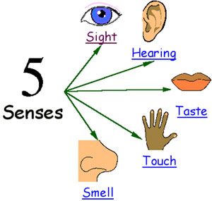
Setting
When you write about a setting, you need to make sure you use lots of description so a reader can picture themselves there.
Effective descriptions appeal to the senses.

Slide 58
Mr Leonard Mead would pause, cock his head, listen, look, and march on, his feet making no noise on the lumpy walk. For long ago he had wisely changed to sneakers when strolling at night, because the dogs in intermittent squads would parallel his journey with barkings if he wore hard heels, and lights might click on and faces appear and an entire street be startled by the passing of a lone figure, himself, in the early November evening.
On this particular evening he began his journey in a westerly direction, towards the hidden sea. There was a good crystal frost in the air; it cut the nose and made the lungs blaze like a Christmas tree inside; you could feel the cold light going on and off, all the branches filled with invisible snow. He listened to the faint push of his soft shoes through autumn leaves with satisfaction, and whistled a cold quiet whistle between his teeth, occasionally picking up a leaf as he passed, examining its skeletal pattern in the infrequent lamplights as he went on, smelling its rusty smell.
HEARING
SIGHT
TOUCH
TASTE
SMELL

Slide 59
TASK: You are going to be shown a selection of different settings. For each image you see, write a description of the setting and include a specific language device.
See if you can experiment with appealing to different senses.

Slide 60
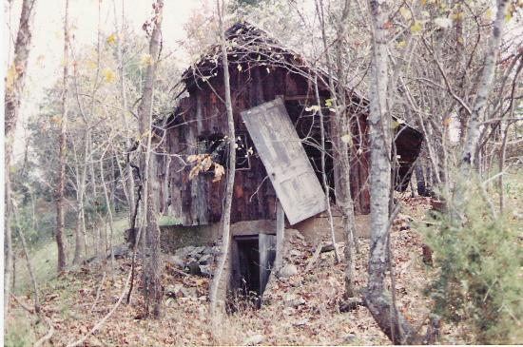
Vocabulary ideas: dilapidated, overgrown, wilderness, lonely, broken.
Describe this setting. You could include a simile (comparing two things using like or as e.g. The house shrivels and rots like a piece of discarded fruit).

Slide 61
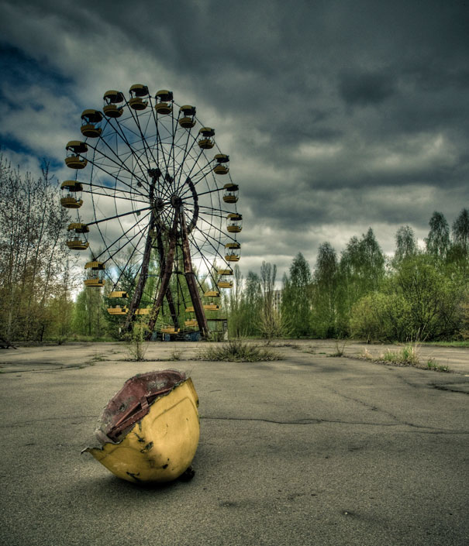
Vocabulary ideas: Menacing, abandoned, hostile, tragic, rotten
Describe this setting. You could include an example of personification (e.g. the clouds scowled)

Slide 62
Vocabulary ideas: crumbling, desolate, silent
You could include a metaphor (saying something is something else e.g. the buildings were skeletons)

Slide 63
Vocabulary ideas: annihilated, unforgiving, glacial
You could include sibilance (using osft constanants e.g. The sand scattered

Slide 64
Vocabulary ideas: Sinister, Menacing, Evil, Intimidating
Describe this setting. You could include a simile (comparing two things using like or as e.g. The walls crumbled like hot ash.

Slide 65
Self assessment
Read through your paragraph. Have you included:
Interesting verbs
Interesting adverbs
A simile
A metaphor
Which senses have you appealed to?

Slide 66
Peer discussion.
Swap jotters with the person next to you and read descriptions of each setting.
Give feedback as to which you found most interesting and why.

Slide 67
The Importance of Setting in The Pedestrian
Create a citizen profile for the average citizen in Leonard Mead's world.
Write a characteristic of a common citizen of 2053 next to each line, with a specific passage from the story to support it.
Write a paragraph profile.
Profile of Citizen 2053
Notes:
Brainstorm as a class probable characteristics for a citizen in 2053, according to Bradbury. For example, he or she ignores the environment, watches TV constantly, does not know the neighbours, and never goes on holiday.
Write the words "Profile of Citizen of 2053" in the center of the board and circle it.
Draw three lines extending from the circle.
Write a characteristic of a common citizen of 2053 next to each line, with a specific passage from the story to support it.
Write a paragraph profile.

Slide 68
Lesson 5
Plot

Slide 69
Elements of a Short Story Plot

Slide 70
Learning Intention
To identify the features of plot
Key words:
Exposition
Conflict
Climax/turning point
Resolution

Slide 71
Key elements of a short story
Setting
Characterisation
Plot
Theme
Point of View

Slide 72
Elements of Plot
Exposition
Conflict
Rising Action
Climax/turning point
Falling Action
Resolution
A plot is a series of events through which the writer reveals what is happening, to whom, and why.

Slide 73
Exposition
Every story must have a beginning. The start, or exposition, is where the characters and setting are established. During this part of the novel, the conflict or main problem is also introduced.

Slide 74
Conflict
The conflict is a struggle between two people or things in a short story. The main character is usually on one side of the central conflict.
The main character may struggle against another important character, against the forces of nature, against society, or even against something inside himself or herself (feelings, emotions, illness).

Slide 75
Rising Action
A series of relevant incidents that create suspense, interest and tension in a narrative.
In literary works, a rising action includes all decisions, characters' flaws and background circumstances that together create turns and twists leading to a climax.

Slide 76
Climax/Turning Point
The climax is the high point of the story. It is the main event or danger that the character faces. This is the darkest moment, the worst challenge the character must oppose.
At this point it looks as if the character will fail, and will never get what he/she wants. The turning point may be either physical or emotional. In a romance, the girl may turn the hopeful lover down, in an action story, the character may be surrounded by enemies with no chance of escape.

Slide 77
Falling Action
Following the climax, the story begins to slowly wind down. Falling action, one of the two final story elements, shows the result of the actions or decisions the character has made. This eventually leads to the final part of the novel, the crisis resolution.

Slide 78
Resolution
The end of the story. Here, the conflicts are resolved, all loose ends are tied up, and the story concludes with either a happy or sad ending.
Not all resolutions are happy or satisfying, however they should allow the reader to feel as if the story has come to a proper conclusion. This is why the resolution is so important: a story must have a clear beginning and conflict, rising action, exciting climax, falling action, and lastly, a clear ending.

Slide 79
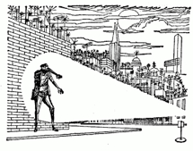
Task 1 – Plot
Using the plot diagram, match up the elements of a short story with the plot of The Pedestrian.
Exposition
Conflict
Rising Action
Climax
Falling Action
Resolution
IN PAIRS

Slide 80
TASK 1. Using the plot diagram, match up the elements of a short story with the plot of The Pedestrian.
IN PAIRS

Slide 81
Exposition
Wearing sneakers so he will not be heard, Leonard Mead walks down abandoned and overgrown sidewalks at night.

Slide 82
Conflict
Leonard has an external conflict with society.
He imagines that he is travelling across a desert because he is alone, different, and apart from other people.

Slide 83
Rising Action
As he walks through the empty streets he occasionally peers into dark windows and whispers to the ghostly, disengaged people inside watching their television sets. He is careful to not make noise, because
dogs in intermittent squads would parallel his journey with barkings...and lights might click on and faces appear and an entire street be startled....

Slide 84
Climax
Just as he turns onto a side street to circle back to his house, a lone car "flashed a fierce white cone of light upon him.“ Leonard stops, stunned and strangely drawn to the light. A voice tells him to raise his hands; Leonard is amazed that it is the one, lone police car.
When he replies that he is a writer, the car says, "No profession" since no-one seems to read anymore.
After further questioning he is told he will be taken to "the Psychiatric for Research for Regressive Tendencies”.

Slide 85
Falling Action
As the car rolls through the dark avenues, one house is well-lit, "every window a loud yellow illumination“. Leonard cries out to the automated vehicle, "That's my house," but he receives no response from the robotic car.

Slide 86
Resolution
The car moves down the empty, silent streets where there is "no sound and no motion" through the remainder of the cold November night.
The last man of imagination, Leonard Mead, is gone.

Slide 87
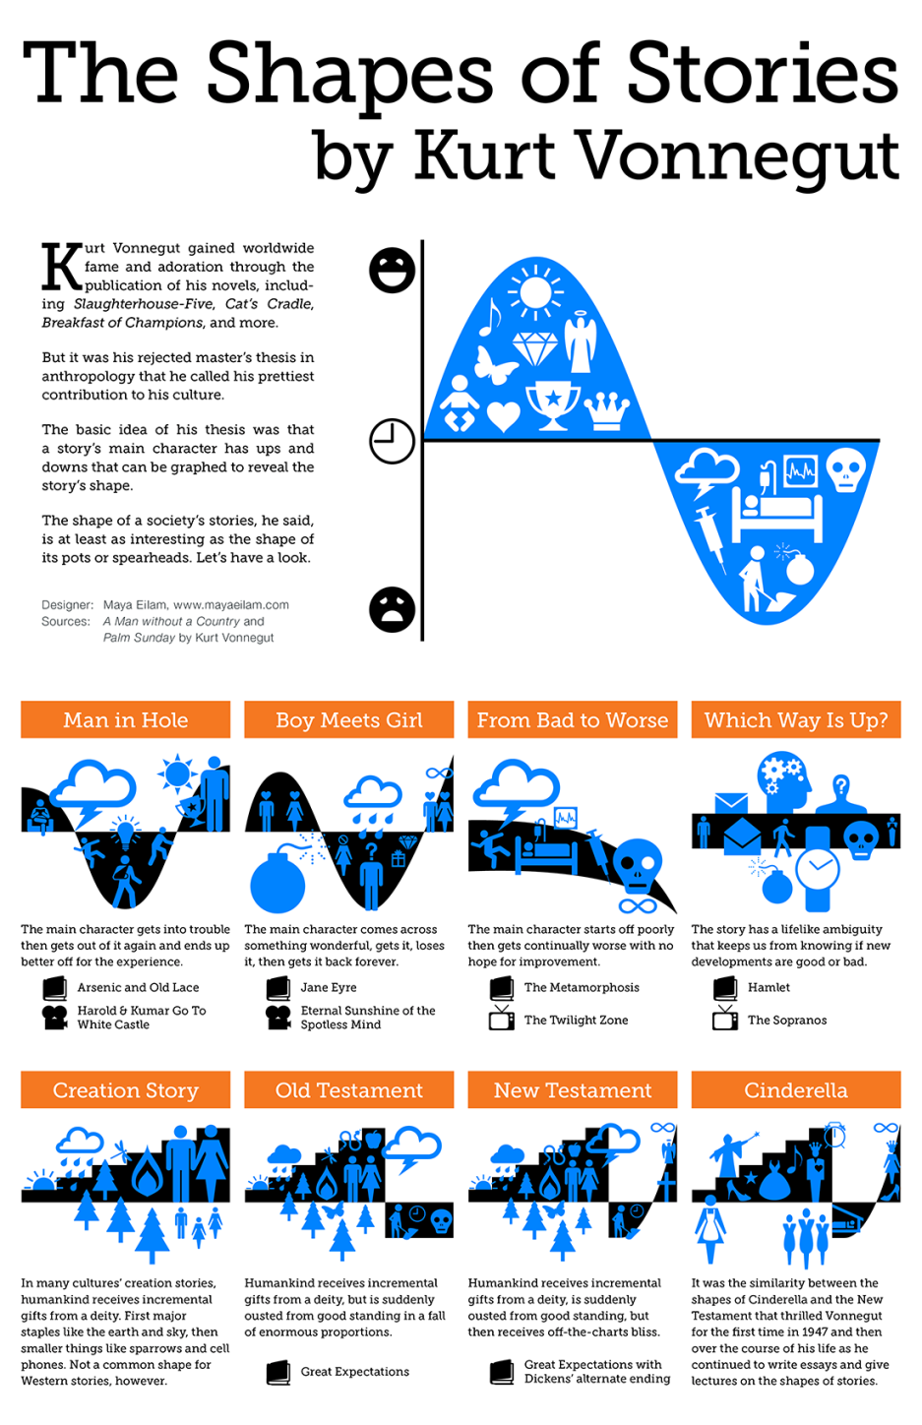
Kurt Vonnegut on the shapes of stories
The writer Kurt Vonnegut was fascinated by the shapes of stories. He liked to look for patterns and similarities within the structures of stories. For instance, he noticed that the New Testament of the Bible was similar, in terms of structure, to Cinderella.
http://thumbnails.visually.netdna-cdn.com/kurt-vonnegut--the-shapes-of-stories_502918a226d9a.png

Slide 88
Task. Do you recognise these story shapes? Can you think of any other stories that fit these patterns?
Notes:
In pairs come up with two examples for each. Film, TV or Movies. 4 mins.

Slide 89
Name of text (book, TV show, film etc.):
Good fortune
Beginning
End
Bad fortune
IN PAIRS
Notes:
Invite students to come and plot the arc on the board. Someone does a book, someone does a TV show and someone does a film.

Slide 90
Your turn…
Look at the shape of the structure of a story you know – the one you’ve just plotted.
Using this structure or shape, devise the basic plotline of a story of your own choosing. If you’re stuck for a hero or heroine, use yourself!
Present your plot summary in bullet points, or as a plot shape, in your jotter.
ON YOUR OWN

Slide 92
Storyboard title:

Slide 93
Lesson 6
Planning

Slide 94
Learning Intention
To plan a short story

Slide 95
Recap - Key elements of a short story
Setting
Characterisation
Plot
Theme
Point of View

Slide 96
A simple short story structure could be...
a character,
in a situation,
with a problem,
who tries repeatedly to solve his problem,
but repeatedly fails, (usually making the problem worse),
then, at the climax of the story, makes a final attempt (which might either succeed or fail, depending on the kind of story it is), after which
the result is “validated” in a way that makes it clear that what we saw was, in fact, the final result.

Slide 97
Think – Pair - Share
What are all the different types of conflict we can experience?
Discuss with your partner. 2 minutes.

Slide 98
Person vs Self - internal conflict - overcoming emotions, feelings
Person vs Person - physical, verbal, emotional, disagreement - can be more complicated between a right side and wrong side
Person vs Society - disagreement with societal values, beliefs and laws
Person vs Nature - forces of nature

Slide 99
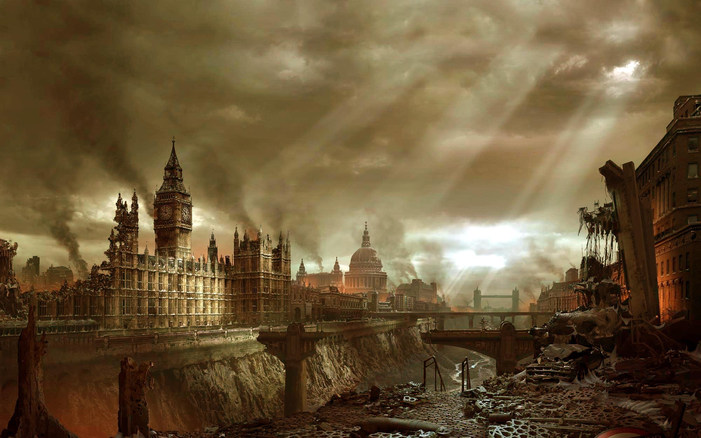
“THE YEAR 2087”
Hope
Freedom
War
Apocalypse
Captivity
Betrayal
Imprisonment
Rebellion
Fear
A.I.
Disaster
Peace
Loyalty
Brotherhood

Slide 100
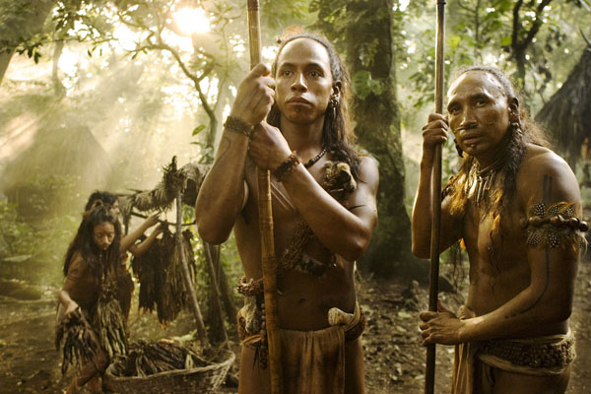
Initial ideas
Brain storm your initial ideas.
Think of a theme (i.e love, loneliness, death, murder, freedom, power etc.) – if this helps develop your plot around this.
Remember:
Your target audience
Your purpose
This is just the part where your story is taking shape.

Slide 101
DEVELOPMENT – Structure of a Story Plan
Use the structure of a story plan provided.
Brainstorm initial ideas.
You should identify:
Title (possible – doesn’t have to be set in stone)
Main characters (2-3 major characters max.)
Setting (place, time)
Plot (beginning, middle, end)
Significant events (what does it look like? What is happening?)
Vocabulary and figurative language choices – words & phrases you want to use
Weather (does this connect with the character’s feelings/emotions).
Start to write down ideas.

Slide 102
Development - Planning
Hopefully, by this time you should have some ideas about your story.
For example:
Beginning
Teenage boy and his father scan a ruined house for supplies. They find another survivor.
Middle
Boy’s father tells his son to run and escape into the street. They hide amongst the rubble and watch as jeeps of survivors race through. They battle to get out of the town to the countryside.
End
They reach the countryside and an abandoned cabin. They find lots of supplies – but are they safe?

Slide 103
In Pairs. Swap and explain!
Read your ideas to your partner.
Discuss what might happen in your story.

Slide 104
Planning a short story: Kurt Vonnegut’s eight tips
Don’t waste your reader’s time. Make the reading experience worthwhile.
Give the reader a character they care about.
Characters should want something – they need motivation.
Every sentence must either tell readers about a character or move on the action of the story.
Start as close to the end as possible.
Be cruel to your characters – no matter how nice they are. Test them – make them struggle.
Write a story with one reader in mind, and try to satisfy this one reader.
Ensure your reader follows the action. From the start of the story, ensure they know what’s going on.

Slide 105
Planning a short story: A tip from Raymond Carver
“I like when there is some feeling of threat or sense of menace in short stories. I think a little menace is fine to have in a story.
There has to be tension, a sense that something is imminent, that certain things are in restless motion, or else, more often, there simply won’t be a story.
What creates tension in a piece of fiction is partly the way the concrete words are linked together to make up the visible action of the story. But it’s also the things that are left out, that are implied, the landscape just under the smooth (but sometimes broken and unsettled) surface of things”.

Slide 106
Lesson 8
Characters

Slide 107
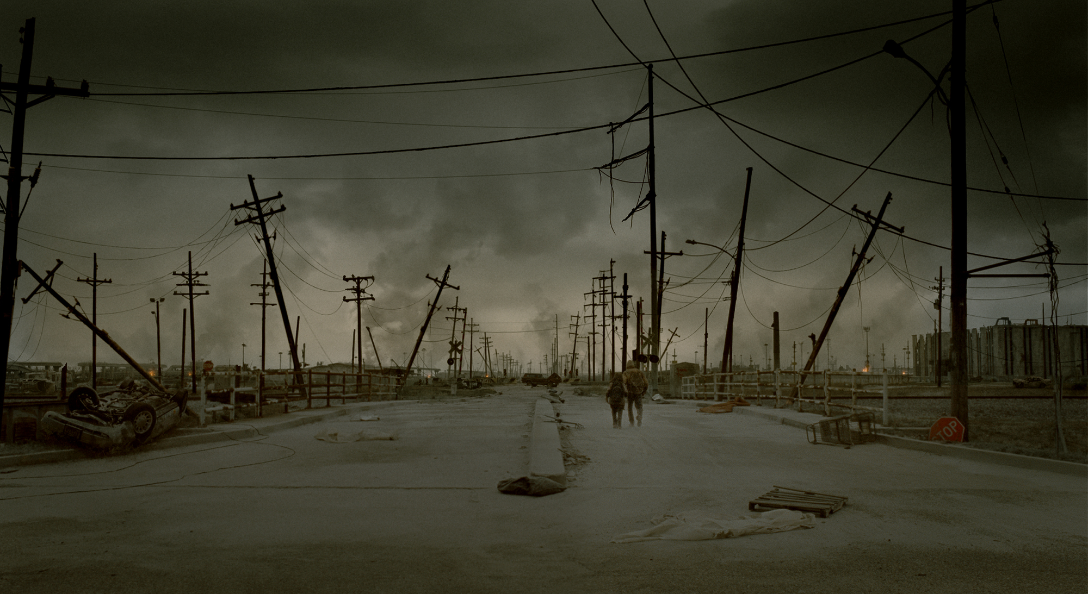
Learning Intention
To explore how to create convincing characters.

Slide 108
Introduction - characters
Characters are the most important part of writing a story – without them the story does not exist!
There are NUMEROUS different characters, but we can identify two main types:
Major characters
Minor characters
A successful character is one that is REALISTIC and at the same time INTERESTING.
A character should DEVELOP over the story – audiences enjoy stories where there is some change to the characters.

Slide 109
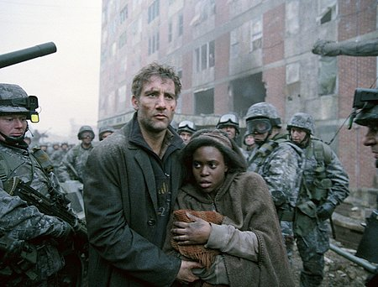
How to introduce characters
The Description
The simplest way.
Describe the physical attributes of a character in one go.
The Slow Reveal
More complex.
Let the facts about a character emerge gradually over the course of the story – show don’t tell.

Slide 110
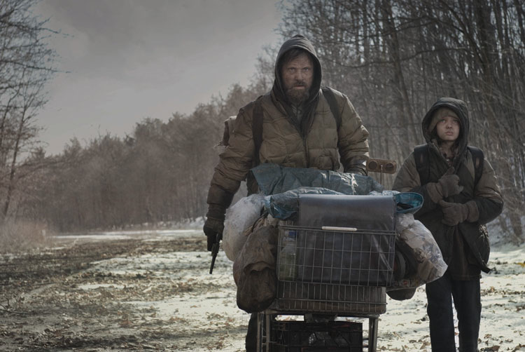
Think of your main character.

Slide 111
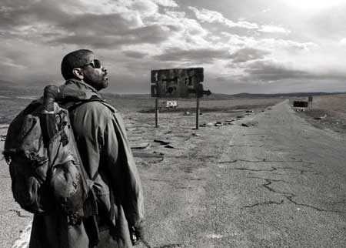
What to focus on?
Clothes
A way of showing ideas about what the person is like.
Physical Appearance
Size, weight
Physical irregularities (scars etc)
Outstanding features (beautiful blue eyes)
Movements
Facial expressions

Slide 112
The Man:
He wore a stained puffer jacket, washed-out and worn but well looked after. The blood stains were faded and several patches of mismatched material covered various tears and scorch marks.
His dusty blonde hair hang lank and greasy over his forehead and he continually had to push it from his wary, dark eyes. On his feet he wore heavy leather boots; a lucky find. They were a few sizes too big for him but he wore three pairs of thick grey socks to fill the space.
As he peered at his reflection in the window of an abandoned car he noticed how dirty his skin was. Dark smudges of ash and grime mixed in with grease and sweat. His thin fingers tucked his layers of t-shirts into the band of his combats. He had lost more weight.

Slide 113
Task. Describe these characters in detail.
Remember to use:
Adjectives – describing words
Verbs – moving/doing words
Simile
Metaphor
The senses – hear, see, smell, touch, taste
Short sentences for effect
Strong vocabulary
Good punctuation

Slide 114
Development
You are now going to introduce the main character of your short story.
You will write as if you are walking along a street and your character catches your attention.
EXT: Introduce a second character of your own devising.

Slide 115
Lesson 9
How to start

Slide 116
Starting a story
How many cliché starters can you think of?
Here are two:
“Once upon a time….”
“In a galaxy, far, far away….”

Slide 117
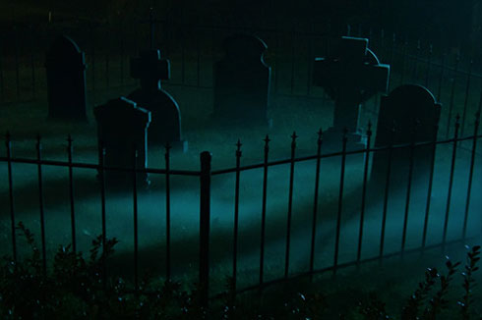
Learning Intentions
To recognise effective creative writing techniques
Success Criteria:
I can effectively start my own short story.

Slide 118
Success Criteria…

Slide 119
One Hundred years of solitude
Many years later, as he faced the firing squad, Colonel Aureliano Buendia was to remember that distant afternoon when his father took him to discover ice.

Slide 120
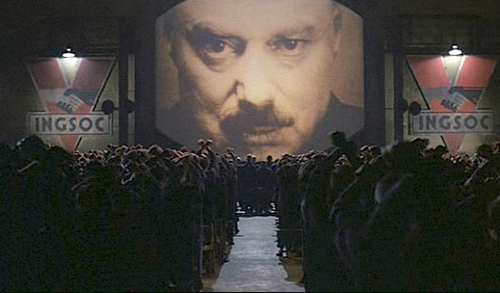
1984
It was a bright cold day in April, and the clocks were striking thirteen.

Slide 121
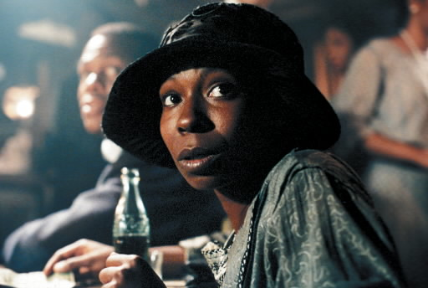
The Colour Purple
You better not never tell nobody but God

Slide 122
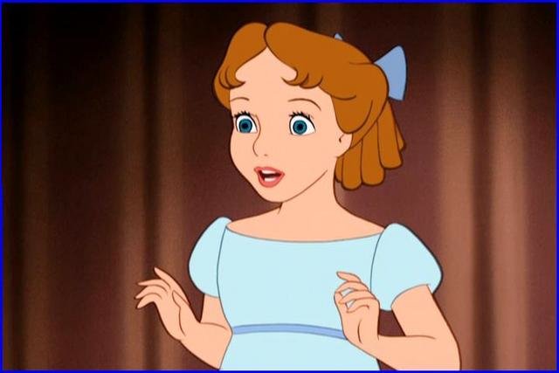
Peter and wendy (Peter pan)
All children, except one, grow up

Slide 123
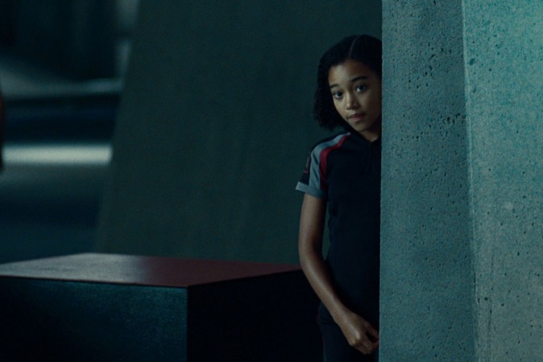
Paradise
They shoot the white girl first.

Slide 124
The Road
When he woke in the woods in the dark and the cold of the night he'd reach out to touch the child sleeping beside him.

Slide 125
Graveyard Book
There was a hand in the dark. And it held a knife.

Slide 126
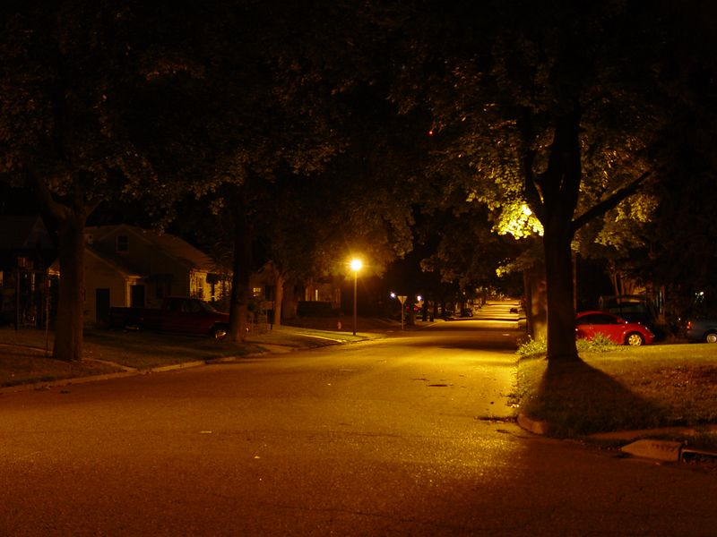
The Graveyard Book By Neil Gaiman
That is the opening to the book.
What are your initial thoughts about the story and what kind of book it is going to be?

Slide 127
The Graveyard Book By Neil Gaiman
There was a hand in the darkness, and it held a knife.
The knife had a handle of polished black bone, and a blade finer and sharper than any razor. If it sliced you, you might not even know you had been cut, not immediately.
The knife had done almost everything it was brought to that house to do, and both the blade and the handle were wet.
The street door was still open, just a little, where the knife and the man who held it had slipped in, and wisps of night-time mist slithered and twined into the house through the open door.
The man Jack paused on the landing. With his left hand he pulled a large white handkerchief from the pocket of his black coat, and with it he wiped off the knife and his gloved right hand which had been holding it; then he put the handkerchief away.

Slide 128
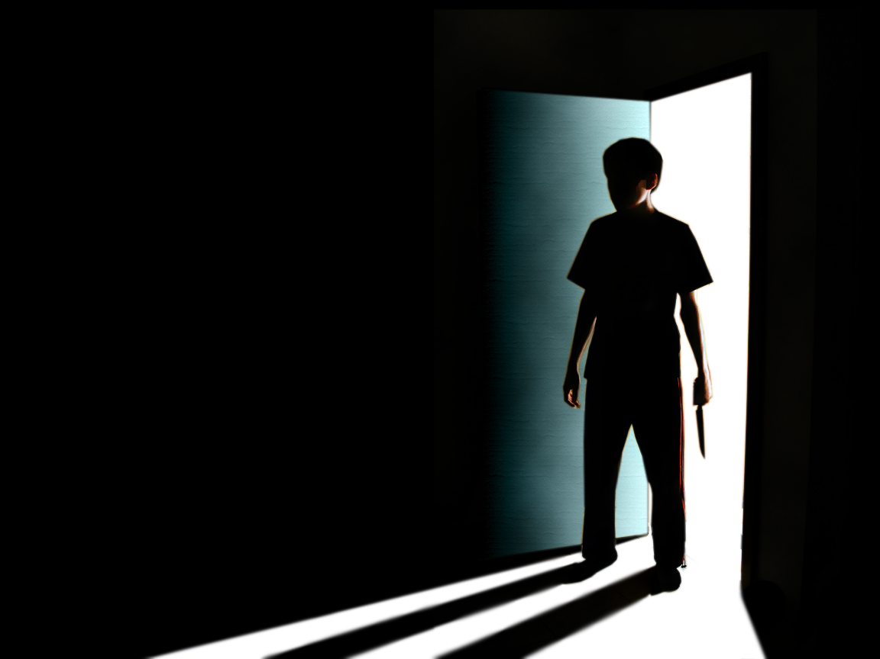
Hook the reader
All of these opening lines HOOK the reader in different ways.
Your opening sentence is very important and deserves a lot of care and attention – there are many books that have been left on book shelves because the opening sentence did not appeal to the reader.

Slide 129
Class discussion
How might this be a good way of starting a story?

Slide 130
The Road Cormac McCarthy
What do you like about this opening?
How does this setting make you feel?
Does it make you want to read on? Why?
When he woke in the woods in the dark and the cold of the night he'd reach out to touch the child sleeping beside him. Nights dark beyond darkness and each day more gray than the one that had gone before. Like the onset of some cold glaucoma dimming away the world. His hand rose and fell softly with each precious breath. He pushed away the plastic tarpaulin and raised himself in the stinking robes and blankets and looked toward the east for any light. But there was none.

Slide 131
The Road Cormac McCarthy
What do you like about this opening?
How does this setting make you feel?
Does it make you want to read on? Why?
They passed through the city at noon of the day following. He kept the pistol to hand on the folded tarp on top of the cart. He kept the boy close to his side. The city was mostly burned. No sign of life. Cars in the street caked with ash, everything covered with ash and dust. Fossil tracks in the dried sludge. A corpse in a doorway dried to leather. Grimacing at the day. He pulled the boy closer.

Slide 132
Development
Short sentences
Questions
Description
Suspense
Write the opening line and an opening paragraph to your story based on ‘The year was 2087”.
Be creative!

Slide 133
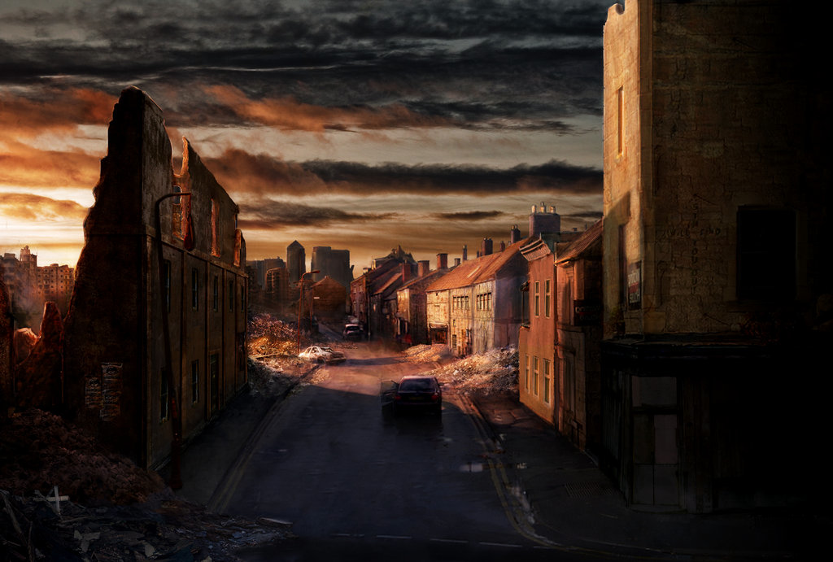
Peer Assess!
Read each others stories.
Does the story start effectively?
If not, what needs to happen to improve it?

Slide 134
You are now ready to begin writing.
Good Luck.

Slide 135
You are now ready to begin writing
A quick recap….

Slide 136
Checklist
Character | Interesting / Subtle / Relatable / Realistic / Air of mystery / Thought provoking / Few in number / Simple / Reveal their personalities slowly.
Setting | Realistic / Pathetic fallacy / Avoid sensory overload / Personification / Effective imagery / Similarities between the character and the setting.
Plot | Not overly complicated / Hooks the reader / Relatable to the audience / Realistic / Interesting / Original.
Language | Sophisticated / Descriptive / Fluid / Language is suitable for character.

Slide 137
Imaginative Writing
Criteria | Example
Mood | Weather; colours (or lack of) used; sounds; through tone; narrative voice; characters used; texture; feeling; imagery; smells; opening sentence; location; seemingly unimportant objects; connotations…
Tone | Emphasising certain words; paragraphing; formal / informal language; dialect / slang; connotation vs. denotation; humour; puns; sarcasm; parenthesis…
Technique | Metaphors; similes; personification; ellipsis; onomatopoeia; alliteration; oxymoron; extended metaphor; hyperbole; inversion…
Stylistic devices | Narrative voice; unreliable narrator; unreliable characters; seemingly simple concept(s) taking on great importance…

Slide 138
Recipe for a Short Story.
These can be done in any order:
Construct a plot line.
Create one or two characters.
Think of a setting.
Choose a theme.
Decide on style and expression.

Slide 139
Date
Today the aim is to continue writing /editing your short story.

