Slide 1
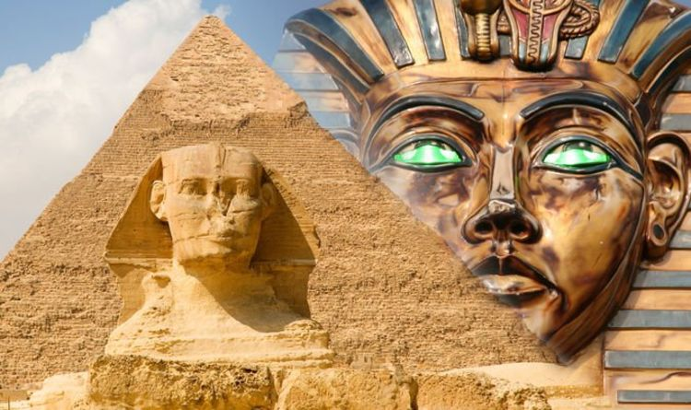
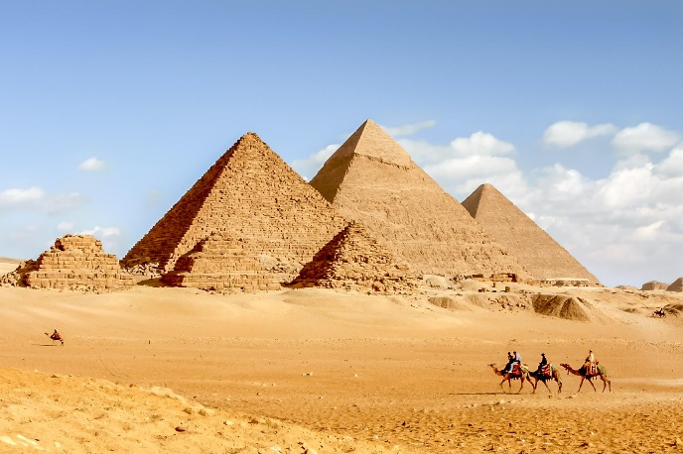
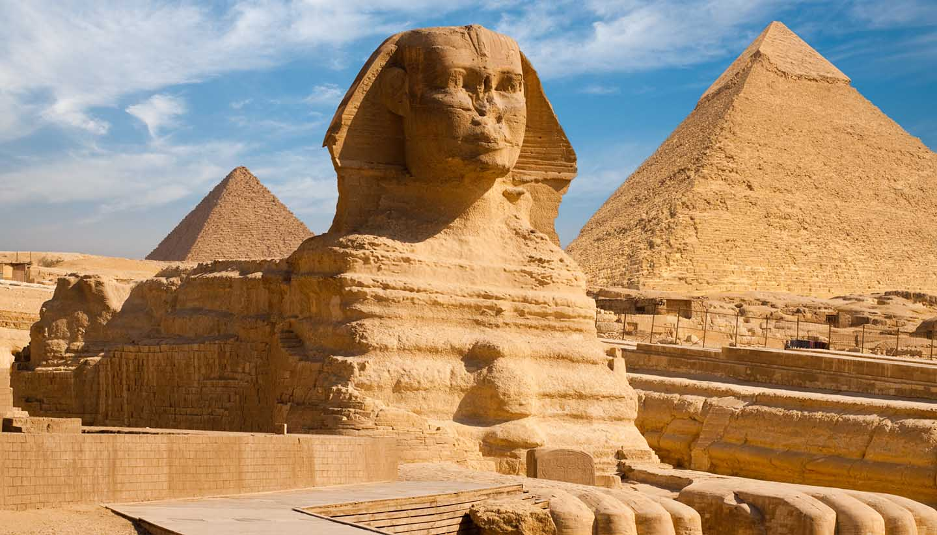
An Egyptian Adventure!
S3 English Creative Writing Project

Slide 2
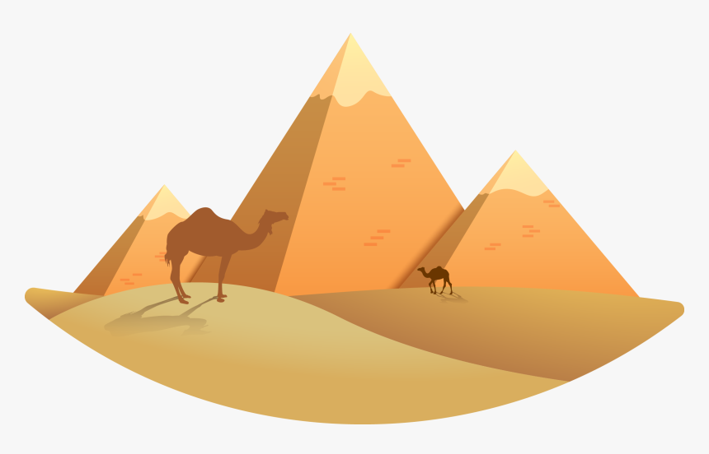
task
Write an exciting story about someone discovering and exploring an ancient Egyptian tomb. Use lots of description to bring your writing to life.
You will be working on this project over some time. The materials you require are:
The paragraph plan/task sheet;
This PowerPoint, which will be regularly updated to include examples of each paragraph.
Feel free to add additional paragraphs, illustrations, maps and so on.

Slide 3
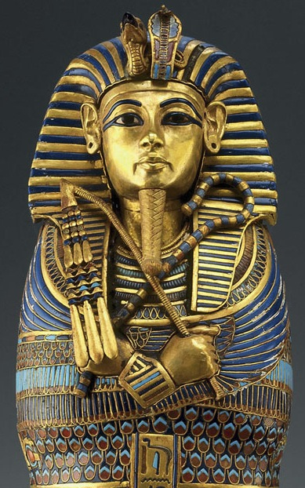
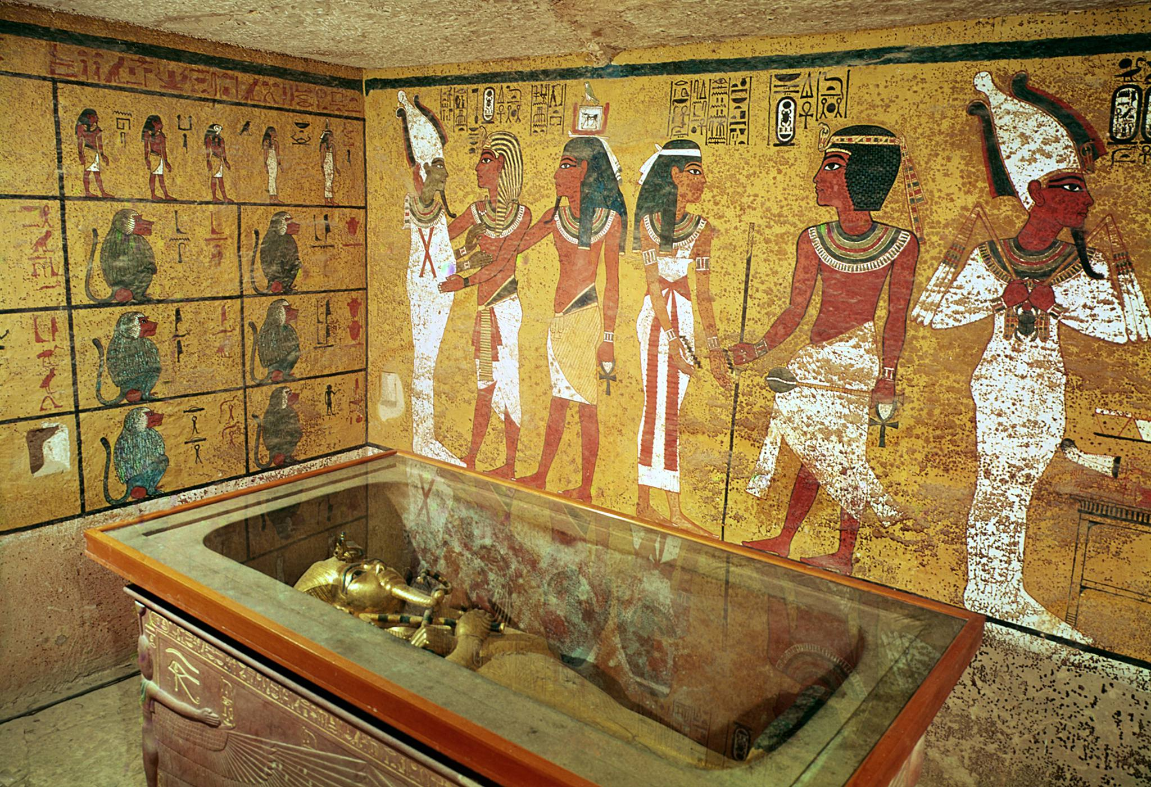
Before we begin
Look at the images of Egypt below. The following link is also useful: https://www.youtube.com/watch?v=ecD5mxJ16UQ

Slide 4
The plot
There is a general plot (storyline) for you to follow, but you can add to this if you like. The main stages of the plot are listed below. Each stage – as you will see from the paragraph plan sheet – can go over several paragraphs to enable you to build character, setting and atmosphere:
Set the scene | Build the tension | Climax | Ending
Your character discovers the entrance to the pyramid. | Your character explores inside the pyramid. | Having found the treasure chamber, your character makes a dramatic discovery. | Your character tries his or her best to escape the pyramid.

Slide 5
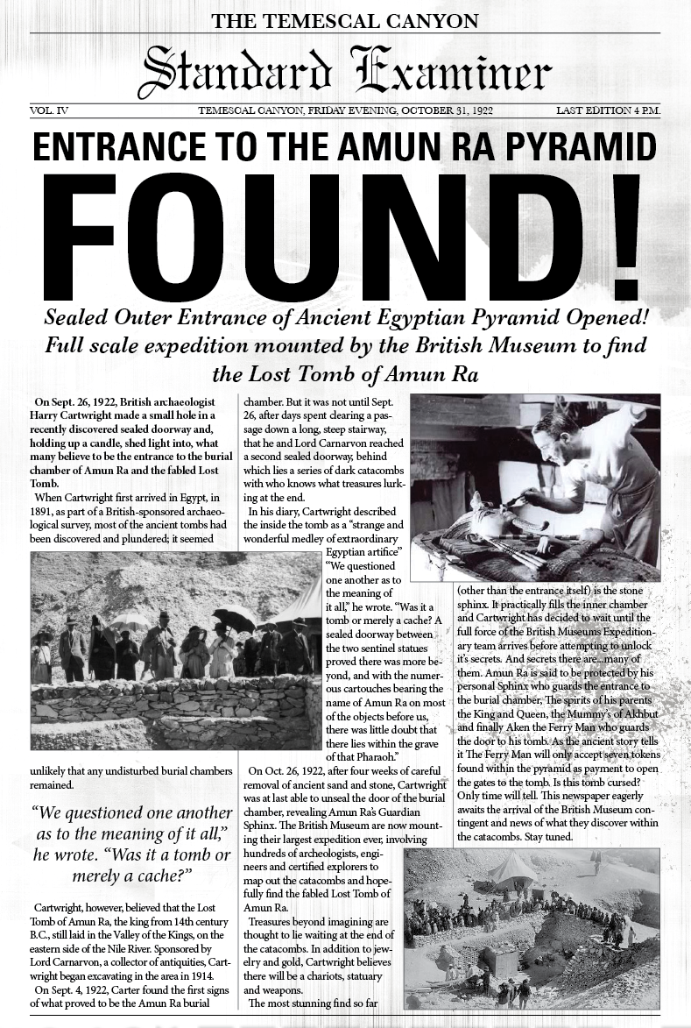
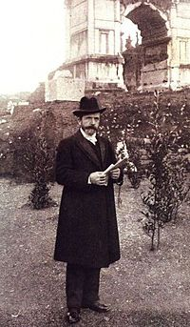
Have a think…
About who your main character is and about when you are setting your story.

Slide 6
General writing tips
No matter what type of writing you are producing, it’s important that you…
Write in varied sentences
Use ambitious words
Write in paragraphs
Check spelling and punctuation
Use similes and other techniques
Blend story-telling with description and some dialogue
Stick to 1st or 3rd person
Stick to one tense

Slide 7
Example paragraphs
The remainder of this PowerPoint will include example paragraphs and writing tips to help you along.
We wish you every success on your…
Egyptian Adventure!

Slide 8
Example paragraph 1: in the desert
In this paragraph, describe what your character is doing in the desert. Introduce your character and the Egyptian setting.
Jacob Mann stood in the middle of the desert, sweat gathering on his brow. It had been a long and tiring day. He and his team hand spent a considerable time trying to find the entrance, but so far they’d had no success. Jacob had dismissed the rest of his team for the day and was now gathering up the last few bits of their equipment.
Notice how the writer sets the scene quite quickly.

Slide 9
Example paragraph 2: the secret entrance
In this paragraph, your character should discover the secret entrance to the pyramid. How does this happen? How do they feel? Use language well.
Just as Jacob reached down to pick up the rest of his tools, he stumbled over a rock and landed bodily against the outer wall of the towering pyramid. Suddenly there was a loud grating noise of stone against stone. What on earth? Jacob couldn’t believe his eyes! Right there in front of him an opening had appeared in the side of the pyramid! All he could see was darkness and cobwebs, but Jacob just knew that he had to explore inside…
Notice how the writer varies sentence structure and punctuation.

Slide 10
Example paragraph 3: corridors and traps
In this paragraph, your character should make their way down the long corridors into the tomb. Use your senses to include interesting descriptions. Do they have a torch? Do they encounter any booby traps? What happens?
Feeling a giddy mixture of nerves and excitement, Jacob made his way into the pyramid. Perhaps he should have gone and found someone to accompany him, but he just couldn’t resist wandering inside. This was something he had only dreamed about. Resting one hand on the cold stone wall, he used the other to switch on his torch with a “click” that echoed around the claustrophobic corridor in which he now found himself in It was full of dust and cobwebs; the air was thick and musty. As he made his was along, he noticed that there were holes in the ground every few feet. Traps! It took all of Jacob’s concentration and strength to ease himself around the openings, which has large metal spikes at the bottom! This was not going to be easy…
Notice how the writer uses a range of senses – sight, touch, hearing…

Slide 11
Example paragraph 4: the treasure chamber
In this paragraph, your character reaches the treasure chamber (probably with a mummy case in the centre). Google some images for ideas of how you can describe this.
After a considerable amount of fumbling and stumbling in the increasingly dull light of his torch, Jacob found himself inside a large room. As soon as he set foot inside, burning torches on the wall suddenly illuminated. Wow! He could see everything perfectly. Jacob switched off his torch and gazed in wonder at the amazing treasure chamber. The walls were covered in intricate hieroglyphs in the most wonderful colours. Time had not taken away the treasure chamber’s beauty. Beautiful vases and sculptures of Egyptian gods were everywhere. And jewels – jewels in abundance! There, in the very centre of the room, was a fabulous sarcophagus – a mummy case! Jacob couldn’t help taking a closer look…
Notice how the writer uses a range of sentence types and lengths.

