Slide 2
Learning Objective
To understand the nature of flash fiction and to create my own.
Success Criteria
To understand what is meant by flash fiction.
To explore ways writers use language and structure to create flash fiction.
To write my own piece of flash fiction.

Slide 3
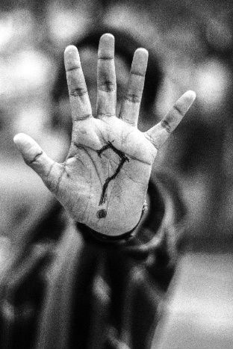
Quickfire Stories
Think of a story you know. It could be a fairy tale, the plot of a film, a book you’ve read…
Now, you’re going to tell the story to your partner in…
one minute.
30 seconds.
ten seconds.
You must use all the time you’re given – no silences!
How easy did you find that task?
What was the difference between the minute version and the 30 second version?
How did you choose what to leave out and what to keep in?

Slide 4
Flash Fiction
Flash fiction is an art form which tells stories in a limited number of words. Pieces of flash fiction are carefully crafted, to ensure the reader is engaged and interested and satisfied – just as they would be by a longer story.
Flash fiction word limits can vary – usually from 50 words to 500.
Knowing this, why do you think it is called flash fiction?

Slide 5
Flash Fiction
One of the most famous pieces of flash fiction is often attributed to the American author, Ernest Hemingway:
For sale: baby shoes, never worn.
Why do you think these six words are thought of as a complete story?
Imagine you had to fill in the gaps. What has come before these words? What might come after?

Slide 6
An Example
Now, read this longer example of flash fiction, titled Scrambled Eggs. This story is 500 words long.
Characters in flash fiction must be believable and three-dimensional – just because there isn’t a lot of space, doesn’t mean they are just sketches. It should be clear from the story that the author knows all about the characters – even if they haven’t written it all down.
What do you notice about the language of the story?
Because the form is so short, flash fiction often relies on implication or hint to tell us what has happened before, or what will happen next. Often, the story just focuses on one part of the narrative arc – although the rest of the story is always implied. Flash fiction can often use flash-forward or flashback to convey details, too.
What do you notice about the structure of the story?
Flash fiction often uses a metaphors, similes and other language techniques to engage the reader in a short space of time.
What do you notice about the characters?
What do you notice about the imagery of the story?
Flash fiction doesn’t have a lot of time to make an impression, so it needs to work quickly! Often, using a powerful image or images is the way to do this – something which will captivate and haunt the reader.

Slide 7
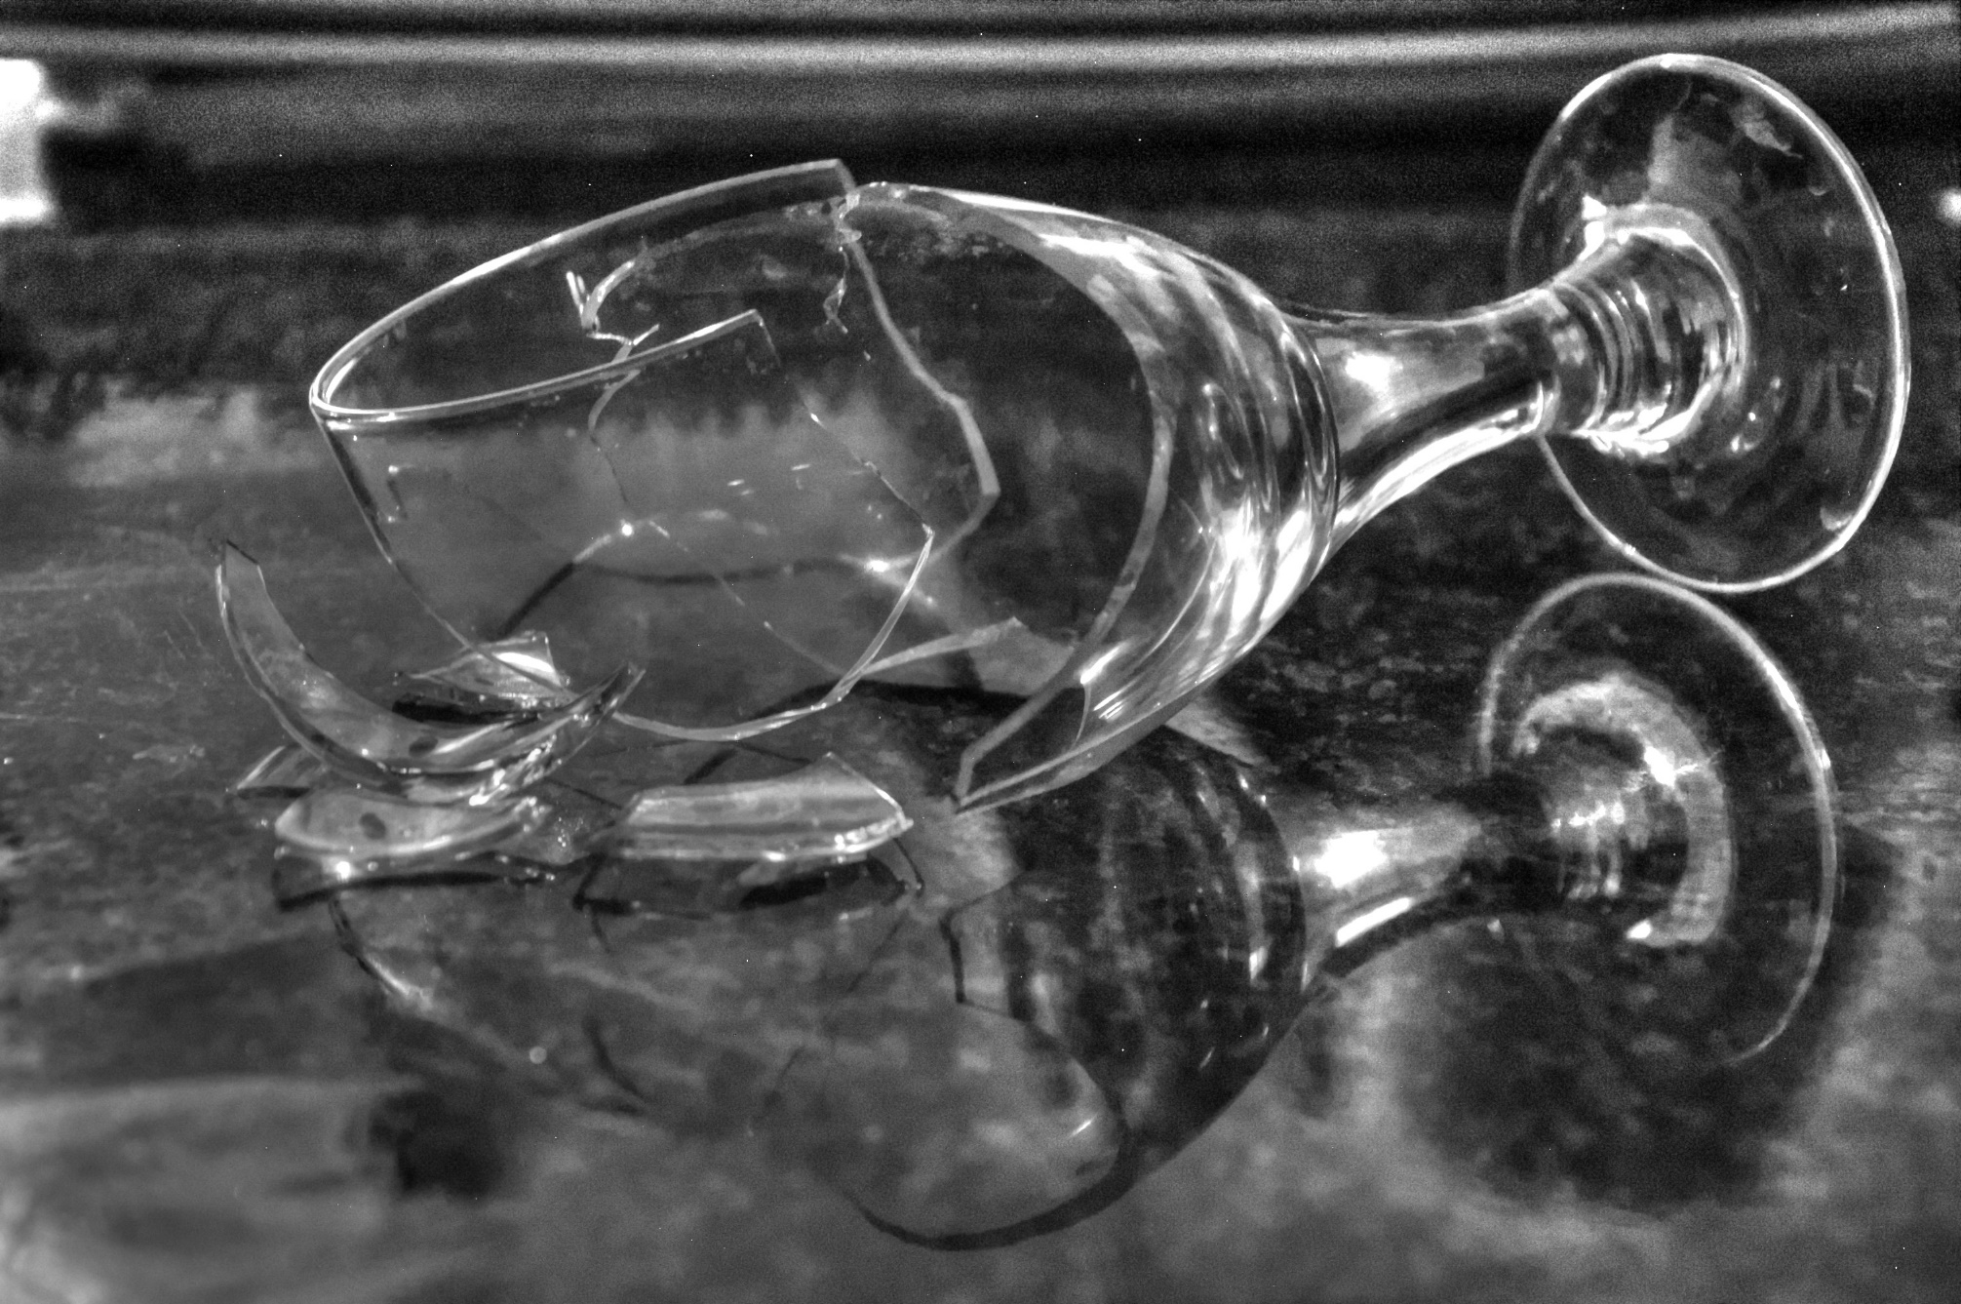
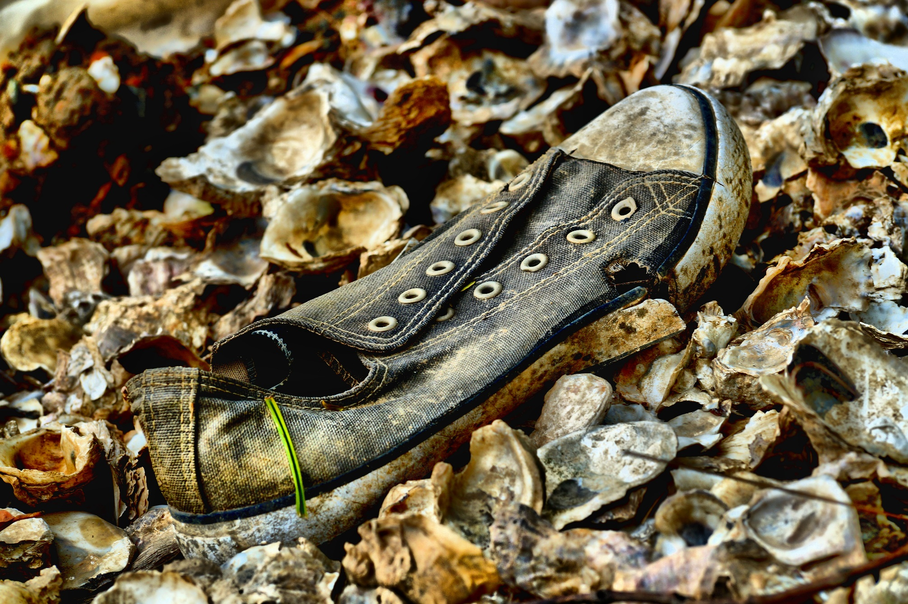
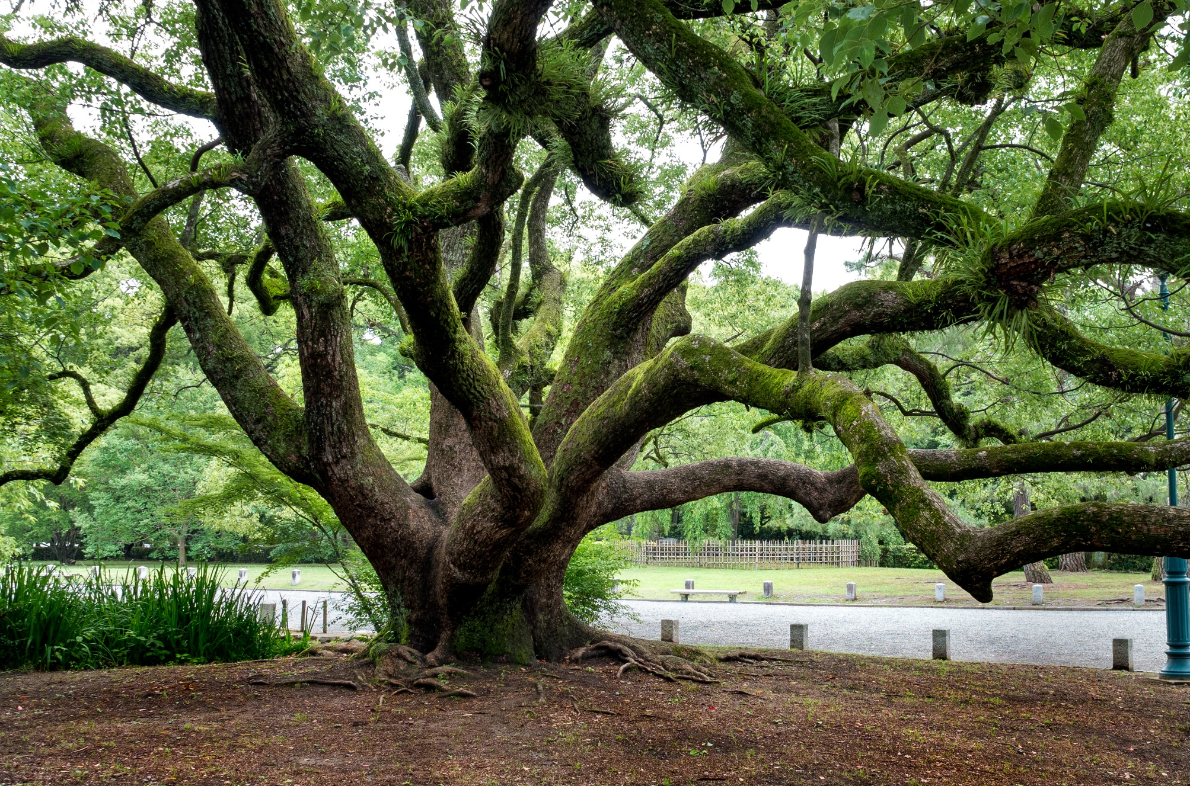
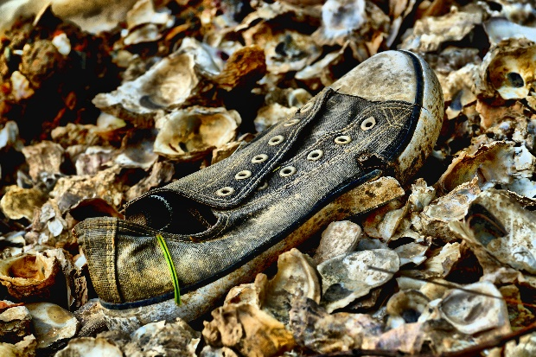
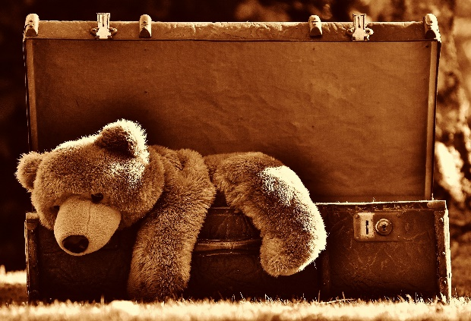
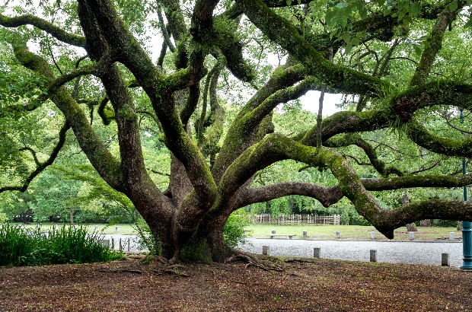
You Try!
Now, try creating your own piece of 500-words-long flash fiction. The first step is to choose a powerful image. There are some suggestions below, or you could draw your own on the Planning Flash Fiction Worksheet.
Top Tip:
Remember to choose an image which you think you could write about – it should make you think of an idea for a story!
Photo courtesy of Razlam (@flickr.com) - granted under creative commons licence – attribution. See license here

Slide 8
You Try!
Now, use the Planning Flash Fiction Worksheet to flesh out your story. Start with your image, and work from there. Use the prompts below if you are feeling stuck.
Did someone lose your object?
Is your object a metaphor for something else?
Remember: your story is short, so it needs to be simple! Stick to one key location and one central image.
Did your object witness something?
What has just happened to your object?
Was your object a gift to someone?

Slide 9
First Draft
Writing the first draft of a piece of flash fiction is tricky – you want to keep within your word limit, but you don’t want that to be your focus: you still have a story to tell!
Write your story using your Planning Flash Fiction Worksheet to help you. If you are stuck for somewhere to start, use your object as a starting point. You can then move forwards or flashback in your story if you need to.
Remember: don’t worry too much about your word count at this stage!

Slide 10
Second Draft
Now you have your first draft, you can count your words. We are aiming for a 500 word short story. The word count does not include the title of the story.
How many words have you got?
You have probably found that your word count is over what it should be. Don’t worry! That’s normal for a first draft. So, now we need to trim out all the words and sentences we don’t need. Have a look at the first draft of the first paragraph of Scrambled Eggs, and how that was edited down.

Slide 11
Second Draft
How would you edit this paragraph? In pairs, use the Editing Worksheet to help you.
Scrambled Eggs
He stared dully at the scrambled eggs on his plate. They lay there, a sticky, cold and congealing mess which was a metaphor for his heart. Once, not so long ago, she had loved making him breakfast; she had lovingly set it before him every day, carefully placing the china plate, the knife and fork, the condiments. He had loved the small ritual of breakfast each morning. Each mouthful had been a testament to her love for him; a physical manifestation of her solicitude. Now, he just felt angry. How could he have swallowed those breakfasts so carelessly? He had ravenously gobbled up the toast, carelessly chewed the bacon, frantically gulped down the coffee, never realising that each serving was bringing him closer to the end, closer to the time when there would be no more.
Scrambled Eggs
He stared dully at the scrambled eggs on his plate. They lay there, a sticky, cold and congealing mess which was a metaphor for his heart. Once, not so long ago, she had loved making him breakfast; she had lovingly set it before him every day, carefully placing the china plate, the knife and fork, the condiments. He had loved the small ritual of breakfast each morning. Each mouthful had been a testament to her love for him; a physical manifestation of her solicitude. Now, he just felt angry. How could he have swallowed those breakfasts so carelessly? He had ravenously gobbled up the toast, carelessly chewed the bacon, frantically gulped down the coffee, never realising that each serving was bringing him closer to the end, closer to the time when there would be no more.
Scrambled Eggs
He stared at the scrambled eggs. They lay there, cold and congealing: a metaphor for his heart. Once, she had made him breakfast; she had set it before him every day, carefully placing the china plate, the knife and fork, the condiments. Each mouthful had been a testament to her love for him; a physical manifestation of her solicitude. How could he have swallowed those breakfasts so carelessly? He had gobbled the toast, chewed the bacon, gulped the coffee, never realising that each serving was bringing him closer to the time when there would be no more.

Slide 12
Third Draft
Now, you need to carefully check your piece for its third and final draft. Go back to the sample flash fiction, Scrambled Eggs. What makes that a successful story? Make a checklist with your partner.
Now, apply your checklist to your own story. Have you covered all the relevant points?

Slide 13
Share!
Let’s share our flash fiction pieces with the rest of the class. For each story you hear, think of:
Three things you really like about it.
Two words you would use to describe the story.
One thing you would change about the story.

Slide 14
Consolidate
What you have learned about flash fiction? Write down five top tips for anyone wanting to write their own piece of flash fiction.
1)
2)
3)
4)
5)

