Slide 1
Sustainability & Interdependance
Key Area 2e
Genetic Technology

Slide 2
Learning Intentions
By the end of this topic you should be able to:
State that the process by which the genetic material within an individual cell is altered by incorporation of foreign DNA is known as genetic transformation.
State that genetic transformation techniques allow one or more genes to be inserted into a genome.
State that the transformed genome is used in breeding programmes.

Slide 3
Genetic technology

Slide 4
Genetic technology
As well as enhancing cultivars and breeds through breeding strategies, plants and animals can be enhanced by use of genetic technologies:
Genome sequencing (remember from Unit 1)
Genetic transformation (remember from Unit 2)

Slide 5
Genome sequencing
Genome sequencing techniques can be used to identify organisms that possess particular alleles/genes for a desired characteristic.
This organism can then be selected for use in a breeding programme.

Slide 6
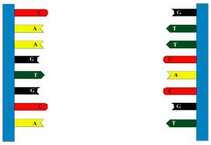
How is Genome Sequencing done?
Constructing a library of overlapping DNA fragments to find an organism’s genome with computer technology.
Entire base sequence can be found.

Slide 7
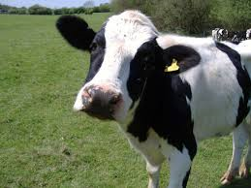
Use of Genome Sequencing
Organisms with desirable alleles of genes can be identified and used in breeding programmes to incorporate useful allele into new crop/animal breed.

Slide 8
Genetic transformation
Genetic transformation is the transfer of genetic information from one organism to another (think back to GM crops in Nat 5).
This technique can be used to enhance a crop species which can then be used in a breeding programme.

Slide 9
Crop Breeding
Single genes for desirable characteristics can be inserted into the genome of crop plants which creates genetically modified plants with improved characteristics

Slide 10
Crop Breeding - Examples
Recombinant DNA technology in plant breeding includes:
Insertion of Bt toxin gene into plants for pest resistance
Glyphosate resistance gene inserted into plants for herbicide tolerance

