Slide 1
Metabolism and Survival
Key Area 7a
Wild Micro-organism Strains

Slide 2
By the end of this topic you should be able to:
State what mutagenesis is and how this can be induced in microorganisms
Describe the process of alteration of the DNA in a bacterial cell by recombination of a gene(genes) from another organism to include the terms endonucleases, ligase, restriction site, vectors
State that wild strains of bacteria can be improved by mutagenesis, selective breeding, or recombinant DNA

Slide 3
Wild Strains
Wild strains of organisms used in industrial processes can be improved to produce:
Genetic stability
Growth on low-cost nutrients
Greater than normal levels of the desired product
Easy harvesting of the product following fermentation
These improvements are brought about by mutagenesis or recombinant DNA technology

Slide 4
Mutagenesis

Slide 5
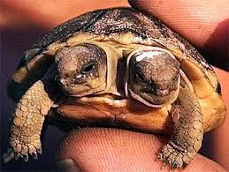
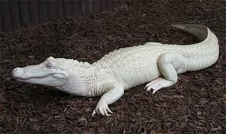
Mutagenesis
A mutation is a heritable change in an organisms DNA that causes genetic diversity
Mutagenesis is the artificial creation of mutations. This usual involves exposure to mutagenic agents such as:
Ultraviolet (UV) light
Other forms of radiation
Mutagenic chemicals (eg mustard gas)

Slide 6
Mutagenesis
Although most mutations are harmful, occasionally a mutation can have a beneficial effect which may improve the strain
Normally the improved strain lacks an inhibitory control mechanism so it no longer expresses an undesirable characteristic or it produces an increased yield of a desired product

Slide 7
Recombinant DNA Technology

Slide 8
Recombinant DNA Technology
Recent advances in technology have allowed scientists to transfer genetic material from one organisms to another or even one species to another
This allows the production of plant or animal protein by organisms that have been artificially transformed
When doing this, scientists tend to introduce specific genes as a safety mechanism that will prevent the transformed organism from surviving in the wild if it was to be released

Slide 9
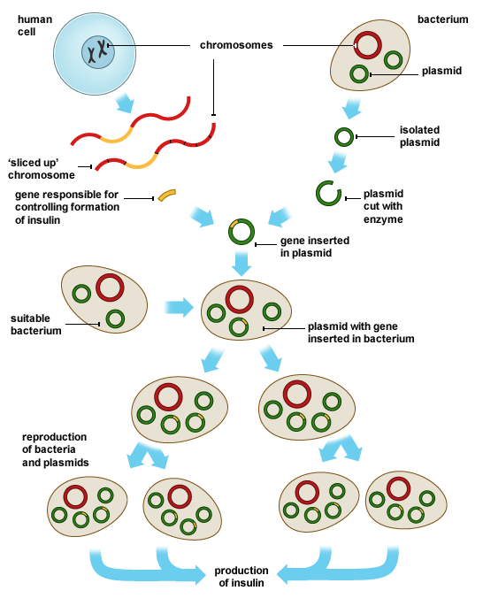
From Nat5
See P209 of textbook

Slide 10
Recombinant Plasmids
Scientists can splice desirable DNA/genes (eg insulin) from one organism into the DNA of a vector.
A vector is a DNA molecule which is used to carry foreign genetic information into another cell and examples of vectors include bacterial plasmids and artificial chromosome.
The modified vector is then inserted into a host cell (eg bacterium such as E. Coli)

Slide 11
Recombinant Plasmids
The transformed host cell can be forced to express this ‘foreign’ gene to make the desired product.
The host is said to contain recombinant DNA as it has a combination of its own DNA and DNA from another organism
This is made possible due to the use of restriction endonucleases

Slide 12
VECTOR
HOST CELL
TRANSFORMED HOST CELL (with recombinant DNA)

Slide 13
Restriction Endonuclease
Restriction endonucleases are enzymes that will cut DNA (nucleic acids) at specific DNA sequences (4 – 8 base pairs long) called restriction sites
The sequence is found on both strands of the DNA (but running in opposite directions) and it produces sticky ends
The more often the sequence appears in the DNA, the more fragments will be produced
They are used to cut out the required DNA/Gene as well as to cut open the vector (usually a plasmid)

Slide 14
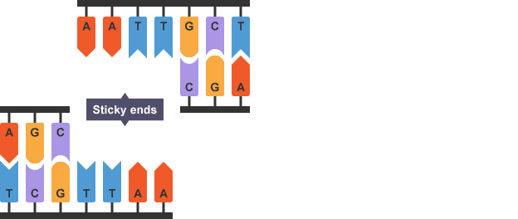
Restriction Endonuclease – Sticky Ends
The following diagram shows an endonuclease that cuts at the sequence AATT to produce sticky ends
Complementary sticky ends are produced when the same restriction endonuclease is used to cut open the plasmid and the gene from the chromosome.
Ligase is then used to seal the gene into the plasmid

Slide 15
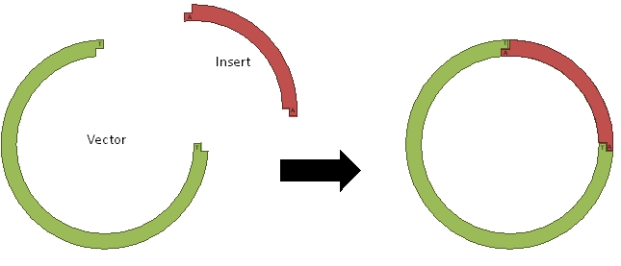
Restriction Endonuclease – Sticky Ends
As both the DNA and vector have been cut with the same endonuclease, the exposed bases are complimentary.
DNA ligase can then seal the gene into the vector

Slide 16
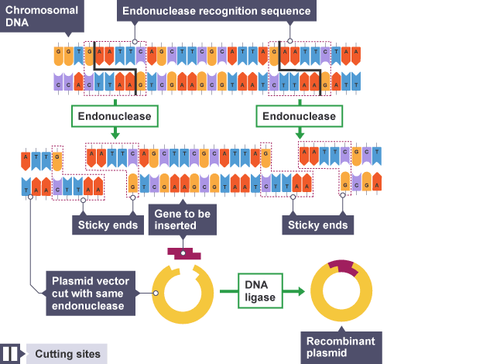

Slide 17
Vectors
Vectors are recombinant plasmids or artificial chromosomes which carry DNA from one genome to another.
Artificial chromosomes are preferable to plasmids as vectors when large fragments of foreign DNA are required to be inserted
Restriction site
Origin of replication
(ORI)
Marker gene
Regulatory sequence

Slide 18
Features of Vectors
Restriction site
Restriction site – contain target sequences of DNA where specific restriction endonuclease can cut
Origin of replication
(ORI)
Marker gene
Regulatory sequence

Slide 19
Features of Vectors
Marker gene – selectable marker genes present in the vector ensure that only micro-organisms that have taken up the vector grow in the presence of the selective agent (antibiotic)
For examples, this gene could offer resistance to ampicillin. The bacteria is grown on media containing ampicillin and only those with the vector successfully back into the host survive and are used in next steps of the research
The gene could also code for fluorescent proteins to help identify bacteria containing the vector
Restriction site
Origin of replication
(ORI)
Marker gene
Regulatory sequence

Slide 20
Features of Vectors
Restriction site
ORI - The vector also contains genes for self-replication and regulatory sequences to control gene expression.
These cause multiple copies of the plasmid/artificial chromosome to be made within the cell, increasing the quantity (yield) of the product that is harvested from the culture.
Origin of replication
(ORI)
Marker gene
Regulatory sequence

Slide 21
Features of Vectors
Restriction site
As a safety mechanism, genes are often introduced that prevent the survival of the micro-organism in the external environment
Origin of replication
(ORI)
Marker gene
Regulatory sequence

Slide 22
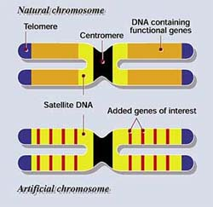
Artificial Chromosomes
As well as plasmids, scientists have made artificial chromosomes that can be used as a vector
The artificial chromosome contains all the same features as a vector but it is able to have larger fragments of ‘foreign’ DNA inserted into it

Slide 23
Problems with using Prokaryotes
DNA from eukaryotes contains exons (coding sequences) and introns (non-coding sequences)
The intronic sequences can be involved in modification of the primary mRNA transcript produced (splicing) and the proteins produced can be further modified after translation
As prokaryotes (eg bacteria) have no introns, they are unable to modify any mRNA by splicing or carry out any type of post-translational modification

Slide 24
Recombinant Yeast Cells
As a result of this, any gene from a eukaryote which is expressed in a prokaryote may produce a polypeptide which has not folded correctly or may lack necessary modification and so the resulting protein may be inactive
Some DNA sequences which code for a desired protein are better off being produced in genetically transformed eukaryotes (eg yeast) even though it is far more challenging to do so

Slide 25
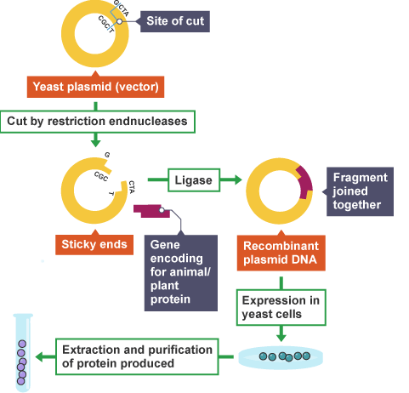
Genetically Modified Yeast

