Slide 1
Metabolism and Survival
Key Area 3b
Heart Comparison

Slide 2
Learning Intentions
By the end of this topic you should be able to:
Describe the mechanisms of delivery of oxygen in terms of cardiovascular system of different animals;

Slide 3
From N5 you should know
The main blood vessels involved in the circulation of blood around the body are:
Arteries – carry blood away from the heart (under high pressure).
Capillaries – smallest blood vessels which exchange nutrients, gases, and waste products between the blood and the body tissue.
Veins – carry blood back to the heart (under low pressure).
The heart has two types of chambers – atria and ventricles. Atria are where blood enters the heart and ventricles are where blood leaves the heart.

Slide 4
Oxygen delivery
High metabolic rates require efficient delivery of oxygen to cells for aerobic respiration.
Multicellular organisms need oxygen delivery systems such as cardiovascular systems

Slide 5
Circulatory Systems in vertebrates
All vertebrates have closed circulatory systems where the blood is contained in a continuous circuit of blood vessels and is kept moving by a muscular pump (a heart).
In closed systems a drop in pressure occurs when blood passes through the capillaries because the narrow tubes offer resistance to the flow of blood

Slide 6
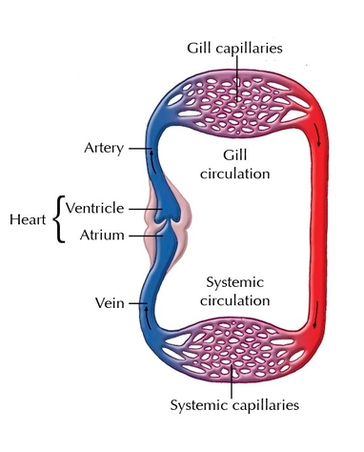
Fish - Single circulatory system
The circulatory system of a fish is described as single because blood passes through the 2-chambered heart only once for each circuit of the body
In the fish the blood flows to the gills at high pressure but is delivered to the capillaries at low pressure. It is a relatively primitive and inefficient method

Slide 7
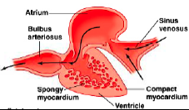
The heart of the fish
It is a 2 chambered heart with one atrium and one ventricle with a valve in between.

Slide 8
Double circulatory system
In organisms where blood passes through the heart twice for each complete circuit of the body, they are said to have a DOUBLE circulatory system
Blood is pumped to both the lungs and the body at high pressure ensuring vigorous flow making it more efficient than single systems.

Slide 9
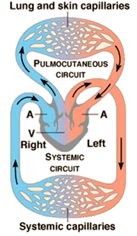
Incomplete double circulatory system
Reptiles and amphibians circulatory systems are described as incomplete because there are 2 atria but only 1 ventricle and some mixing of oxygenated blood from the lungs and deoxygenated blood from the body occurs
In amphibians the mixing is not a major problem as the blood returning from the body has been partially oxygenated through its moist skin

Slide 10
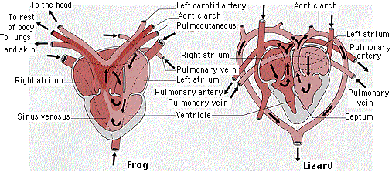
Amphibian and reptile heart
They are made of 3 chambers, 2 atria and 1 ventricle.
In reptiles (eg lizard), little mixing occurs because the single ventricle is partly divided by a septum

Slide 11
Chambers | Diagram/description | Animals that have
Three
2 Atrium
1 Ventricle
Amphibians
eg frog
lungs
body
2 entries for blood
Deoxygenated from body
Oxygenated from lungs
Mixing of blood in the ventricle

Slide 12
Chambers | Diagram/description | Animals that have
Three
2 Atrium
1 Ventricle
Reptiles
e.g. lizard
(NOT birds)
lungs
body
Partial separation of the ventricle means there is less mixing of the bloods from atria

Slide 13
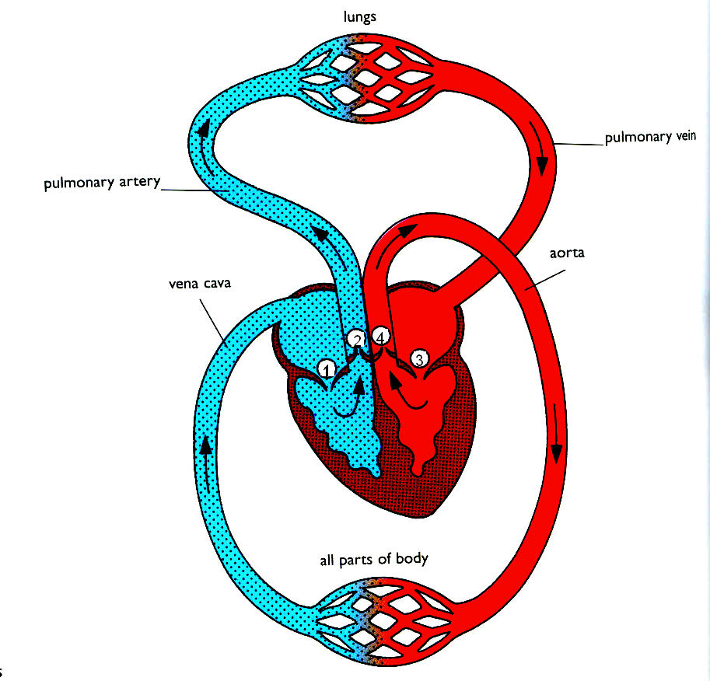
Complete circulatory systems
Birds and mammals have complete circulatory systems.
They are complete because the heart has 2 atria and 2 ventricles completely separated by a septum.

Slide 14
Chambers | Diagram/description | Animals that have
Four
2 Atrium
2 Ventricle
bird or mammal
lungs
body
Closed loops for deoxygenated and oxygenated blood

Slide 15
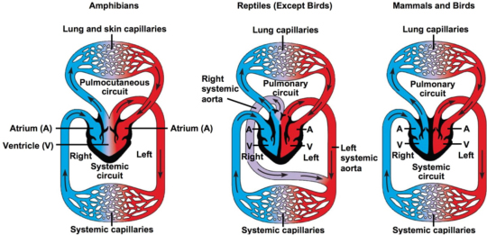
Double circulatory systems

Slide 16
Comparing circulatory systems
Birds and mammals have higher metabolic rates than reptiles and amphibians, which in turn have higher metabolic rates than fish.
The complete double circulatory system in birds and mammals enable higher metabolic rates to be maintained. There is no mixing of oxygenated and deoxygenated blood and the oxygenated blood can be pumped out at a higher pressure. This enables a more efficient oxygen delivery to cells.

