Slide 1
Metabolism & Survival
Key Area 2
Cell Respiration

Slide 2
You should already know that:
the chemical energy stored in glucose must be released by all cells through a series of enzyme-controlled reactions called respiration;
the energy released from the breakdown of glucose is used to generate ATP from ADP and phosphate;
the chemical energy stored in ATP can be released by breaking it down to ADP and phosphate;
ATP can be regenerated during respiration;
each glucose molecule is broken down via pyruvate to carbon dioxide and water in the presence of oxygen, and yields 38 molecules of ATP;

Slide 3
You should already know that:
the breakdown of each glucose molecule via the fermentation pathway yields two molecules of ATP when oxygen is not present;
in the absence of oxygen in animal cells, glucose is broken down into lactate via pyruvate;
in the absence of oxygen in plant and yeast cells, glucose is broken down into alcohol/ethanol and carbon dioxide via pyruvate;
fermentation occurs in the cytoplasm;
aerobic respiration starts in the cytoplasm and is completed in the mitochondria.

Slide 4
By the end of this topic you should be able to:
Describe how glucose is broken down to ultimately deliver ATP
Explain that ATP is used to transfer energy to carry out cell processes.
Explain the reversible nature of ATP production
Describe how ATP is synthesised

Slide 5
ATP (Adenosine triphosphate)
ATP is essential to biological systems as it is the link between reactions that release energy (catabolic) and those that use energy (anabolic).
It is synthesised in a reversible reaction from ADP + Pi
It is the universal link between anabolic and catabolic pathways.

Slide 6
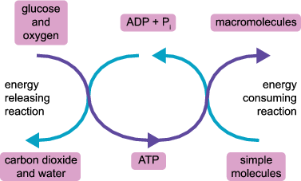
ATP = Energy Currency
ATP is ‘spent’ during cellular work such as muscular contraction or the formation of proteins, and is 'banked' or stored when glucose is broken down during cellular respiration.
Coupling of reactions

Slide 7
How is ATP made?
ATP comes from the breakdown of food (usually glucose) or from photosynthesis
Phosphorylation – the transfer of a phosphate to another molecule
Photophosphorylation..
uses light energy to transfer the phosphate (to the ADP)
Oxidative phosphorylation..
uses energy from oxidation (breakdown) of food to transfer the phosphate (to the ADP)

Slide 8
ATP
When glucose is broken down in a cell, it releases energy which is used to produce ATP.
ATP is made from joining a phosphate to ADP
The end phosphate bond contains a lot of energy which is released when broken off. This is used by cells to do work and carry out anabolic reactions
+

Slide 9
Quantity of ATP
An active cell needs about 2 million molecules of ATP per second to satisfy its energy requirements.
This is made possible by the rapid turnover of ATP: as fast as ATP is broken down to release its energy it is being regenerated from ADP and Pi (using the energy from respiration)
Only about 50g of ATP is stored in the body at any one time, but the body may be using it up and regenerating it at about 400g/hr.

Slide 10
ATP’s other role
ATP also has the role of carrying out phosphorylation reactions in cells (adding phosphates to things) in an enzyme controlled process.
For example, during glycolysis ATP is broken down to ADP + Pi and the phosphate group (Pi) is used to phosphorylate the substrate of glycolysis (glucose and its intermediates)

Slide 11
Oxidation and Reduction Reactions
OILRIG
Oxidation Is Loss (of Hydrogen)
Reduction Is Gain (of Hydrogen)

Slide 12
The chemistry of respiration
There are 3 sets of oxidation reactions in cellular respiration that release the energy contained in food
Glycolysis
The citric acid cycle
The electron transport chain

Slide 13
Respiration
Respiration is a series of enzyme controlled reactions that gradually release energy from food
During respiration, glucose is gradually broken down and hydrogen (+ electrons) are released at various stages along the pathway.
Each of these stages where hydrogen is released is controlled by an enzyme called dehydrogenase.
The hydrogen (+ electrons) combine with the coenzyme NAD to form NADH

Slide 14
Glycolysis
The stage, glucose → (2x) pyruvate, is called glycolysis and takes place in the cytoplasm

Slide 15
To start the process off, energy from two ATP molecules is needed.
This can be thought of as an energy investment phase where ATP is used to phosphorylate glucose (and intermediates) in glycolysis.
The series of reactions eventually produces four ATP molecules, so there is a net gain of two ATP from glycolysis (energy pay-off stage).
Dehydrogenase enzymes remove hydrogen ions (+ electrons) that are passed to a coenzyme called NAD. This is reduced to form NADH..
Later on the hydrogen in NADH will be used to produce ATP

Slide 16
2 ATP to start process
4 ATP produced
>>>Net gain of 2 ATP
>>> electrons also released
H+ ions released by dehydrogenase
These combine with hydrogen carrier NAD
>>>2 x NADH produced

Slide 17
Citric Acid Cycle
The second stage, pyruvate → oxaloacetate, is called Cytric Acid Cycle and takes place in the central matrix of the mitochondria

Slide 18
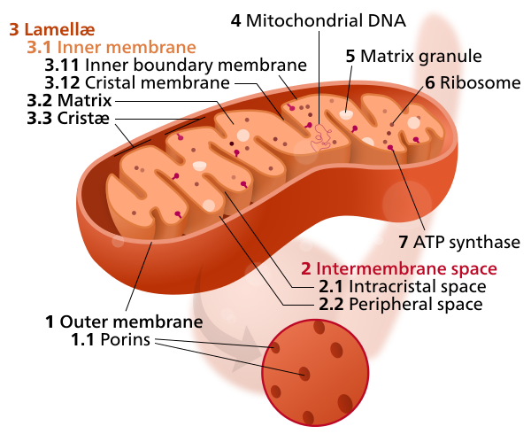
Double Membrane of Mitochondria
The mitochondria has a double membrane.
The inner fluid filled part is called the central matrix
The outer membrane is called the cristae

Slide 19
Reactions in the Mitochondria
The fluid filled central matrix of the mitochondria contains the enzymes involved in the Citric Acid Cycle.
The inner membrane is folded in to many cristae which provide a large surface area.
On the inner membrane the reactions of the Electron Transport Chain (ETC) occur

Slide 20
Citric Acid Cycle in Mitochondria
If oxygen is present (aerobic conditions) pyruvate is broken down to a small acetyl group. To prevent this diffusing away, the acetyl group combines with coenzyme A forming acetyl coenzyme A.
This transports the acetyl group into the citric acid cycle.

Slide 21
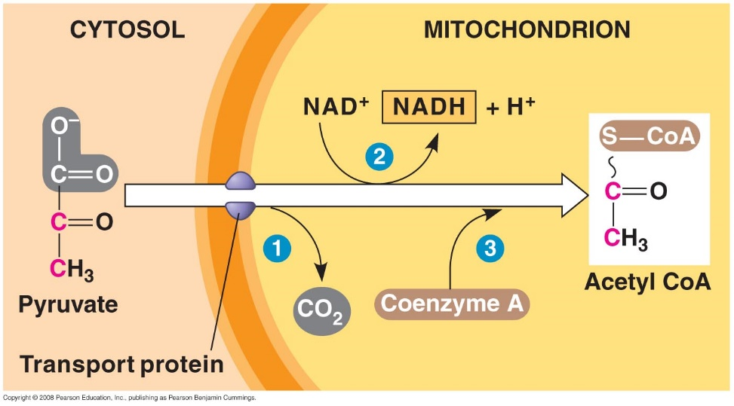
Citric Acid Cycle
Pyruvate preparation!
The 3 carbon pyruvate diffuses from the cytoplasm to the central matrix of the mitochondria.
Once inside the mitochondria, a carbon and two oxygen atoms are removed as waste carbon dioxide along with H ions + electrons
The molecule that remains is a 2-carbon acetate molecule (between steps 2 and 3)
Oxygen is not required for the Citric Acid Cycle to occur but one of the products (H ions) will require oxygen in the final stage (Electron Transport Chain)

Slide 22
Citric Acid Cycle
When carbon dioxide is removed from pyruvate to make acetate, extra electrons are produced. The coenzyme NAD+ captures these electrons and attracts H+ to balance the charge, forming a molecule of NADH. This NADH and the electrons will be used in the last stage of respiration to produce ATP
Because the acetate molecule produced from pyruvate is so small and can easily diffuse away, co-enzyme A is attached to it forming Acetyl CoA. This is now ready for the Citric Acid Cycle.

Slide 23
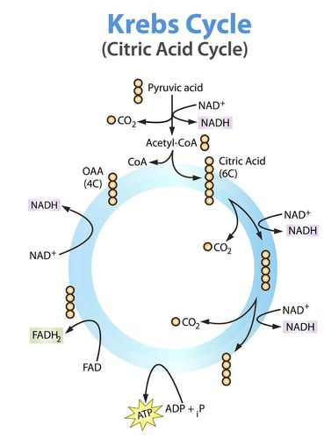
Citric acid cycle
Pyruvate
The acetyl group is released by the coenzyme A and the coenzyme A goes to get another acetyl group. The acetyl group that is released (2C) combines with oxaloacetate (4C) to form a molecule called citrate (6C).
citrate
oxaloacetate
NADH
NAD+

Slide 24
Citric acid cycle
Citrate then goes through a series of enzyme controlled steps back to oxaloacetate. As each carbon is lost from the citrate molecule a carbon dioxide molecule is released and hydrogen ions (+ electrons) are also released
Pyruvate
citrate
oxaloacetate
NADH
NAD+

Slide 25
Hydrogen ions and electrons become bound to coenzyme NAD to form NADH.
The hydrogen ions and the electrons from NADH are passed to the electron transport chain on the inner mitochondrial membrane
During part of this series of reactions, 1 extra ATP is produced
citrate
oxaloacetate
NADH
NAD+

Slide 26
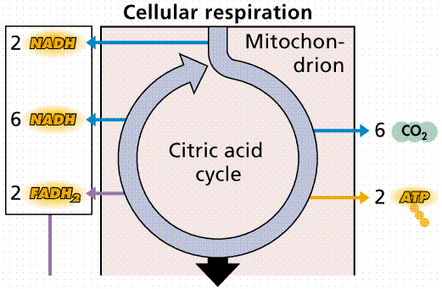
In total, for both pyruvates
10

