Slide 1
Metabolism & Survival
Key Area 1c
Enzyme Control of Metabolism

Slide 2
Learning Objectives
By the end of this topic you should be able to:
Understand that metabolic pathways are controlled by enzymes within the pathway
State that the rate of a pathway’s reaction is controlled by the rate of the enzymes reaction
state that the regulation of pathways can be mediated by signals from both within the cell and from outside the cell;
describe the relationship between the shape (configuration) and activity of an enzyme;
describe the 'induced fit' model of enzyme action;
explain the role and function of the active site;

Slide 3
explain what is meant by the term 'activation energy' and state that enzymes lower the activation energy of a reaction;
explain how the concentrations of both substrate and end product affect the rate of enzyme action;
understand that enzymes often act in groups or complexes;
explain why some genes are constantly expressed and how they are regulated;
describe inhibition of enzymes in terms of a change in configuration;
explain how metabolic pathways can be controlled through competitive and non-competitive inhibition of enzymes;
explain how metabolic pathways can be controlled by feedback inhibition of enzymes.

Slide 4
Enzyme control of Metabolic Pathways
Induced Fit
Competitive, Non-Competitive and Feedback Inhibition of Enzymes
Enzyme Induction

Slide 5
You should already know that:
Enzymes function as biological catalysts and are made by all living cells;
They speed up cellular reactions and are unchanged in the process;
The shape of the active site of enzyme molecules is complementary to a specific substrate

Slide 6
Enzyme Control of Metabolic Pathways
Metabolic pathways are controlled by the presence or absence of particular enzymes.
The regulation of the rate of reaction of these enzymes also plays a role in the control of metabolism.

Slide 7
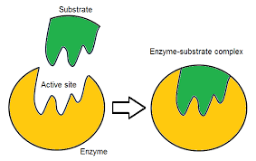
Enzyme Active Site
Enzymes have an active site where the substrate binds and the reaction is catalyzed.
The active site is specific to the substrate(s)

Slide 8
Why are enzymes needed?
Energy is required to initially break bonds for a reaction to happen
The energy required to start a chemical reaction is known as the ‘Activation energy’

Slide 9
A chemical reaction may involve the joining together of simple molecules into more complex ones or the splitting of complex molecules into simpler ones.
Either way, energy is required to initially break the bonds (activation energy) in the reactants to form an unstable compound. The molecules are now in the transition state.
When bonds are made to form the product, energy is released.
Enzymes serve to lower the activation energy needed for a reaction to proceed.
Thus, biochemical reactions are able to proceed rapidly at relatively low temperatures.

Slide 10
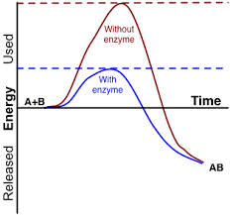

Slide 11
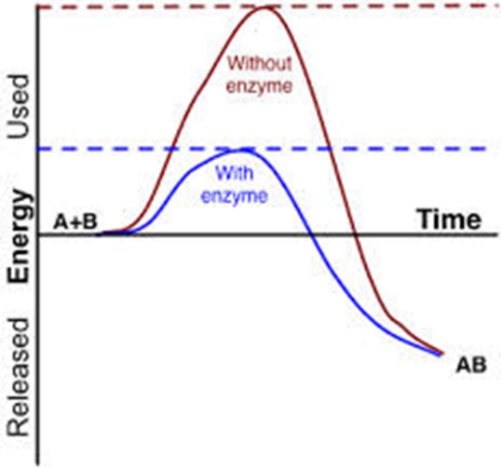
Activation Energy
Without an enzyme or catalyst the energy needed to start the reaction is large and so the reaction is slow
With an enzyme, the energy required is lowered and the reaction is quicker

Slide 12
In earlier biology you were taught..
That the enzyme and substrate fit together like a lock and key.. this is not the reality.

Slide 13
Induced fit model
The active site is not rigid, it is a flexible structure.
It alters it’s shape to fit the substrate
Induced Fit Model of Enzyme Action

Slide 14
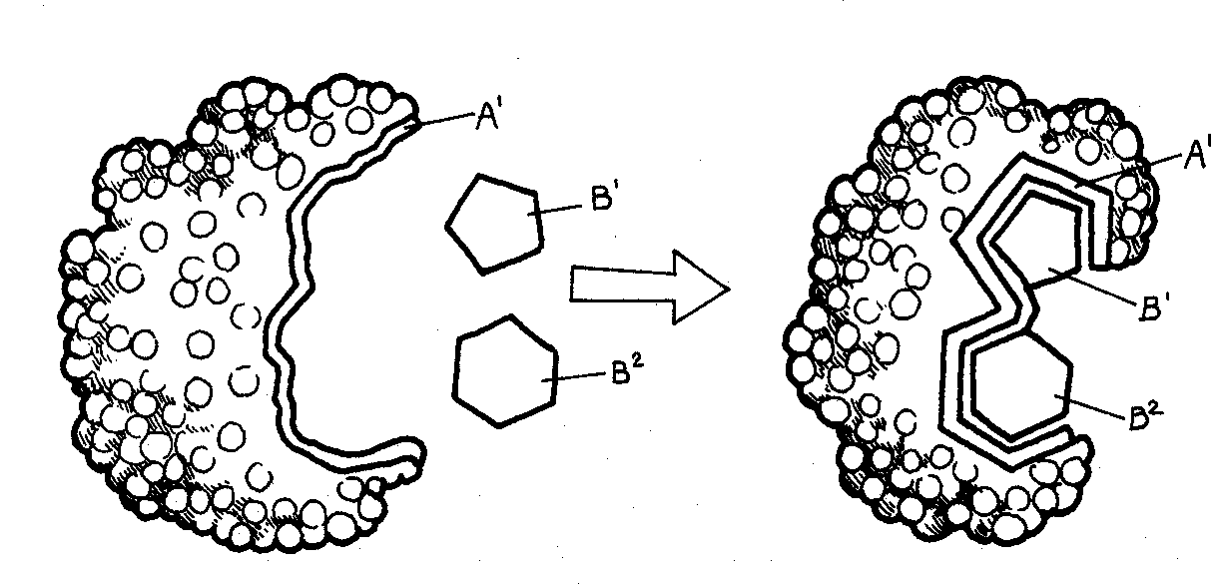
Induced fit occurs when the active site changes shape to better fit the substrate after the substrate binds
The induced fit ensures that the active site comes into very close contact with the molecules of substrate and increases the chance of a reaction taking place

Slide 15
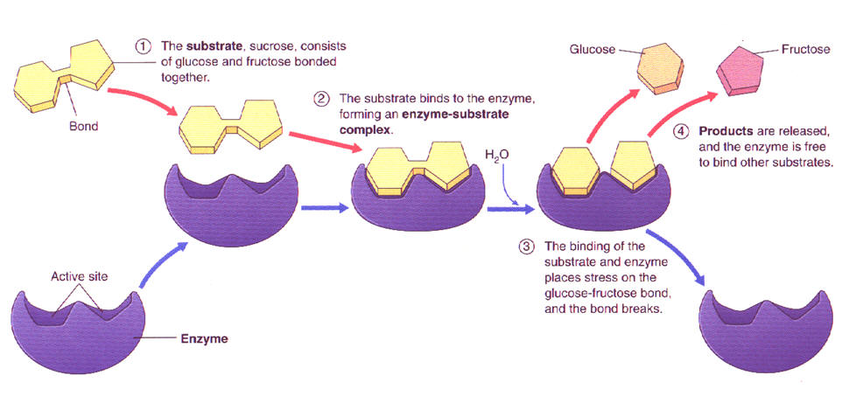

Slide 16
Enzyme – Substrate Complex
Before the reaction occurs, the active site of the enzyme has a high affinity for the substrate(s)
The change in shape of the active site helps the reaction occur as it orients the substrate in the right way for the reaction to occur.
When the reaction is complete the products have a low affinity for the active site and diffuse away

Slide 17
Enzyme – Substrate Complex

Slide 18
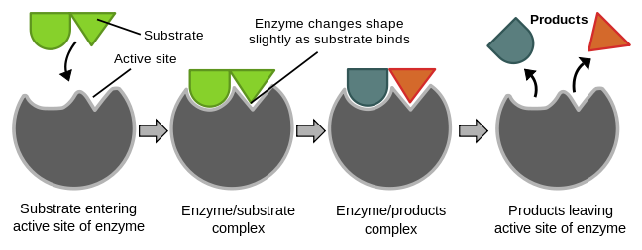
The active site holds the substrate(s) together in an induced fit.
The chemical bonds in the reactants are weakened, the activation energy is reduced.

Slide 19
3. The products now have a low affinity for the active site and are released from the active site.
4. The enzyme is free to repeat the process.

Slide 20
Factors affecting enzyme action
Temperature
pH
An inadequate supply of substrate or the presence of an inhibitor.

Slide 21
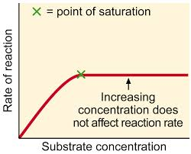
Effect of substrate and enzyme concentration on enzyme activity
Low concentration of substrate – too few substrate molecules present to make use of all the active sites on the enzyme molecules.
Increasing substrate concentration leads to an increase in reaction rate as more active sites are involved.
Further increase in substrate concentration does not increase rate of reaction further (graph levels off) since all the active sites are occupied.
The enzyme concentration has become a limiting factor.

Slide 22
Effect of substrate and enzyme concentration on enzyme activity
As some metabolic reactions are reversible, the presence of a substrate or the removal of a product will drive a sequence of reactions in a particular direction

Slide 23
Enzyme activity
Some enzymes are always present due to constant gene expression (eg, those required for respiration). This means their activity needs to be controlled.
One method of controlling enzyme activity is the binding of other molecules which will inhibit the enzyme

Slide 24
Enzyme Inhibitors
Enzyme inhibitors reduce the rate of an enzyme catalysed reaction by interfering with the enzyme in some way. This effect may be permanent or temporary.

Slide 25
Competitive Inhibition
Competitive inhibitors bind at the active site of an enzyme and so prevent the substrate from binding.
They fit into the active site, but no reaction occurs since they are not the exact same shape as the substrate.
Therefore, less substrate molecules can bind to the enzymes so the reaction rate is decreased.

Slide 26
Competitive Inhibition

Slide 27
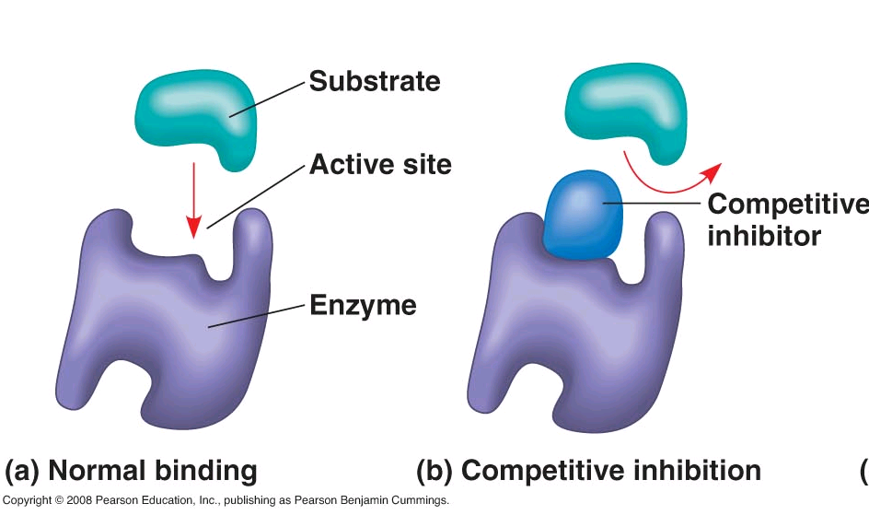

Slide 28
Competitive Inhibition
Competitive inhibition is usually temporary and can be reversed by increasing substrate concentration.
Adding more substrate increases the chance of the substrate reaching the active site before the inhibitor and thereby overcoming competitive inhibition.

Slide 29
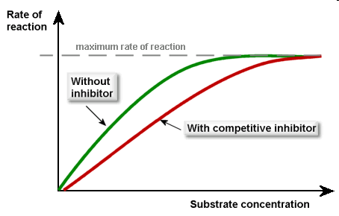
Vmax
The maximum rate of a reaction is known as the Vmax.
The graph opposite shows that when a competitive inhibitor is present, the Vmax can still be reached although it will require a higher substrate concentration

Slide 30
Non-competitive inhibition
Non-competitive inhibitors bind away from the active site but change the shape of the active site preventing the substrate from binding.
Non-competitive inhibition may or may not be reversible

Slide 32
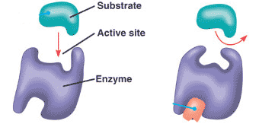
The change in the 3D tertiary structure of the enzyme means that it can no longer catalyse a reaction.
Since they do not compete directly with substrate molecules, non-competitive inhibition cannot be reversed by increasing substrate concentration

Slide 33
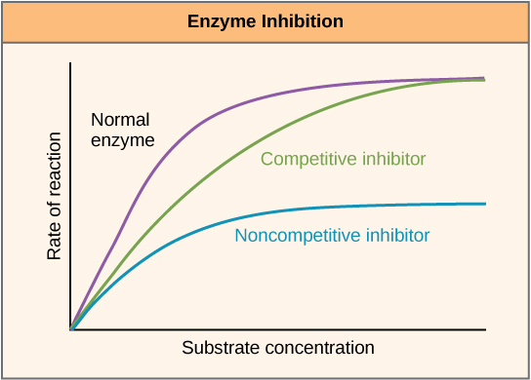
Vmax
With a non-competitive inhibitor, the Vmax will never be reached even if substrate concentration is increased
1/2Vmax
Km

Slide 34
Vmax – the most activity an enzyme will give (at a certain concentration of enzyme)
All active sites of all enzymes have substrate attached
Km – found at ½ Vmax and shows the affinity an enzyme has for a substrate (a lower Km means a higher affinity)

Slide 35
Feed Back Inhibition
The activity of some enzymes, particularly those involved in metabolic pathways, are controlled by a self-regulating mechanism.
Some specific substances, most often the end-product itself, acts as an inhibitor.

Slide 36
Feedback Inhibition
Feedback inhibition (end-product inhibition) occurs when the end-product in the metabolic pathway reaches a critical concentration.
The end product then inhibits an earlier enzyme, blocking the pathway and so prevents further synthesis of the end-product

Slide 37
Feedback inhibition
Threonine
x
The amino acid Isoleucine is made through conversion of threonine in 5 enzyme controlled steps in bacteria.
As isoleucine builds up, it binds to enzyme 1 inhibiting further production of isoleucine. By doing this the cell produces only the isoleucine that is needed.
Enz 1
Intermediate 1
Enz 2
Intermediate 2
Enz 3
Intermediate 3
Enz 4
Intermediate 4
Enz 5
Isoleucine

