Slide 1
Metabolism & Survival
Key Area 1a
Metabolic Pathways

Slide 2
Learning Intentions
By the end of this topic you should be able to:
Understand that metabolism is the sum total of all chemical reactions taking place within an organism
Describe how reactions occur in sequences, each one mediated by a specific enzyme
Describe these sequences as pathways and explain how they are linked and may be reversed
Explain the differences between anabolic and catabolic pathways

Slide 3
Anabolic and Catabolic Reactions Reversible and Irreversible reactions Alternative Pathways

Slide 4
You should already know that:
The cell membrane consists of lipids and proteins and is selectively permeable
Enzymes speed up cellular reactions and are unchanged in the process

Slide 5
Metabolism
All of the chemical reactions that take place in the cell make up the cells metabolism
It involves reversible and irreversible steps (sometimes with alternative routes) and it is all controlled by enzymes

Slide 6
Metabolic Pathways
Metabolic pathways are integrated and controlled pathways of enzyme-catalysed reactions within a cell.
There are 2 types of reaction within a metabolic pathway…Anabolic and Catabolic

Slide 7
Anabolic & Catabolic Reactions
Reactions that build up large complex molecules from simpler smaller molecules are known as anabolic reactions and so require energy.
Reactions that break down large complex molecules into simpler smaller molecules are known as catabolic reactions and so release energy.
Energy is moved in cells in the form of ATP

Slide 8
The two types of metabolic pathway
Glucose + oxygen
Protein
catabolic pathway
anabolic pathway
energy
CO₂ + water
Amino acids

Slide 9
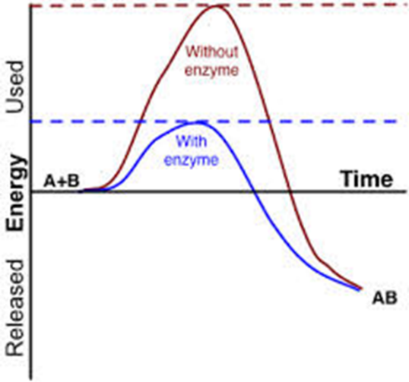
Activation Energy
Without an enzyme or catalyst the energy needed to start the reaction is large and so the reaction is slow
With an enzyme, the energy required is lowered and the reaction is quicker or it can take place at a lower temperature

Slide 10
Consider the following metabolic pathway:
Gene(s)
Gene(s)
Enzyme 1
Enzyme 2
Metabolite A
Metabolite B
Metabolite C
Each step is driven by a specific enzyme
Each enzyme is coded for by a gene or genes.
If the correct enzyme is present then the pathway proceeds.

Slide 11
Consider the following metabolic pathway:
Gene(s)
Gene(s)
x
Enzyme 1
Enzyme 2
x
Metabolite A
Metabolite B
Metabolite C
If one enzyme is absent the pathway will stop.
Enzyme action can be regulated by the level of gene expression….if the gene does not function/is not expressed correctly then the enzyme is not produced

Slide 12
Respiration Example
glucose
Enzyme A
Glycogen
(mammals)
intermediate 1
Starch (plants)
Enzyme B
intermediate 2
Enzyme C
intermediate 3
Many steps, many enzymes
pyruvate

Slide 13
Reversible and irreversible steps
Enzyme A
Glucose
Intermediate 1
IRREVERSIBLE
Glucose diffuses from a high concentration outside the cell to a low concentration inside the cell, then it is converted to intermediate 1.
This reaction is irreversible
It is of benefit to the cell as it maintains a low concentration of glucose inside the cell and therefore allows glucose to diffuse constantly into the cell.

Slide 14
Reversible and irreversible steps
Glycogen (mammals)
Enzyme B
Intermediate 1
Intermediate 2
REVERSIBLE
Starch (plants)
The conversion of Intermediate 1 to Intermediate 2 is reversible.
If more intermediate 2 if formed than the cell needs for the next step then some can changed back into intermediate 1 and used in alternative pathway
e.g to build glycogen in animal cells or starch in plant cells.

Slide 15
Reversible and irreversible steps
Enzyme C
Intermediate 2
Intermediate 3
IRREVERSIBLE
The conversion of Intermediate 2 to Intermediate 3 is irreversible.
Intermediate 3 will always be converted to pyruvate (through many further steps).

Slide 16
Alternative routes
glucose
Pathways can be modified and contain alternative routes, so steps can be bypassed.
Enzyme A
intermediate 1
Alternative route
Enzyme B
intermediate 2
sorbitol
Enzyme C
intermediate 3
Many steps,
many enzymes
pyruvate

Slide 17
Alternative routes
Enzymes often work in groups or as multi-enzyme complexes as it allows many complex steps to be undertaken and ensures a higher concentration of substrates close to the specific enzyme active sites
glucose
Enzyme A
intermediate 1
Alternative route
Enzyme B
intermediate 2
sorbitol
Enzyme C
intermediate 3
Many steps,
many enzymes
pyruvate

