Slide 1
DNA and the Genome
Key Area 6a & b
Mutations

Slide 2
Learning Intentions
By the end of this topic you should be able to:
(a) Mutations
Define ‘mutation’ and describe the effect of one
(b) Single gene mutation
Define ‘single gene mutation’
Name 3 single gene mutations
Describe 3 single gene mutations
Name 3 single-nucleotide substitutions
Explain the difference between missense, nonsense and splice-site mutations
Describe the effects of missense, nonsense and splice-site mutations
Describe 2 possible effects of nucleotide insertions or deletions

Slide 3
Mutations

Slide 4
What is a mutation?
A mutation is a change in the DNA that can result in no protein or an altered protein being synthesised
There are two main type of mutations:
Single Gene mutations
a change in the order of bases on a strand of DNA
Chromosome mutations
a change in the chromosome structure
If a mutation causes a change in phenotype the individual is called a mutant

Slide 5
Mutant Alleles
Mutant alleles are random, spontaneous and rare
They usually result in one of the following:
No protein being produced
An altered protein being produced
Mutations are normally harmful or even lethal but occasionally can be beneficial
The rate of a mutation occurring can be increased by mutagenic agents such as radiation, cigarette smoke, UV light and high temperatures
Most mutations are recessive and they are the only source of new characteristics which drive evolution forward

Slide 6
Single Gene Mutations
Single gene mutations involve the alteration of a DNA nucleotide sequence. There are three types of gene mutation:
Insertion of nucleotide(s)
Deletion of nucleotide(s)
Substitution of nucleotides
If in an exon, the result of these mutations is that 1 (or more) codons and therfor 1 (or more) amino acid(s) is altered which causes a change in the protein synthesised.

Slide 7
Gene mutations
Normal Base Sequence | Type of Mutation | Altered Gene Code | Protein produced | Effect of Mutation
AGAGTC | INSERTION | AGATGTC | Greatly changed due to frameshift mutation i.e. everything from that point on is altered | Non –functional protein e.g. cystic fibrosis
 | DELETION | AGGTC
 | SUBSTITUTION | AGATTC | May only be slightly changed due to a single base (only one amino acid altered) | Protein function altered e.g. sickle cell anaemia

Slide 8
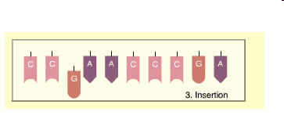
Insertion
An extra base is inserted to a strand of DNA and all the other bases are shifted along.

Slide 9
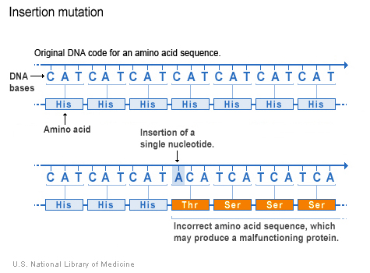
Effect on protein produced
This insertion results in a frameshift mutation.
All of the codons and all of the amino acids after the mutation are changed. This has a major effect on the structure of the protein produced.

Slide 10
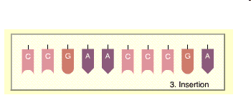
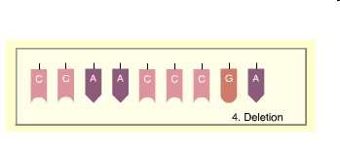
Deletion
A base is deleted on a strand of DNA and all the other bases are shifted along.

Slide 11
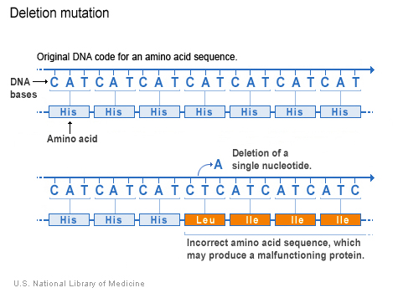
Effect on protein produced
This deletion also results in a frameshift mutation.
All of the codons and all of the amino acids after the mutation are changed. This has a major effect on the structure of the protein produced.

Slide 12
Frameshift Mutations – Insertion & Deletion
These gene mutations are called frameshift mutations and bring about a major change by affecting many amino acids.
A completely different protein is produced and so the organism is affected greatly, sometimes causing death
e.g. albanism - albino plants can’t photosynthesis so die.

Slide 13
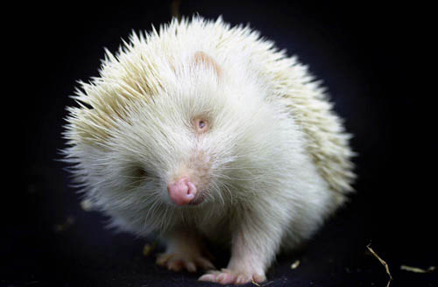

Slide 14
Cystic Fibrosis- Base Sequence Deletion
Cystic Fibrosis is a genetic disorder that affects the pulmonary system of those affected. It is caused by a single gene deletion mutation
Three bases are deleted in the gene which codes for a glycoprotein (component of mucus) located on chromosome 7
The abnormal protein produced results in abnormally thick, sticky mucus causing congestion and blockages

Slide 15
The cystic fibrosis DF508 mutation
The diagram shows the normal and mutated proteins resulting from this gene mutation
The normal protein (CFTR) has phenylalanine (F) at position 508 but the mutant form has this deleted, causing the protein to fold incorrectly.

Slide 16
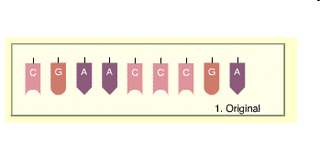
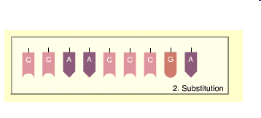
Substitution
One base changed for another on a strand of DNA, one codon affected.

Slide 17
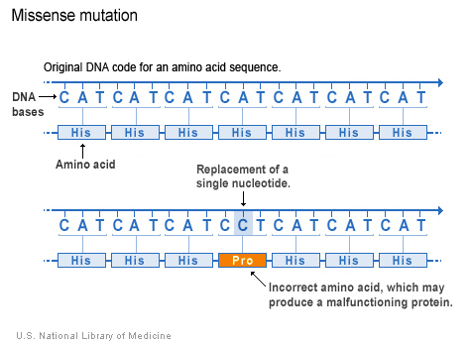
Effect on protein produced
Only 1 nucleotide is affected and so only one amino acid in the protein will be affected
This is known as a point (base) mutation

Slide 18
Point Mutations - Substitution
These gene mutations are called point (base) mutations and can bring about a minor change to the protein:
As it only affects 1 amino acid the protein is usually (but not always) still functional and so the organism is only affected slightly or not at all
However, it can cause a major defect if the mutation is at a critical position in the protein e.g. sickle cell anaemia
Sickle Cell Point Mutation

Slide 19
Types of Point (Base) Mutations
Point (base) mutations can be classified depending on the effect they have on the sequence of amino acids in the protein produced.
There are 3 main types:
Missense Point Mutations
Nonsense Point Mutations
Splice-site Mutations

Slide 20
Missense Point Mutations
The alteration of one base in the codon by a substitution results in one amino acid being changed for another. This may result in a non-functional protein or have little effect on the protein depending on which amino acid is changed.
Nonsense Point Mutations
The alteration of one base in the codon by a substitution results in the amino acid being changed into a stop codon (UAG UAA UGA) which stops protein synthesis prematurely and results in a shorter than normal protein being made.

Slide 21
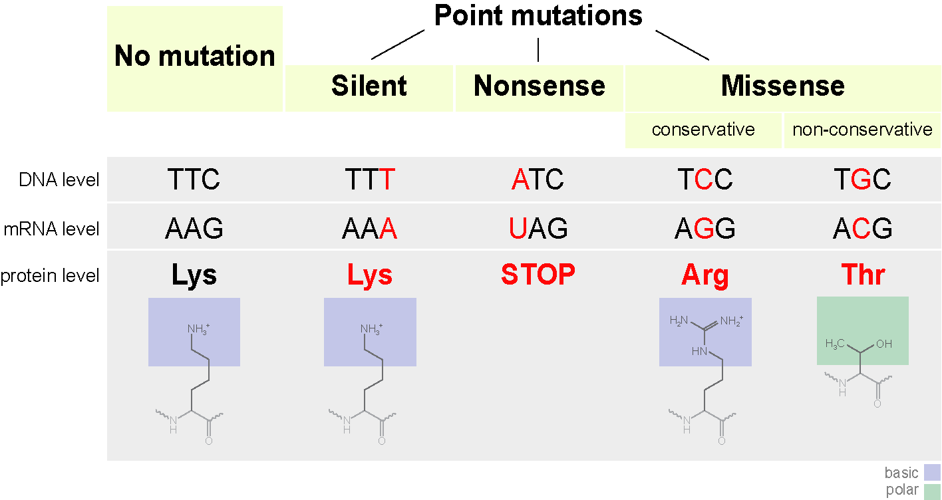
Neutral

Slide 22
Splice Site Mutations
The mutations we have considered until now are all found in the coding regions of DNA (exons)
However, mutations that occur in the non-coding introns can still affect protein function
A splice site mutation is one that substitutes, inserts or deletes one or more nucleotides at a site where introns are usually removed from the primary mRNA

Slide 23
Splice Site Mutations
If a mutated splice site is made non-functional, one or more introns may be left in the mature mRNA and/or some exons will be excluded from the mature mRNA
This will in turn result in the mRNA being translated in such a way that the protein produced will not function properly

Slide 24
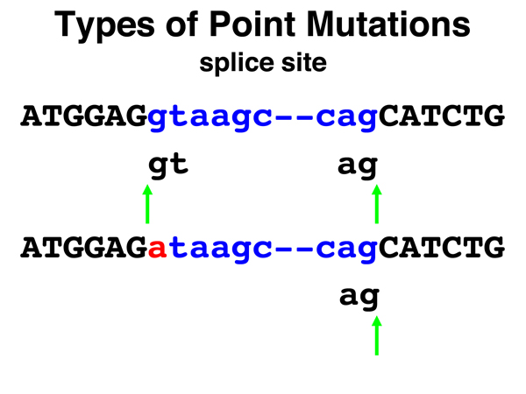
The top sequence shows two exons (in capitals) separated by an intron sequence (lower case)
The intron is usually cut out as the enzyme recognises a particular sequence at the start and end of the intron
The bottom sequence shows a splice site mutation. As the usual recognition sequence is missing, the intron is not cut out
This means the mature mRNA produced will differ greatly from the normal

Slide 25
Thalassemia, a disease caused by a defect in haemoglobin synthesis, is caused by a splice site mutation.
Intron
Exon
Normal splicing
Abnormal splicing
Normal functional haemoglobin with 4 oxygen carrying subunits
Haemoglobin with only 2 oxygen carrying subunits

Slide 26
Point Mutation - Intron
Point mutations can also occur in non-coding regions of the DNA (introns).
If this mutation is in a part of the intron that regulates gene expression it can have a major effect on the protein
Regulator sequence
RNA polymerase ready to start transcription

Slide 27
Point Mutation - Intron
Regulator sequence
Normal protein transcription
RNA polymerase ready to start transcription
No protein transcription as regulator does not bind RNA polymerase
Regulator sequence mutation
RNA polymerase not bound to start transcription

