Slide 1
DNA and the Genome
Key Area 7c
Speciation

Slide 2
Learning Intentions
By the end of this topic you should be able to:
(c) Speciation
Define ‘species’
Define ‘speciation’
Explain the role of isolation in speciation
Name 3 types of isolation barriers
Describe the difference between allopatric and sympatric speciation
Give an example of allopatric evolution of a species
Give an example of sympatric evolution of a species
Explain the role of mutation in speciation
Explain the role of selection in speciation

Slide 3
Speciation

Slide 4
Species Definition
A species is a group of organisms capable of interbreeding and producing fertile offspring, and which does not normally breed with other groups
They are genetically isolated and cannot produce viable, fertile offspring with members of other groups
The number and kinds of species are always changing due to extinction and speciation

Slide 5
Speciation
Speciation is the generation of new biological species by evolution as a result of isolation, mutation and selection
There are 2 types of speciation:
Allopatric Speciation
Sympatric Speciation

Slide 6

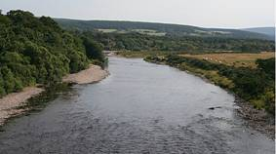
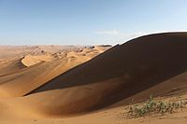
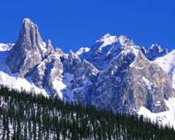
Allopatric Speciation
Gene flow between 2 (or more) populations is prevented by a geographical barrier
Examples of geographical barriers include:
River
Mountain range
Desert
Sea

Slide 7
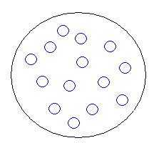
In summary…
The members of a large population of a species occupy an environment
They share the same gene pool and interbreed freely

Slide 8
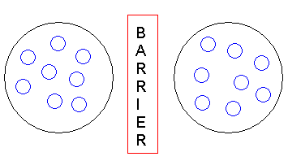
The population is split into two completely isolated sub-populations by a geographical barrier
This prevents interbreeding and gene flow
Population A
Population B

Slide 9
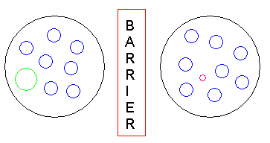
Different mutations occur at random in each population
This results in new variation within each group which is not shared by both groups
Large mutant
Small mutant

Slide 10
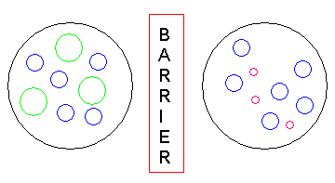
Different selection pressures occur on each group due to different environments (climate, predation, disease…)
Natural selection occurs in each of the 2 sub-populations
e.g. Large mutant may favour dry conditions
e.g. Small mutant may favour wet conditions

Slide 11
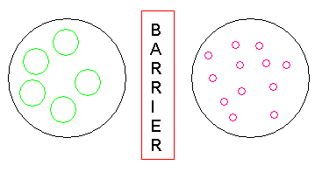
Over a long period of time natural selection increases/decreases the frequency of specific alleles
The two groups gene pools are so altered the groups become genetically distinct and isolated
Species A
Species B

Slide 12
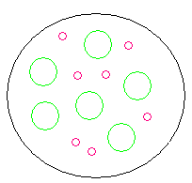
Speciation has occurred
Species A and B cannot interbreed even if barrier is removed
2 separate distinct species have evolved

Slide 13
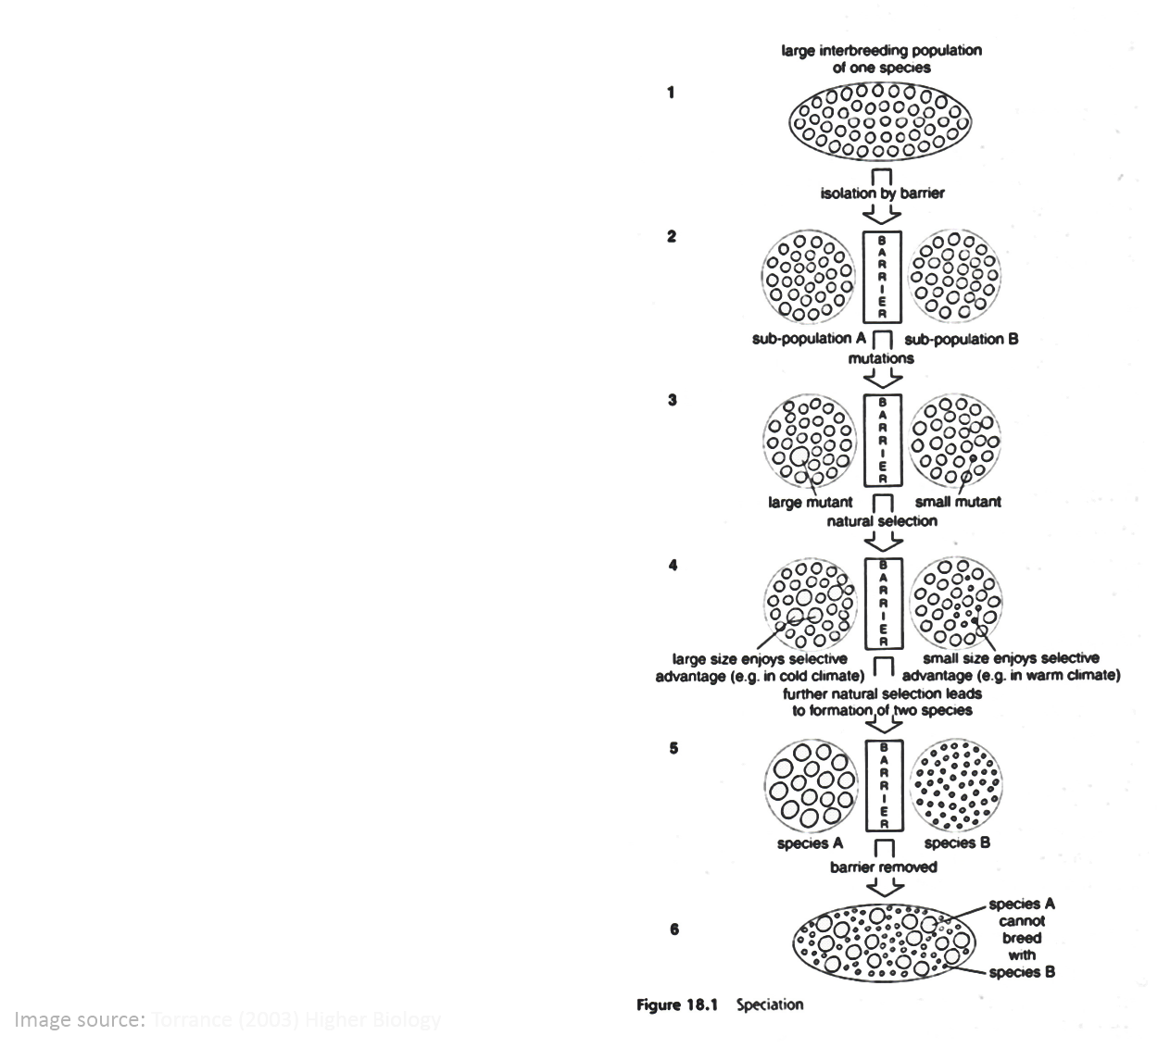

Slide 14
Sympatric Speciation
In sympatric isolation, the 2 (or more) populations still live in close proximity in the same environment but they have become isolated due to:
Behavioural barriers
Ecological barriers
Disruptive selection (2 distinct groups) promotes this type of speciation

Slide 15
In summary
One large interbreeding population sharing the same ecological niche.
(e.g. Fruit flies living on hawthorn bushes)

Slide 16
An alternative ecological/behavioural niche appears
(e.g. new species of apple tree introduced by humans)
Some members of the population start to exploit the new niche

Slide 17
The two populations now exploit different resources (e.g. food source) and no longer interbreed.
Behaviour has become an isolating barrier.

Slide 18
Mutants better adapted to exploit the new resources appear and successfully breed.
(e.g. better camouflaged on apples)

Slide 19
Natural selection favours the new mutants and eventually over a period of time two genetically distinct species are formed which can no longer interbreed.

