Slide 1
DNA and the Genome
Key Area 2b
Polymerase Chain Reaction (PCR)

Slide 2
The polymerase chain reaction (PCR)

Slide 3
Learning Intentions
By the end of this topic you should be able to:
Describe the purpose of PCR
Explain how primers are chosen for a particular PCR
Explain what is involved in the ‘thermal cycling’ of PCR
Describe the role of heat tolerant DNA polymerase (e.g. Taq polymerase) in PCR
Describe 3 practical applications of PCR

Slide 4
Human Genome Project
Scientists from different countries have worked together since the early 90s in a combined effort to sequence the whole of the human genome
With over 3 billion nucleotides this was a massive undertaking but as the project proceeded, the massive leaps forward made with DNA equipment and analysis programmes made this a lot easier and faster than was first thought.
This topic will look at some of these advancements as well as applications of the project

Slide 5
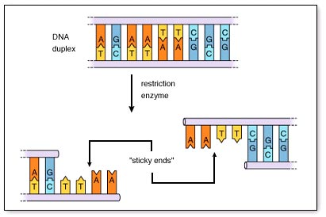
DNA Enzymes
The following enzymes are essential when working with DNA:
Polymerases (DNA / Taq)
Ligase
Endonuclease
    Breakdown of nucleic acid polymers into nucleotides

Slide 6
Polymerases and Ligase Enzymes
DNA polymerase elongates DNA by addition of nucleic acid (nucleotides)
Ligase joins 2 polymers (chains of nucleic acids) together (eg Okazaki fragments)

Slide 7
Taq Enzyme (Polymerase)
This is a special type of polymerase which has been cloned (copied) from Thermus aquaticus bacterium which is an organism that lives and survives at extreme high temperatures
It is an essential endonuclease as it is thermostable – does not denature at high temperatures (approx. 92ºC)

Slide 8
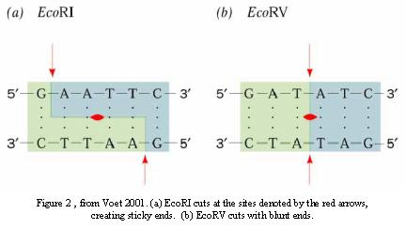
Restriction Enzymes
Endonucleases that usually cut the DNA by breaking phosphodiester bonds (bonds between nucleotides) at a specific sequence

Slide 9
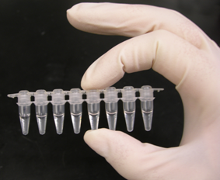
What is PCR (Polymerase Chain Reaction)?
PCR amplifies DNA using complimentary primers for specific target sequences In vitro = in glass.

Slide 10
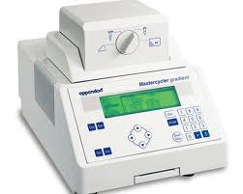
Polymerase Chain Reaction (PCR)
This technique allows us to amplify small, specific fragments of DNA and requires:
- DNA template
- Primers: short strands of nucleotides
which are complimentary to specific
target sequences at the 2 ends of
the DNA to be amplified
- DNA nucleotides: (A T C G)
- Taq Enzyme (polymerase)
- Buffer
- Thermal cycler machine

Slide 11
Primers
To perform PCR, a unique 10-20bp sequence on either side of the sequence to be amplified must be known because DNA polymerase can only add nucleotides to a ready made chain. This short sequence is called a primer and it is specific to the DNA to be copied

Slide 12
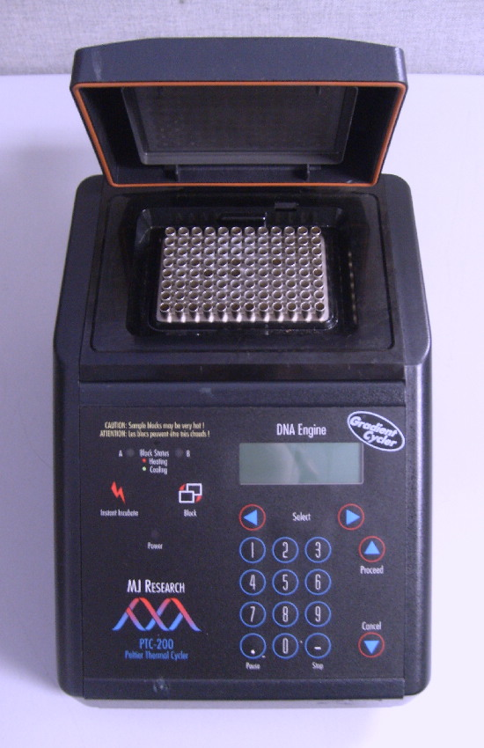
Thermal Cycler
This automated machine carries out all the stages of PCR.
A tube containing template DNA, primers, nucleotides, enzymes, buffer…is placed in machine and the following steps are performed by the cycler

Slide 13
Polymerase Chain Reaction (PCR) terminology
Denaturing
  Breaking the hydrogen bonds between strands of DNA to give single stranded DNA
  Requires a high temperature (approx. 92ºC) to break these bonds (but stronger ‘covalent backbone’ bonds will not be affected)
Annealing (hybridising)
  Reforming a double helix by lowering the temperature again so that complementary bonds reform

Slide 14
PCR
Repeated cycles of heating and cooling within the thermocycler machine are used to amplify the target region of DNA:
  DNA is heated to between 92 - 98ºC to break the hydrogen bonds between base pairs and separate the template DNA strands
  DNA is cooled to between 50 - 65ºC to allow the 2 primers to bind to target sequences on the DNA template strands
  DNA is heated to between 70 - 80ºC for heat-tolerant Taq DNA polymerase to replicate the regions of DNA (optimum temp).
  (1 2 4 8 16 32 64….)
  animation of PCR

Slide 15
The first cycle
5’
3’
Single copy of DNA
3’
5’
Step 1: The DNA is heated at approx. 92 - 98ºC for a few seconds. This causes the DNA to denature and the strands to separate.

Slide 16
5’
3’
5’
3’
PCR primer
3’
5’
3’
5’
Step 2: The DNA is cooled to approx. 50-65ºC for a few seconds. This allows short primers to bond to the separated DNA strands.

Slide 17
5’
3’
3’
5’
5’
3’
3’
5’
Step 3: The DNA is heated again to between 70 - 80ºC for a few minutes. This allows a heat-tolerant DNA polymerase to replicate the region of DNA.

Slide 18
5’
3’
3’
5’
5’
3’
3’
5’
Step 4: Heat the DNA up to 92 - 98ºC again.

Slide 19
5’
3’
5’
3’
5’
5’
3’
3’
3’
3’
5’
5’
3’
5’
3’
5’
Step 5: Cool to between 50 – 65ºC again. The primers now bond to the original fragments and the copies.

Slide 20
5’
3’
3’
5’
3’
5’
3’
5’
3’
3’
3’
3’
5’
3’
5’
3’
5’
3’
3’
5’
Step 6: Heat to 70-80ºC again. The DNA polymerase copies the DNA again. The process is copied over and over again for roughly 20-30 cycles.

Slide 21
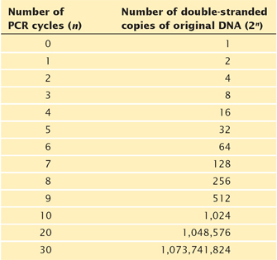

Slide 22
Gel Electrophoresis
After PCR, the DNA produced can be cut with specific endonucleases (enzymes) to produce different sized bands.
These bands can be separated using Gel Electrophoresis:

Slide 23
Gel Electrophoresis
This technique separates fragments of different length
The DNA sample is placed into a well of a gel which has been immersed in buffer solution
As DNA is negatively charged, applying a current through the gel moves the fragments through the gel
  DNA moves to the positive electrode
Shorter fragments are able to move faster and therefore further through the gel
A DNA ladder (contains fragments of known size) is usually run in a separate lane for fragment identification

Slide 24
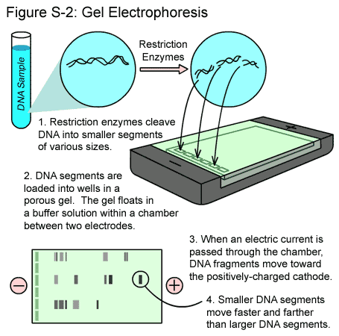

Slide 25
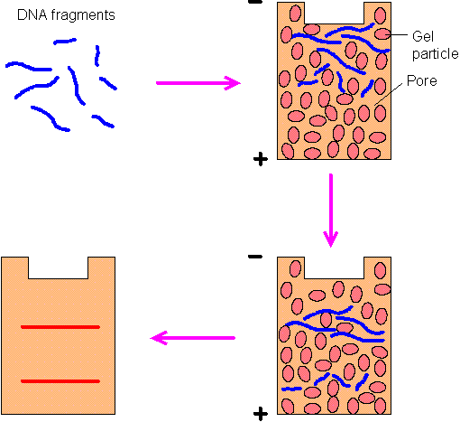
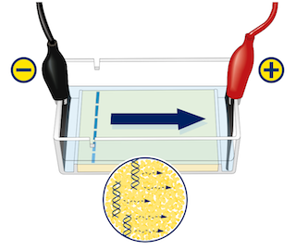

Slide 26
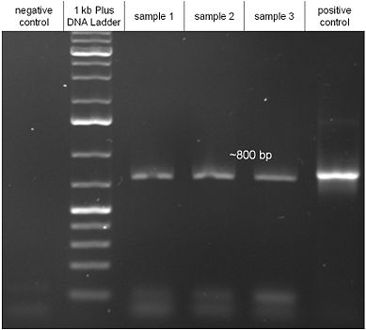

Slide 27
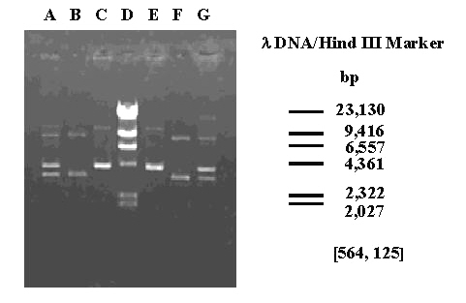
DNA Gel Electrophoresis Ladder
molecular markers of known length in lane D allow the size of unknown fragments in the other lanes to be determined

Slide 28
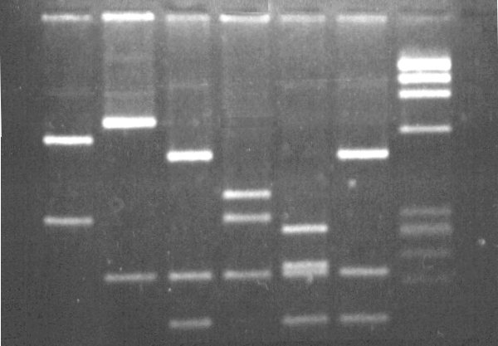

Slide 29
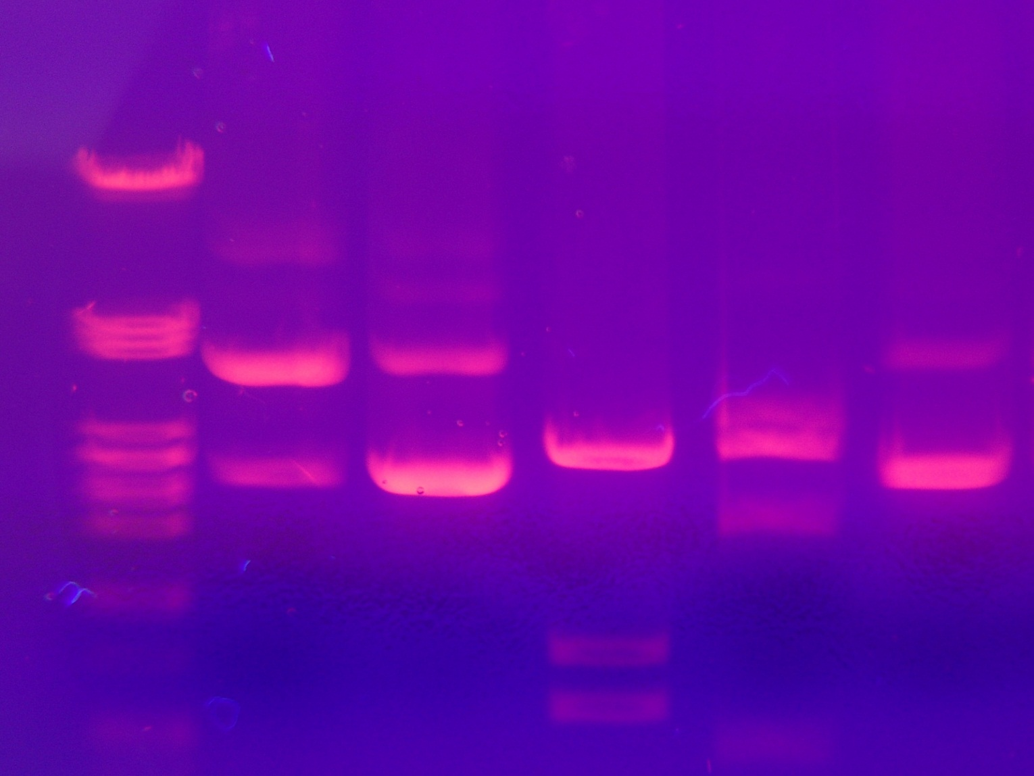
Sometimes the DNA is labelled with fluorescent markers to make it more visible under uv light

Slide 30
Uses of PCR
Forensics (solve crimes)
Settle paternity suits
Screening for genetic disorders

Slide 31
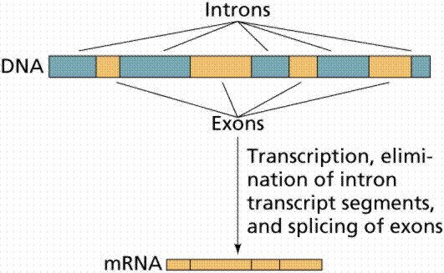
Forensic DNA profiling
Every person’s DNA is different as there are non-coding regions (introns) between genes (exons) that differ from person to person

Slide 32
Forensic DNA profiling
These differences can be used for:
  Genetic fingerprinting:
  This establishes the differences between genomes of individuals and can be used as proof that people were present at a crime scene (not that they committed the crime!)
  Paternity tests
  Diagnose genetic disorders

Slide 33
Forensic DNA profiling
The DNA sequence within the “junk” DNA (between genes) vary more than between the DNA required to make the protein
The most variable DNA is in short repeats – sequences that are repeated various number of times
These repeat sequences are inherited and the size varies from individual to individual and so can be used for identification purposes

Slide 34
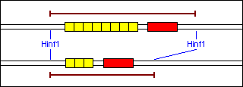
If you take the same intron sequence containing a variable repeat from 2 people and cut both with an enzyme, there will be a difference in size of the bands produced as the repeat sequence is different
The repeat sequence (in yellow) is different for the 2 individuals and so 2 different sized bands would be produced if run on a gel

Slide 35
Stages in profiling
DNA samples are isolated, amplified by PCR then digested with an enzyme which cuts around the variable size sequence
The fragments are separated by electrophoresis and compared to known sized samples or samples from victims/suspects

Slide 36
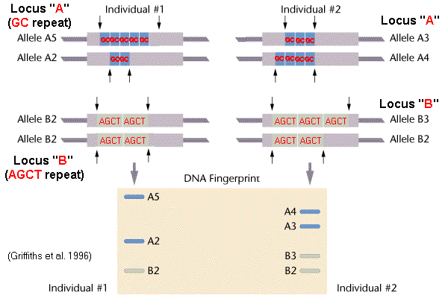
Most people are heterozygous and so will produce 2 different sized bands for each repeat sequence

Slide 37
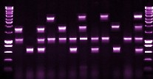
DNA from suspects – but who would you question?
1
2
3
4
5
6
7
8
9
10
11
DNA from crime scene

Slide 39
Screening for Genetic Disorders
As the majority of the human genome is now known, any change to the DNA sequence (mutation) that results in a genetic disorder can now be detected.
This allows proper diagnosis, treatment and counselling to be provided
One example of this is the genetic test for Cystic Fibrosis

Slide 40
Cystic Fibrosis
Cystic fibrosis (CF) is the most common genetic disease in the UK, affecting about 1 in 2500.
It is caused by a mutation in the gene for a channel protein called CFTR
The gene is located on chromosome 7, and there are actually over 300 different mutations known.
The most common mutation is a deletion of three bases, removing one amino acid out of 1480 amino acids in the protein.
This deletion results in a shorter band than normal being produced after PCR and electrophoresis

Slide 41
The cystic fibrosis DF508 mutation (2)
Diagram shows the normal and mutated proteins.
Normal CFTR has phenylalanine (F) at position 508.
In the mutant form this is deleted, causing the protein to fold incorrectly.

Slide 42
Test for cystic fibrosis defective allele
A short sequence that spans the mutated region is amplified using the polymerase chain reaction.
In lane 1 a normal homozygous pattern is shown.
In lane 2 a carrier (heterozygous) shows two bands, one normal and one smaller by 3 nucleotides (one codon, representing the deleted phenylalanine).
In lane 3 a CF-affected individual (homozygous recessive) shows one band at the lower position.

Slide 43
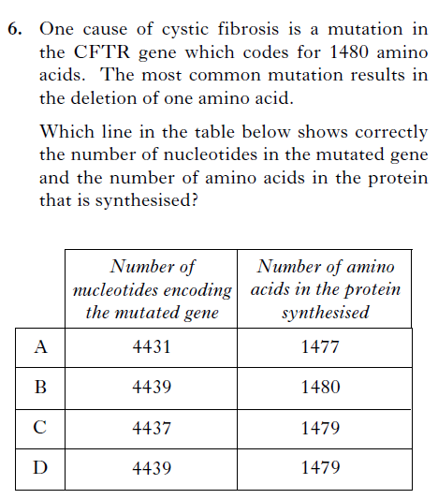

Slide 44
Look at the following website which gives information on different genetic disorders
At the right hand side, click on a disorder for more detail on that disorder
Once clicked on a disorder, click on the “how is it diagnosed” tab on the right hand side to see how PCR is involved
PCR for genetic testing

Slide 45
Paternity testing
As all offspring produced from sexual reproduction receive half their DNA from the mother and half from the father it is possible to compare DNA from the offspring to DNA from the potential father to see if they are related

Slide 46
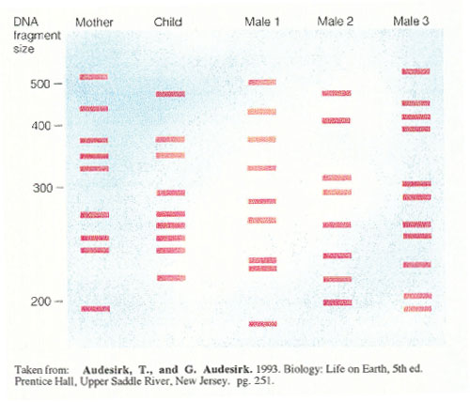
Which male is the father?

Slide 47
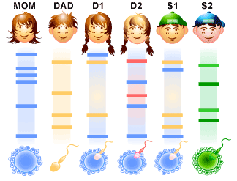
Which children are definitely his?

