Slide 1
DNA and the Genome
Key Area 3a
Gene Expression RNA

Slide 2
Learning Intentions
By the end of this topic you should be able to:
Explain why only a fraction of genes in a cell are expressed
State which processes are regulated to control gene expression

Slide 3
Learning Intentions
Structure and functions of RNA
Name the molecules in a RNA nucleotide and identify them in a diagram
Name the type of bond on the backbone of the RNA molecule
Give the names of the 4 RNA bases
Describe the base pairing rule for RNA bases
Describe 3 differences between RNA and DNA molecules
State what mRNA is and describe its role
Describe the structure of a ribosome
State what tRNA is and describe its role

Slide 4
A little revision….
What is inheritance?
All characteristics of living things are determined by genetic information.
This is carried on the chromosomes found in the nucleus of all cells
Each body cell has 2 matching sets of chromosomes
Offspring receive half their genetic information from each parent

Slide 5
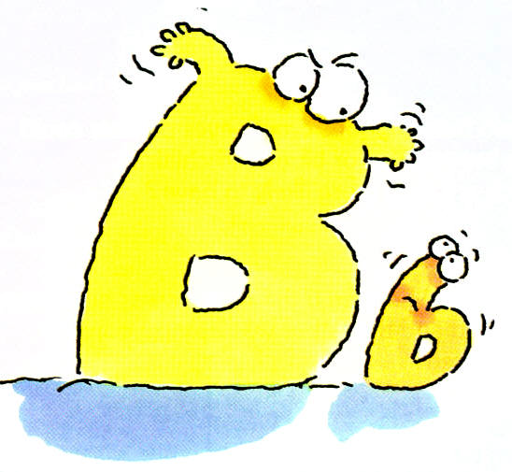
Genes
Each chromosome carries information in units called genes
The gene for each characteristic exists in 2 or more forms called alleles
One form is usually dominant, this is represented by a capital letter e.g. ‘B’
The other form is recessive, this is represented by the small letter e.g. ‘b’

Slide 6
Definitions
The genotype is the type of alleles an organism carries
The phenotype is what the organism looks like (and its chemical state) and is determined by the genotype
The dominant allele is the one that always shows even if the recessive allele is present
The recessive allele only shows if both alleles are the recessive form

Slide 7
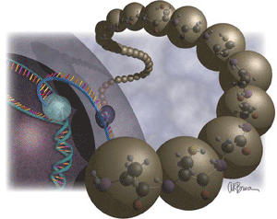
Role of Genes
The structure and function of all cells are determined by their genes. Each gene on a strand of DNA codes for each protein that the cell requires.
To prevent resources being wasted only a fraction of the genes within a cell are expressed
Enzyme induction is the name for the process of switching on a gene when the protein is required.
Image source: library.thinkquest.org

Slide 8
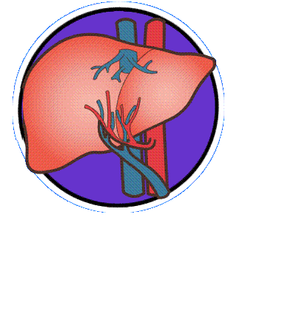
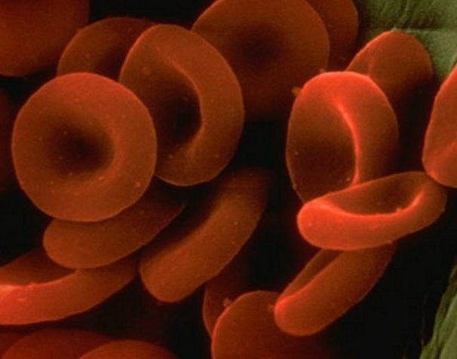
As an organism develops, tissues such as muscle, liver or blood become differentiated from each other.
Each tissue consists of specialised cells which only carry out certain functions.

Slide 9
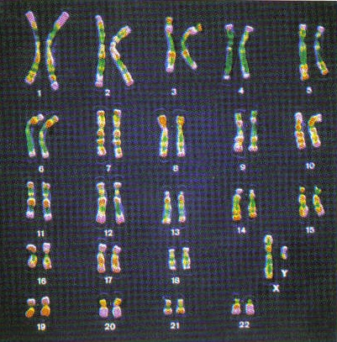
Although a specialised cell has a complete set of the organism's genes……

Slide 10
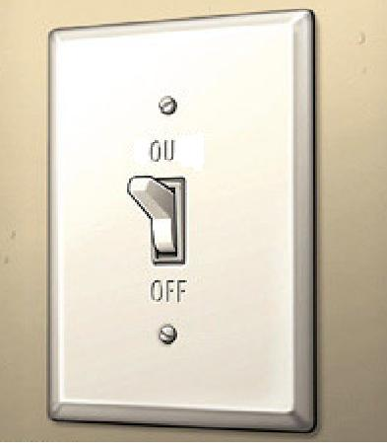
…….only those genes needed for its specialised functions are switched on.
All other genes are switched off!

Slide 11
Genes switched on in ALL cells
Genes switched on in SOME cells
Genes that code for vital metabolites necessary for basic life processes
Genes that are only switched on in certain differentiated cells.
e.g.
enzymes needed for aerobic respiration
proteins in plasma membrane
Proteins needed to make cell organelles
e.g.
insulin made by pancreas cells
antibody production
Production of digestive enzymes
Production of keratin

Slide 12
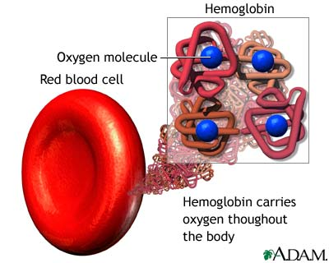
Genetic control of Differentiation: Blood as an example
All human cells contain the genes that allow them to become blood cells. The type of cell they become depends on the genes that are switched on during differentiation (when stem cells undergo mitosis and develop into specialised cells).
Although red blood cells and white blood cells contain all of the same genes, they have different genes switched on and off.
Red blood cells have the gene for the production of haemoglobin switched on.
Some white blood cells have the gene for the production of antibodies switched on

Slide 13
Transcription and Translation
Gene expression involves the TRANSCRIPTION and TRANSLATION of DNA sequences and involve 3 types of RNA:
Messenger Ribonucleic Acid (mRNA)
Transfer Ribonucleic Acid (tRNA)
Ribosomal Ribonucleic Acid (rRNA)

Slide 14
Structure and Function of RNAs

Slide 15
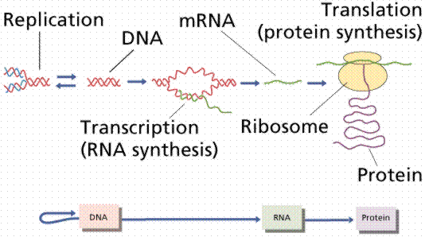
Overview

Slide 16
RNA
DNA is one type of nucleic acid but there is another type called Ribonucleic Acid (RNA).
There are 3 different types of RNA:
mRNA (messenger RNA)
tRNA (transfer RNA)
rRNA (ribosomal RNA)
All 3 have the same nucleotide structure and are involved in transcription and translation

Slide 17
RNA Nucleotides
RNA is single stranded and is composed of nucleotides (see below)
RNA nucleotides differ from DNA nucleotides in 3 ways:
RNA is single stranded (DNA is double stranded)
RNA has ribose sugar (DNA has deoxyribose sugar)
RNA has the base uracil (DNA has thymine)
phosphate
5’ end
base
3’ end
ribose sugar

Slide 18
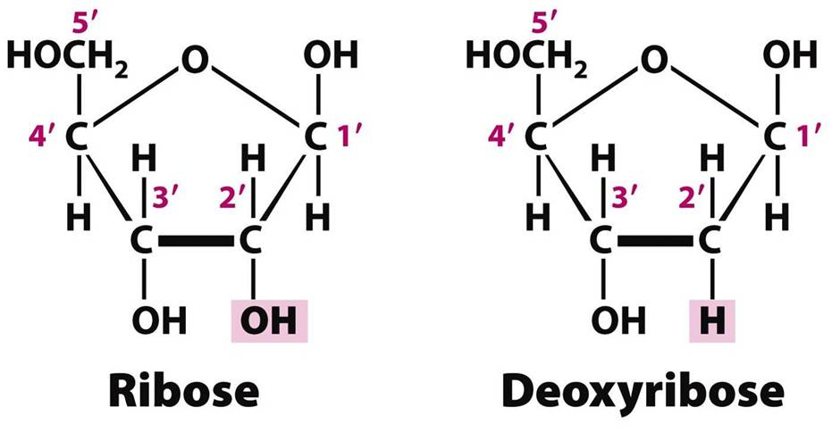

Slide 19
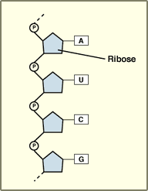
The base is still attached to carbon number 1 (C1) and the phosphate to carbon number 5 (C5)
When forming the sugar phosphate backbone, the phosphate still attaches from C5 to C3 of next nucleotide as shown
Notice the U instead of the T

Slide 20
mRNA
Protein synthesis occurs in the cell cytoplasm at the ribosomes but as the DNA cannot leave the nucleus a copy of the info on DNA must be made
mRNA carries a copy of the DNA code from the nucleus to the ribosome during transcription
mRNA is transcribed from DNA in the nucleus and translated into proteins by the ribosomes

Slide 21
DNA determines
inherited characteristics
An organisms inherited characteristics (e.g eye colour) are determined by the genetic information contained by the DNA.
The information present in DNA takes the form of a code language called the ‘genetic code.’ The sequence of bases can be thought of as ‘codewords.’

Slide 22
The sequence of bases in a gene provides the genetic code for proteins
A sequence of 3 DNA bases (triplet) codes for one amino acid
(remember, proteins are made from long chains of amino acids)
Each triplet allows 64 (4³) possible combinations.

Slide 23
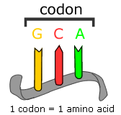
Codons
The basic unit of the genetic code is called a codon. This is a triplet of bases on the mRNA which has been copied from the DNA.
Image source: evolution.berkeley.edu

Slide 24
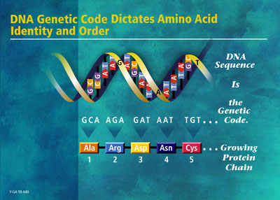
Codons
Each triplet codes for one of 20 different amino acids.
The combination of amino
acids determines which protein is produced.
Image source: science.howstuffworks.com

Slide 25
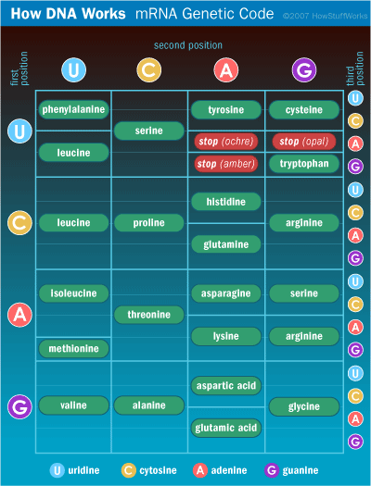

Slide 26
rRNA
When the DNA is transcribed into mRNA, the mRNA leaves the nucleus, enters the cytoplasm and travels to the ribosome where it will be translated into the protein
Ribosomes are themselves made of protein combined with ribosomal RNA (rRNA).
The ribosomal RNAs form two subunits, the large subunit (LSU) and small subunit (SSU).
mRNA is sandwiched between the small and large subunits and the ribosome catalyzes the formation of a peptide bond between the 2 amino acids that are contained in the rRNA

Slide 28
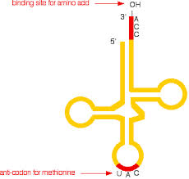
tRNA
When the mRNA reaches the ribosome it is translated into proteins with the help of transfer RNA (tRNA), which are found in the cytoplasm (and ribosome).
Each tRNA transports specific amino acids to the ribosome.

Slide 29
tRNA
The tRNA folds due to complimentary base pairing in such a way that they have a specific triplet of bases exposed at one end called an anti-codon.
They also have an attachment site for a specific amino acid at the other end

Slide 30
Nucleus
A G A G G T T G A C G A A
T C T C C A A C T G C T T
DNA
Overview of gene expression
Transcription
mRNA
U C U C C A A C U G C U U
codon
ser
pro
thr
ala
Ribosome
Translation
Protein

