Slide 2
Complete a 1-page travel review following a virtual field trip of one of the worlds most famous museums:
Choose from the selection of virtual tours (in the following slides) and write a review of your experience and recommendation to future visitors.
Your review should be completed on a page of A4 (digitally or handwritten) your guide could include a drawing of an art or design work you like on display from your virtual trip.
This will be shared as part of the whole class project called " The Virtual Art Travel Guide“
See if you can find out further information about the piece you chose to talk about, from the site or google, and include this in your review.

Slide 3
This iconic museum located in the heart of London allows virtual visitors to tour the Great Court and discover the ancient Rosetta Stone and Egyptian mummies. You can also find hundreds of artefacts on the museum’s virtual tour.
This museum will allow you to discover historical art and design pieces from different cultures…
Happy exploring!

Slide 4
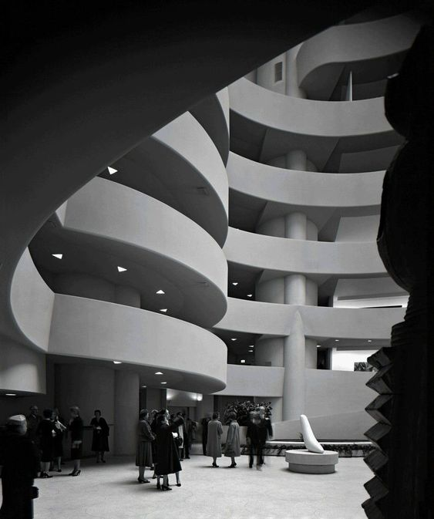
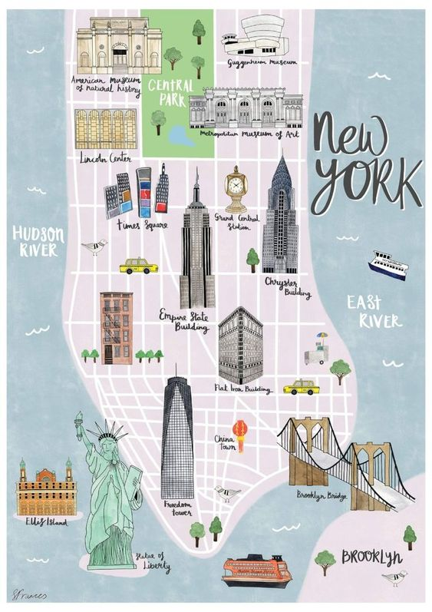
Google’s Street View feature lets visitors tour the Guggenheim’s famous spiral staircase without ever leaving home. From there, you can discover incredible works of art from the Impressionist, Post-Impressionist, Modern and Contemporary eras.
Happy exploring!

Slide 5
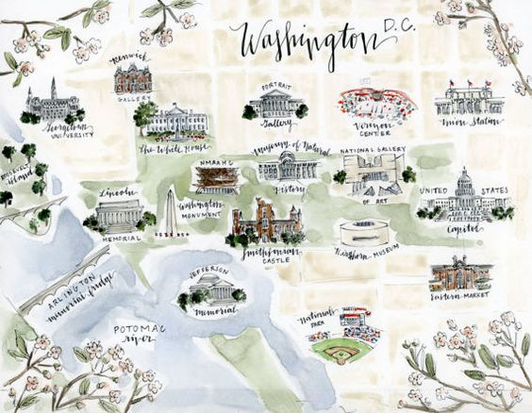
This famous American art museum features two online exhibits through Google. The first is an exhibit of American fashion from 1740 to 1895, including many renderings of clothes from the colonial and Revolutionary eras.
The second is a collection of works from Dutch Baroque painter Johannes Vermeer.
Happy Exploring!

Slide 6
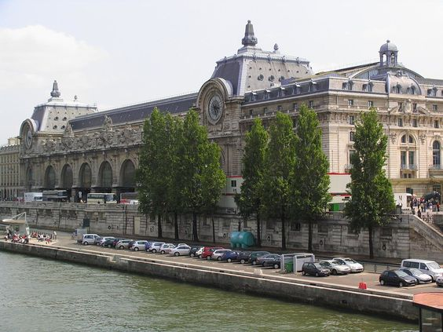
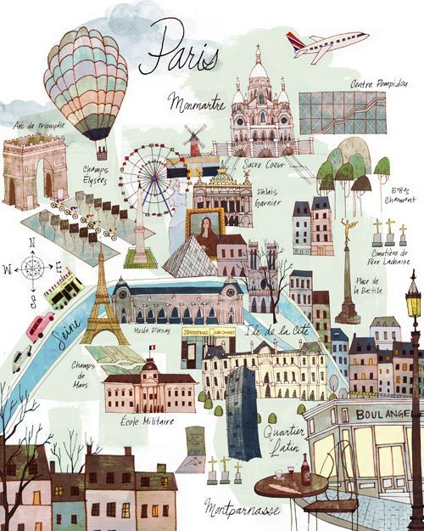
You can virtually walk through this popular gallery that houses dozens of famous works from French artists who worked and lived between 1848 and 1914. Get a peek at artworks from Monet, Cézanne, and Gauguin, among others.
Happy Exploring!

Slide 7
Visit the museum's exhibition rooms and galleries, contemplate the façades of the Louvre in it's very own virtual tours.
Happy Exploring!

Slide 8
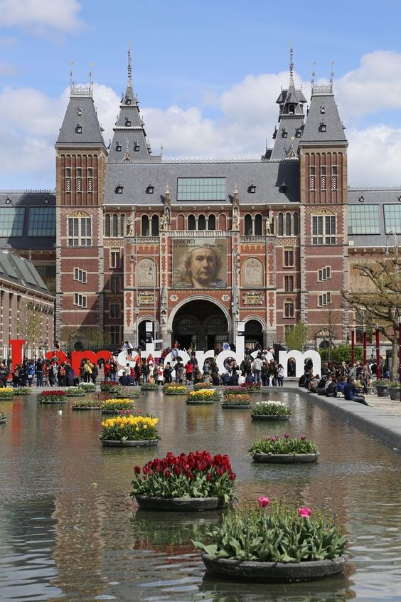
Explore the masterworks from the Dutch Golden Age, including works from Vermeer and Rembrandt. Google offers a Street View tour of this iconic museum, so you can feel as if you’re actually wandering its halls.
Happy Exploring!

Slide 9
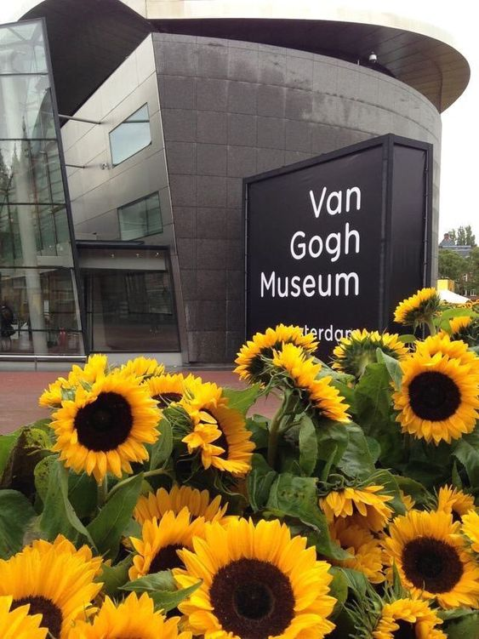
Anyone who is a fan of this tragic, ingenious painter can see his works up close (or, almost up close) by virtually visiting this museum – the largest collection of artworks by Vincent van Gogh, including over 200 paintings, 500 drawings, and over 750 personal letters.
Happy Exploring!

Slide 10
Many museums, galleries and cultural spaces, like The Louvre, offer virtual tours on their own websites, out with the Google Art & Culture archive, maybe you'll discover a virtual tour online that I don't know about and you can share with the class on your return!
Happy Exploring!

