Slide 1
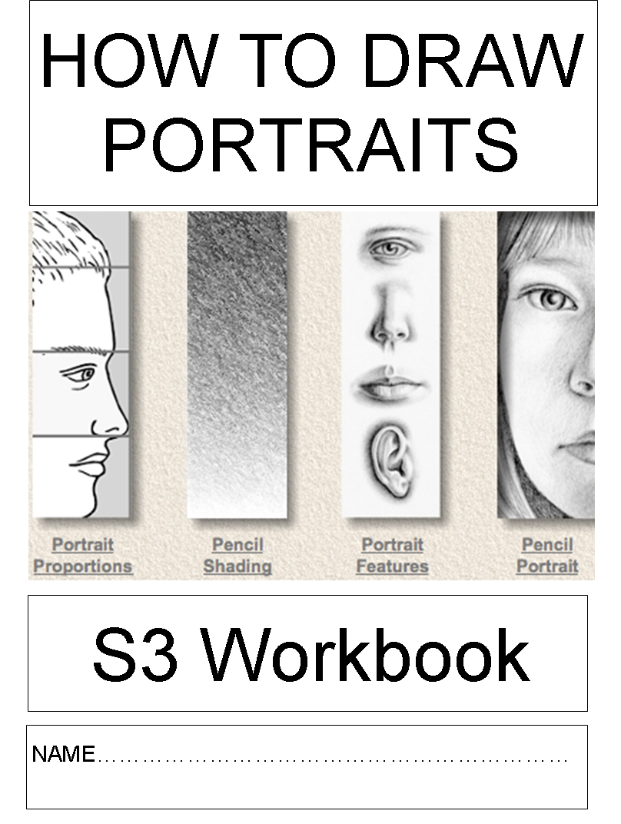
This project is intended to improve your skills and increase your confidence.
To become better at anything in life, you need to be able to focus on one thing at a time, to be patient, and not give up when you make a mistake or find something difficult.
Aim to change your mindset, and think positively about how you learn.

Slide 2
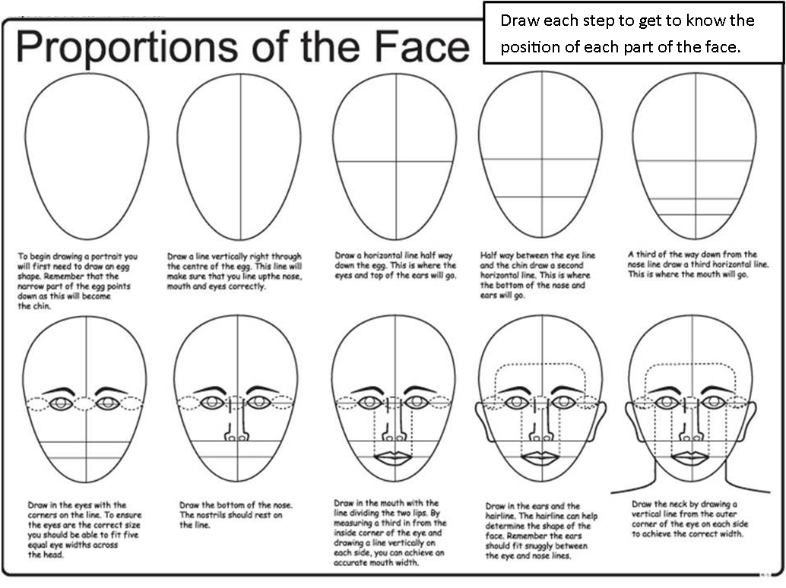
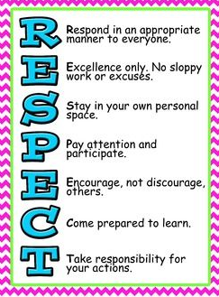
Learning intention: To understand and recognise the correct proportions of the face
Learning Outcome: An A4 drawing of the face and head
Success = All of the features in the correct place, and are the correct size & shape, extra details, e.g. hairstyles, may be added if you wish.

Slide 3
Learning Intention:
To develop your skills and understand how to use tone.
Learning Outcome:
A drawing of a mouth using highlights and shadows.
Success =
Neat and careful drawing
Mouth and lips look rounded and realistic
Good control of pencil showing smooth shading

Slide 4
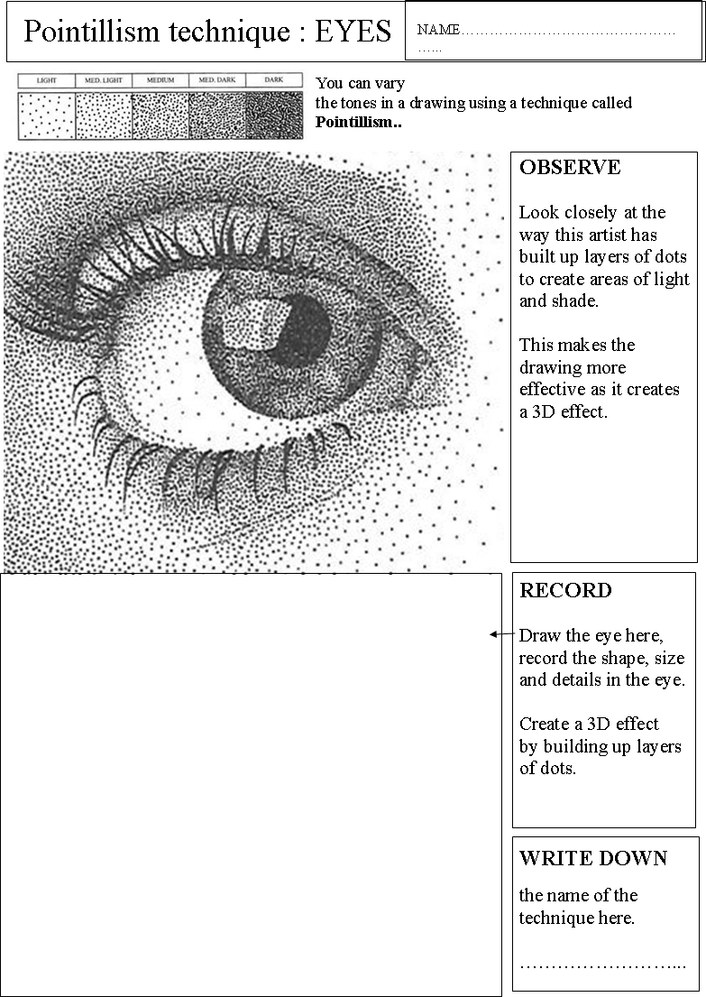
Learning Intention:
To observe and record detail and explore a new technique
Learning Outcome
To create a drawing of an eye, in the Pointillist style
Success =
Accurate shape and size
Lots of detail ( lids, lashes, waterline, pupil, iris. )
Tone is created by controlling amount of dots.

Slide 5
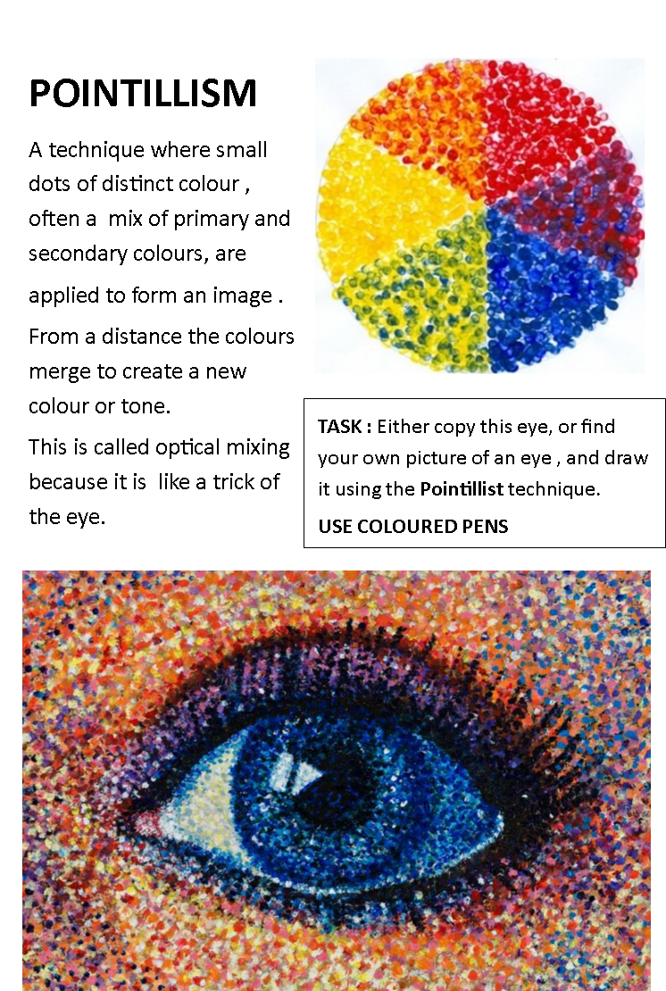
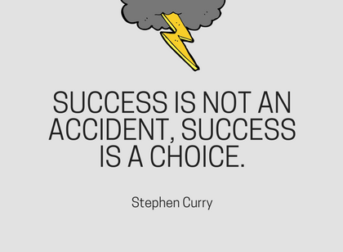
Learning Intention: To create an image which shows your understanding, and application of Pointillism.
Learning Outcome: A colour drawing of an eye , This should take 1 hour.
Success = There is obvious use of the optical mixing effect , when you look at your drawing from a distance.

Slide 6
Learning intention: To create a drawing which identifies the planes of the face.
Learning outcome: A tonal drawing, using the code above.
Success = The tones are drawn in the correct places, showing where the light hits each plane. The head and face look 3D

Slide 7
EXTENTION TASK

Slide 8
IMPROVING YOUR DRAWING TECHNIQUE
Learning Intention: To practice and improve your drawing technique
Learning Outcome:
Complete the 3 tasks showing how to draw hair textures.
Success =
Textures observed closely
Dark and light areas shown
Lines show the direction of hair growth

Slide 9
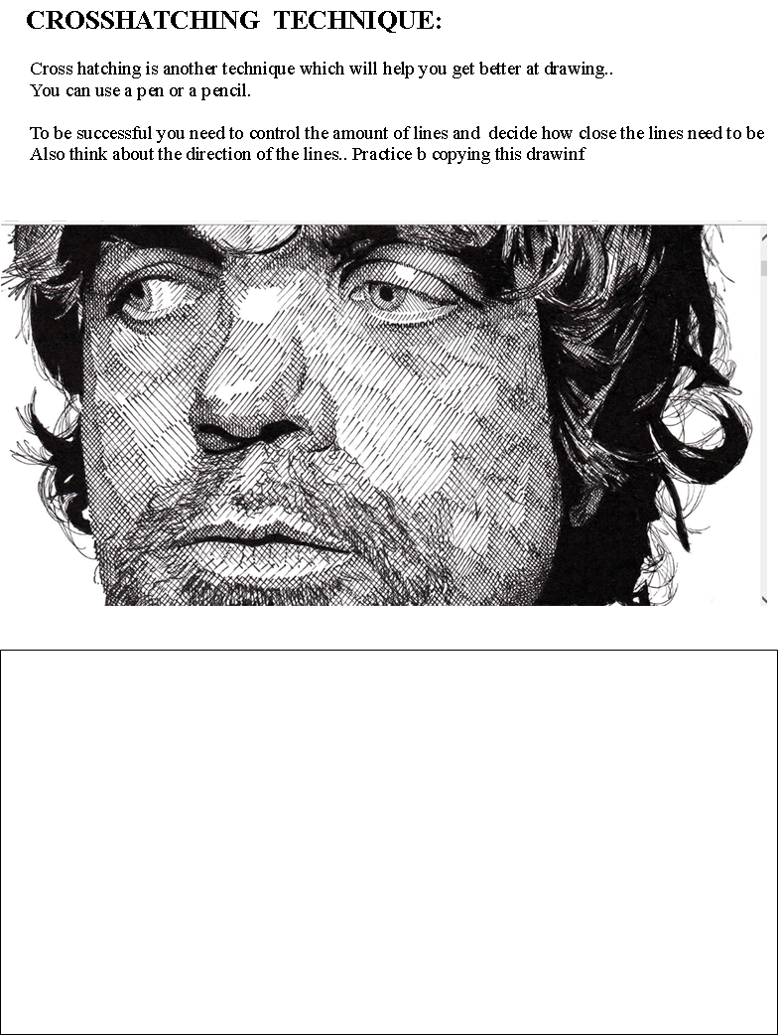
Learning Intention:
To explore using crosshatching and pen techniques to create areas of tone.
Learning Outcome: Pen drawing from booklet
Success = Accurate details, facial proportions. There is variety in the tones, showing layers of pen built up in different amounts.

Slide 10
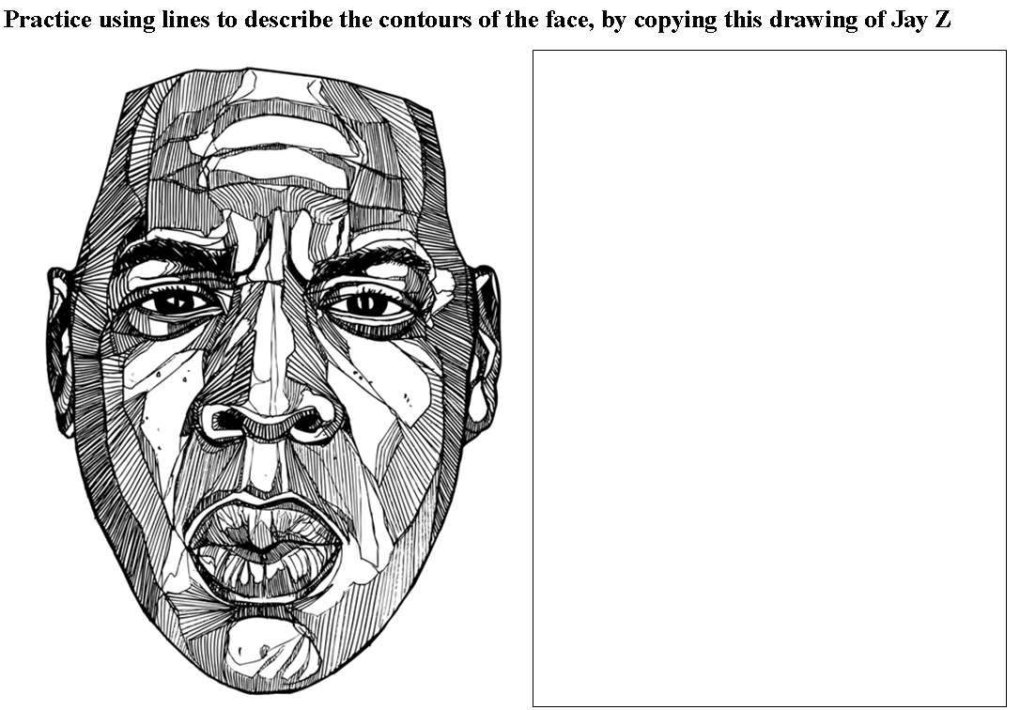
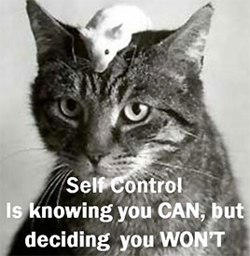
Control your behaviour, control your success
Learning Intention: To experiment with lines, to create the contours of the face
Learning Outcome: Complete the drawing exercise above, in 2 periods.
Success = It looks like Jay Z . The amount, the direction and type of lines create the effect of an uneven, contoured surface.

Slide 11
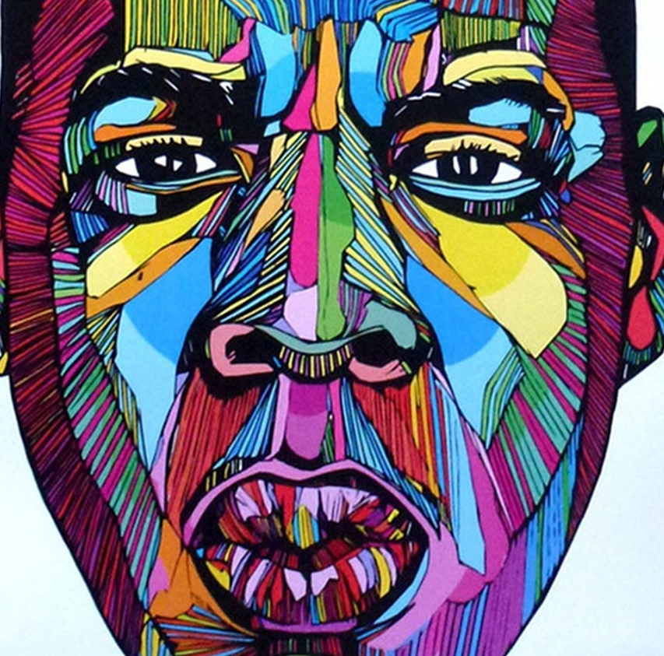
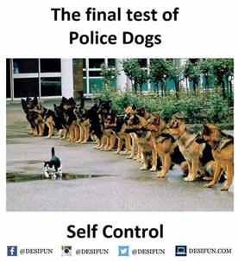
JAY Z EXTENTION WORK
Add colour to your line drawing…….
It takes self control and patience to complete this task well.
Why is it important to control your impulses?

Slide 12
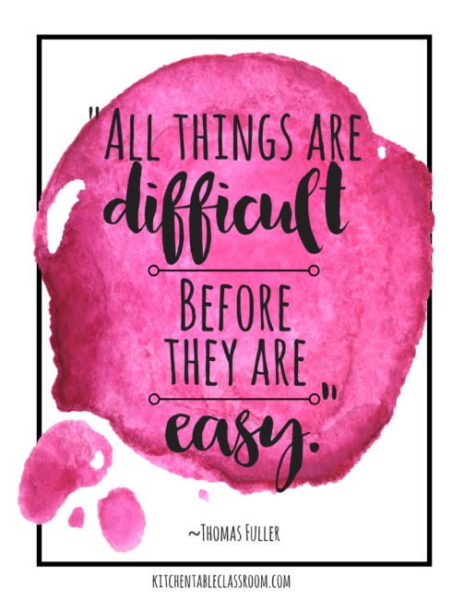
Learning Intention: To build skills using coloured pencils, by layering and blending.
Learning Outcome: A realistic portrayal of the face, using appropriate colours.
Success = Colours match well with the photograph, evidence of mixing by layering, neatly applied, carefully blended technique.

Slide 13
Your Final Task: Draw a Celebrity Portrait
Learning Intention: To apply the skills you have learned in the project.
Learning Outcome: An A3 drawing of a celebrity, of your choice. Select the technique you feel most comfortable with.
Success = Evidence that you have learned one of the techniques and can use it appropriately.
You can concentrate better on your work, for a longer period of time.
You feel more confident in drawing
Think: What made your celebrity a success?

Slide 14
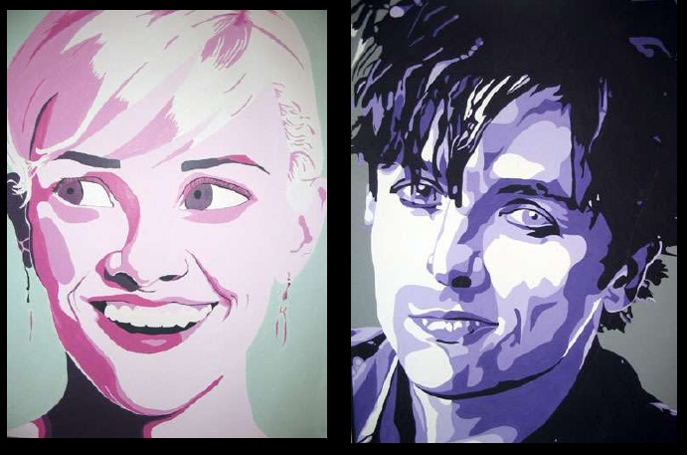
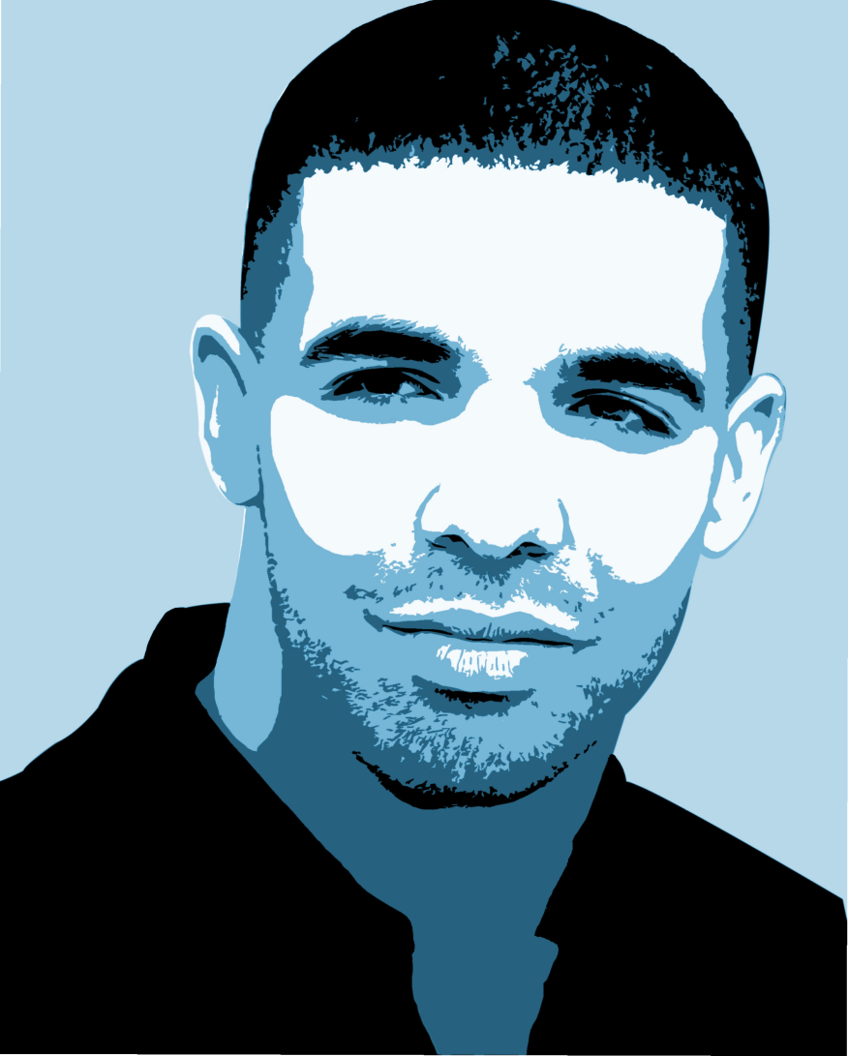
Celebrity Portrait Painting

Slide 15
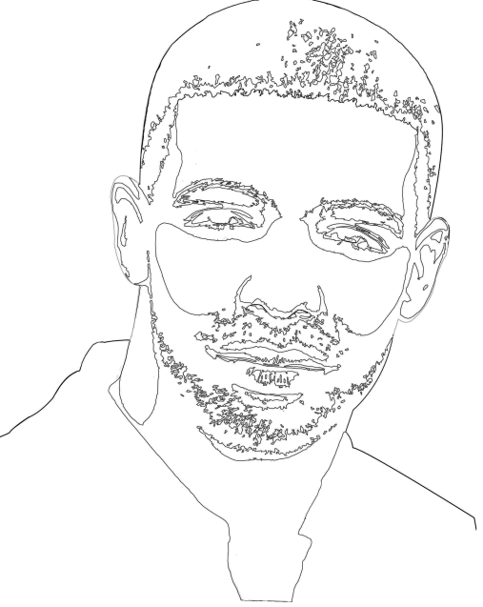
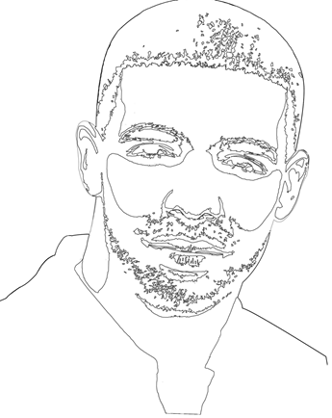
Celebrity Portrait Monochrome Painting
Step 1:
Trace your “Cut out effect” photo.
Draw lines where you notice a change in the tones.
Step2:
TURN THE TRACING PAPER OVER and trace the lines on the back.
Step 3:
TURN TRACING PAPER OVER AGAIN and trace onto a piece of paper.

Slide 16
Painting technique
Step 4: Paint the white areas first
Step 5: Paint the black areas next
Step 6: Look at the rest of the tones. How light or how dark are they?
Choose one colour and mix the correct tones to fill in all the other shapes.
How much white do you need to add?
How much black do you need to add?

Slide 17
By the end of this unit, you should, hopefully, feel a bit more confident in your drawing and painting skills. Hopefully you have come to the conclusion that it’s best to keep going, and not give up!
How well did this project help you to improve the detail in your drawings?
How well do think you improved your use of the visual elements eg line, tone, colour ?
How much more confident do you feel when experimenting with different techniques?

