Slide 1
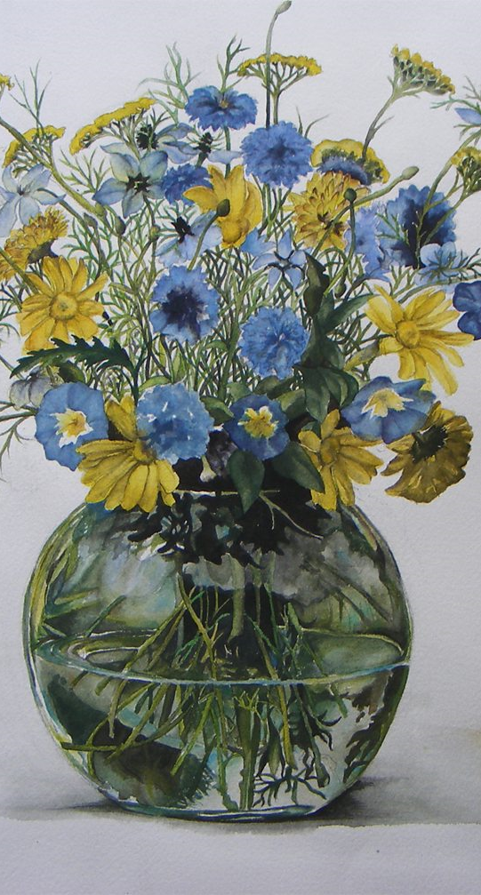
Watercolour
Watercolour comes in metal tubes or as dry tablets that need to be mixed with water. It also comes in a liquid form that is commonly used for airbrushing.
Watercolour paint is a translucent medium. Watercolour is often used to create a muted, subtle image and has a softened look.
Watercolour can be a good choice if you want to work quickly or if you are on location as it requires little extra equipment, dried quickly and can be cleaned from brushes with just water.
A drawback of using watercolour is that it is difficult to fix mistakes. You need to know what you are doing because you can't make changes by painting over them. You also need to be careful that you don't damage the surface you are using by repeatedly wetting it.

Slide 2
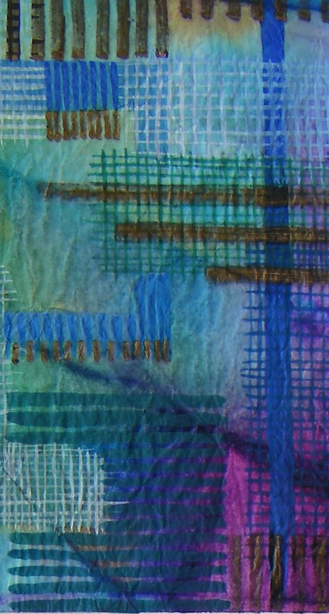
Gouache
Gouache paint is often called 'Designers gouache.' It is opaque, dries quickly and produces a matt finish.
It is used by graphic designers, illustrators and commercial artists.
It is also referred to as 'opaque watercolour' because it can be used like watercolour but is not transparent.

Slide 3
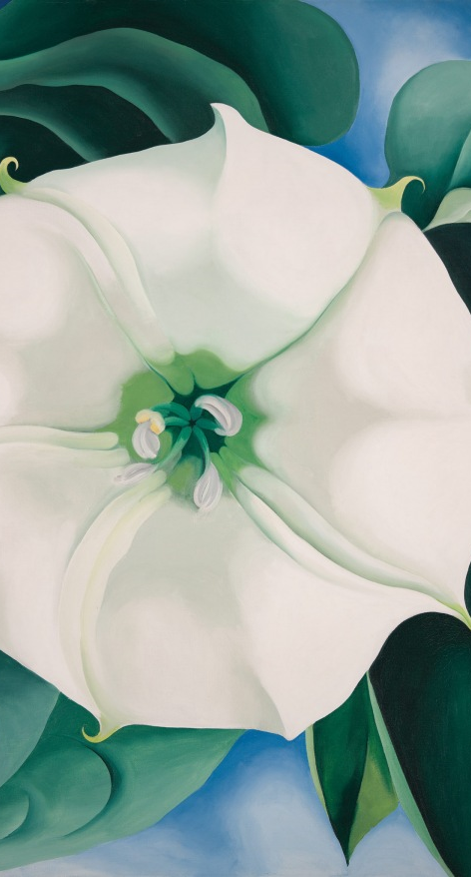
Oil Paint
Oil paint is rich and vibrant. Oil paintings are often very detailed and colourful and are composed of many layers of paint.
Oil paint is a permanent and durable medium. However it is expensive and can take a very long time to dry - between six months and a whole year where there are many layers.

Slide 4
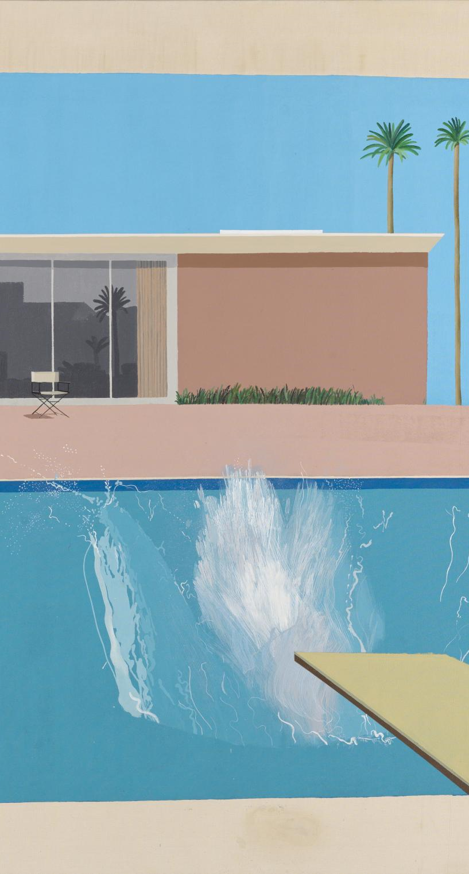
Acrylic
Like oil paint, acrylic paint is well-suited for detail, but it is easy to use.
Depending on the technique used by the artist, acrylic can produce results that are like oil or watercolor.
Acrylics are water-based which means they can be cleaned from brushes more easily.
Acrylic dries very quickly so should be kept moist on the palette to prevent drying out.

Slide 5
Brushes for Acrylics
Round or pointed tip brushes are good for sketching, outlining, detailed work and filling in small areas.
Flat square end brushes are good for bold strokes, washes and filling wide spaces. The can also be used for fine lines, straight edges and stripes.
Filbert flat and oval-shaped end brushes work well for blending and creating soft-rounded edges like flower petals.
Fan flat brushes have hairs that spread. They are good for smoothing, blending and feathering. They are effective for textural effects, such as for clouds and leaves on trees.
Angular flat brushes have angled hairs. They are good for curved strokes and filling corners.
Detail round brushes have short hairs. They are a good choice for working on details and making short strokes.

Slide 6
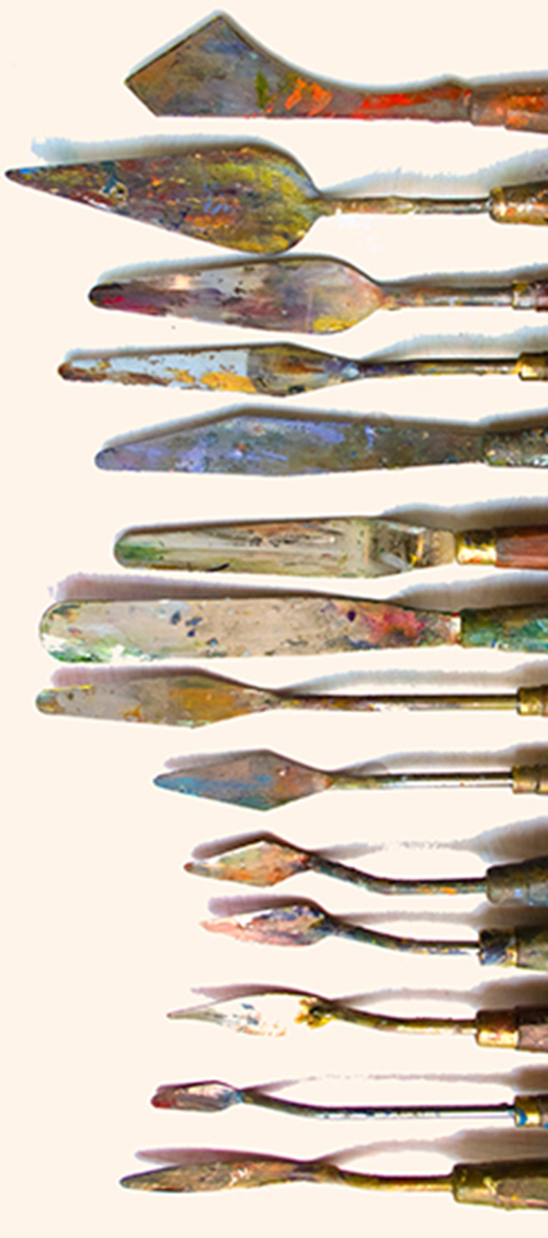
Palette Knives
Acrylics often have a buttery consistency. Palette knives and painting knives are useful for mixing paints together into a consistent colour. They can be used to apply thick, textured paint directly onto the canvas.

Slide 7
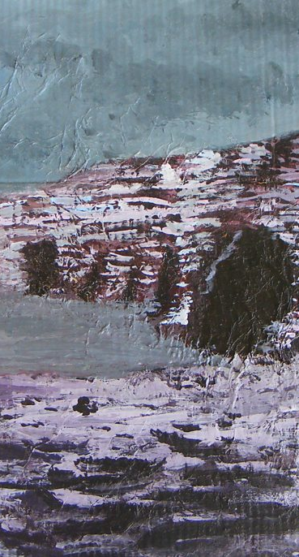
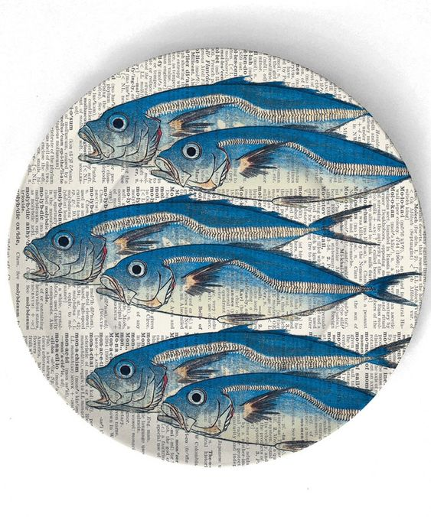
Painting Surfaces
Canvas, wood panels, MDF, cardboard and paper are all suitable surfaces for acrylics.
Canvas can be bought in primed or unprimed form. Primed canvas has already been coated with a primer, such as gesso. Unprimed canvas has not been coated.
Canvas that has been primed will accept the paint more easily. Gesso and acrylic primer comes in jars, tubes, squeezable bottles and even spray cans.

Slide 8
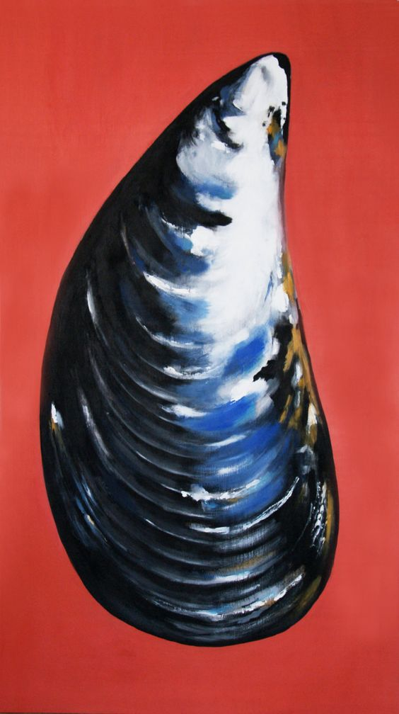
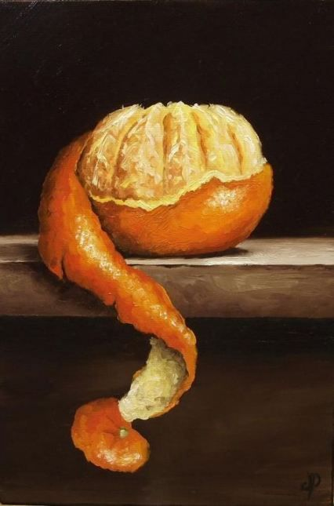
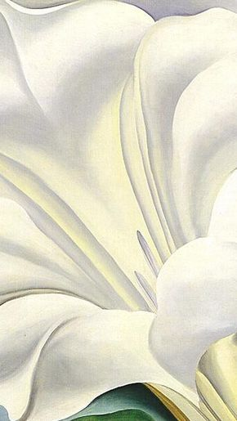
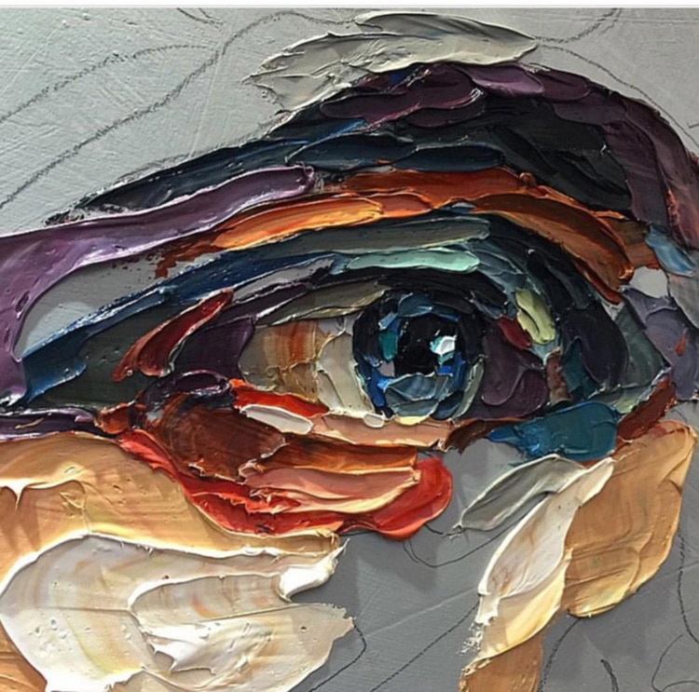
Techniques
Water down acrylic to create transparent effects
Scratch into paint once it has dried
Use a little paint on a dry brush to bring out textures in your paper or other surface
Add matte medium or texture gels to acrylic to make creative effects
Try applying thick acrylic with a palette knife to create an impasto effect

Slide 9
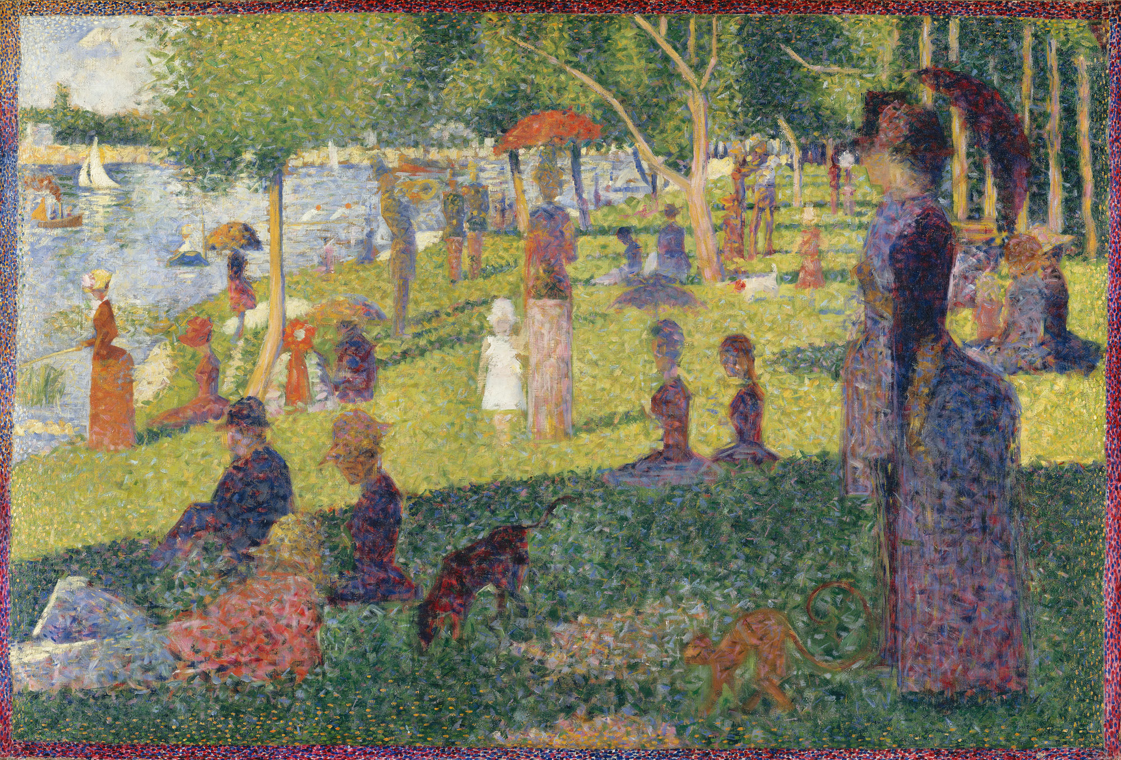
Pointillism
Pointillism is an Impressionist painting technique developed by Georges Seurat, based on colour theory and the use of complementary colours in particular.
The painting is created using countless tiny dots of pure colour, placed in close proximity to each other.
When viewed at a distance, the human eye is meant to fuse the individual dots together into areas of solid colour.
A Sunday on La Grande Jatte — 1884, Oil on Canvas
Detail of painting technique

Slide 10
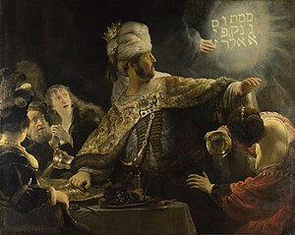
Impasto
In painting, impasto (from the Italian for dough) describes areas of the surface of a painting which are heavily built up with paint layers.
Impastoed paint is highly textured; brush or palette knife marks are usually clearly evident.
The intention is to make the light falling across the painting reflect in a particularly noticeable way.
Highlights, or perhaps jewels on a costume, may be heavily impastoed for this reason, as in some of the works of Rembrandt.
Belshazzar's Feast by Rembrandt, Oil on Canvas
Detail from headpiece with thickly applied paint highlighting the jewels in the crown

Slide 11
Impasto
Later, artists such as Van Gogh employed the impasto technique extensively for decorative and expressive purposes.
Sunflowers by Vincent van Gogh, 1888, Oil on Canvas
https://www.youtube.com/watch?v=YV4YGUAHPJU

Slide 12
Scottish Colourists
A group of Scottish painters comprising S.J. Peploe, F.C.B. Cadell, Leslie Hunter and J.D. Fergusson who were active in the early twentieth century.
They all spent time in France and were influenced by French artists’ bold use of colour and free brushwork.

Slide 13
Peploe
This work was painted during a time when Peploe was experimenting with using areas of bright colour in his still life paintings.
Peploe had spent time studying in Paris and was influenced by contemporary French painting. He felt that every plane was to be represented by a change of colour and selected material for his still lifes which could be treated in flat areas of strong colour: lemons, oranges, roses, tulips, blue and white china, bowls and drapes were his main subjects.
In this work the outlines are bold - some are blue or dark red - to emphasise the objects and their relation to one another.
Samuel John Peploe
Pink Roses, Chinese Vase, Oil on Canvas
https://www.youtube.com/watch?v=OxOfQcCRaME

Slide 14
Michael Corr
Michael Corr is an award-winning contemporary painter and mural artist, who is based at his garden studio space in Alloa, Scotland.
His work centres around portrait painting with an emphasis on colour and spontaneous mark making.

Slide 15
Gary Hume
This body of work focuses on a range of subjects, but at its core is a suite of highly personal paintings about memory and loss.
Hume’s mother is 86 years old and suffers from dementia. And while the outward subjects of many of the new paintings are flowers, their titles — Mourning, Spent, Blind — reflect Hume’s thoughts of her.
​
Grandma Looks at the Garden, 2017​
Enamel paint on aluminum​ 40 1/8 x 48 inches (102 x 122 cm)

Slide 16
Wayne Thiebaud

Slide 17
Things to consider before you start a painting:
Equipment
What equipment will you need?
What surface will you paint on?
What tools will you need?
How will you set up your palette?
Objects
What will you paint?
What viewpoint will you take?
How will you compose your object(s)?
What is the focal point of your composition?
Idea
How will you respond?
What size will you work on?
What visuals elements will you focus on?
What technique will you explore?

