Slide 1
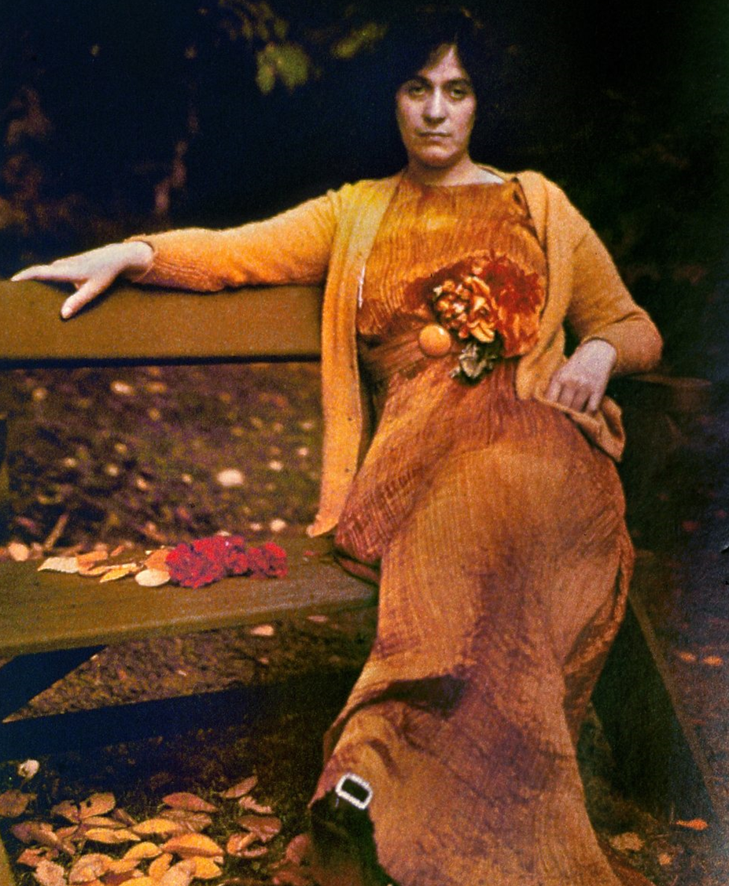
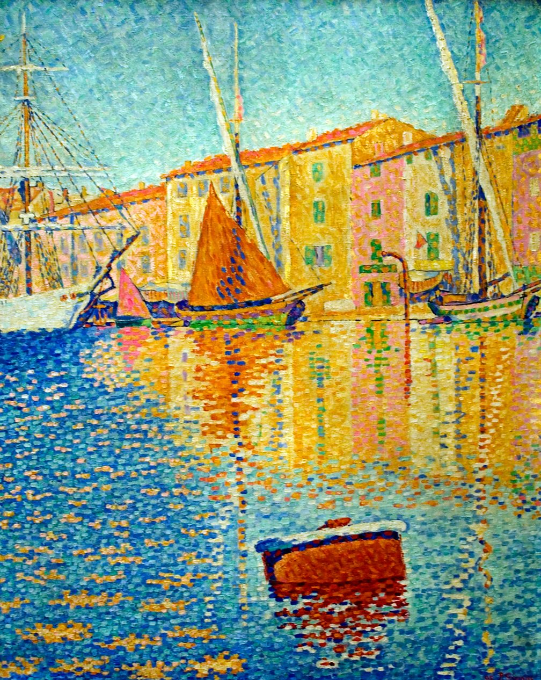
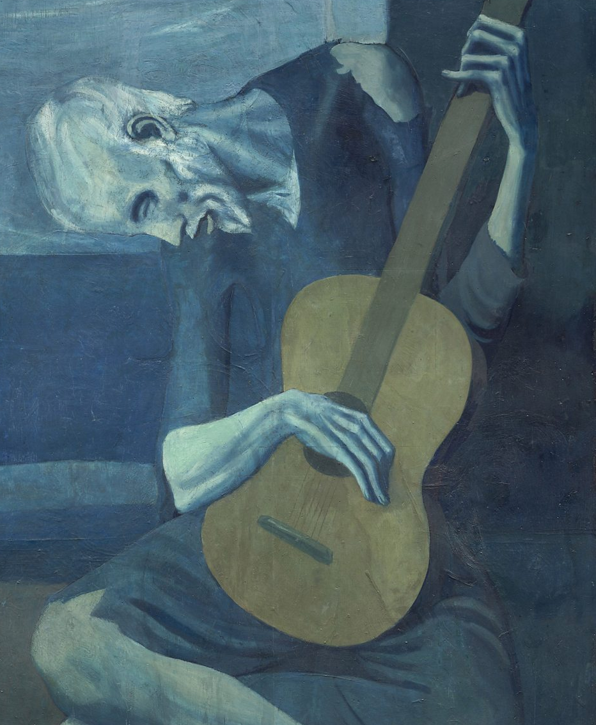
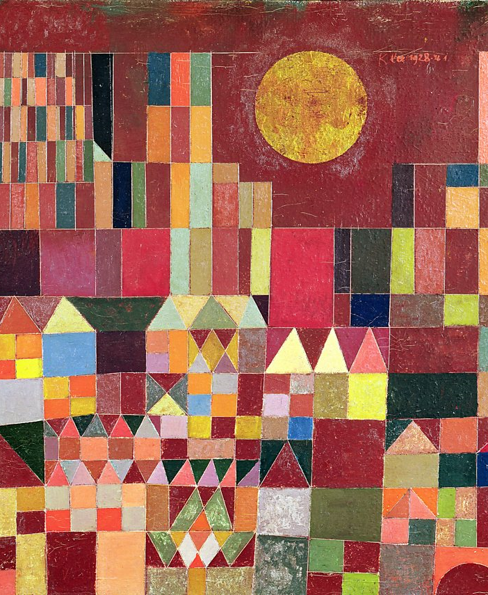
Colour can affect the composition of a painting, it can be used to:
harmonize or contrast
unify a scene
set a visual path
produce a rhythm
create emphasis
The effect of
colour in art
The effects of colour can be purely:​
optical - creating visual interest and drawing the viewers eye.​
emotional - cool colours like blue or green have a calming effect. Red and yellow are more stimulating to the senses.​
aesthetic - the beauty that springs from the juxtaposition of two or more harmonious colours.

Slide 2
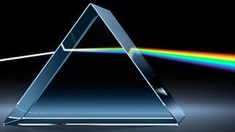
Spectrum
The Spectrum
Here are the seven colours of the spectrum listed in order of their frequency, from the lowest frequency (fewest waves per second) to the highest frequency (most waves per second):
red
orange
yellow
green
blue
indigo
violet
Dispersion of white light by a prism into a spectrum
White light is a mixture of many different colours, each with a different frequency. White light can be split up into a spectrum of these colours using a prism, a triangular block of glass or Perspex.
Light is refracted when it enters the prism, and each colour is refracted by a different amount. This means that the light leaving the prism is spread out into its different colours, a process called dispersion.
https://www.dailymotion.com/video/x60ndy9

Slide 3
Colour Wheel
The colour wheel helps us understand the relationships between colours.
The 12 part, red, yellow and blue (RYB) wheel shown is called a subtractive model.
This type of colour wheel is used when discussing art and design works.
https://www.bbc.co.uk/bitesize/guides/z3bqycw/video

Slide 4
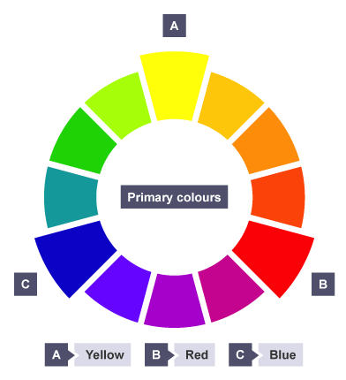
Primary Colours
These are the 3 pigment colours that cannot be mixed or formed by any combination of other colours.
All other colours are derived from these 3 hues.

Slide 5
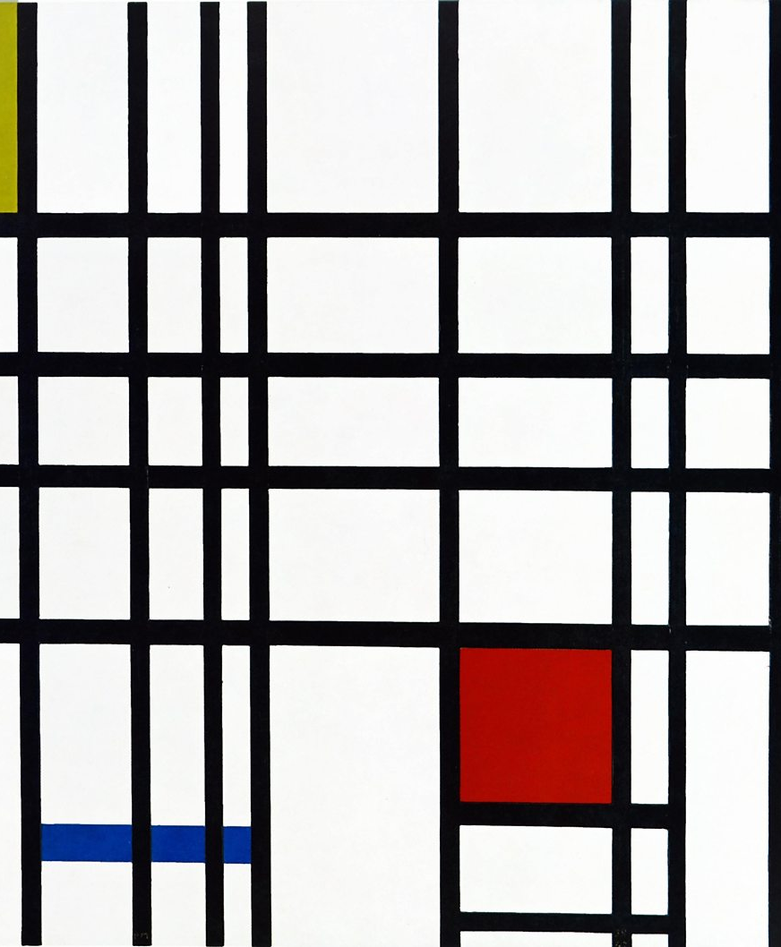
Piet Mondrian often used primary colours in his works. In Composition with Yellow, Blue and Red (1937-42) the solid blocks of colour are relatively small. But because they are bright, pure primary colours, they stand out boldly against the white background and black grid lines.
Composition with Yellow, Blue and Red, Piet Mondrian, 1937-42, oil on canvas

Slide 6
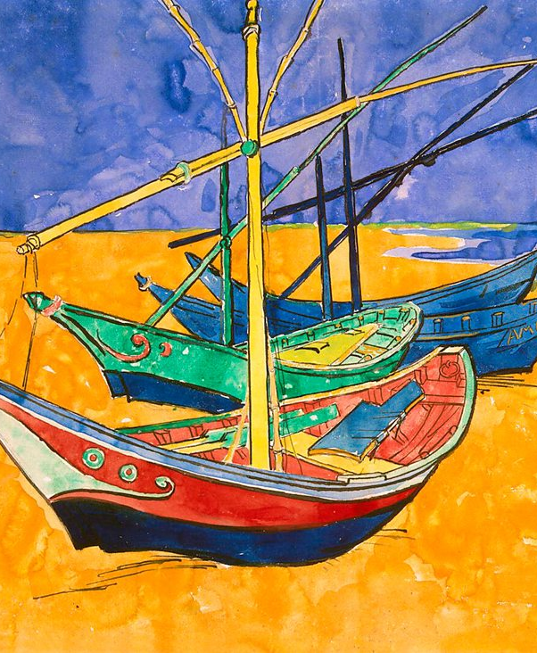
Van Gogh used primary colour to great effect in this version of his 1888 work Fishing Boats on the Beach at Saintes-Maries-de-la-Mer.​ ​ The fact that the main colours in the painting are red, blue and yellow makes a striking image that stands out to the viewer.
Fishing Boats on the Beach at Saintes-Maries-de-la-Mer, Vincent van Gogh, 1888, pen and ink with watercolour

Slide 7
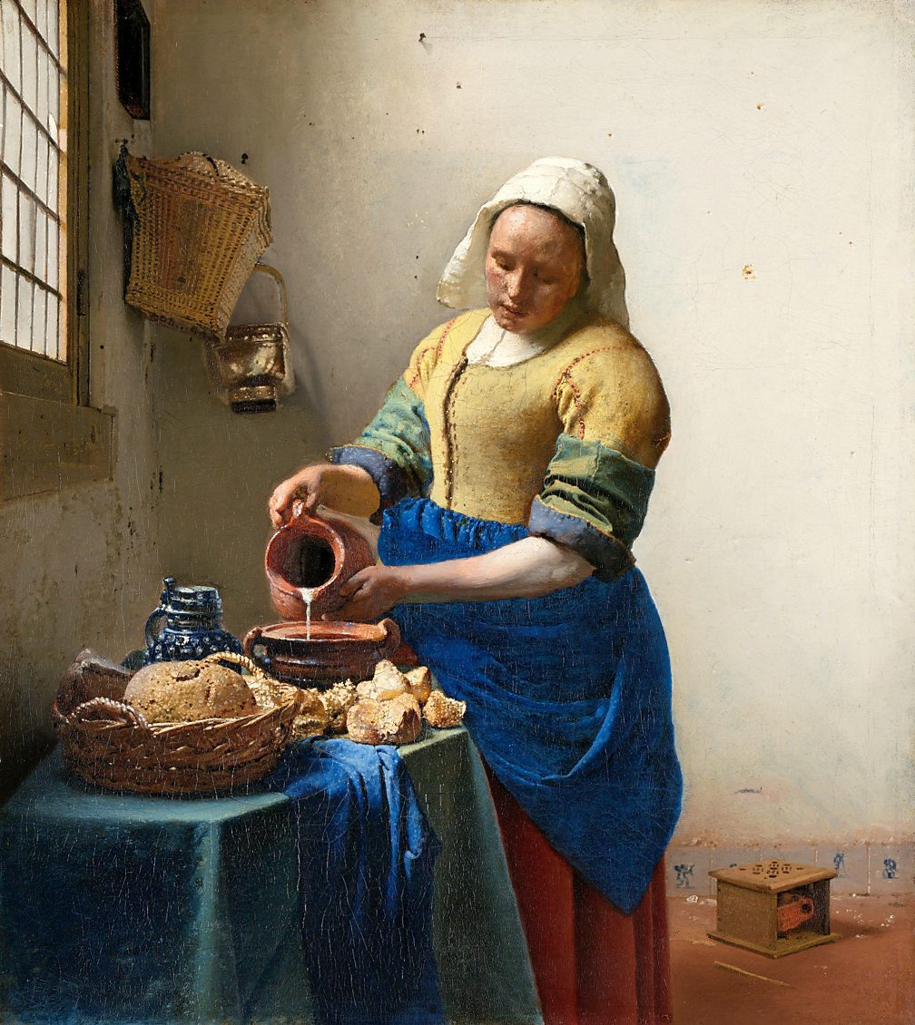
The bright colours of paint used by Mondrian and Van Gogh were not yet available for earlier painters. The Milkmaid by Vermeer (c.1658-60) uses tints, shades and tones of the primary colours and neutral browns in a way that is more subtle and natural looking. Placing the three colours next to each other in the woman’s clothes helps make them stand out in contrast to each other.
The Milkmaid, Jan Vermeer, c.1658-60, oil on canvas

Slide 8
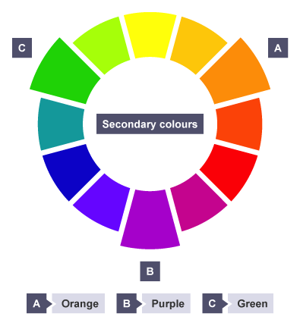
Secondary Colours
Secondary colours are made by mixing equal amounts of primary colours together:
Blue and red mixed together make purple
Yellow and red mixed together make orange
Blue and yellow mixed together make green
Purple, orange and green are secondary colours. On the colour wheel, each secondary colour sits halfway between the two primary colours it is mixed from.

Slide 9
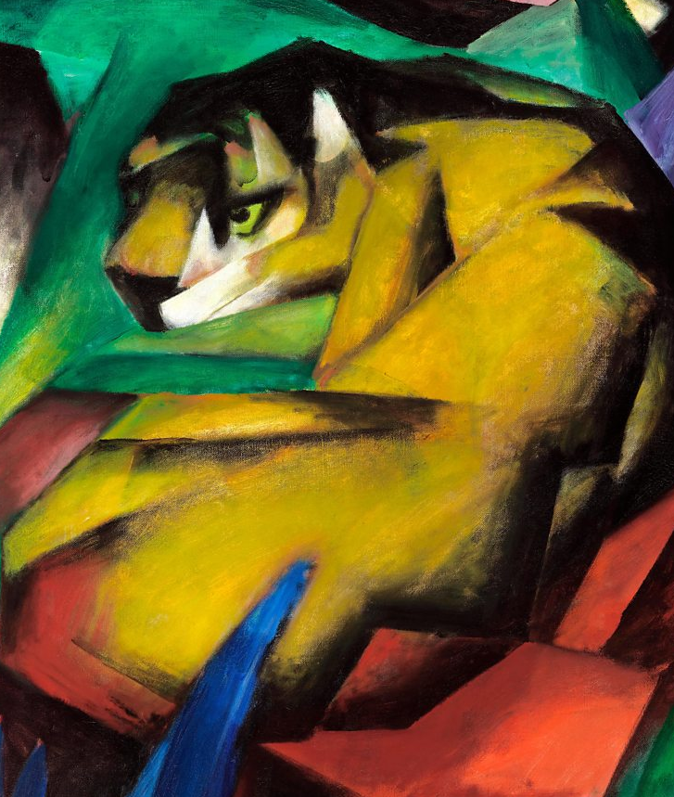
Franz Marc uses primary and secondary colours in The Tiger. The tiger is made from bold yellow and black shapes. They stand out against the blue leaf shapes in the bottom left of frame and the purple areas to the top right. There is a closer harmony with the green and orange – both secondary colours that contain yellow. These colour relationships and the similar shapes used suggest the tiger is at home in its surroundings.
The Tiger, Franz Marc, 1912, oil on canvas

Slide 10
Tertiary Colours
A tertiary colour is made by mixing equal amounts of a primary colour and a secondary colour together. There are six tertiary colours. On the colour wheel, they sit between the primary and secondary colour they are mixed from.

Slide 11
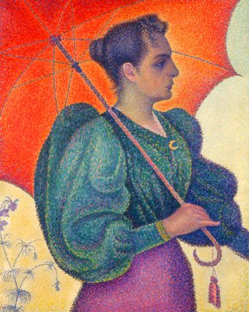
In Woman with Parasol (1893), Paul Signac creates a vibrant image based on tertiary colours. Instead of mixing different colours of paint Signac applied small dabs of red-orange, blue-green, red-purple (and yellow) to his canvas. From a distance our eyes mix these to see different hues, tints and tones. Using pure contrasting tertiary colours results in an intense, bright image.
Woman with a Parasol, Paul Signac, 1893, oil on canvas

Slide 12
Temperature
The twelve part colour wheel can be split in half into a section of six warm colours and a section of six cool colours.

Slide 13
Warm Colours
Warm colours are said to advance towards you as if they are jumping out of the painting. These colours can be exciting and energetic and will catch the viewer’s attention by drawing their eye towards them.
Warm colours remind us of things associated with the concept of heat such as summer, beaches, the sun, fire etc. The warm colours are:
Red-purple
Red
Red-orange
Orange
Yellow-orange
Yellow
Brown and tans

Slide 14
Castle and Sun (Paul Klee, 1928) features a number of different colours but is dominated by the reddish brown of the background and the bright yellow sun. These and the many red, yellow and orange shapes that make up the buildings create a warm image that suggests hot sunlight shining down on the scene.
Castle and Sun, 1928 (no 201), Paul Klee, 1928, oil on canvas

Slide 15
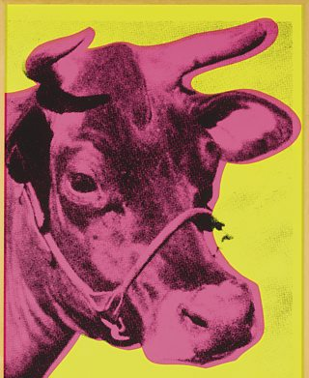
Andy Warhol’s Cow (1966) was one of a series of brightly coloured prints used as a wallpaper design. Warhol deliberately used bright and unnatural warm colours. These strong colours advance and stand out so that they catch the viewer's eye when hung on a wall.
Andy Warhol, Cow (F. & S. II.11), 1966, Screenprint

Slide 16
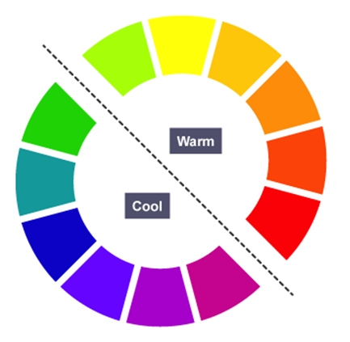
Cool Colours
Cool colours are said to recede into the background, meaning that they move away from the viewer. Cool colours can be calming and relaxing but can also be used to signify sadness.
Cool colours remind us of things associated with the absence of heat – such as winter, ice, water, etc. The cool colours are:
Purple
Blue-purple
Blue
Blue-green
Green
Yellow-green
Most greys

Slide 17
The Old Guitarist was painted by Picasso between 1903 and 1904, during his Blue Period. It features cool colours including dark blues, light blues, some turquoises and greens. The mood seems sad or even bleak. The only warmth comes from the brown of the guitar. This suggests a single source of comfort and warmth in the man’s life.
The Old Guitarist, Pablo Picasso, 1903-04, oil on canvas

Slide 18
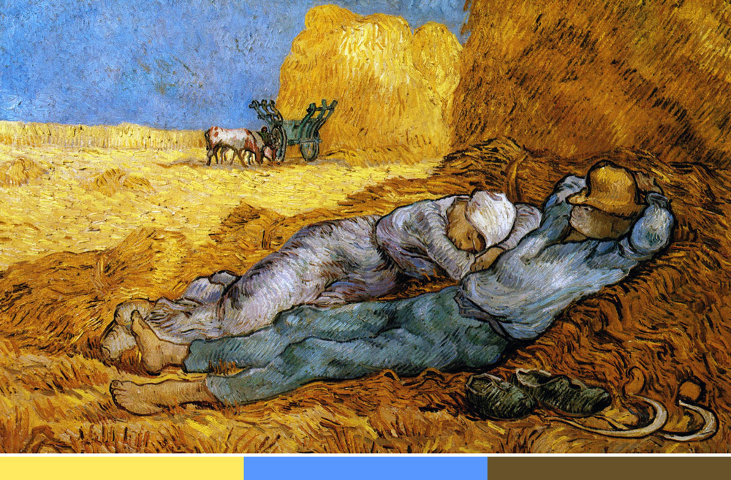
Combining warm and cool
Warm and cool colours can be used together to create a sense of drama, to add interest and contrast, or to balance the temperature of a composition.

Slide 19
Paul Signac painted The Red Buoy using different temperatures of colour. The colours used make this a very bright and vibrant painting. The painting of a harbour in the South of France uses warm colours such as reds, yellows and oranges to communicate a feeling about sunshine and heat. These are balanced by the cool blue of the water and the green shutters. This balance makes the scene look pleasantly warm rather than just hot. Signac’s choice of colour means that the viewer gets a feeling of a warm summer’s night as the sun sets on the village.
The Red Buoy, Paul Signac, 1895, oil on canva

Slide 20
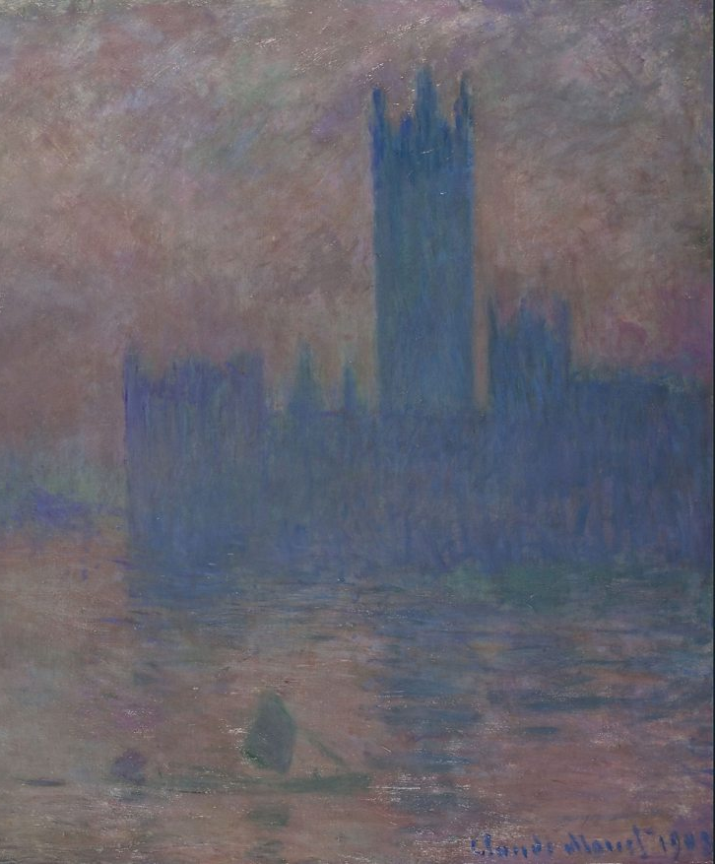
Monet's painting Houses of Parliament (1903) shows a dramatic scene suggesting a sunrise or sunset on a cold winter's day. The warm red, orange and yellow of the sun advance and stand out against the contrasting cool blues and purples which recede into the background.
Houses of Parliament, Claude Monet, 1903, oil on canvas

Slide 21
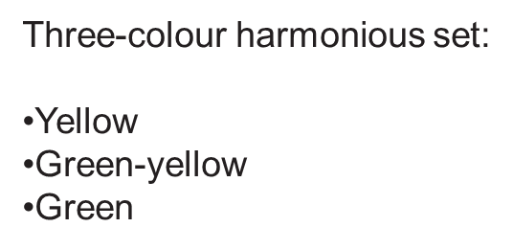
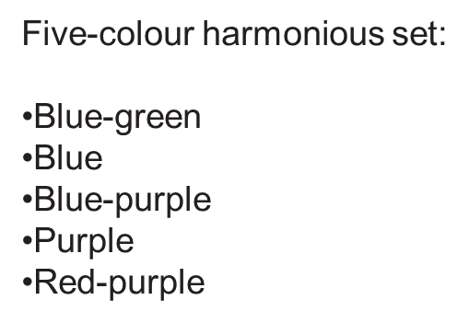
Harmonious Colours
Harmonious colours sit beside each other on the colour wheel. These colours work well together and create an image which is pleasing to the eye.
Harmonious colours may also be referred to as analogous colours.
A harmonious colour scheme uses 3 to 5 colours that are beside each other on the colour wheel.

Slide 22
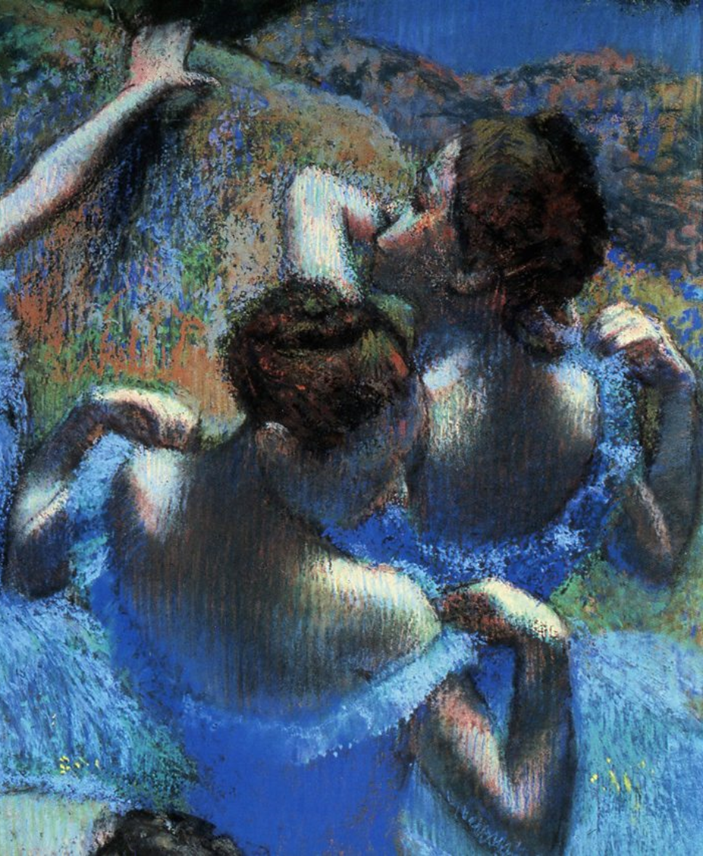
In Blue Dancers (1899) Edgar Degas uses harmonious blue and green pastels that create a calm atmosphere.
Blue, blue-purple and blue-green tints in the dresses are repeated in the background, linking it and the subjects.
These cool colours contrast with warm red, pink and yellow-brown in the dancers’ skin and the space around them.
Blue Dancers, Edgar Degas, c.1899, pastel on paper

Slide 23
In this photograph of Mrs Selma Schubart (Arthur Stieglitz, 1907) the orange tone of the dress harmonises with the lighter tint of the cardigan and with the fallen leaves and red petals on the bench. The use of similar colours creates a sense of harmony between the dress and the natural autumn surroundings. The result is a warm and relaxed composition.
Mrs. Selma Schubart, Alfred Stieglitz, 1907,
autochrome photograph

Slide 24
Complementary Colours
Complementary colours sit across from each other on the colour wheel.
These are often referred to as opposite colours and even contrasting colours.
Don't be confused by the three different names, they all mean the same thing.

Slide 25
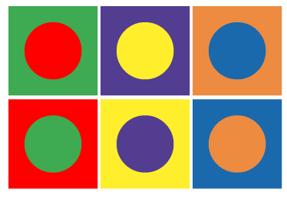
Complementary Colours
When complementary colours are placed next to each other, a very strong contrast is created. The colours appear more vivid and brighter. Some people say these colours clash when used next to each other and create very visually stimulating artwork.

Slide 26
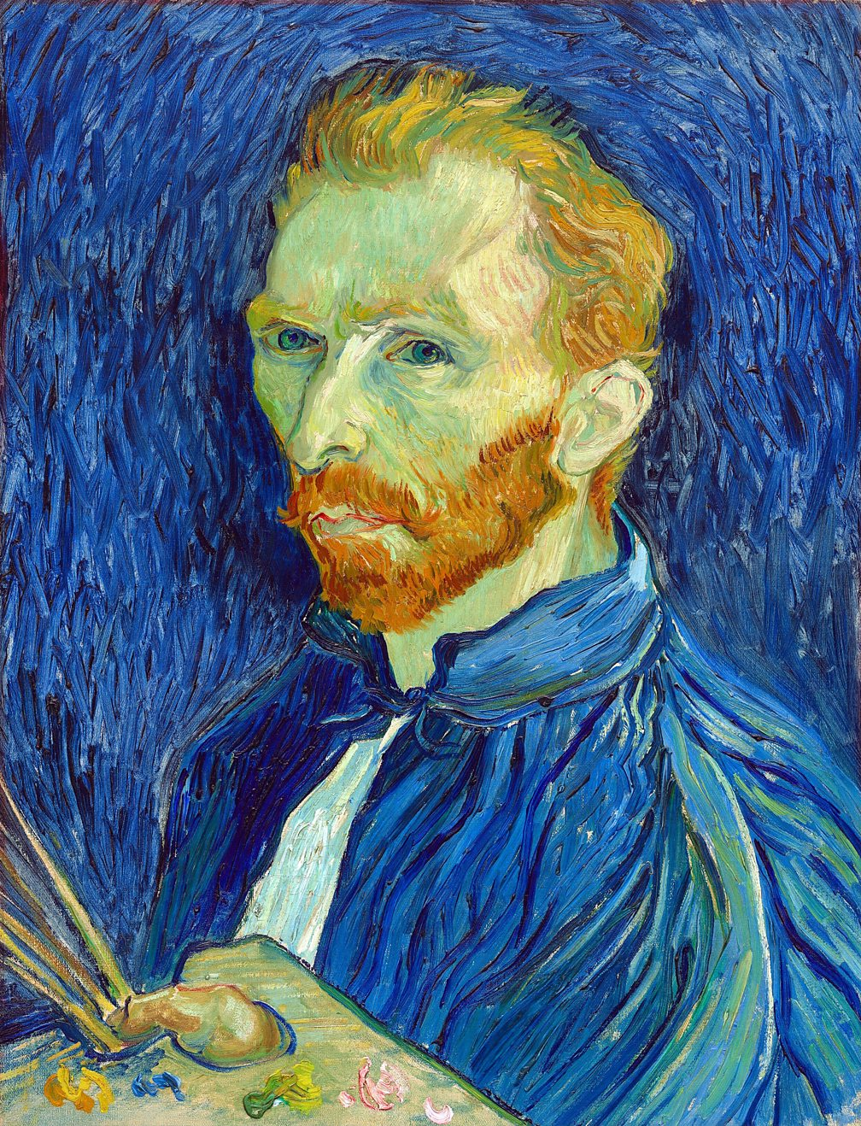
In Van Gogh's Self portrait (1889), the blue of his shirt matches the background colour. The blue complements the bright orange of the beard and hair and the greenish colour of Van Gogh’s face. The painting palette and brushes are similar colours to the artist’s skin. There are patches of orange, green and pink paint on the palette. These make a visual link between the artist and his work that stands out against his surroundings.
Self-portrait, Vincent van Gogh, 1889, oil on canvas

Slide 27
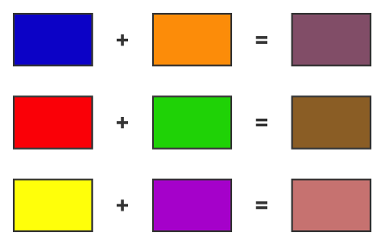
Brown
Sometimes you may see brown referred to as a tertiary or a neutral colour.
Brown can be made in a variety of different ways, however three basic brown colours can be made by mixing complementary colours with each other.
Blue + a small amount of orange = Grey-brown
Red + a small amount of green = Red-brown
Yellow + a small amount of purple = Yellow-brown
By varying the amounts of each of these colours it is possible to make a large range of browns.

Slide 28
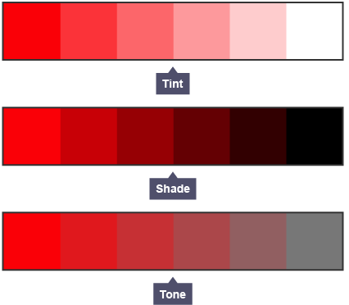
Tints Shades Tones
A tint is where an artist adds a colour to white to create a lighter version of the colour. An example of a tint is pink. Pink is a tint created by adding white to red.
A shade is where an artist adds black to a colour to darken it down.
A tone is where an artist adds grey to a colour.

Slide 29
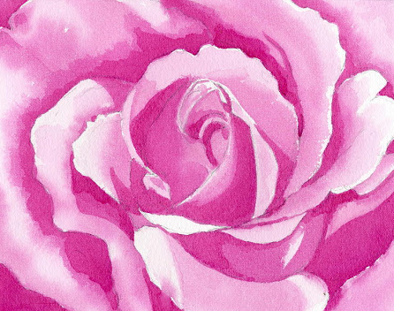
Monochromatic Colours
An artist may decide to create a piece of artwork which is monochromatic.
This means that the artist uses tints, shades and tones of a single colour.

Slide 30
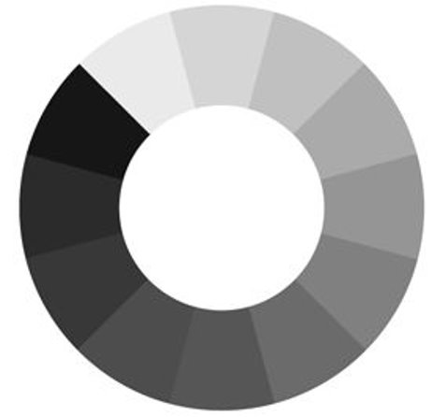
Achromatic Colours
Achromatic means literally “without colour” or lacking hue.​
Black​
Greys​
Whites

Slide 31
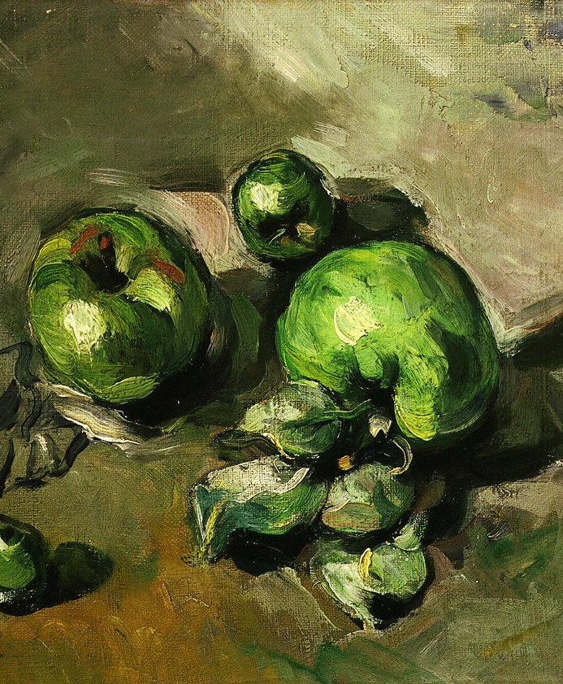
Still Life with Green Apples (Paul Cezanne, 1873) is almost completely monochromatic. The apples are painted using greens that range from very pale near white tints to nearly black shades. The background is made up of green-browns.
Subtle contrast is made between all these greens and three strokes of red on one apple. A small amount of yellow is used to add more variety of colour to the bottom left corner and to the apples and their leaves.
Green Apples, Paul Cezanne, c.1872-73, oil on canvas

Slide 32
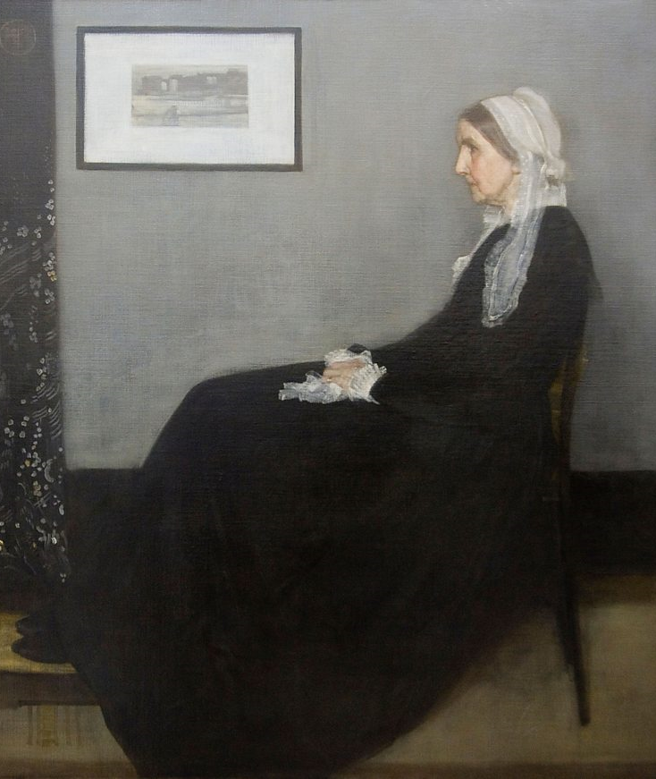
Portrait of the Artist’s Mother (James Whistler, 1871) is almost without colour. The composition is dominated by the large patches of black created by the subject’s dress and the curtain, and the large rectangle of grey wall. There is stark contrast with the white of the picture frame, the woman’s bonnet, cuffs and handkerchief. Neutral browns are used for the floor and the step that the woman’s feet rest on. The woman’s face and hands stand out in this stark composition because the tints and tones of red and yellow used make her skin appear bright and warm.
Portrait of the Artist’s Mother, James Whistler, 1871,
oil on canvas

Slide 33
