Slide 1



P1 Literacy
Parental Workshop
20th January 2026

Slide 2

Phonics
Tricky Words
Reading
How can you help?

Slide 3

Phonics

Slide 4
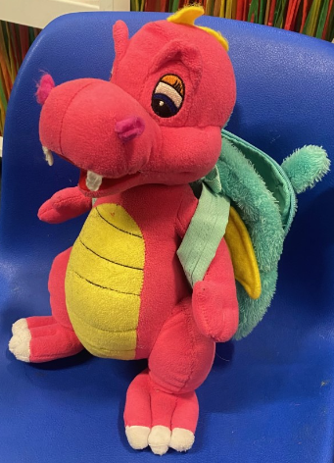

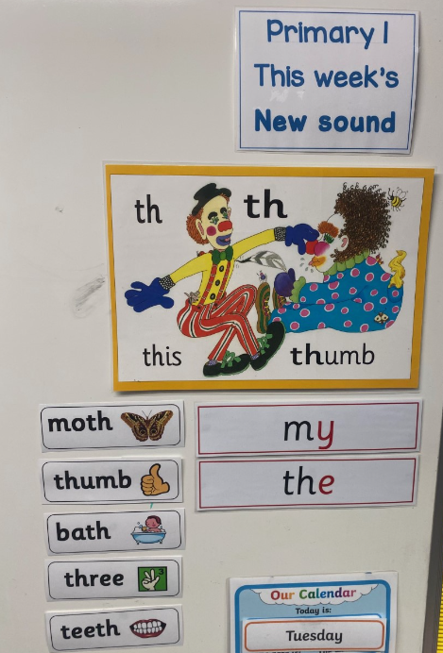


How do we introduce a new sound?
Multi Sensory
Approach
fish
sheep

Slide 5
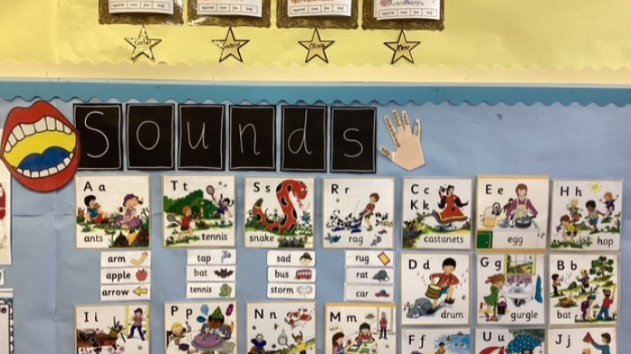

Slide 6

Sunnybank Colour Coding
Red sounds
Yellow sounds
Blue sounds
Black sounds

Slide 7

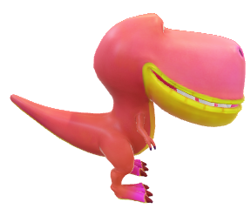
Make sure you are viewing this resource in slideshow mode.
Task
Now, blend with the dinosaur as it moves along.
s
a
t
Click when ready.

Slide 8
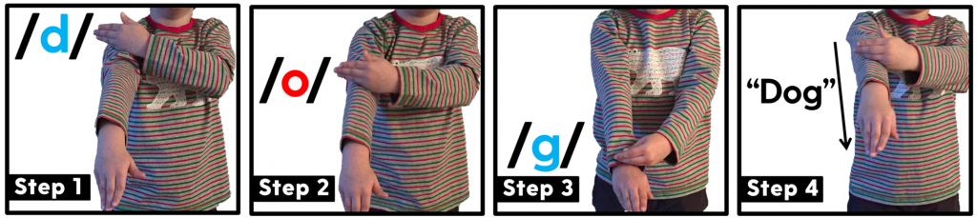
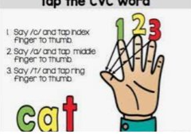
Blending and Segmenting Sounds

Slide 9
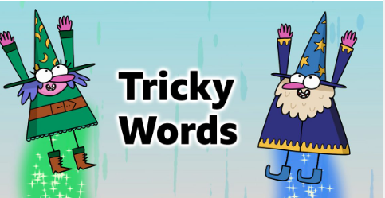

Slide 10




What are they?
Words that cannot be sounded out.
For example the word dog – not tricky
With tricky words if you sound them out and then try to blend the sounds, you will get a word that does not sound right.
They are words that must be recognised by sight.

Slide 11
How do we teach them?
Introduced after all initial sounds are taught- firm understanding.
30 words in total for P1.
We have grouped into “families” where possible
I | the
he | me | be | she | we
go | so | no

Slide 12


Strategies
Look at the word
Sound it out
Tricky Letters – Looking at the position of tricky letters in the word
Give children a sentence with the tricky word
How many sounds are in word? Shape of the word? Tall letters, small letters.

Slide 13

Examples
Tricky part highlighted in red
o

Slide 14


We talk about “e” a lot!!!

Slide 15
Points to note
Tricky words are called tricky for a reason……
Not all children can instantly recognise them
Every child has a different learning process of how they go about learning them- not one size fits all!!
Some children may need more support/time to help retain words
End goal is for the children to instantly recognise the tricky words and be able to apply this in their everyday writing

Slide 16
At Home
1.Confidence
2. Fluency
3.Enjoyment
4.Understanding
Practise

Slide 17
Reading

Slide 18

Spelling
Reading
Phonics

Slide 19
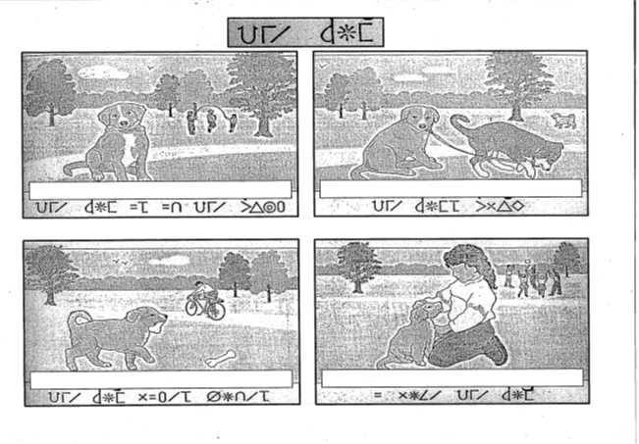

Slide 20
The dog is in the park.
The dogs play.
The dog likes bones.
I love the dog.

Slide 21

What strategies will help me?

Slide 22

sound
it out
look at
the first / last letters
look at
the
pictures
read the sentence again
Can you
spot a phoneme?
break the word into syllables

Slide 23

Guided Reading
Decodable books
Majority 2 books per week
Soon introduce use of PM books
Day 1 – fluency, Day 2 – comprehension

Slide 24


Oral comprehension
Find it / Prove It
Read to write tasks

Slide 25

Ask questions – can they find it?
Can they retell the story in their own words?
Make predictions
Use the pictures for clues
Always refer back to the book!

Slide 26



Slide 27


Slide 28


Slide 30







Some Websites / Apps to support Literacy at home

Slide 31

Questions?

Slide 32
Thank You

