Slide 1

P4 Literacy
Parental Workshop
11th September 2025

Slide 2
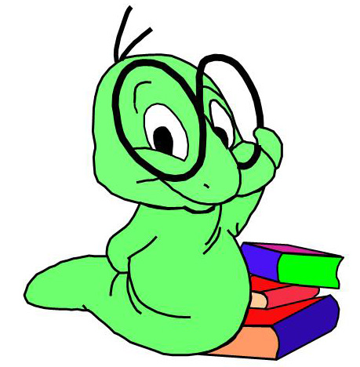
Phonics into Spelling
Reading
Writing
How can you help?
Notes:
This workshop is designed to give you an overview of Literacy in P4 and how we teach spelling, phonics, reading and writing.

Slide 3

Phonics
Notes:
We as a school and authority follow NLC Active Literacy Programme. Generally Stage 1 applies to children in P1, stage 2 – P2 and so on but we know that children don’t all follow the same levels at the same time and some of you here will have children who are ready to move on to stage 4 Literacy programme, others perhaps needing a bit more consolidation at different levels. This is just to give you an insight into what might be expected at P4 levels and in some cases beyond.

Slide 4
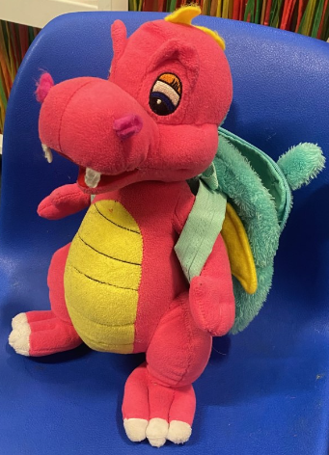
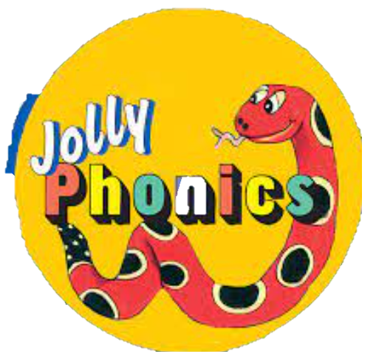
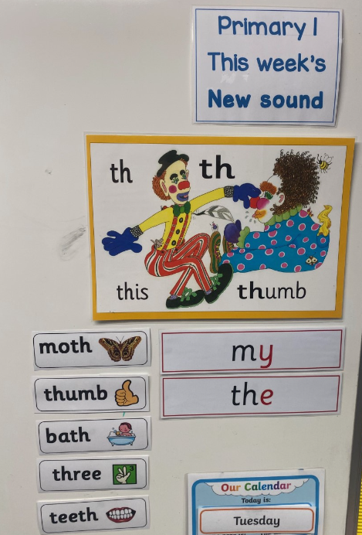

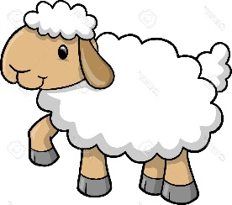
P1 – P3 phonics and spelling
Multi Sensory
Approach
fish
sheep
Notes:
From stage 1 – 3 phonics and spelling were taught as two separate subject areas to enhance children’s skills in word building, reading, writing and spelling. This was very much a multi sensory approach to develop their phonological skills. Children were generally introduced to a new phoneme each week, new spelling words each week and then after a block of 3 weeks would possibly have a consolidation week to revise the previous taught phonemes.

Slide 5

Phonics into Spelling
4 week Programme
2 weeks on Phonics – problem solving approach
2 weeks on Common Words / Spelling Rules – thinking strategies approach
Notes:
Stage 4 and 5 works on a 4 week approach. In week one and two it involves a problem solving approach where the children are using their knowledge of phonics to help with spelling then in weeks three and four it is more of a thinking strategy approach in which children look at strategies to help them spell and spelling rules. At stages 4 and 5 the two areas are combined in which the teacher now teaches one daily session.

Slide 6
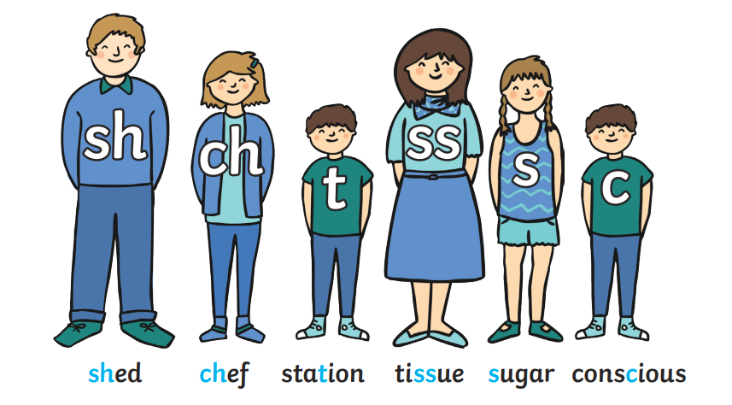
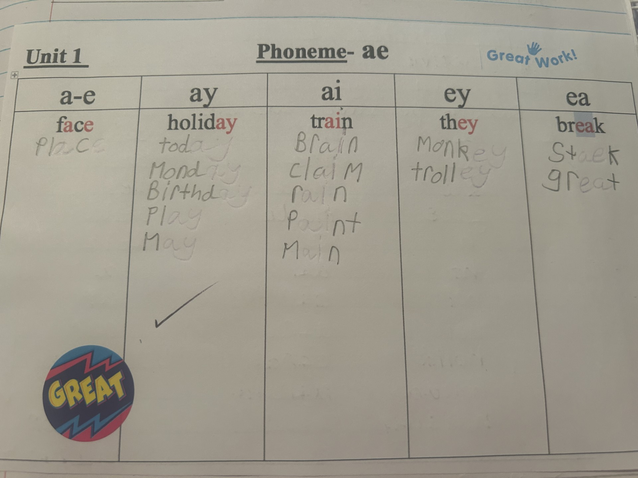

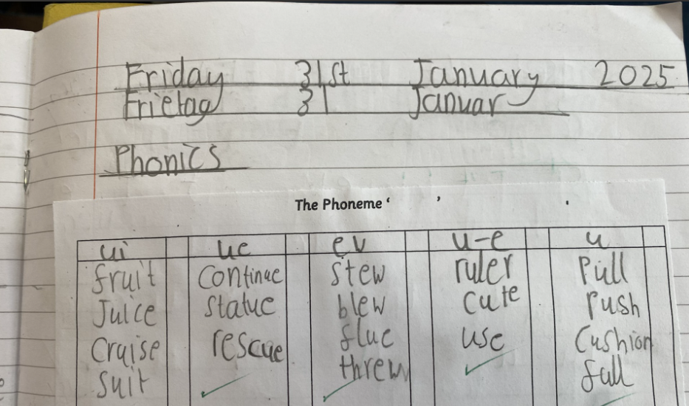

Phoneme Representations
15 Units
P4 – units 1 – 7, P5 – Units 8 - 15
Notes:
Within the stage 4 -7 programme children are encouraged to think, investigate and build up words with different phoneme representations. They will use their knowledge of all previously taught phonemes (and by phonemes we mean two or more letters making one sound) but begin to group the phonemes into different families and looking at the different representations. There are 44 taught phonemes across stages 1 -3 that are introduced progressively to build reading and spelling skills. Now in stages 4 and 5 we look at those phonemes together to try and distinguish the correct way to spell words using these phonemes. So the example on the screen is ‘a’ – they would be investigating all of the different ways to make a which they have met before, for example ay, ai, a-e, ea, ey. Children would create a phoneme chart with the teacher and then by themselves another day to explore the different spellings of words with the same sound. There would be lots of discussion and playing about with words together when they introduce this.

Slide 7
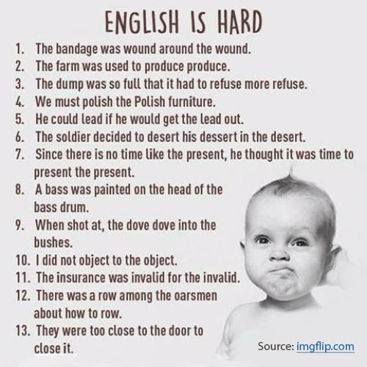
Notes:
This is hard – we have so many different ways of pronouncing the same phoneme visually in the English Language!

Slide 8
The phoneme ‘oe’

Slide 9

Phoneme Stories / Dictation - ee
Unit 2 Phoneme Story (Core)
It happened yesterday on my way home from the shops. Mum had agreed to let me go on ahead. As I walked along the street towards my house, I could see the back door was lying open.
‘There is something strange going on here,’ I thought.
Indeed there was. I couldn’t believe my eyes. A man was leaving my house with pieces of jewellery in his hands. I was so shocked I was not able to speak. Thankfully, a quick acting neighbour saw the thief and chased him down the street and into a field. Others realised what was happening and three more men joined in the chase. But the young thief was too quick and he got away.
When Mother reached the house she was upset but relieved that the thief had been disturbed and had not taken very much.
‘This will teach us all a lesson. We must be more careful and make sure we lock up carefully. We shouldn’t make it easy for a thief to get into houses,’ she said to me.
Notes:
Similar to stage 1 – 3, children are often introduced to the phoneme through a stimulus such as a phoneme story. This may be read aloud by the teacher or the children or accessed through ICT. Here is the phoneme ee as another example, children would be asked to think about the different representations of ee and then asked to identify examples of these in the text.

Slide 10
Phoneme Stories / Dictation
Unit 2 Phoneme Story (Core)
It happened yesterday on my way home from the shops. Mum had agreed to let me go on ahead. As I walked along the street towards my house, I could see the back door was lying open.
‘There is something strange going on here,’ I thought.
Indeed there was. I couldn’t believe my eyes. A man was leaving my house with pieces of jewellery in his hands. I was so shocked I was not able to speak. Thankfully, a quick acting neighbour saw the thief and chased him down the street and into a field. Others realised what was happening and three more men joined in the chase. But the young thief was too quick and he got away.
When Mother reached the house she was upset but relieved that the thief had been disturbed and had not taken very much.
‘This will teach us all a lesson. We must be more careful and make sure we lock up carefully. We shouldn’t make it easy for a thief to get into houses,’ she said to me.

Slide 11
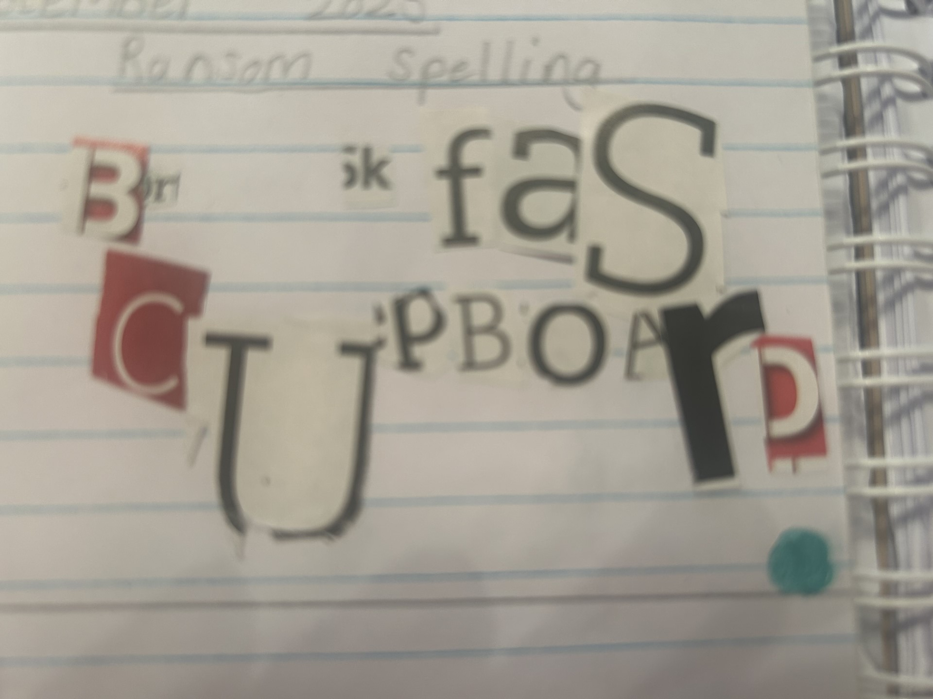
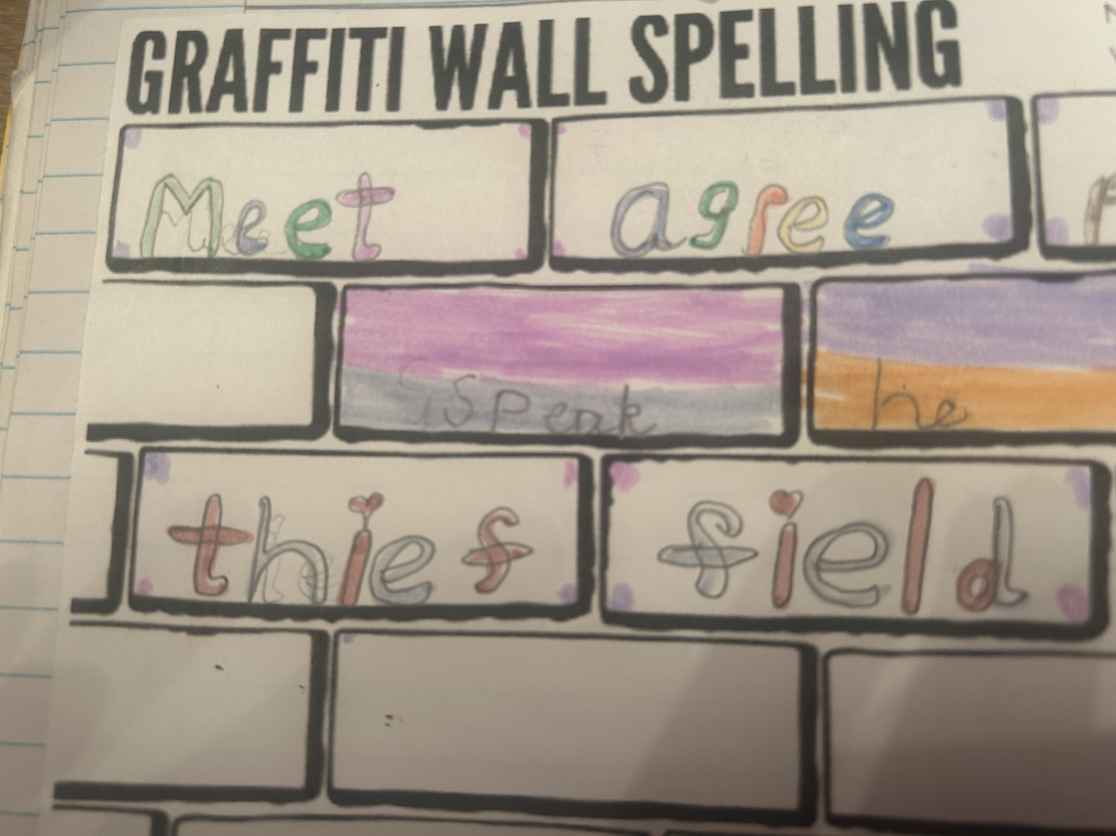
G | a | r | t | c | o | sh
Notes:
As part of the phonological awareness elkonin boxes may be used – this is when the children break down the word into the smallest units of sound. The rules with these boxes is one box for one sound. This is not something new to the children, they will have done this in stage 2 and 3.

Slide 12

Diacritical Marking??
Single sound
Joined Phoneme
Split Phoneme
Notes:
This method of Elkonin boxes then supports them with something that is new – Diacritical marking. Within diacritical marking there is a code. . is a single sound, _ is a joined phoneme and arch is a split phoneme, magic e.

Slide 13
Single sound
Joined Phoneme
Split Phoneme
cat shop shape shaken
Notes:
A wee reminder or health warning when it comes to phonics and spelling. Children spell a word how they hear it so correct use of phonics and speech is vital. We need to ensure that we are modelling correct use of language and encouraging the children to do so as well. Its not the first time I’ve said to children ‘there’s a t in that word’. So its just a polite reminder if you can do the same and just encourage the correct pronunciation and articulation of sounds in words.
In stages 6 and 7 there is more of a focus on the structure and meaning of words but phonological awareness is key to being able to access this. Phonological awareness links with spelling, reading and writing which is obviously at the centre of accessing most parts of the curriculum. Children can’t progress onto stage 6 and 7 literacy if the foundations aren’t there beforehand.

Slide 14
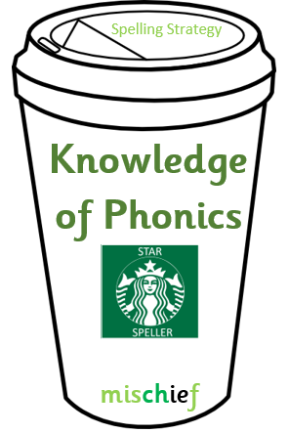
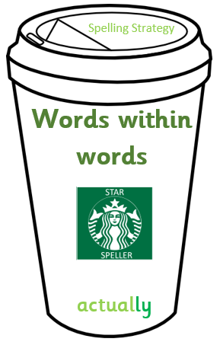
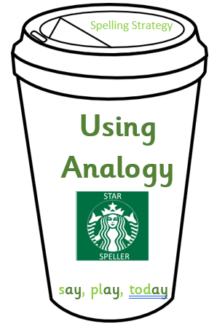
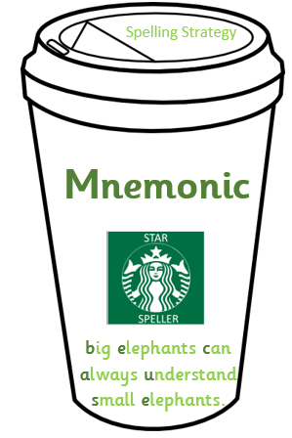
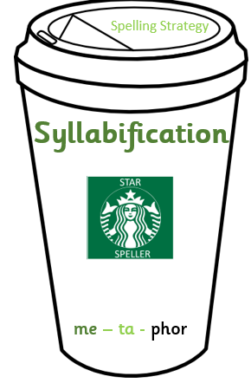
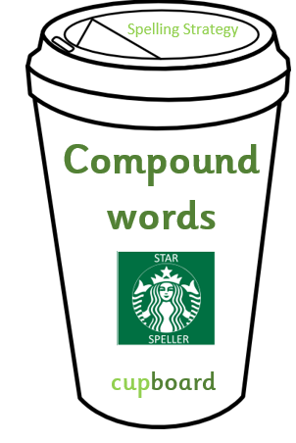
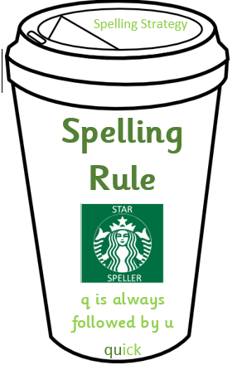
Weeks 3 and 4 – Spelling
Spelling
Strategies
Notes:
Within stage 4 and 5 the children are explicitly taught spelling strategies and spelling rules, within 6 and 7 the children the children are expected to use these automatically and independently.
The strategies are
sounding out – links there with the diacritical marking
syllabification - breaking words into syllables, each part syllable containing a vowel going, remember, yesterday
words within words – looking at smaller words hidden that they already know for example – example – exam, ample
compound words – two words joined to make one word, strawberry, homework
using analogy – if you know how to spell one word, you can do others, e.g. light, bright, might, fight etc
mnemonic – memory aid, because (big elephants) could – c, oh you lucky duck)

Slide 15
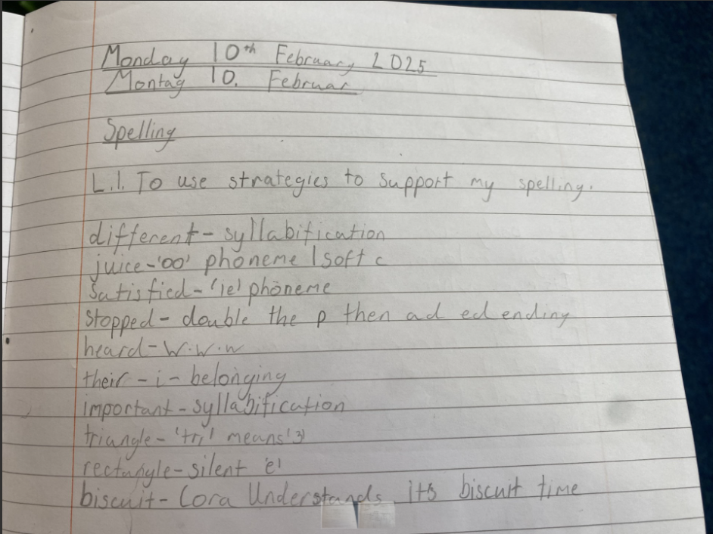

Slide 16
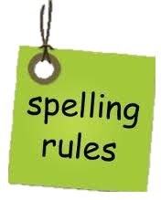
ck is used after a short vowel.
i before e except after c
prefix all written with one l
q is always followed by u
soft c
ed at the end of words can have 3 different sounds
soft g
suffix full written with one l
Notes:
spelling rules – there are lots of spelling rules that children will look at such as I before e except after c, q is always followed by u, ed can make different sounds at the end of words for example jumped (t), wanted , lived
children are encouraged to think about all of these strategies and rules if they become stuck at spelling a word. They will work on various activities throughout the week to explore these rules or strategies using a variety of words.

Slide 17
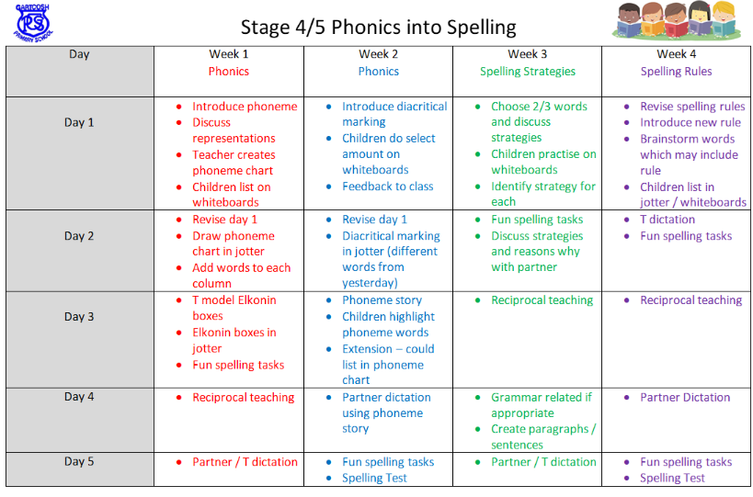
Notes:
Children will be involved in many different activities to help support their phonics and spelling but spelling needs to be taught, heavily teacher input at the start of the week and then more child led nearer the end e.g. reciprocal teaching with partners or partner dictation.

Slide 18

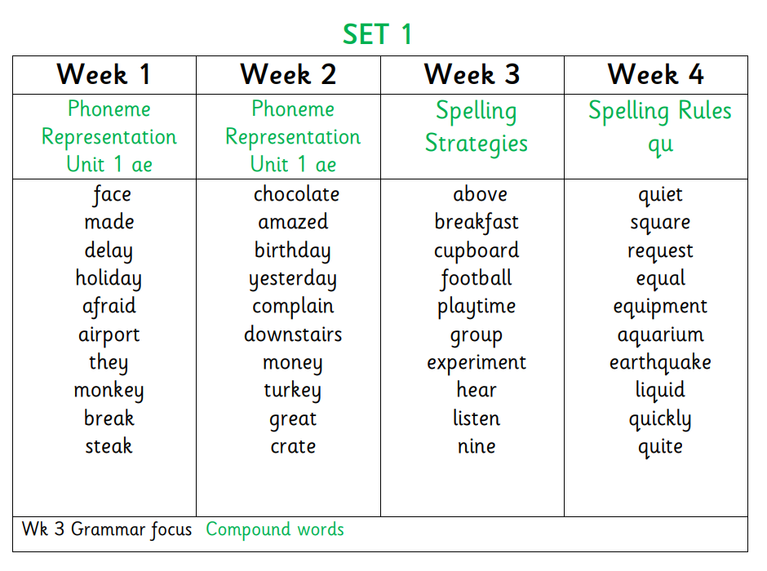
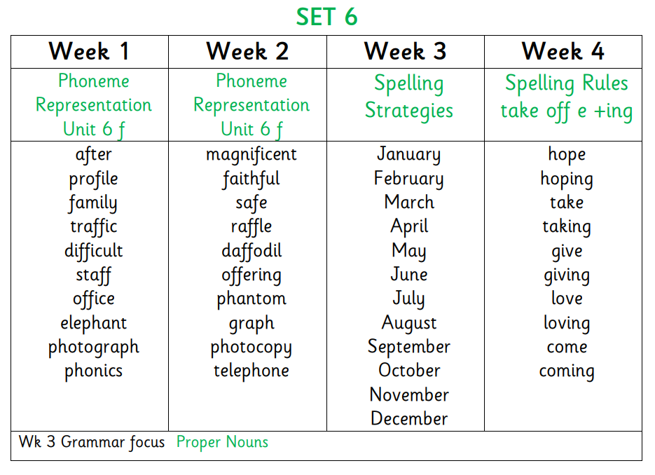
Notes:
Grammar is tied in to the spelling programme where there are natural links, e.g. compound words / Proper Nouns.

Slide 19

Questions?

Slide 20

Reading

Slide 21
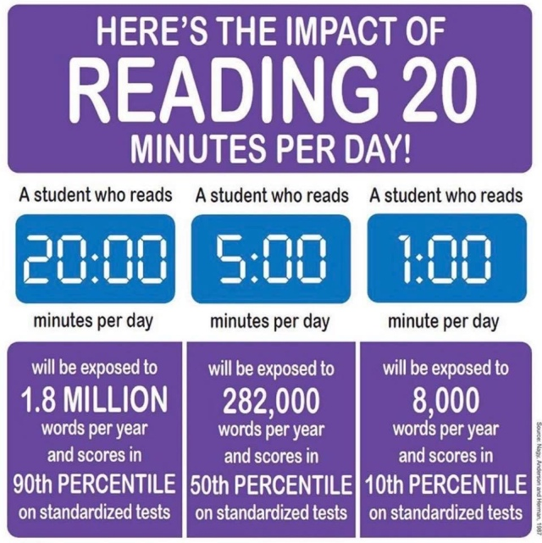
Why read?
Notes:
Literacy permeates everything in the curriculum and reading is such a huge part of this. Even just 20 minutes a day can make a big difference. We know that busy family life can get in the way but it can really help expose children to a wide range of vocabulary which can in turn help in assessments.

Slide 22





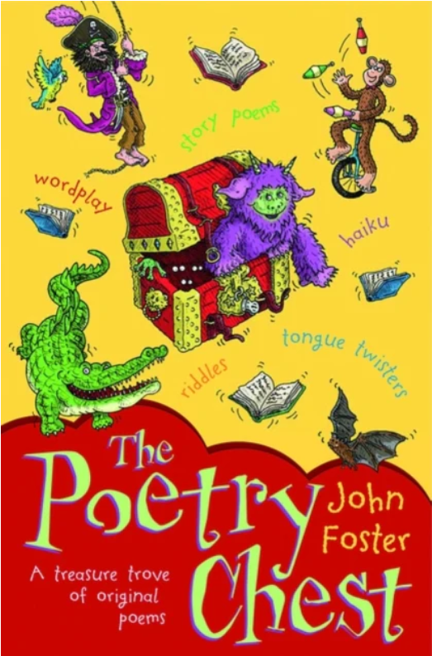
The Skills of Reading
Fluency, expression, pace, accuracy​.
Reading unfamiliar words.
Skimming and scanning.
Answering different types of questions.
Predicting and summarising​.
Notes:
In class, the children will focus on these skills of reading.

Slide 23
North Lanarkshire Reading Programme
Comprehension Strategies
Prior Knowledge
Main Theme
Inference
Metalinguistics
Visualisation
Summary
Notes:
As part of the NLC Active Literacy programme the children are taught these comprehension strategies to support them in their understanding of the texts.
Prior Knowledge – can we use what we know about an author / character / setting to help us understand and predict what might happen?
Main Theme – what is this book about? Is it about friendship / love / good over evil etc?
Inference – the little things that might not be sad explicitly but help to build a bigger picture.
Metalinguistics – tricky words
Visualisation – can you use words or phrases to help build an image of what is happening or what a character might look like?
Summary – can you pick out the key parts of what is happening and put in your own words?

Slide 24

Read to Write Tasks
Diary entry
Alternative ending
Newspaper report
Film synopsis
Write a new blurb
Notes:
Children will be given lots of opportunities for daily writing linked to the books, here are some examples of what these could be.

Slide 25
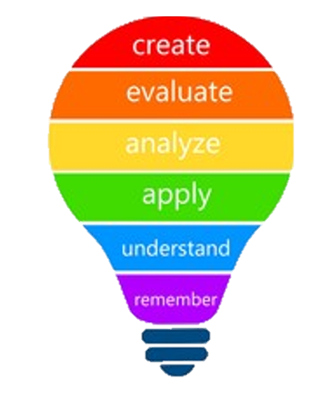
Blooms Taxonomy
Questioning that develops Higher Order Thinking skills.
Notes:
As a school we are developing the children’s higher order thinking and will use this to help plan for discussions and writing tasks.

Slide 26
Reading at Home
Support your child in reading accurately
Encourage expressive reading.
Support with the meaning of unfamiliar words.
Ask questions about what they have read.
Notes:
When your child is reading at home, please have a look at how you could help them get the most from that.

Slide 27

Reading at Home
Support your child in reading accurately
sound
it out
look at
the first /last
letters
Can you
spot a phoneme?
look at
the
pictures
read the sentence again
break the word into syllables
Notes:
Children are always encouraged to read accurately but should also be encouraged to have a go at reading tricky words. A much as it can be tempting to just give your child the word, encourage them to try these word attack strategies.

Slide 28

Reading at Home
Encourage expressive reading.

Slide 29
Reading at Home
Ask questions about what they have read.
Can you summarise what has just happened?
Why do you think that happened?
What do you think is going to happen next?
Which words tell you that the character is feeling……?
What would you have done if…..?

Slide 30
Reading at Home
Metalinguistic Strategies:
Re-read the sentence
Read the section before/after
Find similar words
Support with the meaning of unfamiliar words.
‘He stood there for a moment longer, thinking back to that morning when she’d come with him to the north end and he’d blurted out that question about her mother. Whatever had happened must have been awful or else she would never have been so upset. He looked inside the window and saw Maria’s long hair shining and glistening in the light. He had to find some way of saying sorry. He had to.’
Notes:
Metalinguistics just means tricky words. In school children are asked to try and work out the meaning of tricky words from clues in the text.

Slide 31

Reading at Home
  Encourage independent reading:
  Visit the local library
  Give books as presents
  Make reading an enjoyable activity that you do at the same time
  No distractions
  Set up a bookshelf
  Don’t force it!
  Reading doesn’t just mean books!
  Audio books – listen together and
  then talk about it afterwards
  Instructions
  Websites
  Recipes
  Song lyrics
  Magazines and comics
  Even subtitles on the TV!

Slide 32

Promoting Reading for Pleasure
Encouraging children to read different texts
Developing a positive culture of Reading
Notes:
As a school we are working towards becoming a Reading School and will be promoting reading for pleasure. All classes will be involved in DEAR time (Drop Everything And Read) to encourage a love of literature.

Slide 33

Writing
Fictional/narrative writing
characterisation
plot and setting development
dialogue
suspense
Non fiction genres
Information report
Instructions
Explanation text
Recount
Persuasive
Discursive (later stages)
Notes:
Writing – in school at P4 we will cover these types of writing.

Slide 34
Writing – Core Targets
Legible writing:
  Small letters are the same size.
  Tall letters touch the top line.
  Letters like j, p and y are under the line.
Accurate spelling of most commonly used words Use full stops and capital letters with increasing
accuracy
Use some other forms of punctuation ? ! Starting sentences in different ways.
Using the correct tense. Using paragraphs to separate thoughts / ideas
Making sure that capital letters are used where Using common conjunctions to link sentences
needed. (eg. and, because, but, so, then).
Checking and editing work.
Notes:
Children will learn about writing targets and these are the core targets expected at P4 level. In order to achieve First Level within Primary 4, the majority of these targets should be met.

Slide 35






Writing at Home
Don’t force it
Be positive – give praise and make it specific
Don’t point out every mistake – focus on one or 2 core targets.
Remember that every child learns at a different pace.

Slide 36
Questions?

Slide 37
Thank you
Notes:
Thank you for taking the time to look over this, if you have any questions then please do not hesitate to contact the school.

