Slide 1

P1 Literacy
Parental Workshop
26th February 2025

Slide 2

Phonics
Tricky Words
Reading
How can you help?

Slide 3

Phonics

Slide 4
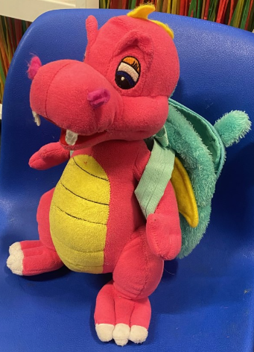

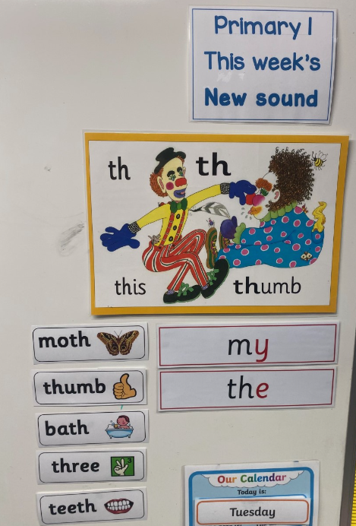


How do we introduce a new sound?
Multi Sensory
Approach
fish
sheep

Slide 5

Sunnybank Colour Coding
Red sounds
Yellow sounds
Blue sounds
Black sounds

Slide 6

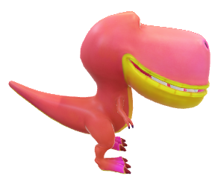
Make sure you are viewing this resource in slideshow mode.
Task
Now, blend with the dinosaur as it moves along.
s
a
t
Click when ready.

Slide 7
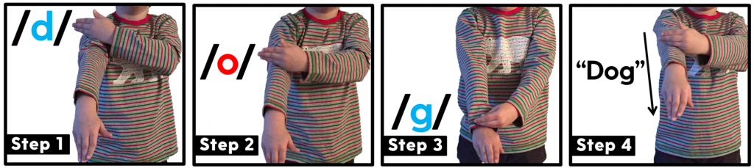
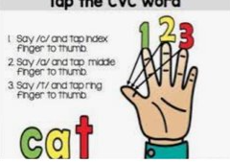
Blending and Segmenting Sounds

Slide 8
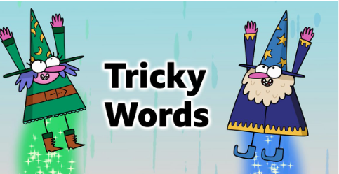

Slide 9




What are they?
Words that cannot be sounded out.
For example the word dog – not tricky
With tricky words if you sound them out and then try to blend the sounds, you will get a word that does not sound right.
They are words that must be recognised by sight.

Slide 10
How do we teach them?
Introduced after all initial sounds are taught- firm understanding.
30 words in total for P1.
We have grouped into “families” where possible
I | the
he | me | be | she | we
go | so | no

Slide 11


Strategies
Look at the word
Sound it out
Tricky Letters – Looking at the position of tricky letters in the word
Give children a sentence with the tricky word
How many sounds are in word? Shape of the word? Tall letters, small letters.

Slide 12

Examples
Tricky part highlighted in red
o

Slide 13


We talk about “e” a lot!!!

Slide 14
Points to note
Tricky words are called tricky for a reason……
Not all children can instantly recognise them
Every child has a different learning process of how they go about learning them- not one size fits all!!
Some children may need more support/time to help retain words
End goal is for the children to instantly recognise the tricky words and be able to apply this in their everyday writing

Slide 15
At Home
1.Confidence
2. Fluency
3.Enjoyment
4.Understanding
Practise

Slide 16

Reading

Slide 17

Spelling
Reading
Phonics

Slide 18
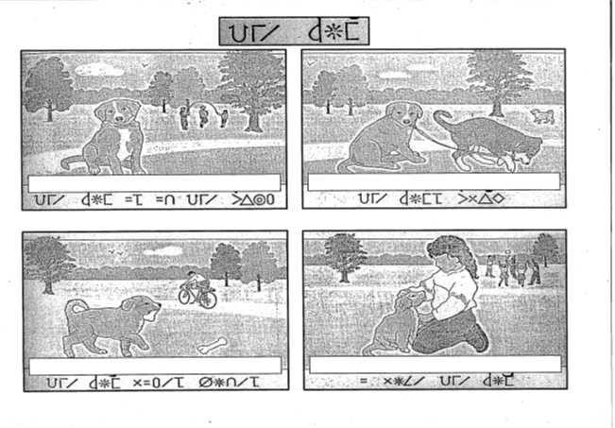

Slide 19
The dog is in the park.
The dogs play.
The dog likes bones.
I love the dog.

Slide 20

What strategies will help me?

Slide 21

sound
it out
look at
the first / last letters
look at
the
pictures
read the sentence again
Can you
spot a phoneme?
break the word into syllables

Slide 22

Guided Reading
Decodable books
Majority 2 books per week
Soon introduce use of PM books
Day 1 – fluency, Day 2 – comprehension

Slide 23


Oral comprehension
Find it / Prove It
Read to write tasks

Slide 24

Ask questions – can they find it?
Can they retell the story in their own words?
Make predictions
Use the pictures for clues
Always refer back to the book!

Slide 25
Have a go!

Slide 26



Slide 27

Reading at Home
Encourage independent reading:
Visit the local library
Give books as presents
Make reading an enjoyable activity that you do at the same time
No distractions
Set up a bookshelf
Don’t force it!
Reading doesn’t just mean books!
Audio books – listen together and
then talk about it afterwards
Instructions
Websites
Recipes
Song lyrics
Magazines and comics
Even subtitles on the TV!

Slide 28

Promoting Reading for Pleasure
Encouraging children to read different texts
Developing a positive culture of Reading

Slide 29


Slide 30







Some Websites / Apps to support Literacy at home

Slide 31

Questions?

Slide 32
Thank You

