Slide 1

P4 Literacy
Parental Workshop
20th February 2024

Slide 2

Phonics into Spelling
Reading
Writing
How can you help?

Slide 3

Phonics

Slide 4
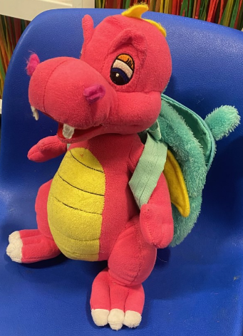

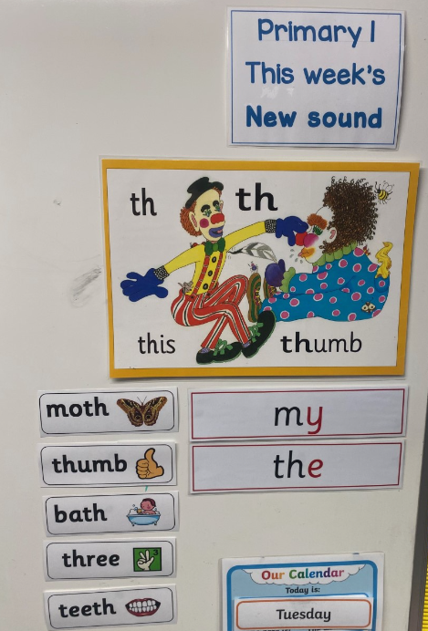

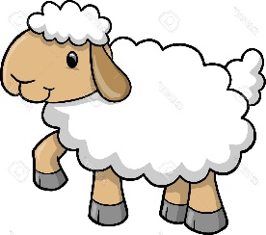
P1 – P3 phonics and spelling
Multi Sensory
Approach
fish
sheep

Slide 5

Phonics into Spelling
4 week Programme
2 weeks on Phonics – problem solving approach
2 weeks on Common Words / Spelling Rules – thinking strategies approach

Slide 6
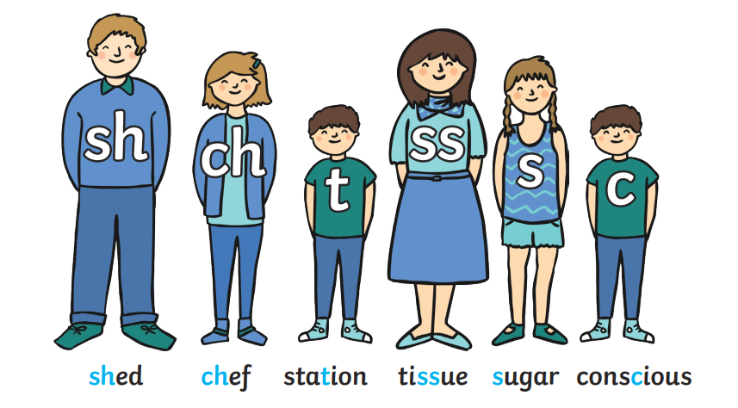
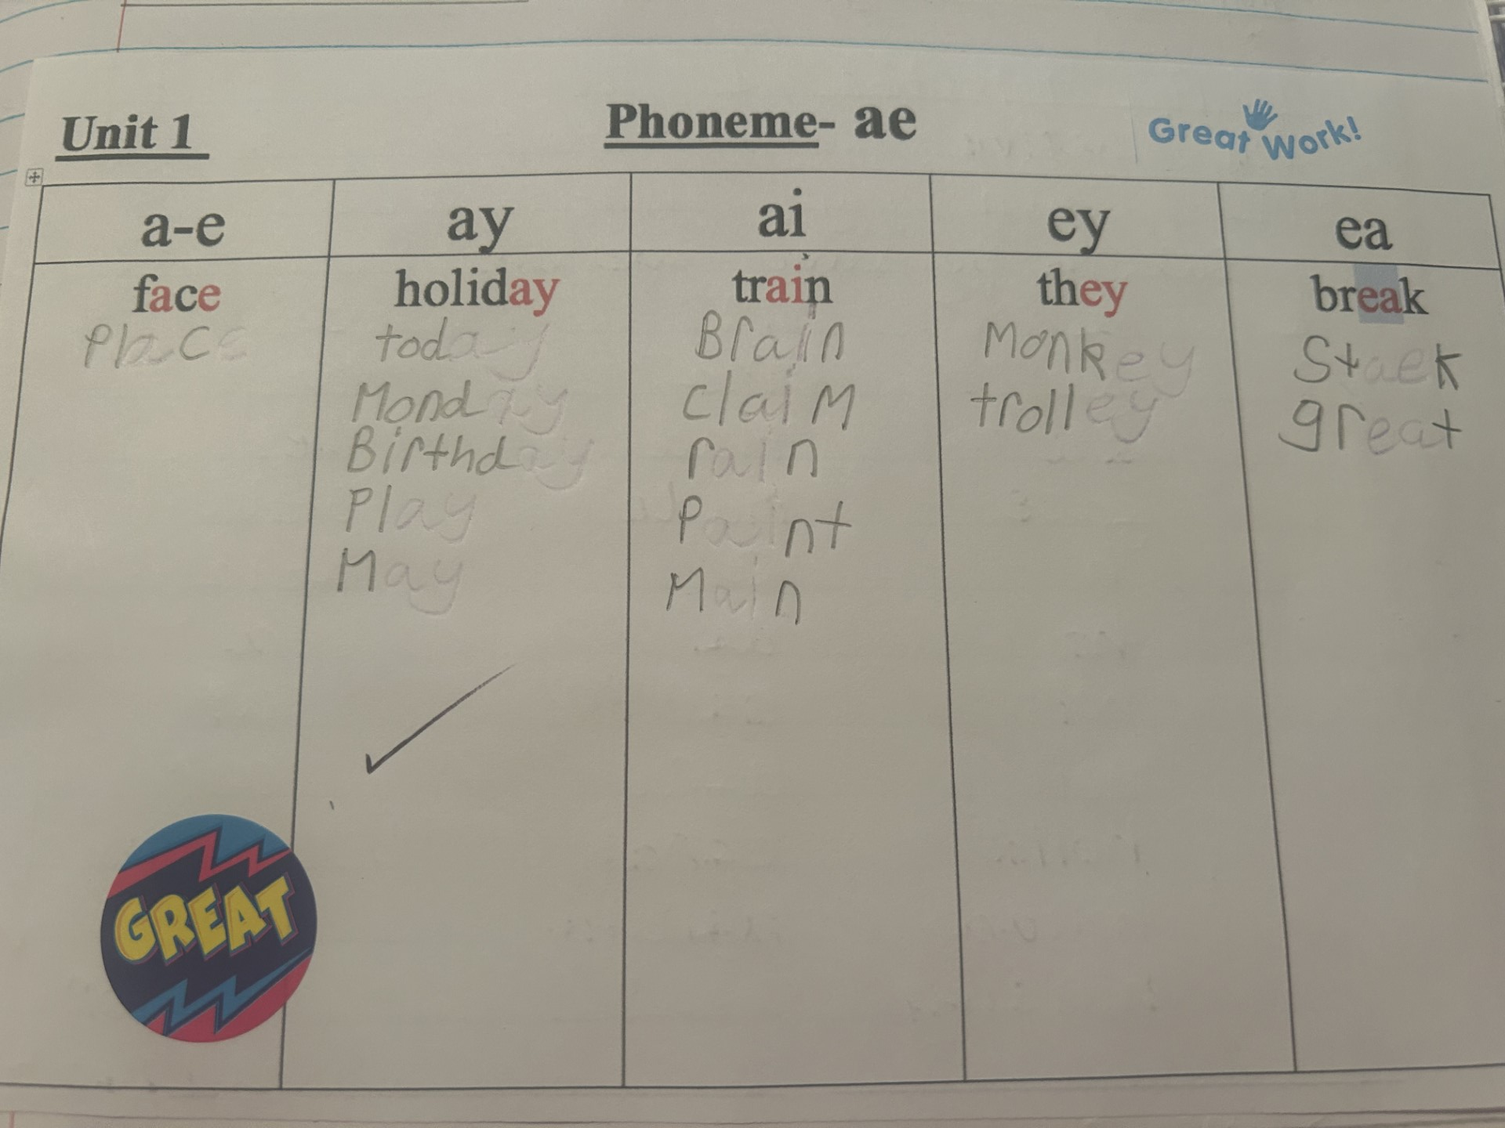


Phoneme Representations
15 Units
P4 – units 1 – 7, P5 – Units 8 - 15

Slide 7
The phoneme ‘oe’
oe
oa
o - e
ow
o
potatoes coach whole window no
goes toast those know so
heroes groan telephone shallow go

Slide 8
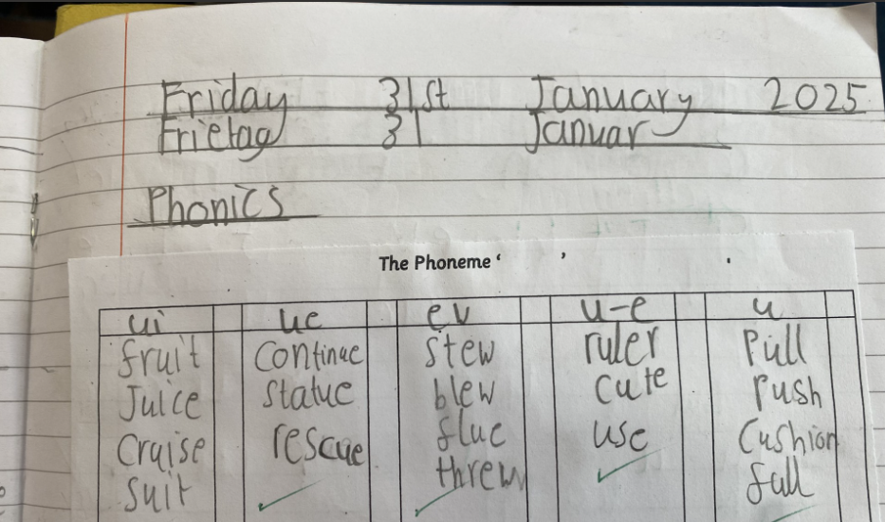

Slide 9

Phoneme Stories / Dictation - ee
Unit 2 Phoneme Story (Core)
It happened yesterday on my way home from the shops. Mum had agreed to let me go on ahead. As I walked along the street towards my house, I could see the back door was lying open.
‘There is something strange going on here,’ I thought.
Indeed there was. I couldn’t believe my eyes. A man was leaving my house with pieces of jewellery in his hands. I was so shocked I was not able to speak. Thankfully, a quick acting neighbour saw the thief and chased him down the street and into a field. Others realised what was happening and three more men joined in the chase. But the young thief was too quick and he got away.
When Mother reached the house she was upset but relieved that the thief had been disturbed and had not taken very much.
‘This will teach us all a lesson. We must be more careful and make sure we lock up carefully. We shouldn’t make it easy for a thief to get into houses,’ she said to me.

Slide 10
Phoneme Stories / Dictation
Unit 2 Phoneme Story (Core)
It happened yesterday on my way home from the shops. Mum had agreed to let me go on ahead. As I walked along the street towards my house, I could see the back door was lying open.
‘There is something strange going on here,’ I thought.
Indeed there was. I couldn’t believe my eyes. A man was leaving my house with pieces of jewellery in his hands. I was so shocked I was not able to speak. Thankfully, a quick acting neighbour saw the thief and chased him down the street and into a field. Others realised what was happening and three more men joined in the chase. But the young thief was too quick and he got away.
When Mother reached the house she was upset but relieved that the thief had been disturbed and had not taken very much.
‘This will teach us all a lesson. We must be more careful and make sure we lock up carefully. We shouldn’t make it easy for a thief to get into houses,’ she said to me.

Slide 11

Diacritical Marking??
Single sound
Joined Phoneme
Split Phoneme

Slide 12
Single sound
Joined Phoneme
Split Phoneme
cat shop shape shaken

Slide 13
Single sound
Joined Phoneme
Split Phoneme
cat shop shape shaken

Slide 14
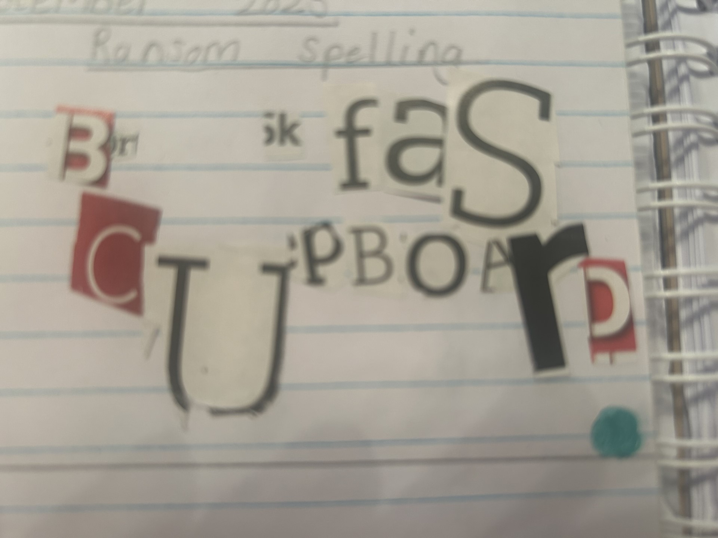
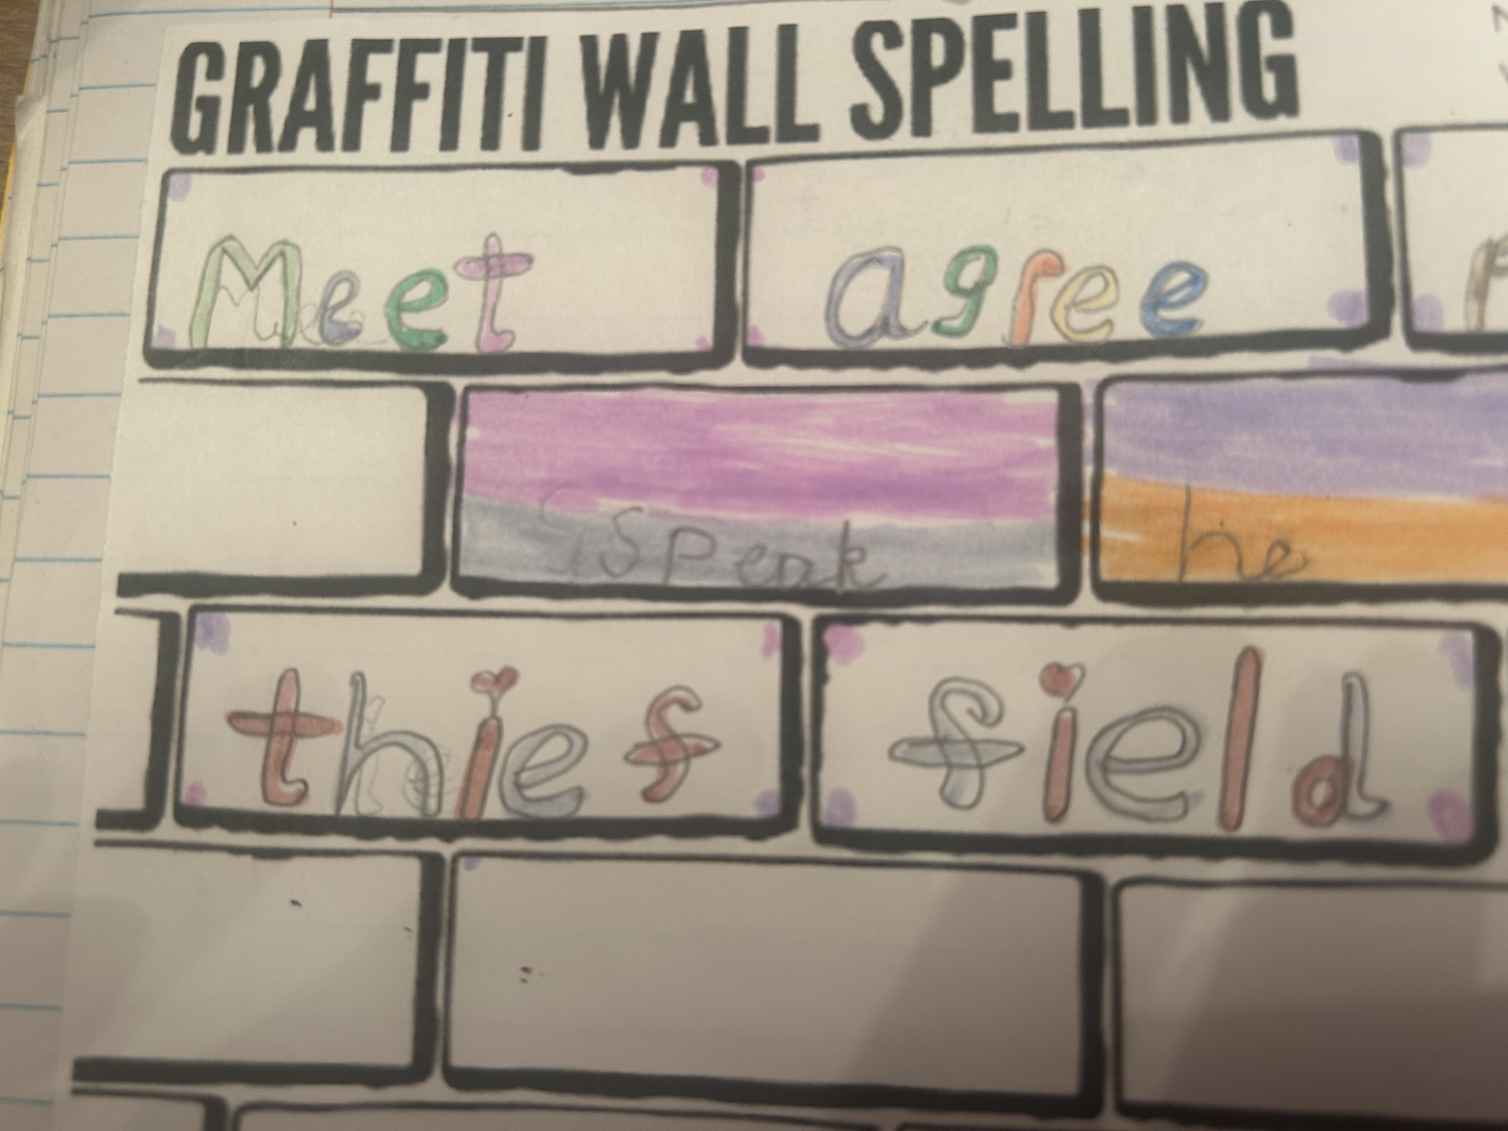
G | a | r | t | c | o | sh

Slide 15


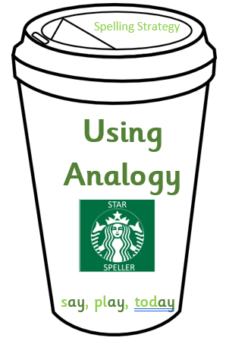
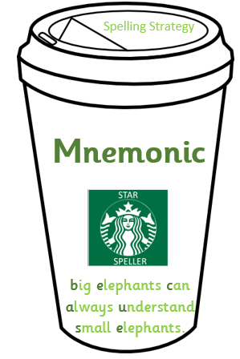



Weeks 3 and 4 – Spelling
Spelling
Strategies

Slide 16
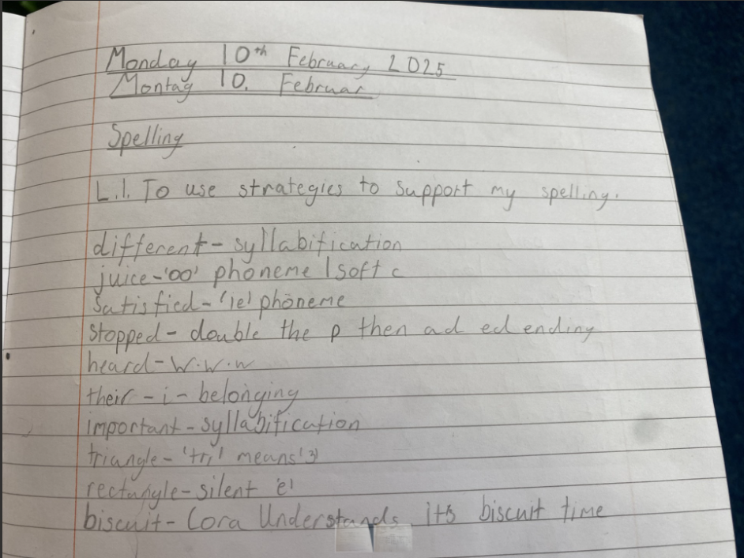

Slide 17

ck is used after a short vowel.
i before e except after c
prefix all written with one l
q is always followed by u
soft c
ed at the end of words can have 3 different sounds
soft g
suffix full written with one l

Slide 18

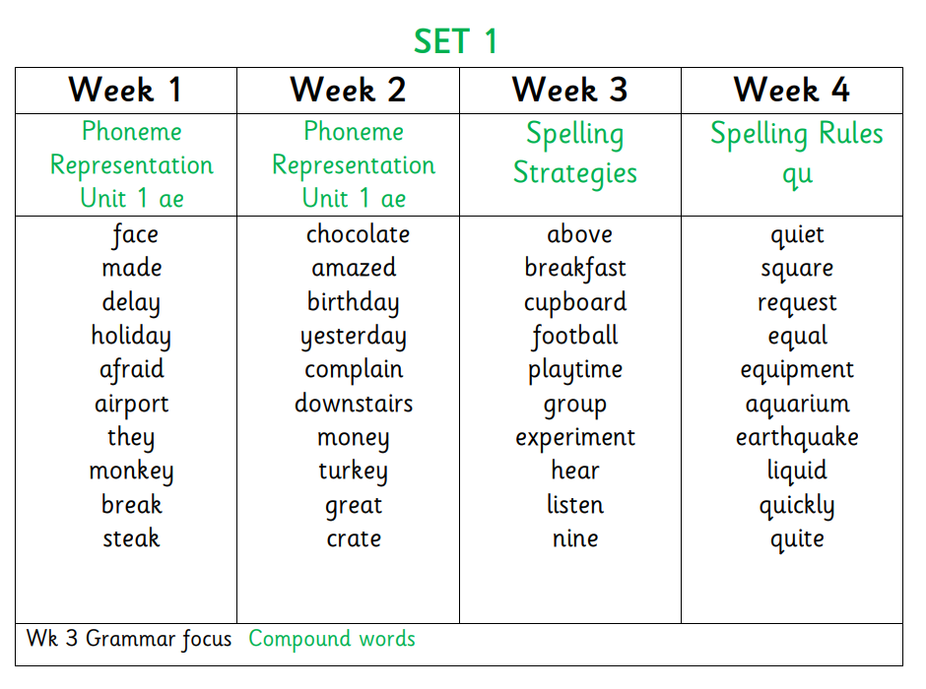
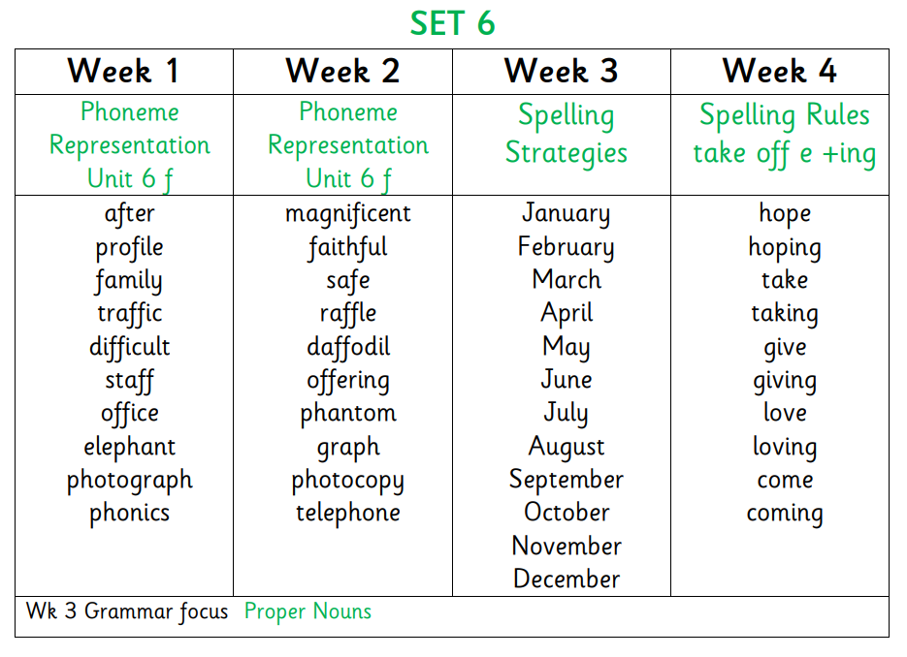

Slide 19

Questions?

Slide 20

Reading

Slide 21

Why read?

Slide 22






The Skills of Reading
Fluency, expression, pace, accuracy​.
Reading unfamiliar words.
Skimming and scanning.
Answering different types of questions.
Predicting and summarising​.

Slide 23
North Lanarkshire Reading Programme
Comprehension Strategies
Prior Knowledge
Main Theme
Inference
Metalinguistics
Visualisation
Summary

Slide 24

Read to Write Tasks
Diary entry
Alternative ending
Newspaper report
Film synopsis
Write a new blurb

Slide 25

Blooms Taxonomy
Questioning that develops Higher Order Thinking skills.

Slide 26
Reading at Home
Support your child in reading accurately
Encourage expressive reading.
Support with the meaning of unfamiliar words.
Ask questions about what they have read.

Slide 27

Reading at Home
sound
it out
Support your child in reading accurately
look at
the first /last
letters
Can you
spot a phoneme?
look at
the
pictures
read the sentence again
break the word into syllables

Slide 28

Reading at Home
Encourage expressive reading.

Slide 29
Reading at Home
Ask questions about what they have read.
Can you summarise what has just happened?
Why do you think that happened?
What do you think is going to happen next?
Which words tell you that the character is feeling……?
What would you have done if…..?

Slide 30
Reading at Home
Metalinguistic Strategies:
Re-read the sentence
Read the section before/after
Find similar words
Support with the meaning of unfamiliar words.
‘He stood there for a moment longer, thinking back to that morning when she’d come with him to the north end and he’d blurted out that question about her mother. Whatever had happened must have been awful or else she would never have been so upset. He looked inside the window and saw Maria’s long hair shining and glistening in the light. He had to find some way of saying sorry. He had to.’

Slide 31

Reading at Home
  Encourage independent reading:
  Visit the local library
  Give books as presents
  Make reading an enjoyable activity that you do at the same time
  No distractions
  Set up a bookshelf
  Don’t force it!
  Reading doesn’t just mean books!
  Audio books – listen together and
  then talk about it afterwards
  Instructions
  Websites
  Recipes
  Song lyrics
  Magazines and comics
  Even subtitles on the TV!

Slide 32

Promoting Reading for Pleasure
Encouraging children to read different texts
Developing a positive culture of Reading

Slide 33

Writing
Fictional/narrative writing
characterisation
plot and setting development
dialogue
suspense
Non fiction genres
Information report
Instructions
Explanation text
Recount
Persuasive
Discursive (later stages)

Slide 34
Writing – Core Targets
Legible writing:
  Small letters are the same size.
  Tall letters touch the top line.
  Letters like j, p and y are under the line.
Accurate spelling of most commonly used words Use full stops and capital letters with increasing
accuracy
Use some other forms of punctuation ? ! Starting sentences in different ways.
Using the correct tense. Using paragraphs to separate thoughts / ideas
Making sure that capital letters are used where
needed.
Checking and editing work. Using common conjunctions to link sentences
(eg. and, because, but, so, then).

Slide 35






Writing at Home
Don’t force it
Be positive – give praise and make it specific
Don’t point out every mistake – focus on one or 2 core targets.
Remember that every child learns at a different pace.

Slide 36
Questions?

Slide 37
Thank you

