Slide 1
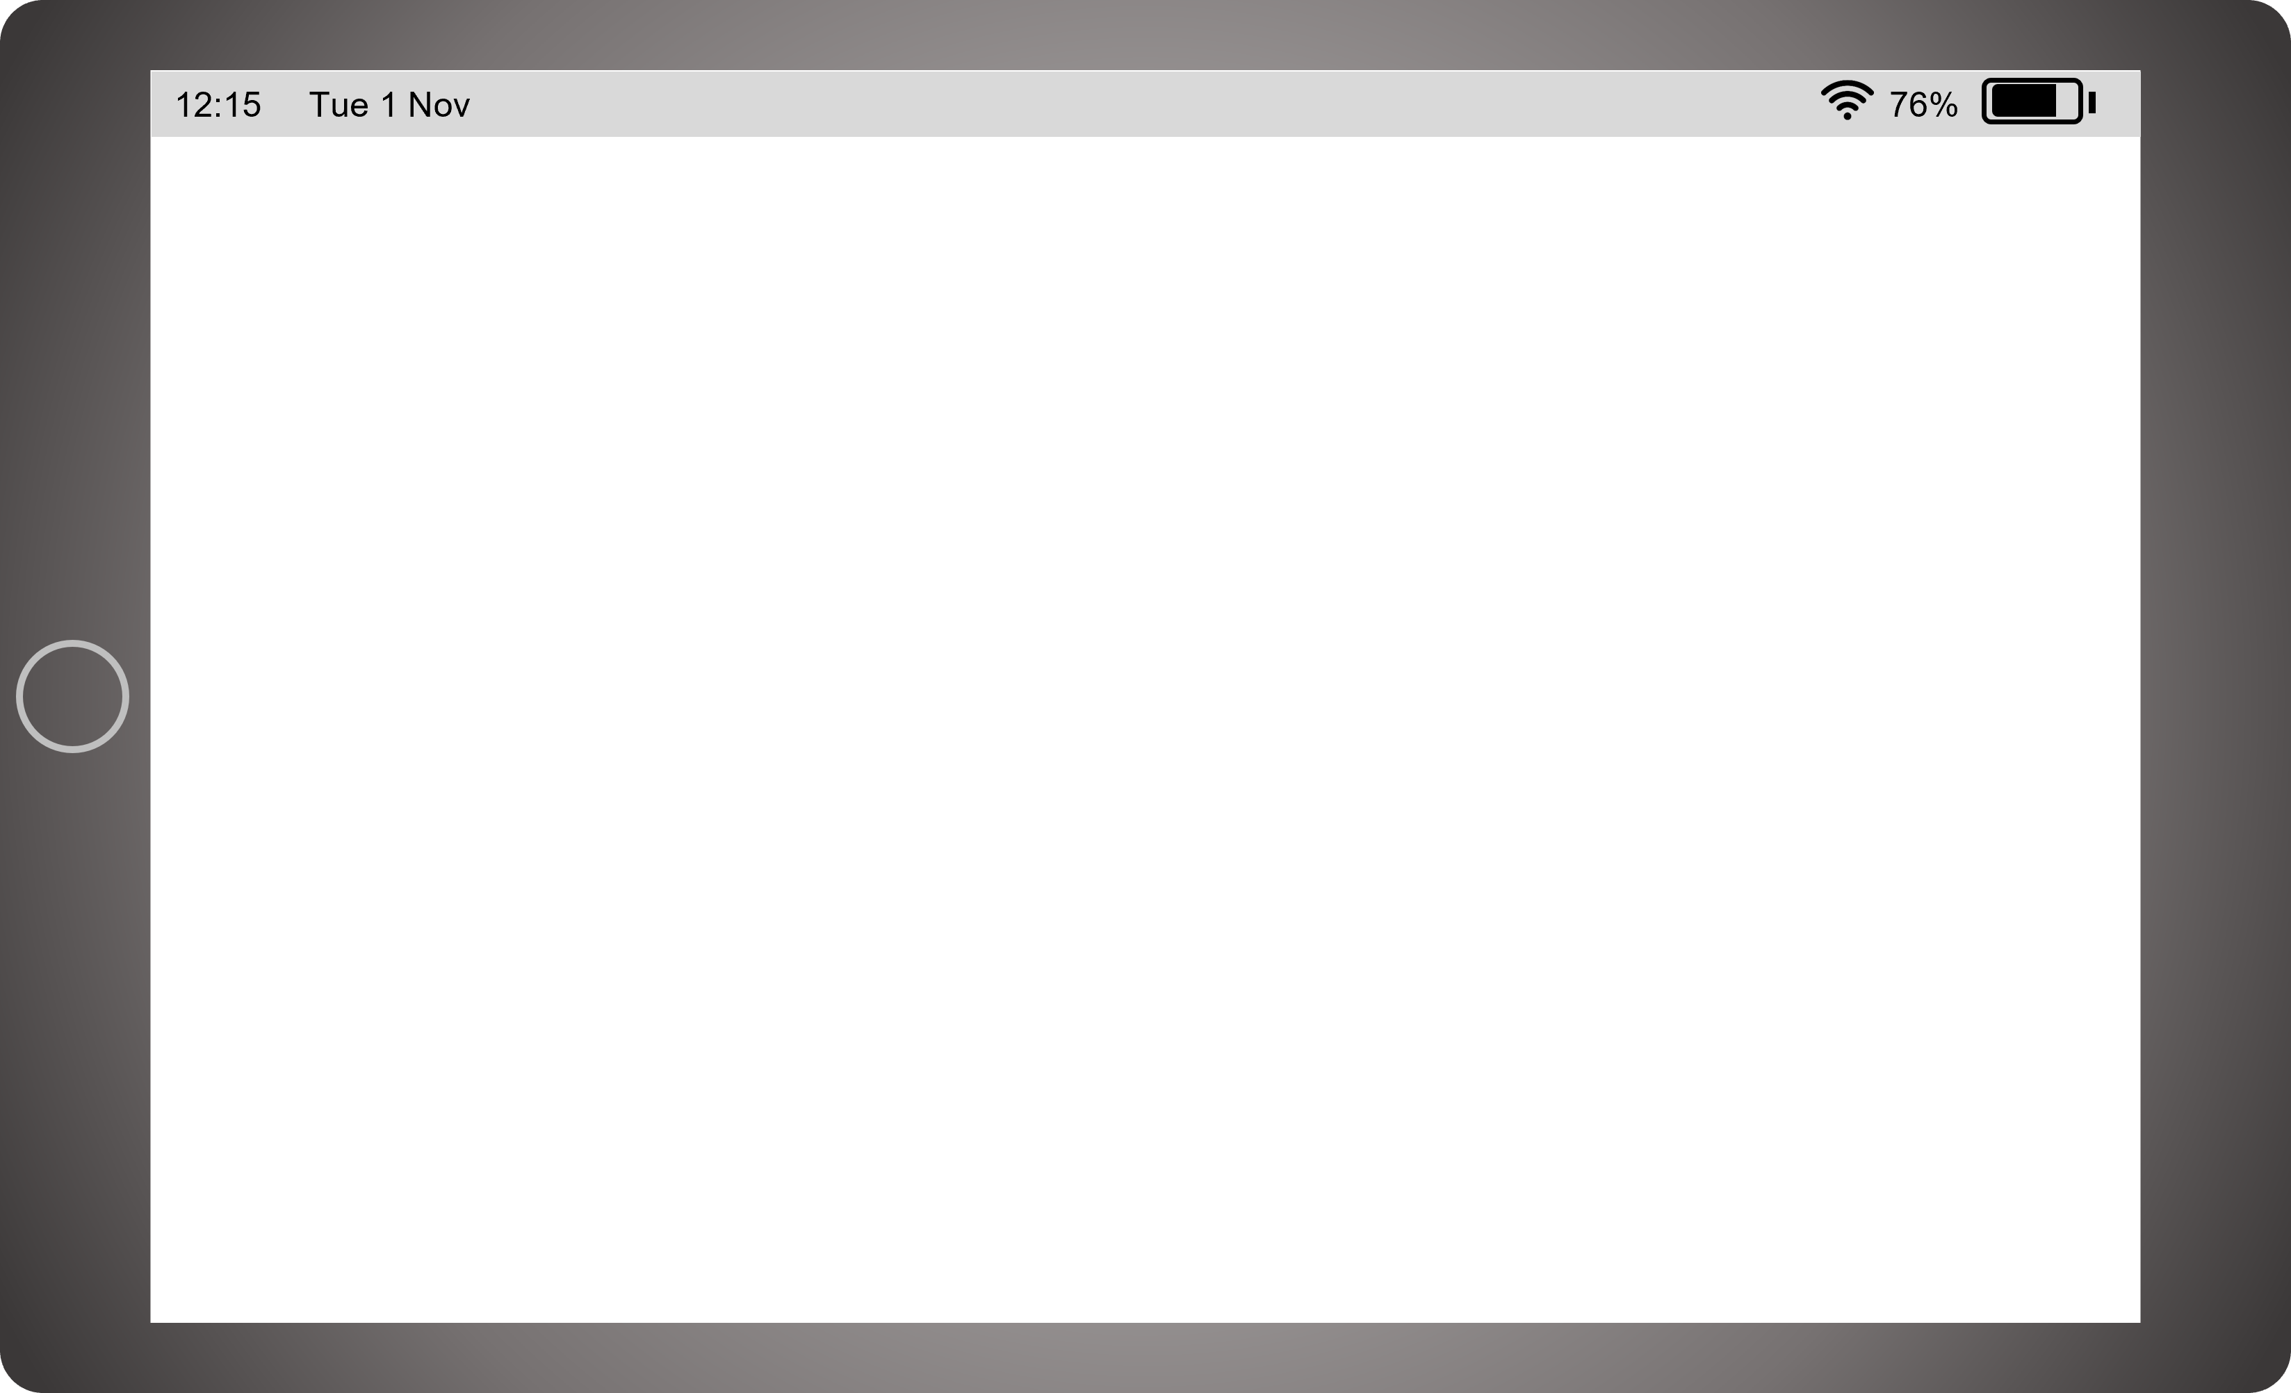


Body
(Gill Sans MT)
Heading
(Marvin)
Underline
Tinkering with Sphero Indi
Logo
Notes:
Welcome and introduce to lesson, stating whether it is computing science or digital literacy

Slide 2

Tinkering with Sphero Indi
In this Tech Tuesday bite-sized lesson, you will be exploring the skill of Tinkering.
The video will guide you through the process of tinkering with a programmable robot using coloured mats to sequence a path. You will find further suggestions of how this skill can be used across the curriculum within this guide.
Choose either “this skill can be used” or “Your learning can be applied”
Learning intention
Success criteria
We are learning to tinker with robots using directional commands.
I can…
describe what a robot is.
use directions to guide a robot.
create different journeys for a robot to follow.
Notes:
Just go through whole slide (taking care not to repeat yourself), quickly cover LI and SC. Feel free to pause, rewind and replay the video at any point.

Slide 3
Prior Knowledge
What is a robot?
What does the word tinkering mean?
What are directional instructions? Can you give an example?
Notes:
Quickly run through this. Remember, the teacher is responsible for ensuring the children have the necessary prior knowledge.

Slide 4
Activity
1
First, learners will explore the different coloured tiles and actions.
2
Secondly, the learners will predict what Indi will do.
3
Lastly, the learners will create their own paths for Indi to follow.
Important information
Top tips
Suggested for Early Level
Requires Sphero Indi's and Smart board to display video.
Best to work with a partner or with digital leaders.
Sphero Indo Educator Book
Notes:
Not in video

Slide 5

Modelled Example
Click the link to watch a North Lanarkshire Digital Pedagogy Practitioner model this activity.
Remember, you can use this knowledge and understanding in a different context.
Notes:
Not included in video

Slide 6
Activity
First steps
Looking for a challenge?
Working in pairs place a row of 3 or 4 coloured mats on the floor and allow Indi to go over each mat. If Indi veers off the path move the mats so Indi will go over all the mats.
Working in pairs, one partner creates a path of mats that has a wrong mat in the sequence. The other partner tests the path and notices an error and must change out the incorrect mat for the correct one.
Notes:
Not included in video

Slide 7
Suggested activities
Literacy
Numeracy
Learners can create a path using the coded mats to get Indi to draw the ‘Letter of the Week’.
Learners can create a path using Indi to reach a destination and use the correct directional language associated with position and movement.
Social studies
technologies
Learners could design and build a model of their local area or school to show Indi around.
Learners could become mini engineers and design and build small ramps, seesaws etc for Indi to climb up and over.
Notes:
Here are some suggested activities (don't read through)

Slide 8

Curricular Links
I can develop a sequence of instructions and run them using programmable devices or equivalent. TCH 0-15a
Link to pathways
Computing Science
Design, Building & Testing
Notes:
Not in video

Slide 9
Key Vocabulary
Robot
Tinkering
A machine that does tasks without the help of a human and is usually coded by a human.
Allowing learners to explore and play with a device to self-teach.
Sequence
Program
A list of instructions in a specific order.
A set of instructions that a computer can run.
Sensor
Directions
An input device that can sense light, movement and how close it is to objects.
Information that tells a programmable device where to go.
Notes:
Not in video

Slide 10


Share your learning
We love to see you all taking part in our Tech Tuesdays lessons. Remember to share your learning with us on Twitter.
@NLDigitalSchool
#NLTechTuesdays
Notes:
We love to see you all taking part in our Tech Tuesdays lessons. Remember to share you learning with us on twitter by tagging us at @NLDigitalSchool
I am looking forward to seeing some of the photos that you have taken! See you all next week! Goodbye ☺

Slide 11
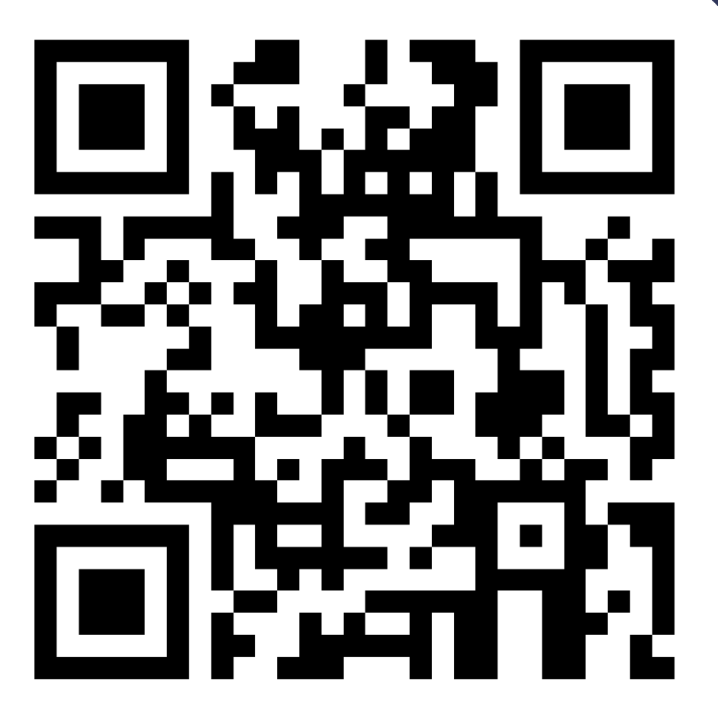
Teacher feedback
Feedback helps us to improve our lessons or just lets us know we’re doing a good job. Please scan or click the QR code below to access our Tech Tuesdays feedback form, to share your comments and views.
Notes:
Not included in video We love to see you all taking part in our Tech Tuesdays lessons. Remember to share you learning with us on twitter by tagging us at @NLDigitalSchool
I am looking forward to seeing some of your green screen creations! See you all next week! Goodbye ☺

Slide 12
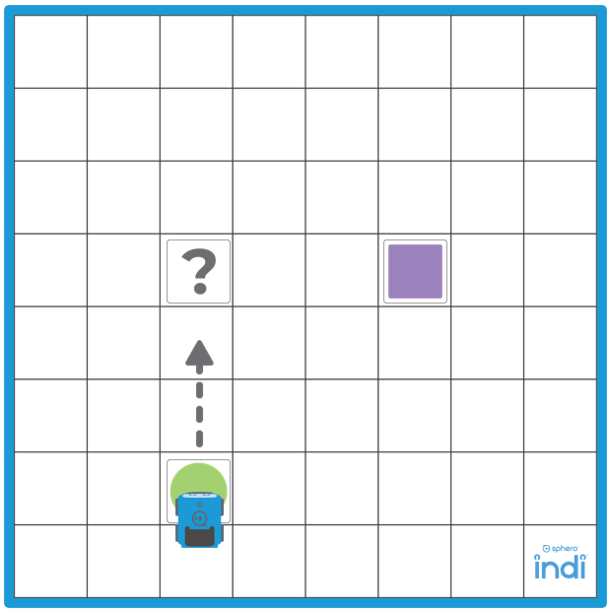
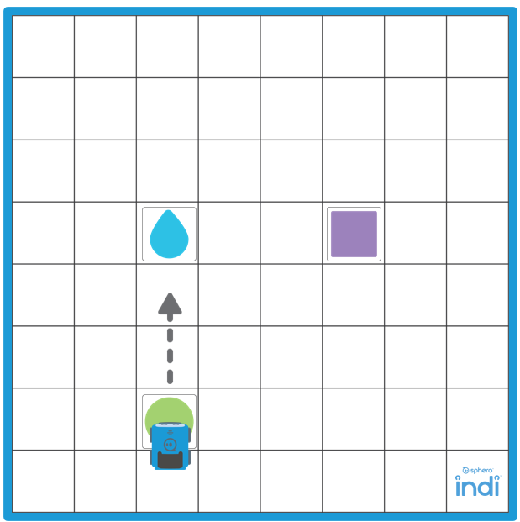
Challenge 1
Notes:
We love to see you all taking part in our Tech Tuesdays lessons. Remember to share you learning with us on twitter by tagging us at @NLDigitalSchool
I am looking forward to seeing some of the photos that you have taken! See you all next week! Goodbye ☺

Slide 13
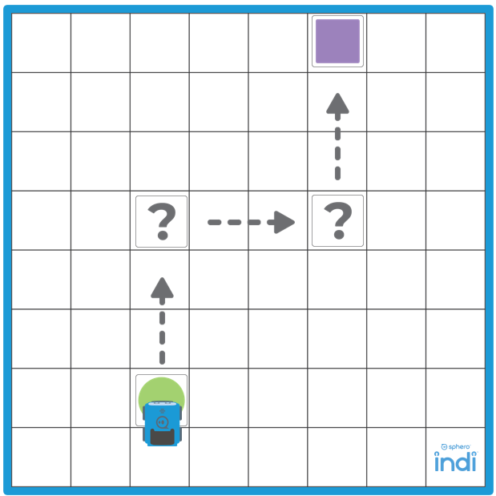
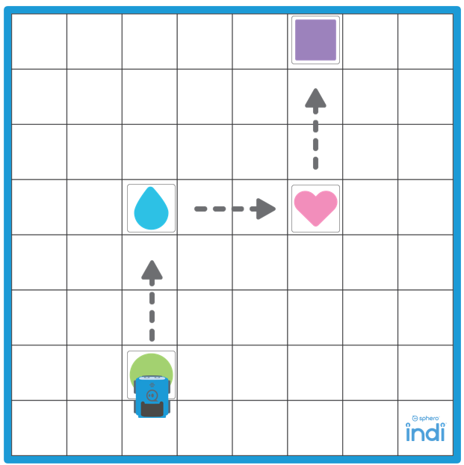
Challenge 2
Notes:
We love to see you all taking part in our Tech Tuesdays lessons. Remember to share you learning with us on twitter by tagging us at @NLDigitalSchool
I am looking forward to seeing some of the photos that you have taken! See you all next week! Goodbye ☺

