Slide 1









Digital Pedagogy Scratch CLPL
L.I:
To explore Scratch and it’s basic functions
S.C: I can…
Explain what Scratch coding is
I can…
Do you enjoy playing computer games or creating digital stories? Would you like to learn how to make your own computer games and stories?
Identify other platforms that are similar to Scratch
I can…
Create my own chase game

Slide 2


Hello, my name is Scratch Cat and I am the official mascot and default sprite when you open up a new project in Scratch and Scratch Jr!
Click on the link below to open Scratch online. Then, minimise it in your browser ready for some fun later on.
Forever
When link clicked open Scratch
https://scratch.mit.edu/

Slide 3

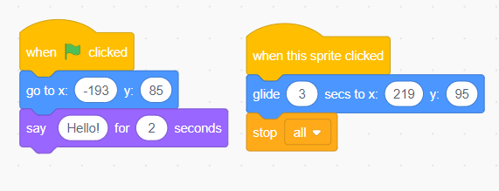
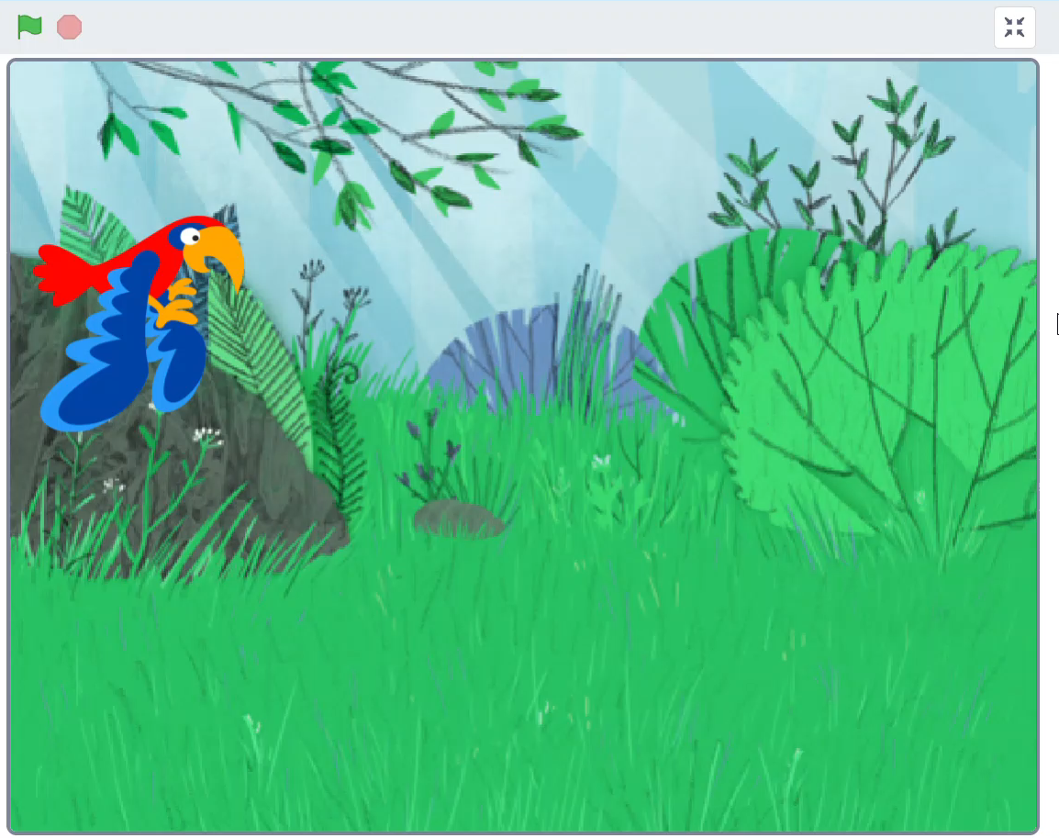
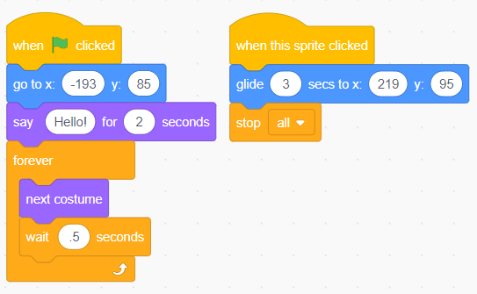
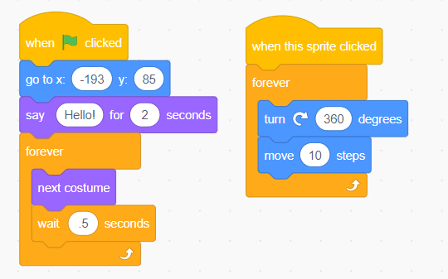
When clicked
Scratch Match Activity
A
B
C

Slide 4
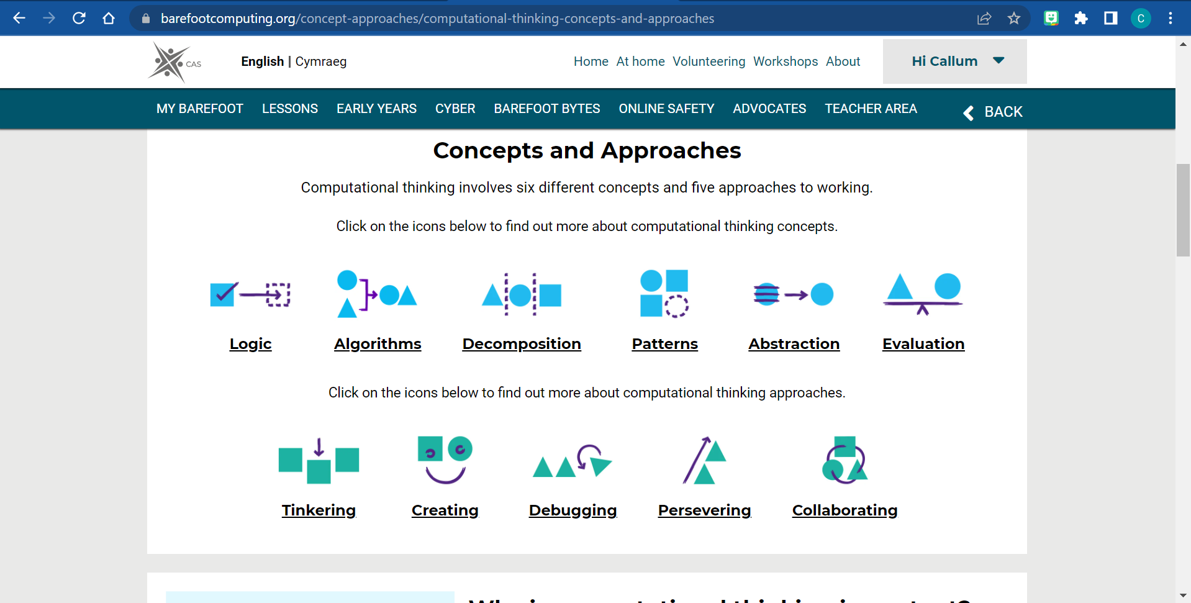

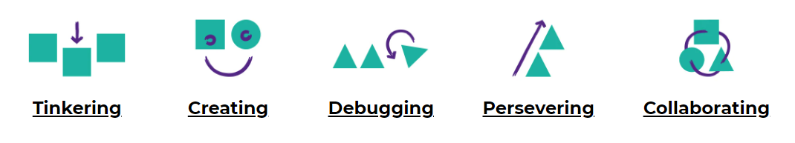
When clicked
Concepts
When clicked
Approaches
Notes:
https://www.barefootcomputing.org/concept-approaches/computational-thinking-concepts-and-approaches
Matching activity link to Logic, Algorithms, Decomposition, Abstraction, Persevering

Slide 5
When clicked
Curriculum Knowledge
Designing, building and testing computing solutions
Understanding and analysing computing technology
Understanding the world through computational thinking
Notes:
The Scottish Curriculum is splits Computing Science in to 3 organisers…
Lets say the CS Curriculum is like lego blocks that fit together nicely and give learners a well rounded knowledge of CS. The organisers are set in a way that you need to have a good base knowledge before you can move on to the design and building organisers. Learners can design and create pieces of code but would they be able to read it and explain what each part will do? Can they recognise when something isn’t working and how to fix it? This is where the first 2 organisers provide all that base knowledge.

Slide 6

When clicked
Progression Pathways
The Organisers build upon each other.
It is a spiral curriculum.
Practitioners should avoid teaching the organisers discretely.
The Progression Pathways should be used flexibly to meet learners needs.​
The Progression Pathways are not resource driven.​
Not all computing science needs to be taught as ‘plugged’.
Notes:
These Progression Pathways are designed for practitioners to use in the planning, teaching, learning and assessing of computing science and in preparing our learners for a digital world of work, life and leisure.​
​
Each pathway is split across three levels to highlight progress through a level.​
Higher Order Thinking Skills are highlighted in bold and can be used to support staff to form Learning Intentions and Success Criteria.​
Learners can be supported in understanding the purpose of their learning and the journey of computing science learning.​
Practitioners can use the pathways to ensure their professional judgements are consistent, robust and reliable.​
The pathways can support ongoing professional dialogue during the planning, teaching, learning and assessment cycles to ensure a shared understanding of standards and expectations.​

Slide 7
When clicked
What is Scratch?
Scratch is a free programmable toolkit that enables beginners to have an opportunity to create their own games, stories and interactive art using a basic block coding language.
Scratch has been developed by computing engineers at the MIT Media Lab in Massachusetts to allow young learners get involved in coding.
Notes:
Anyone else with previous knowledge want to expand upon that?

Slide 8
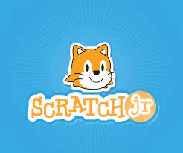
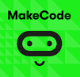


When clicked
Block Coding Platforms
Scratch uses a very basic visual programming language that uses blocks of code that join together similar to a jigsaw.
This was created to help get young learners in to coding without being overwhelmed by text based coding such as Java Script, HTML, Python etc.
Although each platform is slightly different the idea is exactly the same. Some platforms allow you to switch between block code and text based coding such as MS MakeCode.
And many others…
Notes:
Click link! Scratch Jr: App only and developed for younger learners from ages 4-7 but still uses a block based visual programming language but much more simplified.

Slide 9
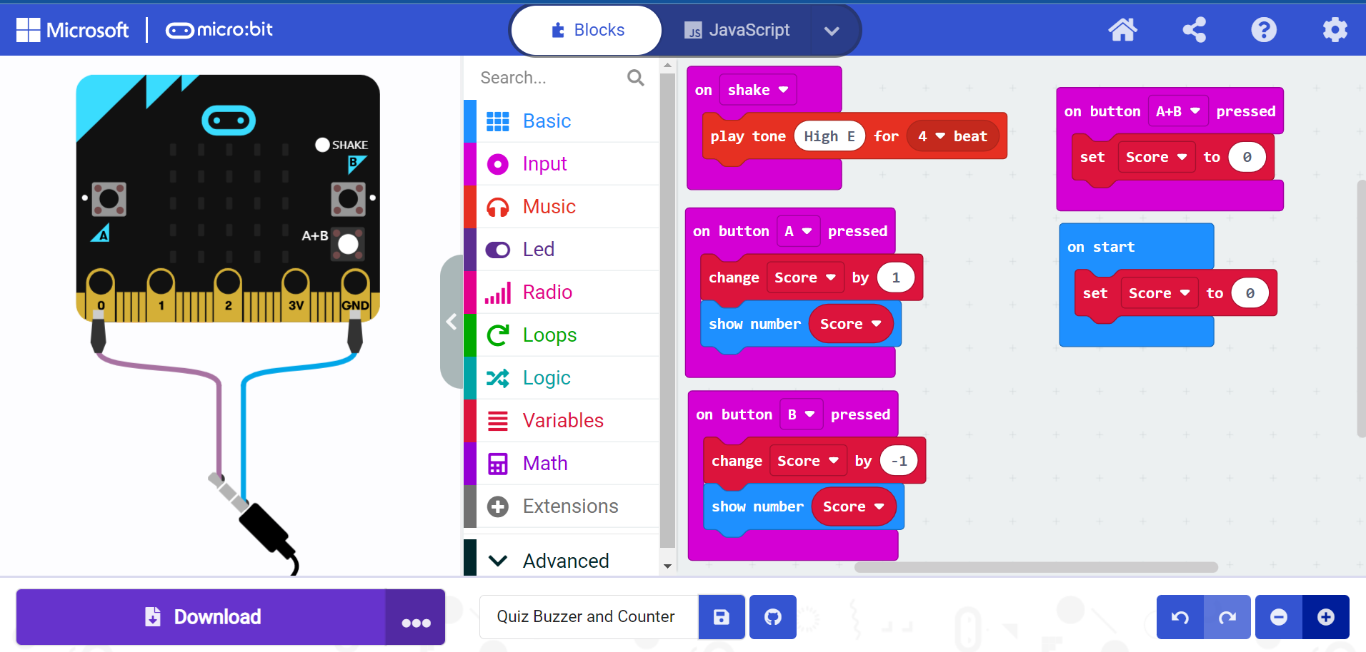
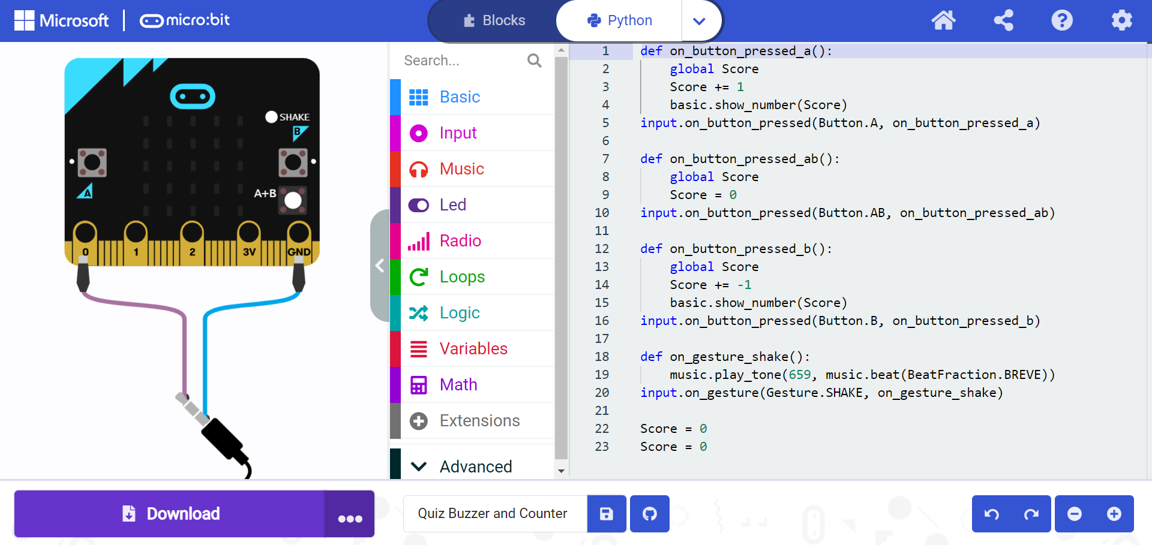
When clicked
Block VPL
When clicked
Text Based CL
Notes:
This is where we can see how versatile a resource such as the MicroBit can be as it could be used with all learners from P1 to S6.
VPL= Visual Programming Language
CL= Coding Language

Slide 10
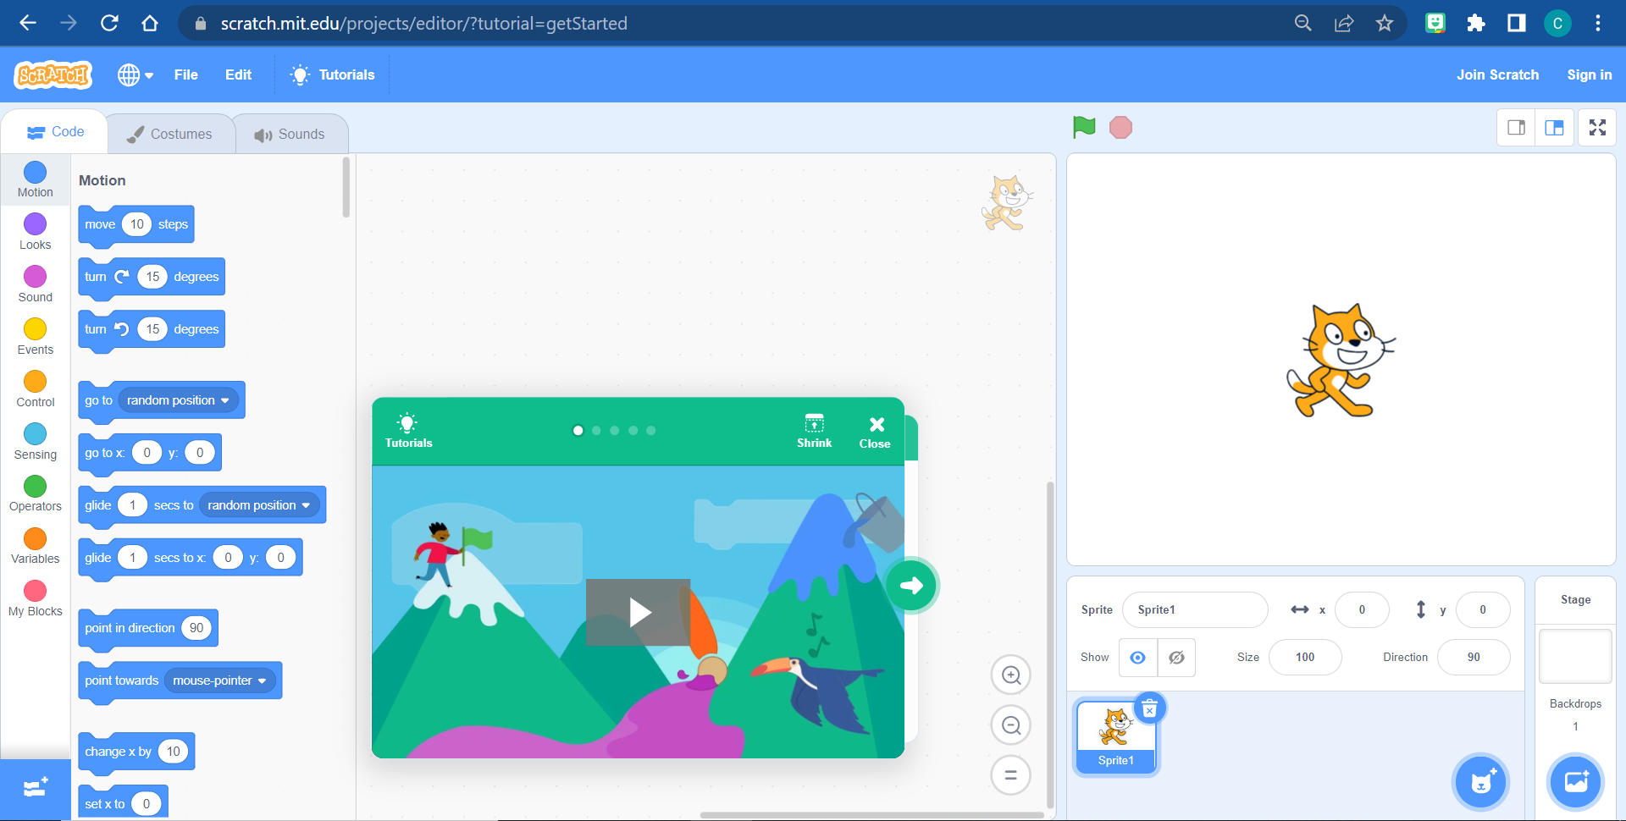
When clicked
Scratch Online
Scratch can be operated in two formats: Online Webpage or Scratch can be downloaded and held as a program that can be opened offline.
You do not need to have an account with Scratch to have fun and start creating but you can sign up and save all your programs to your account. Also, as a teacher you can sign up for an educator account which helps you set up pupil accounts and allows you to browse and share pupils high quality work.
Lets have a look at the Scratch interface, blocks, workspace, stage and sprites.

Slide 11
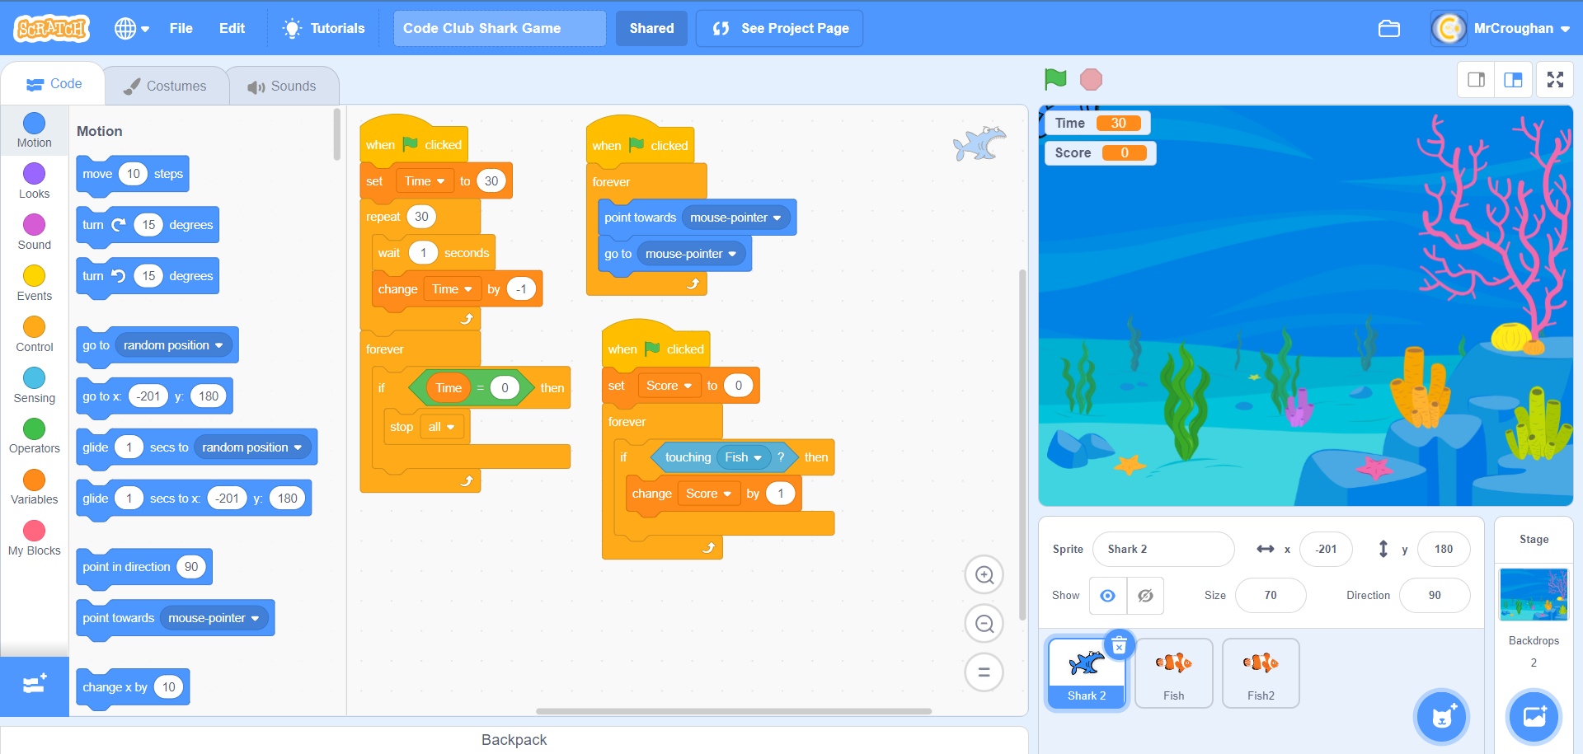
Costumes/
Sound
Start/Stop
Stage
Block Categories
Blocks
Script
Workspace
Sprites
Backdrops

Slide 12
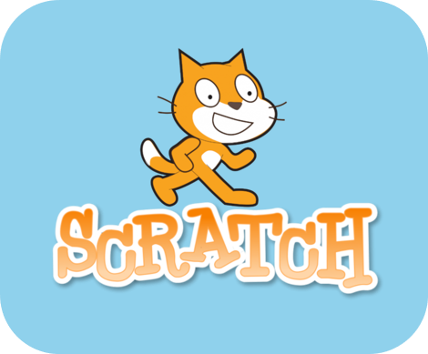
Lets get coding!

Slide 13
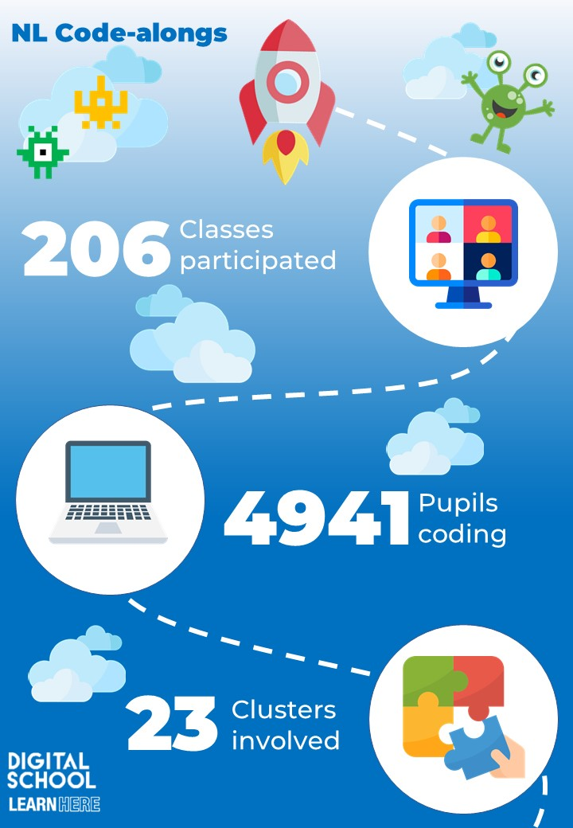
NL Live Code-alongs
Jasmine and I are very proud of the code-alongs we developed and delivered last year and would be rude not to highlight how engaging Scratch can be to the young learners of North Lanarkshire.
The Digital School has a YouTube Playlist that has the three code-alongs pre recorded and can be looked back at any time. This may be useful to some of you as we go through the blocks and interface prior to starting the code-along.
We are hopeful that we can develop and deliver more code-alongs this year in line with themed weeks throughout the year.
Notes:
https://www.youtube.com/playlist?list=PLDdluZC0OlaGIT1a6GSr6JZmGITfUHWNV

Slide 14

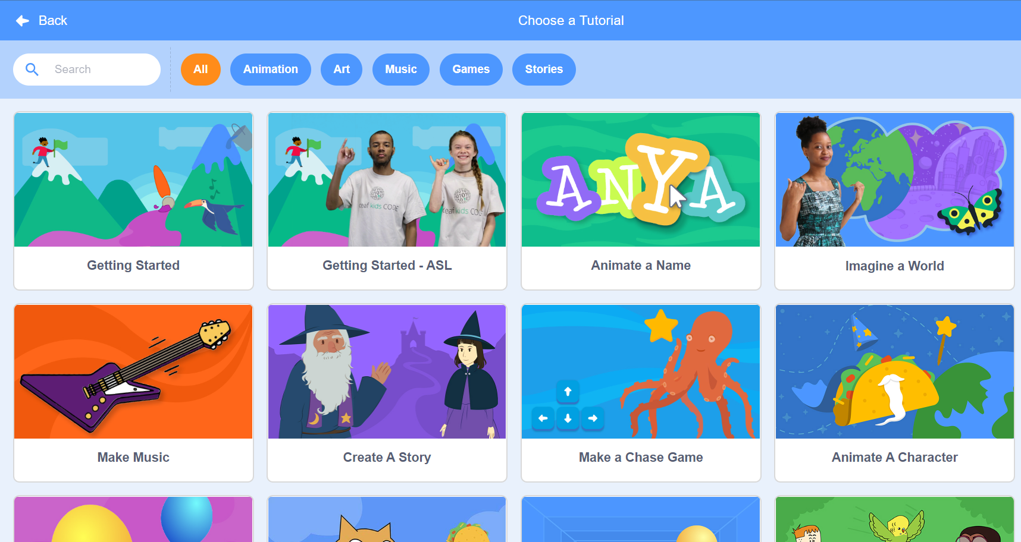

When clicked
Resources/CLPL
You can find excellent Scratch challenges and activities to continue your own development.
Education Scotland have dedicated Teams to help support practitioners with webinars and CLPL. Also, they allow teachers to share their own experiences nationally.
Use the Scratch tutorials to get you started coding and building your Scratch confidence and knowledge!

Slide 15
Digital Pedagogy Scratch CLPL
L.I:
To explore Scratch and it’s basic functions
S.C: I can…
Explain what Scratch coding is
I can…
Any questions?
Identify other platforms that are similar to Scratch
I can…
Create my own chase game

