Slide 1



OLGA Cathedral Primary School
CLPL Objectives:
Explain what Sway is and how it can be used.
Explore examples of content and a live Sway.
Create a Learning Journal using Sway
Sway CLPL
Learning Journal Focus
@NLDigitalSchool

Slide 2
What is Sway?
Sway CLPL
Learning Journal Focus
Digital Storytelling Tool
Free Software on Glow
Combine Media to story tell
Easily Shared
@NLDigitalSChool
Create using templates
View Analytics
Notes:
Microsoft Sway is a mobile, adaptive digital storytelling tool that lets students and educators focus on content over format.
This free Office 365 tool combines text, images, video, and other embedded content to tell a story.
A Sway can be linked to a QR code for easy sharing, or a Sway can be embedded into a OneNote Class Notebook page.
A Sway can be viewed and copied as a template, and the creator of the Sway can even track how many times their Sway has been viewed.

Slide 3
What is Sway use for?
Sway CLPL
Learning Journal Focus
Digital Storytelling
Digital Posters
Innovative Presentations
Blog
Easily Shared Newsletters
@NLDigitalSChool
Create Pupil Learning Journals
Resume
Welcome Pack

Slide 4
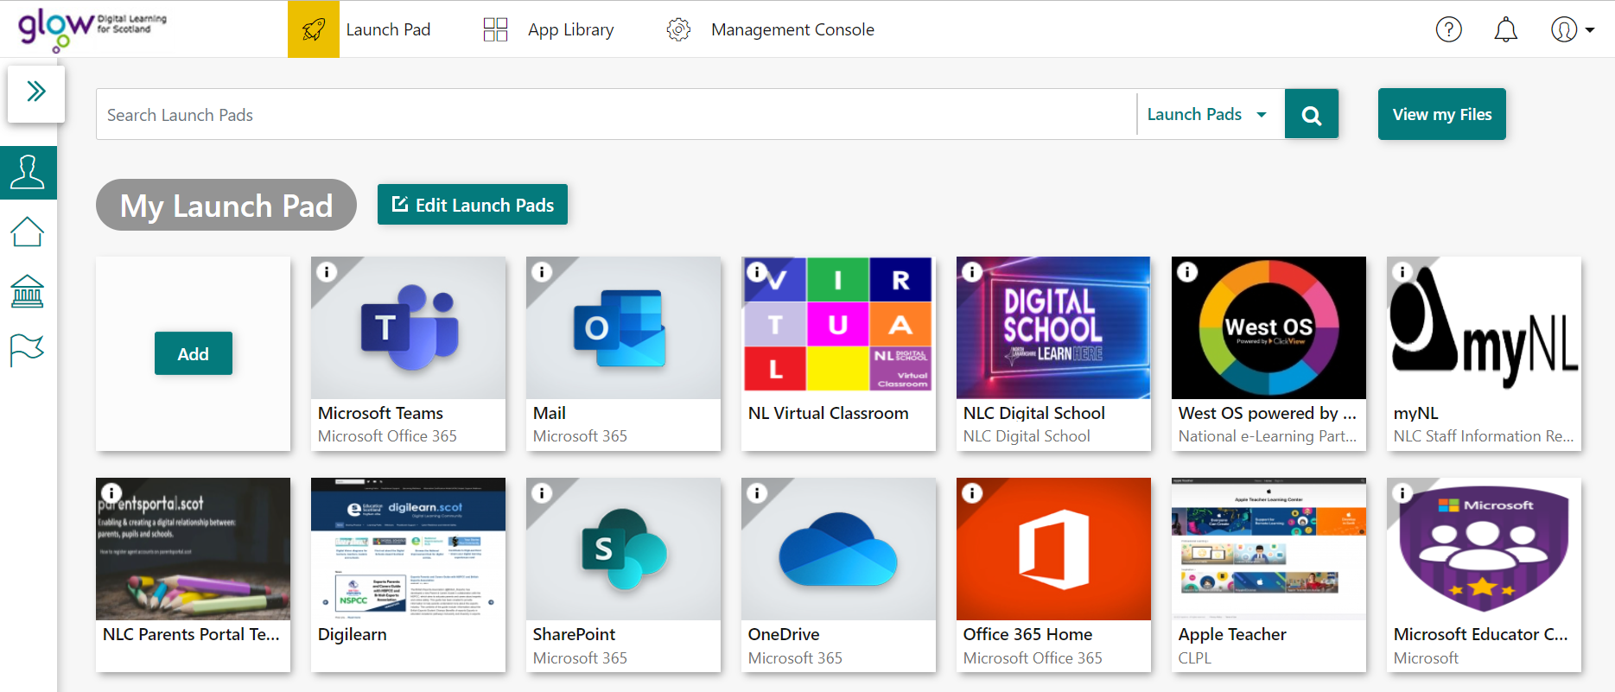


Getting Started with Sway
Sway CLPL
Learning Journal Focus
If you do not have Office 365 Home, add new tile here.
@NLDigitalSChool
Log into Glow to access your Glow Launch pad, then select Office 365 Home.
Or you can go to www.sway.com and sign in using your Glow login details.

Slide 5

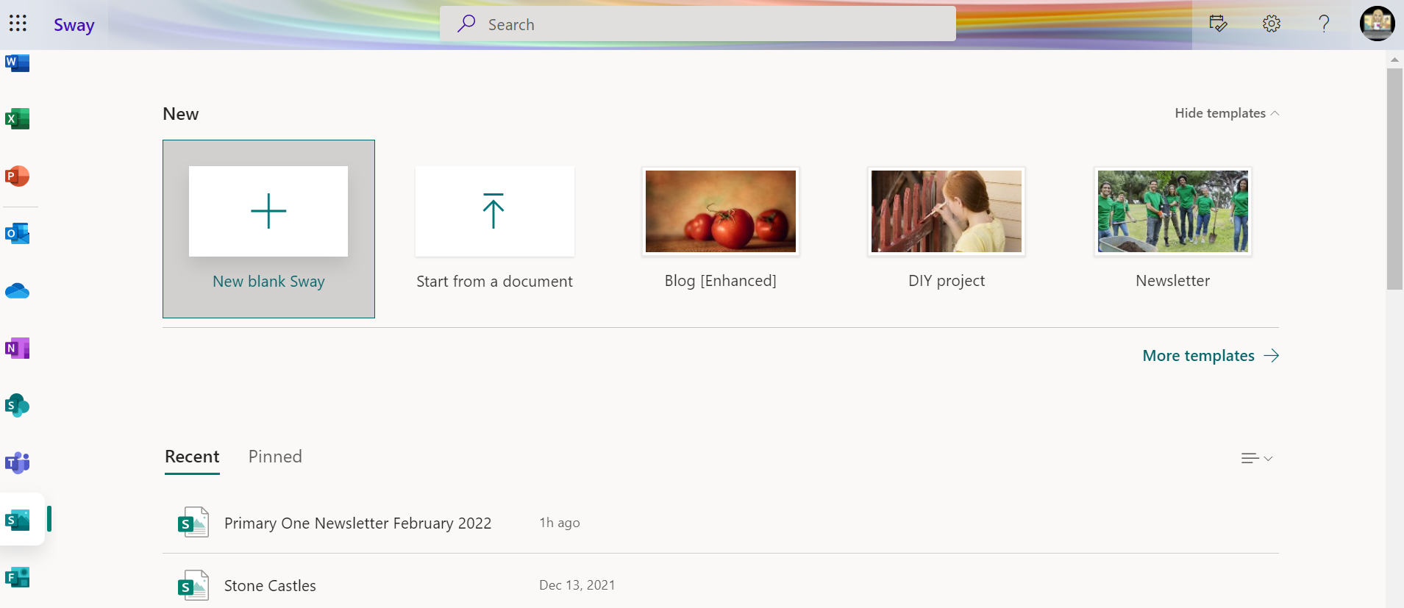

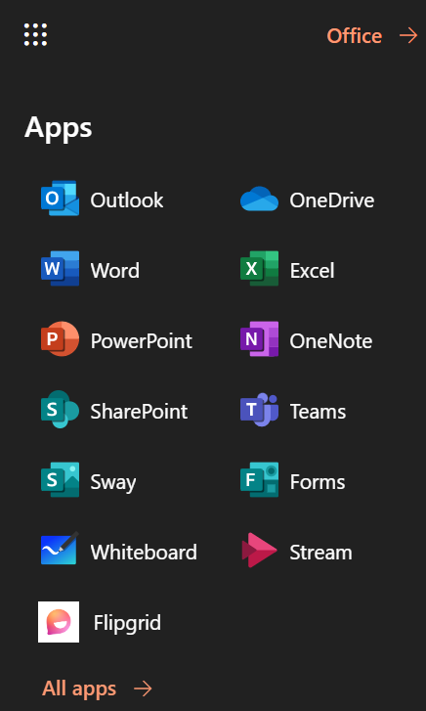


Getting Started with Sway
Sway CLPL
Learning Journal Focus
Click on the App Launcher and select Sway.
If you are creating your Sway for the first time, click on + New Blank Sway or
+ Create New.
@NLDigitalSChool
Once you’ve created your first Sway newsletter, you can use the template you will create today and update the information for your next one.
Click here for a video explanation on using the website.
Notes:
Be careful not to muddle up Sharepoint logo and Sway logo. There are also templates that you can use. There is also the start from a topic, if you use the website version and it will add content for you based on that topic.

Slide 6
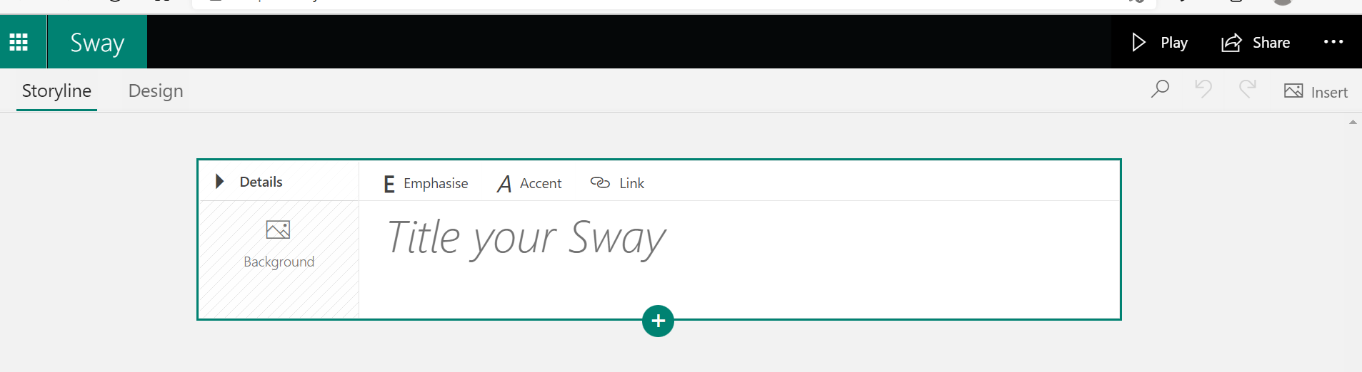
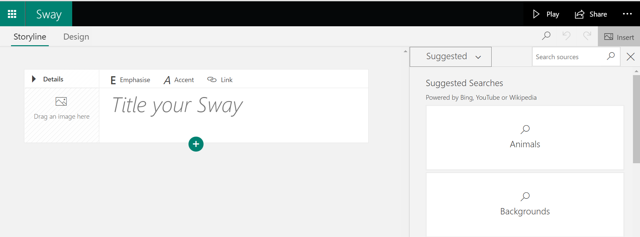
Adding Content - Title
Microsoft Sway works off two main elements: the Storyline and Cards.
The Storyline represents the sequencing of your information whilst cards are the different types of elements you can include.
Sway CLPL
Learning Journal Focus
Heading card - Type in what the title of your newsletter will be.
To add a background image to your title, find an image you have already saved or search for a suitable image by clicking on Insert and dragging it into the Background box.
@NLDigitalSChool
Click Suggested to access your files on your computer or One Drive. Type in the Search box to look for online images.
Click here for a video explanation on adding images.

Slide 7
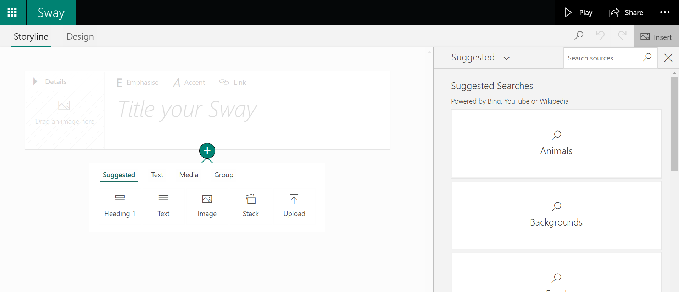
Adding Content – Card Options
Sway CLPL
Learning Journal Focus
Click on the green plus sign to add a new card.
Use the Insert and then Suggested option to add content i.e images or videos.
@NLDigitalSChool
Choose what type of card you would like to add in next from the pop up menu.

Slide 8
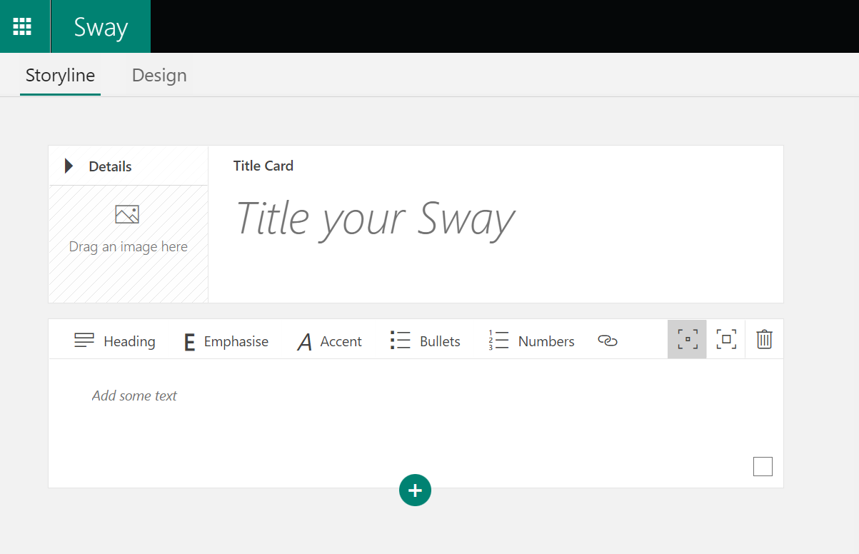



Adding Content - Text
Sway CLPL
Learning Journal Focus
Choose the text option to insert a new card to type in a welcome message.
See features:
Emphasise – make your text stand out (bold)
Accent – Differentiate this text from the text next to it (italics)
Bullets – Create a bullet point list
Numbers – Create a numbered list
- Create a link to a website
- Subtle or moderate emphasis
- Delete card
@NLDigitalSChool

Slide 9
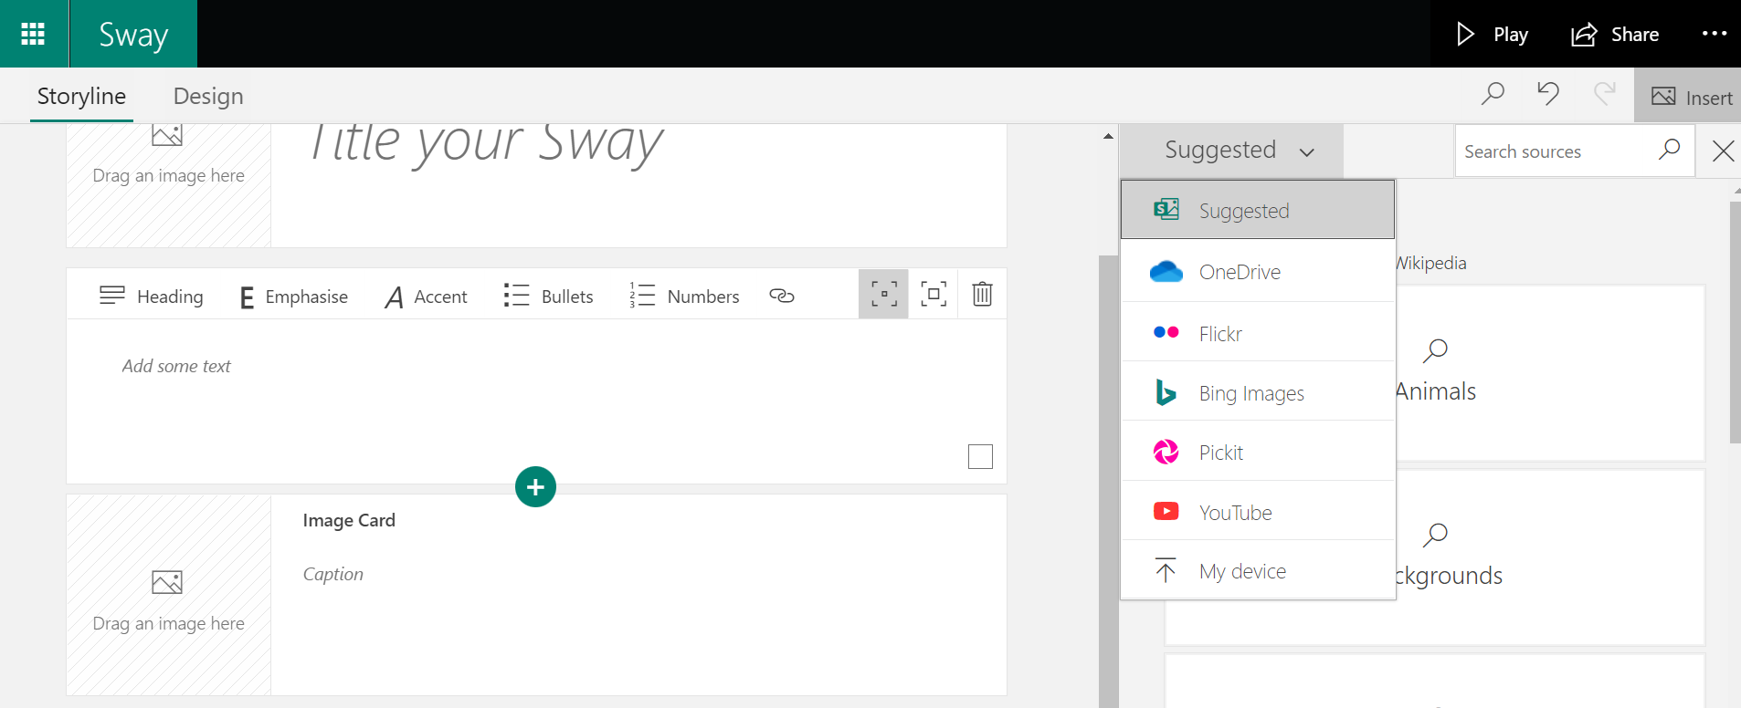
Adding Content - Image
Sway CLPL
Learning Journal Focus
Choose the image option to insert a new card with an image embedded.
Use the Insert and then Suggested option to add images or videos from the internet (Bing), your One Drive, Flickr, Pickit, You Tube or upload from your computer.
Tip: As you build and adjust your Sway, it's always good to view the Sway to see what the audience will experience.
Select the Design tab to view the Sway as it will appear or select Play to view the Sway in full screen.
To return to editing from the play view, select the Edit button at the top of the screen.
@NLDigitalSChool
Click here for a video explanation on adding and viewing content.

Slide 10
Adding Content – Multiple Images
Sway CLPL
Learning Journal Focus
You can choose how you want your images to be displayed…
In a grid, stack,
Use the Insert and then Suggested option to add images or videos from the internet (Bing), your One Drive, Flickr, Pickit, You Tube or upload from your computer.
Tip: As you build and adjust your Sway, it's always good to view the Sway to see what the audience will experience.
Select the Design tab to view the Sway as it will appear or select Play to view the Sway in full screen.
To return to editing from the play view, select the Edit button at the top of the screen.
@NLDigitalSChool
Click here for a video explanation on adding and viewing content.

Slide 11
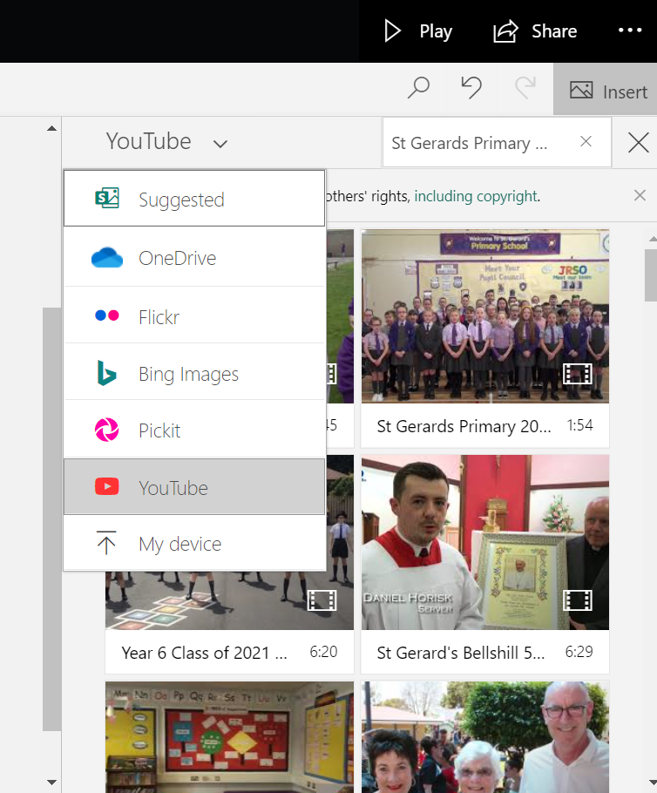

Adding Content - Video
Sway CLPL
Learning Journal Focus
Click the green plus sign and choose media from the pop up menu then video.
Use the search to look for content. Remember if using YouTube, it is safer change that link to a video.link and embed the link instead.
@NLDigitalSChool
Click here for a video explanation on adding video content.
Tip: Remember Sway is an online tool and saves as you go.

Slide 12
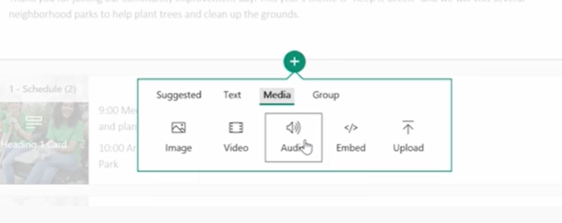
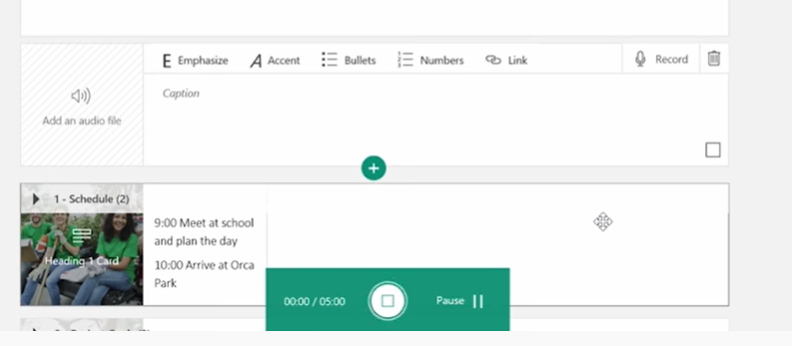
Adding Content – Audio
Sway CLPL
Learning Journal Focus
Click the green plus sign and choose media from the pop up menu then audio.
Use the search to look for audio in your files or record straight onto Sway using the record function.
@NLDigitalSChool
Click here for a video explanation on adding audio content.

Slide 13
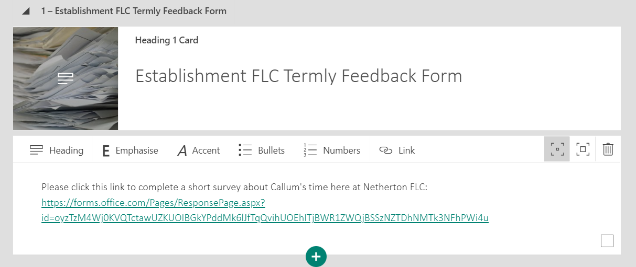
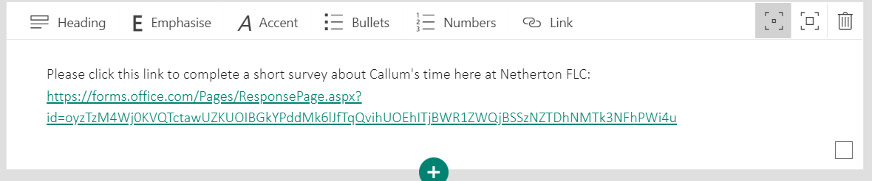
Adding Content – Forms Link
Sway CLPL
Learning Journal Focus
Click the green plus sign and choose text from the pop up menu then add an intro to the form you wish to link out.
Copy and paste your Forms link or QR Code in to the text box to share the form. The example below shows what it could look like.
@NLDigitalSChool

Slide 14
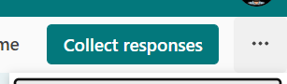
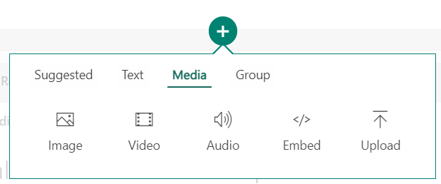
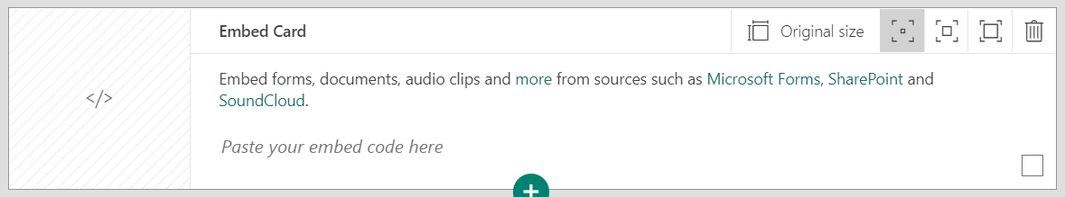
Adding Content – Embedding Forms
Sway CLPL
Learning Journal Focus
Click the green plus sign and choose media from the pop up menu then click the Embed option.
Go in to the form you wish to embed and click on collect responses.
@NLDigitalSChool
The Embed Card will ask you to paste the Embed code from your Form.

Slide 15
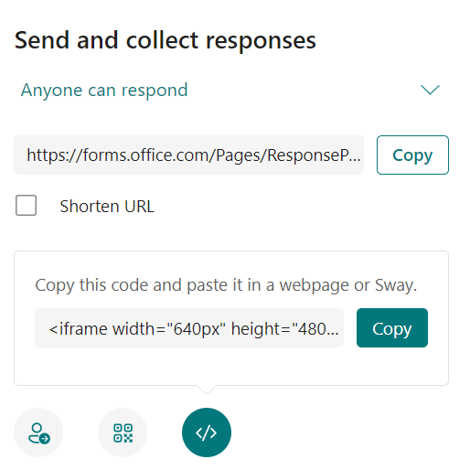
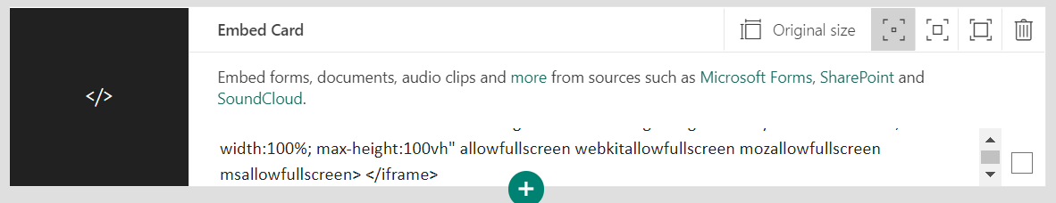
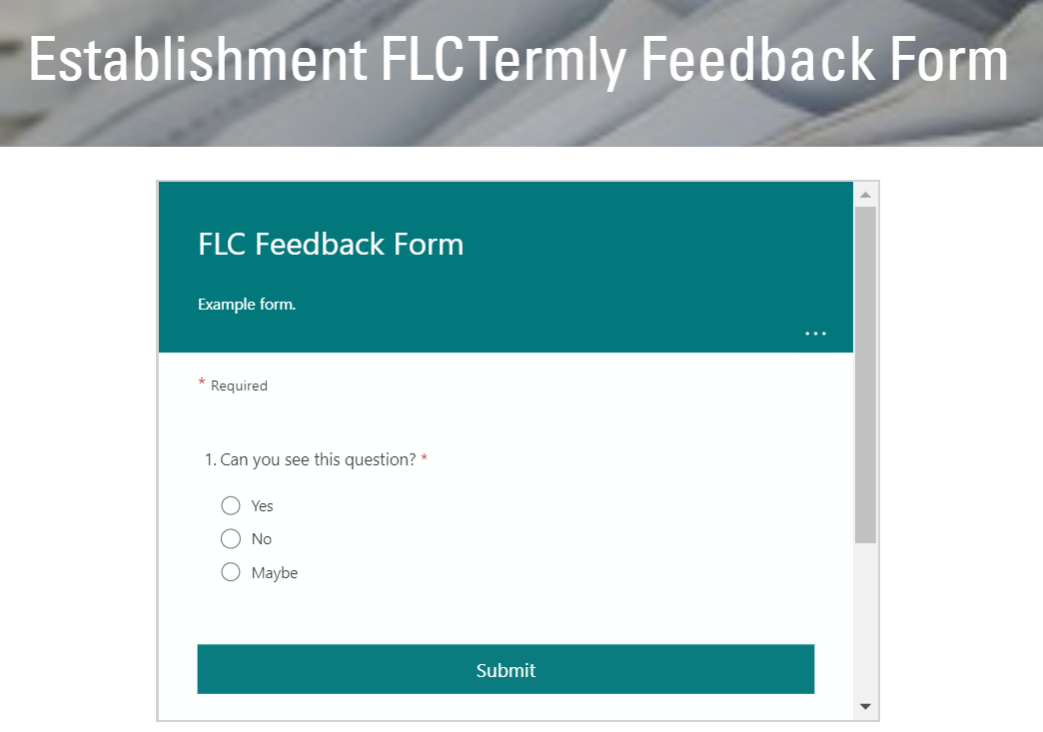
Adding Content – Embedding Forms
Sway CLPL
Learning Journal Focus
The Embed Card will look like the example above and should now be embedded in to your Sway. Go have a look.
Click Design and scroll through your Sway to find the Form. The Form should now appear in the section you embedded it to
@NLDigitalSChool
Click the Embed button at the bottom of the screen and a code will appear beside the green Copy button. Press copy and paste this in to the Embed Card.

Slide 16
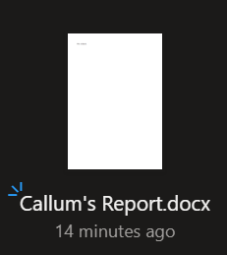
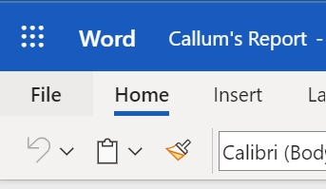
Adding Content – Embed Documents
Sway CLPL
Learning Journal Focus
Click the green plus sign and choose media from the pop up menu then click the Embed option.
You will need to have created the word document and save it to your Cloud Drive (OneDrive, SharePoint etc).
@NLDigitalSChool
The Embed Card will ask you to paste the Embed code from your Form.
Open the document online and click on the File tab. This will open up a few options.

Slide 17
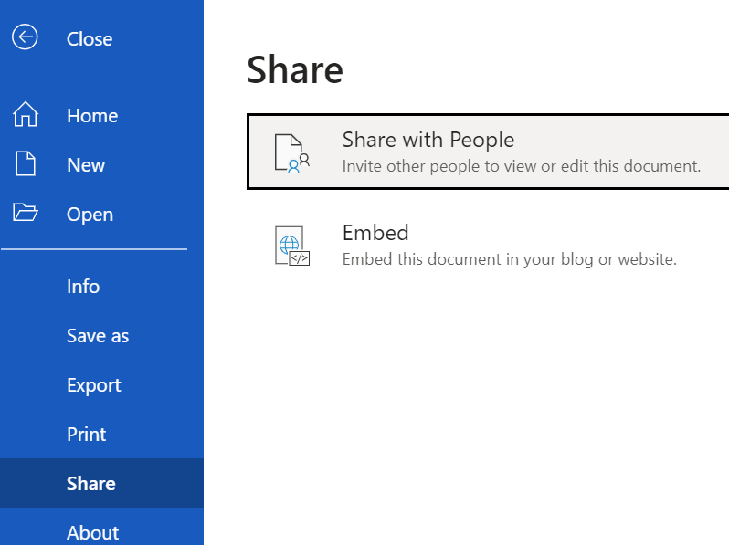
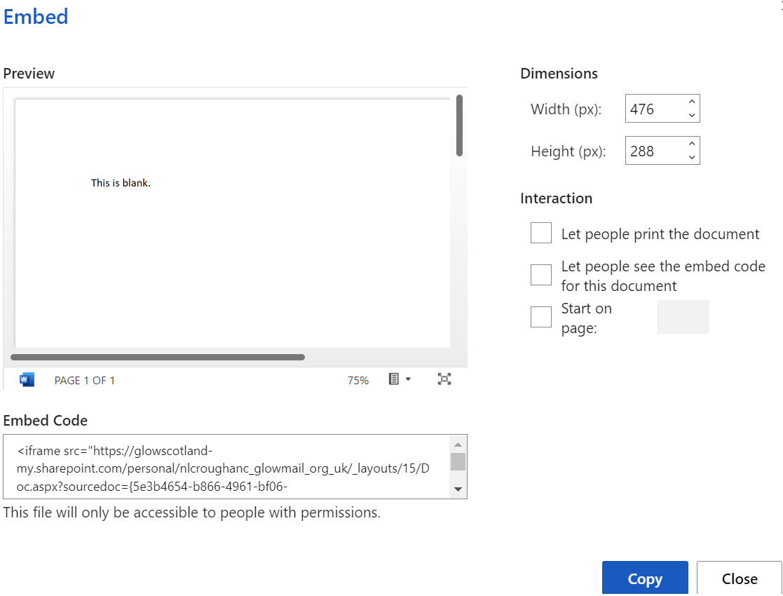
Adding Content – Embed Documents
Sway CLPL
Learning Journal Focus
In the example below it shows what the Word Document embed screen looks like. Click the blue Copy button and paste this link in to the Embed Card in your Sway. Untick all the boxes under the Interaction title.
@NLDigitalSChool
Click on Share and then click the Embed option.

Slide 18
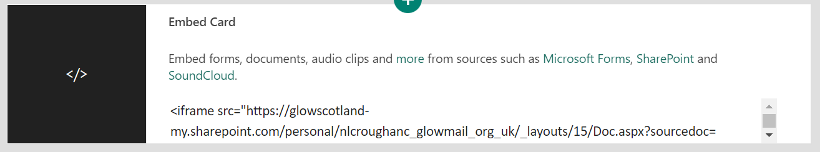
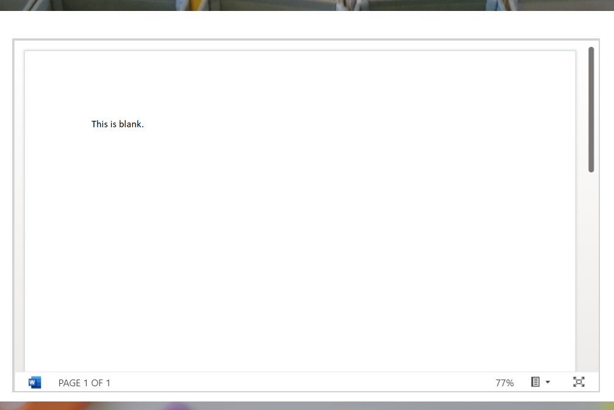
Adding Content – Embed Documents
Sway CLPL
Learning Journal Focus
The Embed Card will look like the example above and will contain the location of the document within your Cloud Drive.
The Document will look like this when embedded in to the Sway. Click on the Design tab and check it has embedded successfully.
@NLDigitalSChool

Slide 19
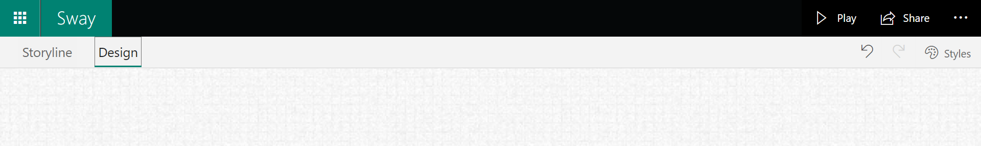
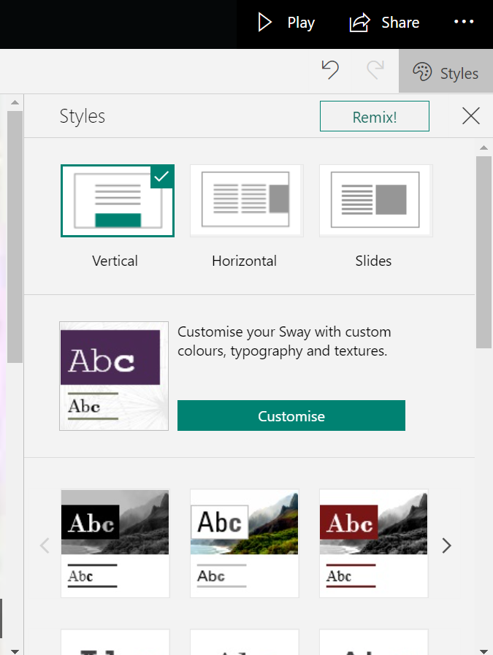
Styling your Sway
Sway CLPL
Learning Journal Focus
Sway has a built-in style gallery which lets you easily switch between the different styling options until you find the way you like. From the Storyline view, click the Design tab.
@NLDigitalSChool
This allows you to spend time on the content of your Sway then remix the designs until you fine one that suits you. You can also scroll through the different styles and pick one from there.

Slide 20
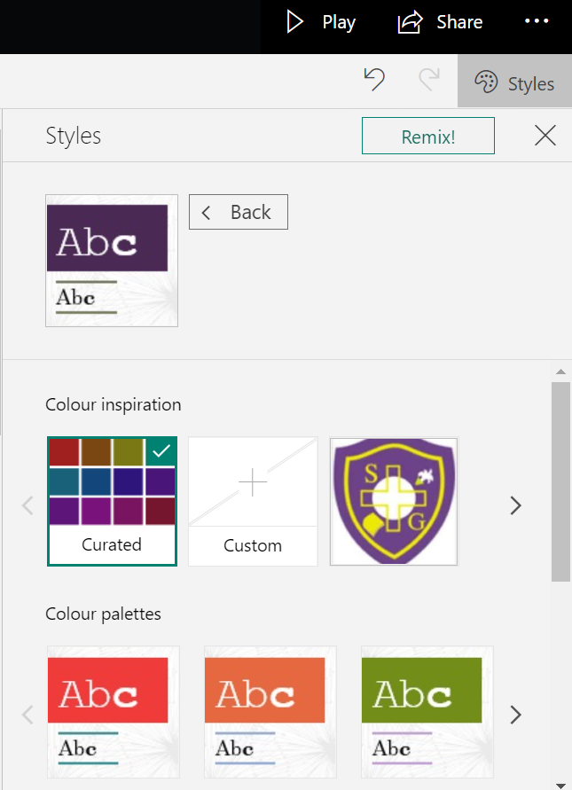
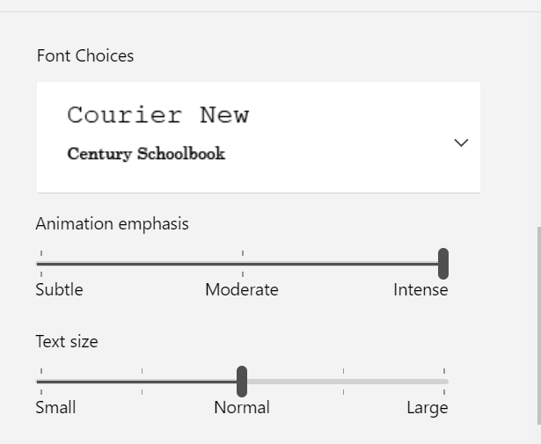
Styling your Sway
Sway CLPL
Learning Journal Focus
To make more changes to the design of your Sway, click on Customise.
This allows you to customise colours and choose the font and font size that you desire.
@NLDigitalSChool
Click here for a video explanation on styling your Sway.

Slide 21
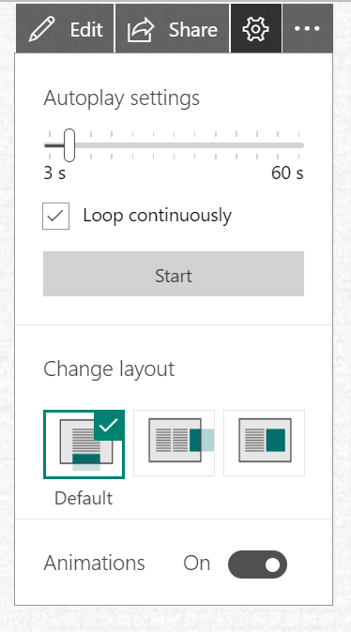
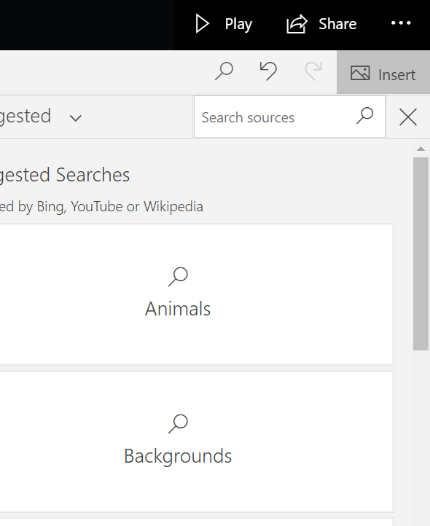
Viewing your Sway
Sway CLPL
Learning Journal Focus
Click play to see what your Sway will look like.
You can also change the Autoplay settings and layout by clicking on the cog.
@NLDigitalSChool
To be sure that a Sway is visible to all viewers, it is always a good choice to run the Accessibility Checker. This video clip explains how to find the Accessibility Checker in Sway.

Slide 22
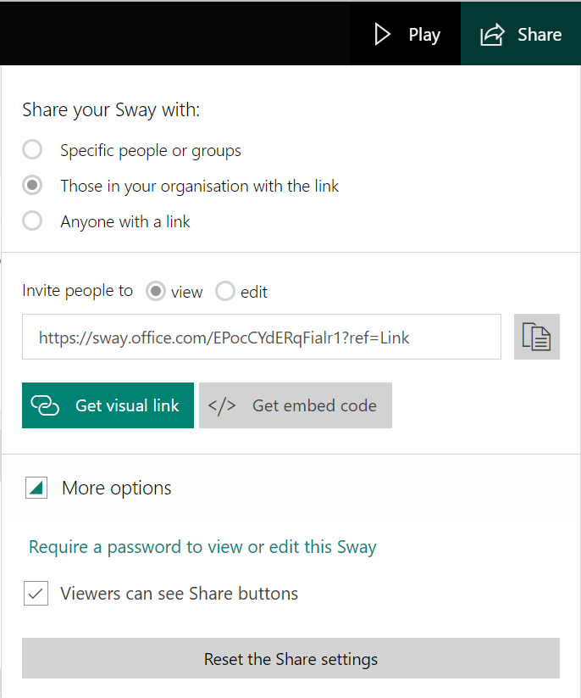
Sharing your Sway
Sway CLPL
Learning Journal Focus
Once you are happy with your Sway you are ready to share it with others. You have the option of sharing only within your organisation or school, specific people or groups or open it up for anyone to access your Sway.
From your Sway, click the Share button on the main toolbar.
Select who you want to share your Sway with from the options provided.
You can select if you want people to be able to view or edit your sway.
Copy the Link provided and paste this into an email, a class Teams’ page or your preferred method to share this link.
@NLDigitalSChool

Slide 23
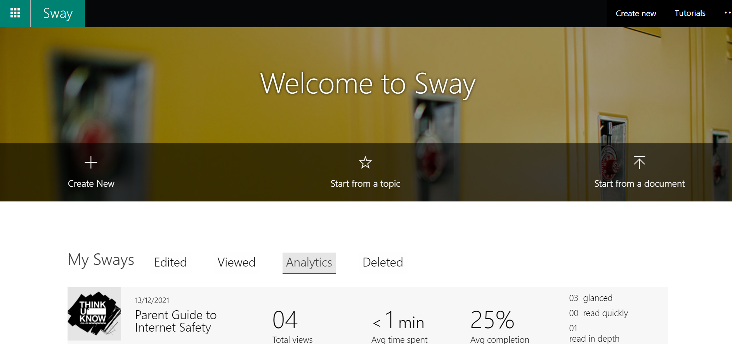
Analysing your Sway
Sway CLPL
Learning Journal Focus
Once you have shared your Sway it is important to know if your audience is being reached, therefore Sway includes analytics. Analytics let you know if your digital story is being viewed by parents or students.
Select Analytics from the dashboard to view all your Sways and their viewing data. You will learn if people have glanced at the Sway, gave it a quick read, or spent more time giving it a deep read. This data can help you when preparing future newsletters.
@NLDigitalSChool

Slide 24
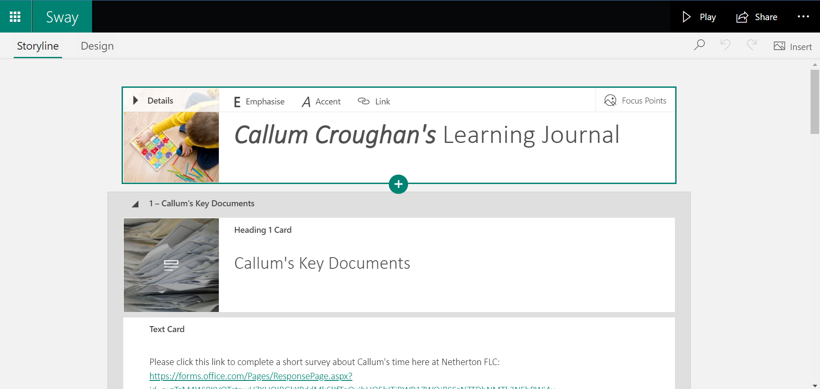
Example Sways
Sway CLPL
Learning Journal Focus
@NLDigitalSChool
Let’s go on and have a look at an example Sway I have created including some of the content you will use in your very own learner’s Learning Journal. Also, have a look at a possible template option.
Notes:
https://sway.office.com/lekXgmBxGEF02Ir0

Slide 25
OLGA Cathedral Primary School
Sway CLPL
Learning Journal Focus
Let’s get creating a
Learning Journal
@NLDigitalSchool

Slide 26
OLGA Cathedral Primary School
CLPL Objectives:
Explain what Sway is and how it can be used.
Explore examples of content and a live Sway.
Create a Learning Journal using Sway
Sway CLPL
Learning Journal Focus
@NLDigitalSchool

Slide 27
OLGA Cathedral Primary School
Sway CLPL
Learning Journal Focus
Any questions or feedback?
@NLDigitalSchool

