Slide 1



Introduction to MS Forms
WELCOME
@NLDigitalSchool

Slide 2
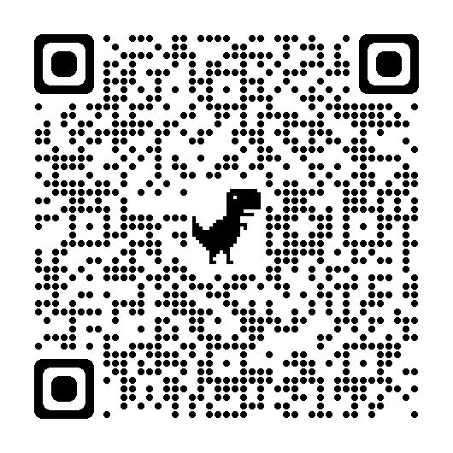
Let’s get Jamy!
Use the QR code or link shared by SLT to access the JamBoard.
You are asked:
“Have you used MS Forms before and how would you explain it to someone new?”
@NLDigitalSchool
Notes:
https://jamboard.google.com/d/1BhumX6bq2vKGdayF-3qlnOyljfpc4OFJHDExskEZf70/edit?usp=sharing

Slide 3
Introduction to MS Forms
We will explore:
What MS Forms is and how it can be used at Secondary
How to create & share a MS Form
Different types of questions and texts
@NLDigitalSchool
Notes:
Today’s CLPL session will be very much question led and require some participation from you all. When I say question led I mean the hints and tips I give you today are all questions everyone asks when beginning to use MS Forms. When I say participation I am talking about the second half of our CLPL session where you will create a simple MS Form following along with my instructions but you will personalise this Form to your department.

Slide 4
What is MS Forms?
MS Forms CLPL
Introduction
Online survey creator.
Available in Office 365 through Glow.
‘Form’ – to create surveys and gather information (ideal for parents)
‘Quiz’ – to assess pupils’ understanding, mark answers, allocate scores etc.
Pupils can create and assign their own Forms/Quizzes.
Can be shared through Teams / link/ collaboration / duplication.
@NLDigitalSChool

Slide 5
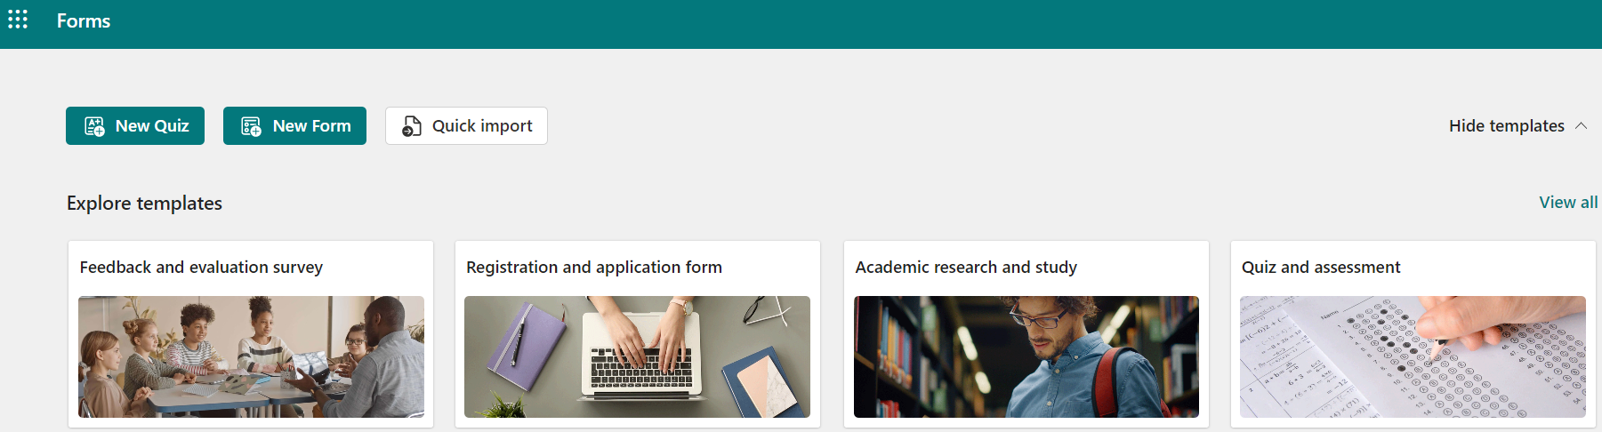

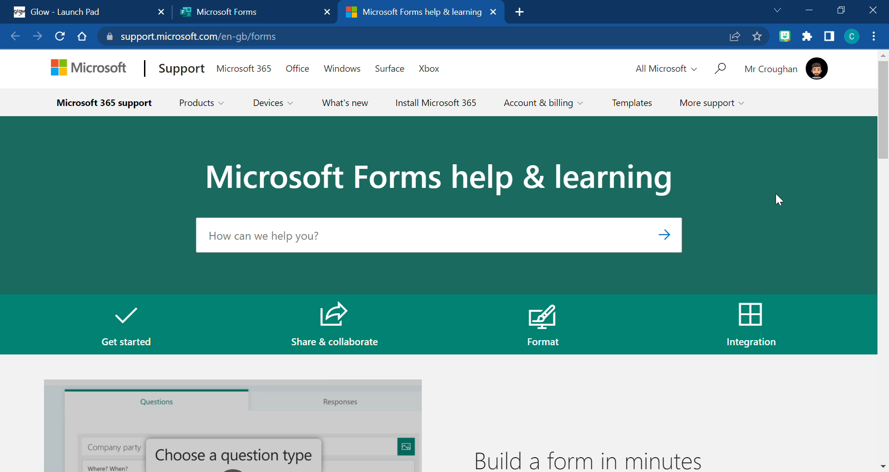
Can I see examples of MS Forms?
MS Forms CLPL
Introduction
Click the image to the left to gain access to hundreds of templates created by Microsoft.
@NLDigitalSChool
You can also get further support on the Microsoft Help & Learning Page.
Notes:
https://forms.office.com/Pages/DesignPageV2.aspx?subpage=templatesall
https://support.microsoft.com/en-gb/forms

Slide 6
How can it be used in my setting?
MS Forms CLPL
Introduction
P.E.
Add in videos or images of techniques to critique using short or long answers.
Maths
End of unit assessments using a multiple choice quiz or gathering data digitally as part of a lesson.
English
Provide a short text and pupils can answer using multiple choice, short or long answers.
Mod
Langs
Quizzes to check grammar and vocabulary using multiple choice or short/long answer questions.
@NLDigitalSChool
Music
Provide short video or audio clips to listen to and answer multiple choice questions.
Social
Subs
Use Likert scale questions to determine pupil confidence on specific learning areas.

Slide 7
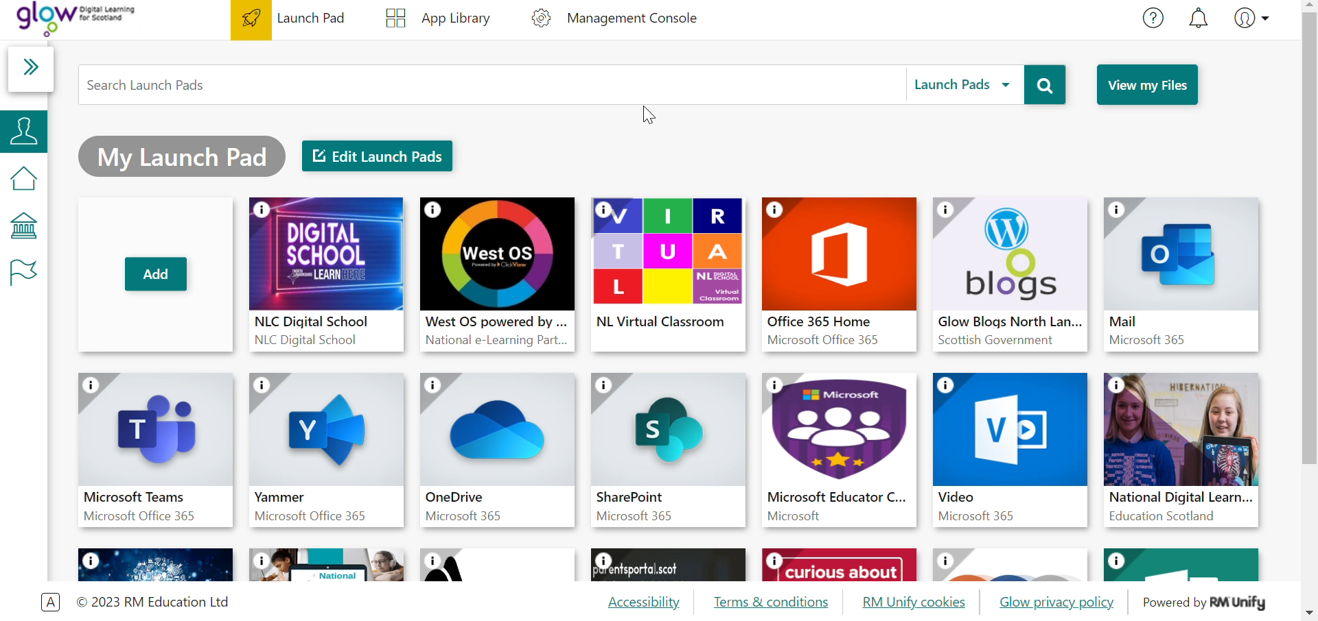
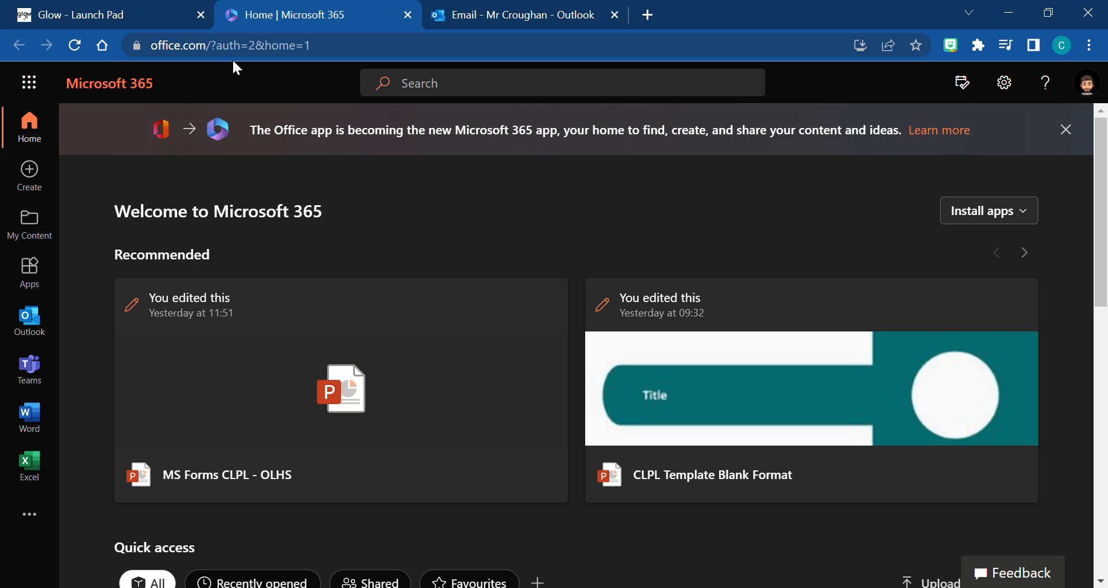
How can I access MS Forms?
MS Forms CLPL
Introduction
You can access MS Forms through Glow and click on Office 365 tile. Click on the App Launcher to open up further Microsoft programs, find and click on Forms.
@NLDigitalSChool
You can also add a Personal Tile on your Glow Launch Pad.

Slide 8

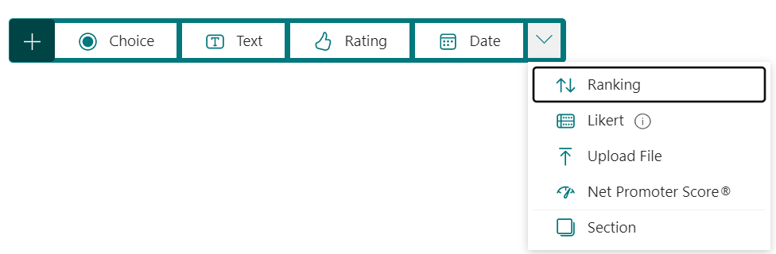
What question formats are available?
MS Forms CLPL
Introduction
Let’s look at a live example and go through all the question types in the Forms and Quizzes.
If you are interested in Maths questions then you must create a Quiz!
We will also go through some helpful hints and tips!
@NLDigitalSChool
Notes:
Immersive Reader, translate and text preferences available
Print responses as evidence
Shuffle questions and lock specific questions in …

Slide 9
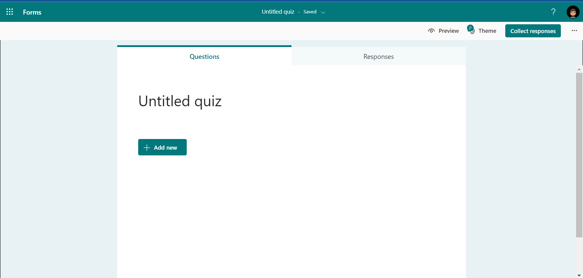
Let’s get creating!
MS Forms CLPL
Introduction
@NLDigitalSChool
When you start a new quiz or form this is what you will be presented with…
Now we will go live and start creating your very own personalised quiz.

Slide 10
Introduction to MS Forms
Any
questions?
@NLDigitalSchool

