Slide 1

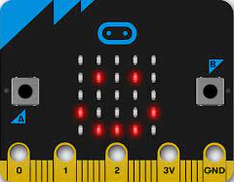


Introducing micro:bit Challenges

Slide 2

Instructions
In these slides, there are 10 tinkering challenges that start off fairly simple and get progressively more challenging.
Each challenge will provide the learners with a design challenge statement and they must decide how to build the program to match the description.
Each challenge allows the learners 5 minutes to complete the challenge before the block code is displayed and discuss the solution as a class.
Click the space bar to start the 5 minute timer and see the bar begin to disappear. Once the timer is up click the space bar again to reveal the block code.
Introducing micro:bit Challenges
Experiences & Outcomes
I can demonstrate a range of basic problem solving skills by building simple programs to carry out a given task, using an appropriate language. TCH 1-15a
I can create, develop and evaluate computing solutions in response to a design challenge. TCH 2-15a

Slide 3

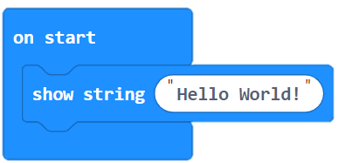
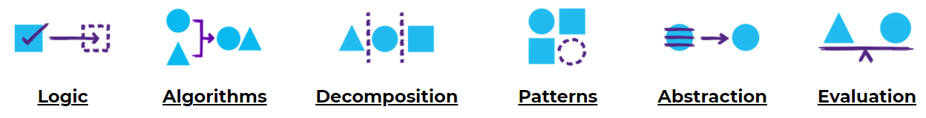
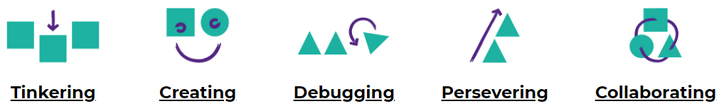
Concepts & Approaches
concepts
approaches

Slide 4
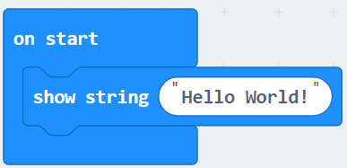
Challenge 1
Show String
I can code my micro:bit to show a string “Hello World!” when the micro:bit starts.
0
1
2
3
4
5

Slide 5
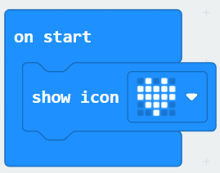
Challenge 2
Show a Heart
I can code my micro:bit to show a heart icon when the micro:bit starts.
0
1
2
3
4
5

Slide 6
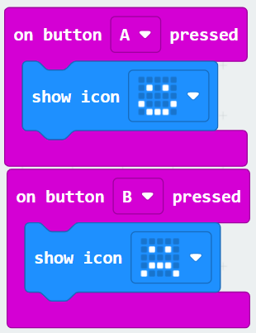
Challenge 3
Happy or Sad?
I can code my micro:bit to show a happy face when button A is pressed and a sad face when button B is pressed.
0
1
2
3
4
5

Slide 7
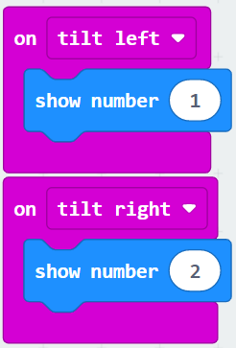
Challenge 4
Tilt Left and Right
I can code my micro:bit to show a number 1 when tilted left and the number 2 when tilted right.
0
1
2
3
4
5

Slide 8
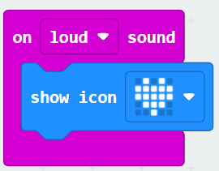
Challenge 5
Clapping Heart
I can code my micro:bit to show a heart icon when a loud noise is heard e.g. a clap.
0
1
2
3
4
5

Slide 9
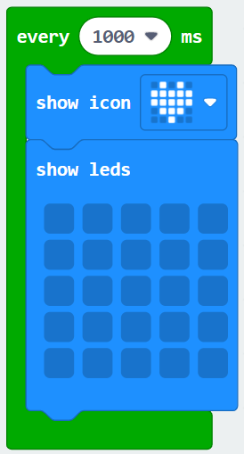
Challenge 6
Flashing Icon
I can code my micro:bit to flash a heart icon every second.
0
1
2
3
4
5

Slide 10
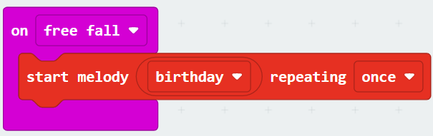
Challenge 7
Falling Melody
I can code my micro:bit to start playing the birthday melody once when dropped.
0
1
2
3
4
5

Slide 11
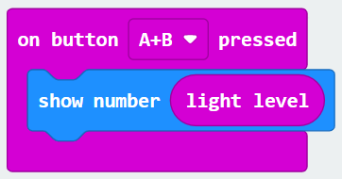
Challenge 8
Light Level
I can code my micro:bit to show the light level when I press buttons A + B at the same time.
0
1
2
3
4
5

Slide 12
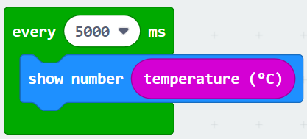
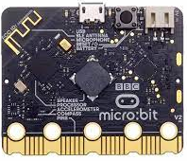
Challenge 9
Thermometer
I can code my micro:bit to show the temperature every 5 seconds.
Tip: put your finger on the
Processor and see how it
changes the reading.
0
1
2
3
4
5

Slide 13
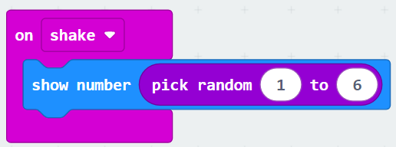
Challenge 10
Virtual Dice
I can code my micro:bit to show a random number between 1 and 6 when it is shaken.
0
1
2
3
4
5

Slide 14
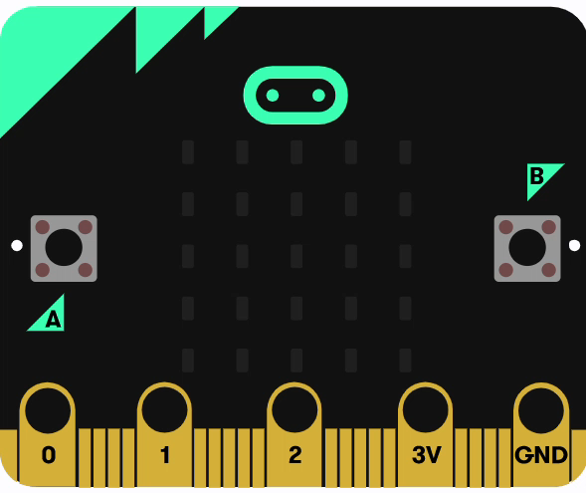
Congratulations!
Well done if you managed to complete all of these challenges!
Why not have a go at creating a challenge for someone in your class? Or tinker some more with MakeCode and see what else you can make Micro:bit do.
Introducing micro:bit Challenges

