Slide 1
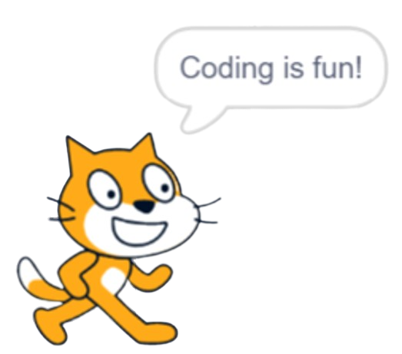

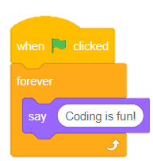


Introducing Scratch Challenges

Slide 2
Instructions
In these slides, there are 10 tinkering challenges that start off fairly simple and get progressively more challenging.
Each challenge will provide the learners with a design challenge statement and they must decide how to build the program to match the description.
Each challenge allows the learners 5 minutes to complete the challenge before the block code is displayed and discuss the solution as a class.
Click the space bar to start the 5 minute timer and see the bar begin to disappear. Once the timer is up click the space bar again to reveal the block code.
Introducing micro:bit Challenges
Experiences & Outcomes
I can demonstrate a range of basic problem solving skills by building simple programs to carry out a given task, using an appropriate language. TCH 1-15a
I can create, develop and evaluate computing solutions in response to a design challenge. TCH 2-15a

Slide 3
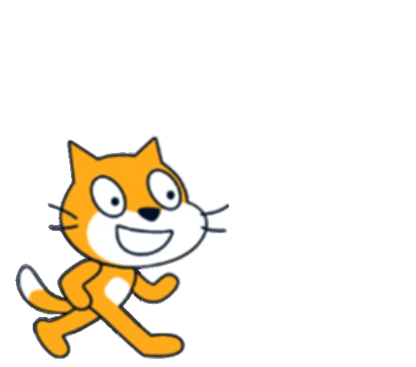
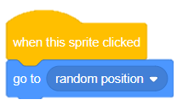
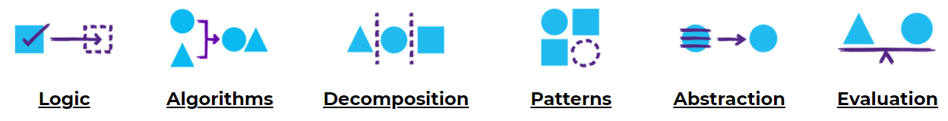
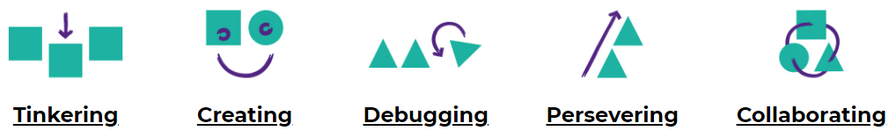
Concepts & Approaches
concepts
approaches

Slide 4
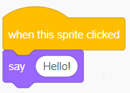
Challenge 1
Say Hello
I can code Scratch Cat to say hello when I click on him.
0
1
2
3
4
5

Slide 5
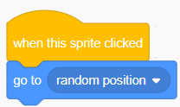
Challenge 2
Random Position
I can code Scratch Cat to go to a random position when I click on him.
0
1
2
3
4
5

Slide 6
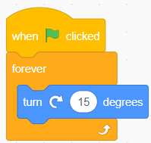
Challenge 3
Spinning Cat
I can code Scratch Cat to turn forever when the green flag is clicked.
0
1
2
3
4
5

Slide 7
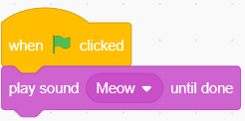
Challenge 4
Meow
I can code Scratch Cat to play sound Meow when the green flag is clicked.
0
1
2
3
4
5

Slide 8
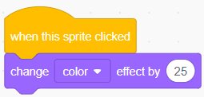
Challenge 5
Change Colour
I can code Scratch Cat to change colour when the sprite is clicked.
0
1
2
3
4
5

Slide 9
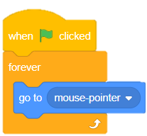
Challenge 6
Follow Code
I can code Scratch Cat to follow my mouse pointer or finger when the green flag is clicked.
0
1
2
3
4
5

Slide 10
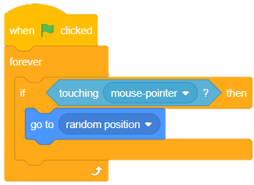
Challenge 7
Sensing Blocks
I can code Scratch Cat to forever, sense when touching the mouse pointer and then go to a random position.
0
1
2
3
4
5

Slide 11
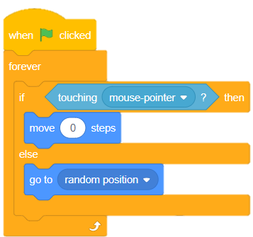
Challenge 8
IF THEN
I can code Scratch Cat to forever, sense if touching the mouse pointer then move zero steps, else go to a random position.
0
1
2
3
4
5

Slide 12
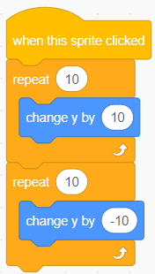
Challenge 9
Jumping Cat
I can code Scratch Cat to jump up and land when the sprite is clicked.
0
1
2
3
4
5

Slide 13
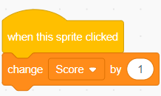
Challenge 10
Scoring Cat
I can code Scratch Cat to add a point to a score variable when the sprite is clicked.
0
1
2
3
4
5

Slide 14
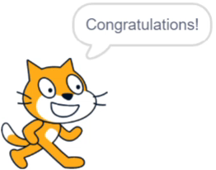
Congratulations!
Well done if you managed to complete all of these challenges!
Why not have a go at creating a challenge for someone in your class? Or tinker some more with Scratch and see what else you can create.
Introducing Scratch
Challenges

