Slide 1

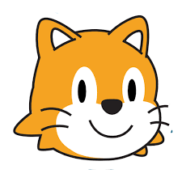



Introducing ScratchJr Challenges

Slide 2
Instructions
In these slides, there are 6 tinkering challenges that start off fairly simple and get progressively more challenging.
Each challenge will provide the learners with a design challenge statement and they must decide how to build the program to match the description.
Each challenge allows the learners 5 minutes to complete the challenge before the block code is displayed and discuss the solution as a class.
Click the space bar to start the 5 minute timer and see the bar begin to disappear. Once the timer is up click the space bar again to reveal the block code.
Introducing ScratchJr
Challenges
Experiences & Outcomes
I can develop a sequence of instructions and run them using programmable devices or equivalent. TCH 0-15a
I can demonstrate a range of basic problem solving skills by building simple programs to carry out a given task, using an appropriate language. TCH 1-15a

Slide 3

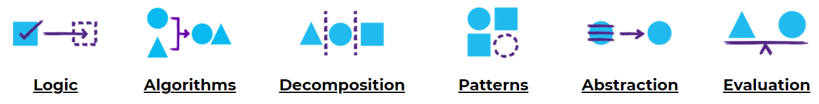
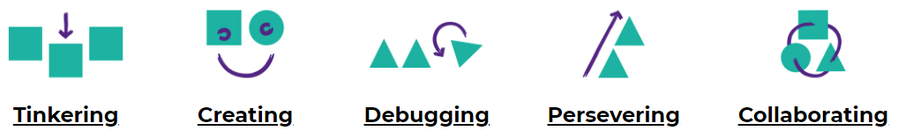
Concepts & Approaches
concepts
approaches

Slide 4
Challenge 1
Say Hello
I can code ScratchJr to say hello when the green flag is clicked.
0
1
2
3
4
5

Slide 5

Challenge 2
Walking Cat
I can code ScratchJr to walk to the right forever when the green flag is clicked.
0
1
2
3
4
5

Slide 6

Challenge 3
Growing Cat
I can code ScratchJr to get smaller, wait and then grow back to normal size when the green flag is clicked.
0
1
2
3
4
5

Slide 7

Challenge 4
Disappearing Cat
I can code ScratchJr to forever say Goodbye, hide, wait and then reappear when the green flag is clicked.
0
1
2
3
4
5

Slide 8

Challenge 5
Jump, Speak and Spin
I can code ScratchJr to jump, play sound pop, spin and stop when the sprite is clicked.
0
1
2
3
4
5

Slide 9

Challenge 6
Repeating Square
I can code ScratchJr, when the sprite is clicked, to move up, left, down and right to make a square and repeat 4 times.
0
1
2
3
4
5

Slide 10
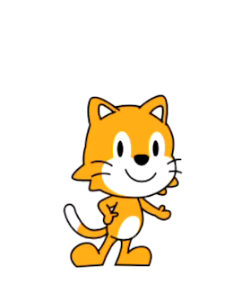
Congratulations!
Well done if you managed to complete all of these challenges!
Why not have a go at creating a challenge for someone in your class? Or tinker some more with ScratchJr and see what else you can create.
Introducing ScratchJr
Challenges

