Slide 1
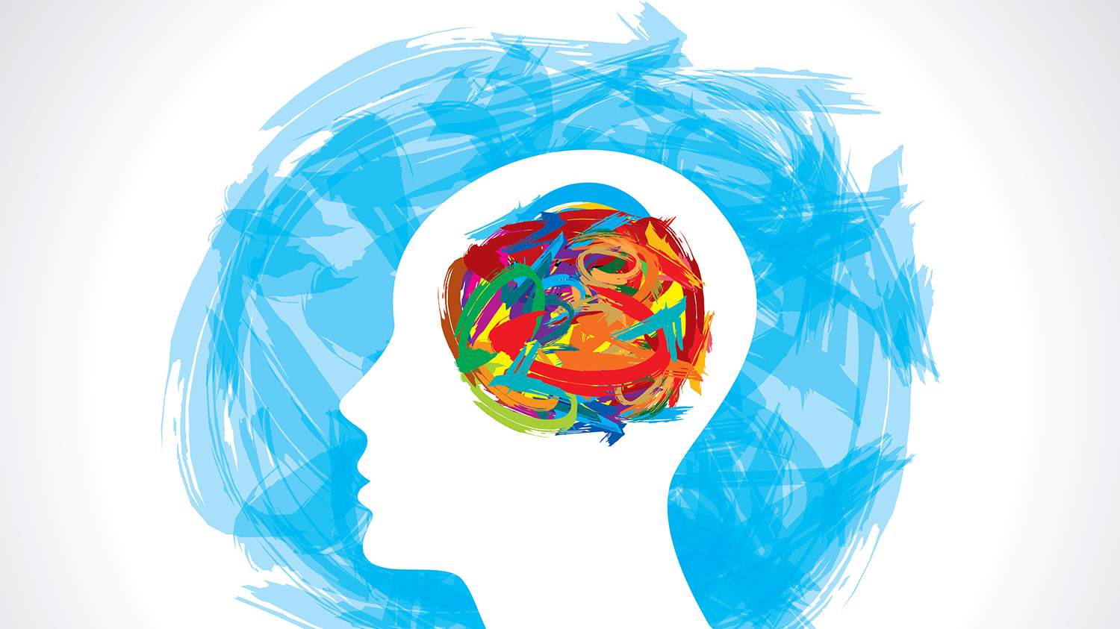
Depression
Individual Behaviour

Slide 2
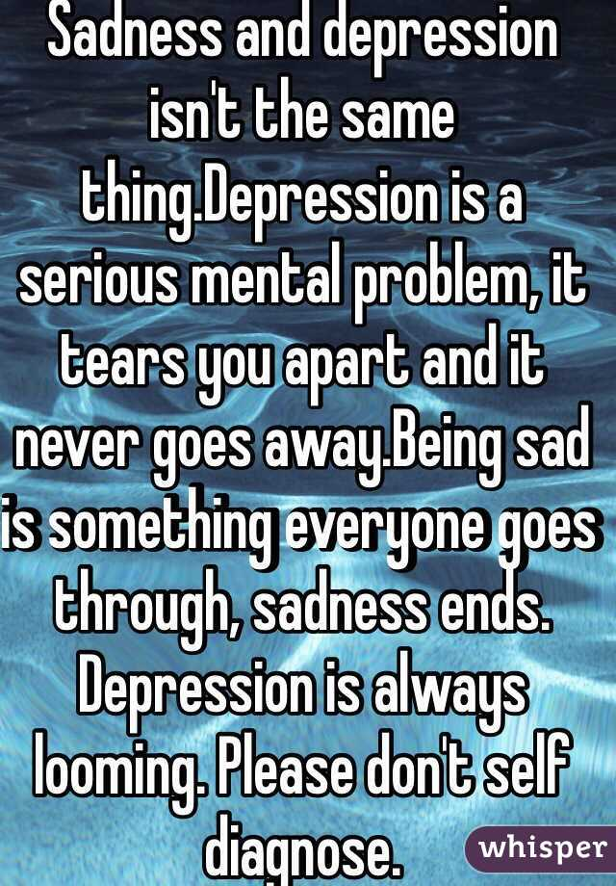
We are going to be going into detail about different types of depression and how they are diagnosed.
Please do not self diagnose, it is only a professional who is able to diagnose depression. If you are experiencing the symptoms we are talking about and you believe you may truly be suffering from this mental illness, talk to someone. Don’t keep it to yourself, find someone you trust and tell them how you are feeling.

Slide 3
What do we need to know for this topic?
Definitions + Diagnosis of depression (MDD and PDD)
Biological Causes of Depression
Neurochemistry
Hormones
Diathesis-Stress model
Biological Treatments of Depression
4 antidepressants
Electroconvulsive therapy
Cognitive Causes of Depression – Beck’s theory
Negative self-schema
Faulty information processing
Negative cognitive triad
Cognitive Treatments of Depression
CBT
Cognitive study - Giovanni (1998)
Biological study - McGuffin et al (1996)
Notes:
Copy all of what we need to know…… Then take title first point as title.

Slide 4
Definitions and Diagnosis
Definition of depression
DSM – 5 for diagnosis

Slide 5
What is depression? Definition
Work in groups or pairs to try and come up with a definition

Slide 6
Copy definition
Depression is a mood, or affective disorder. This mental illness is a collection of physical, emotional, mental and behavioural experiences that are severe, prolonged and damaging to everyday functioning.

Slide 7
Stephen Fry openly speaks about his struggles with manic depression and bi-polar disorder
“It's not all bad. Heightened self-consciousness, apartness, an inability to join in, physical shame and self-loathing—they are not all bad. Those devils have been my angels. Without them I would never have disappeared into language, literature, the mind, laughter and all the mad intensities that made and unmade me”

Slide 8
Diagnosing depression The DSM-5 (2013)
Diagnostic and Statistical Manual of Mental Disorders known as the DSM-5 (2013)
The DSM-5 is a useful tool in diagnosing psychological disorders and helps to reduce the subjectivity involved in identifying psychopathology. It helps psychologists and other health professionals to make objective diagnoses of psychological disorders.
What do we mean if something is objective v subjective?
Subjective refers to personal perspectives, feelings, or opinions entering the decision making process. Objective refers to the elimination of subjective perspectives and a process that is purely based on hard facts

Slide 9
Diagnosing depression DSM-5 (2013)
The DSM-5 outlines certain criteria which must be met in order to make a diagnosis of any mental health disorders.
We will go into this in more detail regarding what these symptoms are later but The DSM-5 outlines the following criterion to make a diagnosis of depression.
The individual must be experiencing five or more symptoms during the same 2-week period and at least one of the symptoms should be either (1) depressed mood or (2) loss of interest or pleasure.
In your pairs evaluate the use of the DSM-5. Can you think of any reasons why it would be a good/bad resource to rely on?

Slide 10
Evaluation - DSM 5
The Diagnostic and Statistical Manual of Mental Disorders (DSM) is the handbook used by health care professionals in the United States and much of the world as the authoritative guide to the diagnosis of mental disorders. DSM contains descriptions, symptoms, and other criteria for diagnosing mental disorders.
Weaknesses
Some people feel the DSM 5 removed some useful diagnostic categories
Once someone has been given the label of ‘mentally ill’ it is likely to stay with them for life.
Relies on ‘pigeon hole’ categories - mental health isn’t always so neat and tidy
Links with the pharmaceutical companies in the USA
Strengths
Recognition of new disorders can lead to heightened awareness and more consistent treatment
Helps to make diagnoses more objective.

Slide 11
Depression
Depressive symptoms can be behavioural, emotional or cognitive.
Behavioural (How do you BEHAVE when you're depressed?): Neglect of personal appearance, loss of appetite, disturbed sleep patterns (insomnia), loss of energy (tiredness), withdrawal from others.
Emotional (How do you FEEL when you're depressed?): Intense sadness, irritability, apathy (loss of interest of enjoyment), feelings of worthlessness, anger.
Cognitive (How do you THINK when you're depressed?): Negative thoughts, lack of concentration, low self-esteem, poor memory, recurrent thoughts of death, low confidence.
Notes:
Copy bold

Slide 12
Task
“Ben recently moved away from home to go to university. He was loving his new life of going out, meeting new friends, his new university course. However, after a while he struggled getting out of bed and started to become very tired. His eating patterns changed and he lost a lot of weight. He noticed that he got angry at little things and snapped at his friends. When he was sat in lectures, he found it hard to concentrate for long periods of time.”
Identify the behavioural, emotional and cognitive aspects of Ben’s state.

Slide 13
Task
Behavioural – Change in eating and sleeping patterns. Loss of weight
Emotional – Getting angry at little things
Cognitive – Unable to concentrate for long periods of time

Slide 14
Task
Look at the symptoms of depression on the following slide. Categorise them into the following four domains:
Emotion (how people feel),
Cognitive (thoughts people have)
Behaviour (how people behave).
Physical (how their bodies change)
So – for example, low mood would be Emotional while Social Withdrawal would be Behavioural.

Slide 15
Classifying the symptoms
Emotion (how people feel), Cognitive (thoughts people have), Behaviour (how people behave), Physical (how their bodies change).
Low self-esteem
Sleep disturbance (insomnia/hypersomnia)
Loss of weight
Sadness
Negative thoughts
Poor memory
Irritability
Anhedonia (no interest or pleasure in activities)
Suicide attempts
Cognitive | Behavioural | Emotional | Physical
Loss/gain of appetite
Decrease in sexual activity
Aches & pains
Menstrual changes
Loss of libido
Feelings of guilt
Poor care of self & others
Self dislike

Slide 16
Classifying the symptoms
Emotion (how people feel), Cognitive (thoughts people have), Behaviour (how people behave), Physical (how their bodies change).
Cognitive | Behavioural | Emotional | Physical
Negative thoughts Poor memory | Sleep disturbance Loss/gain of appetite Poor care of self & others Irritability Decrease in sexual activity | Sadness Feelings of guilt Self dislike Low self-esteem Anhedonia (no interest in pleasure in activities) | Loss of weight Suicide attempts Aches & pains Menstrual changes Loss of libido

Slide 18
Types of depression
Major depressive disorder
Persistent depressive disorder

Slide 19
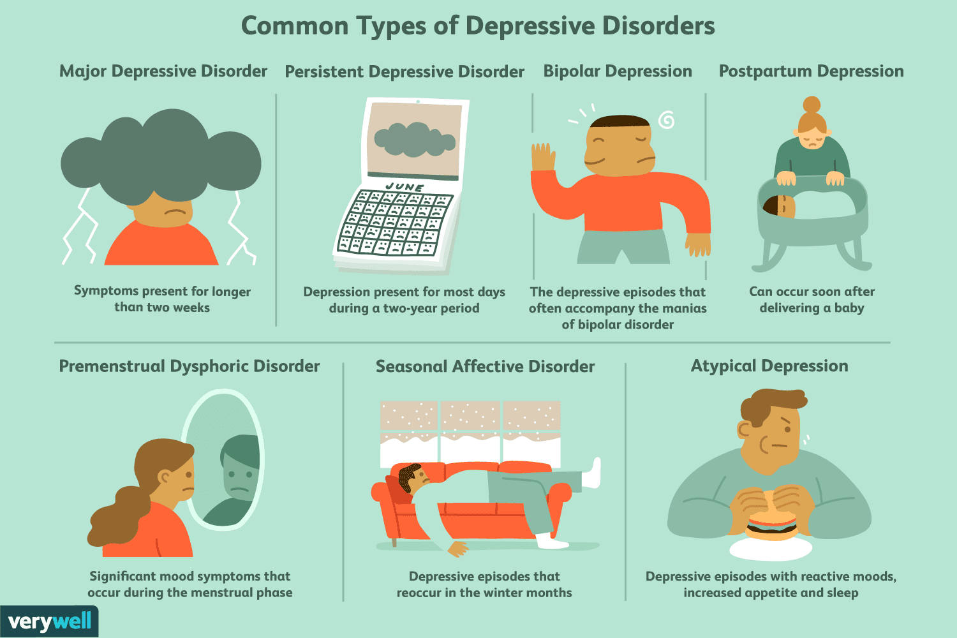

Slide 20
Major depressive disorder
Major depressive disorder also known as clinical depression
Sadness is a natural part of the human experience. People may feel sad or depressed when a loved one passes away or when they’re going through a life challenge, such as a divorce or serious illness.
However, these feelings are normally short-lived. When someone experiences persistent and intense feelings of sadness for extended periods of time, then they may have major depressive disorder (MDD)
Here is a small clip of what it might be like to live with MDD

Slide 21
What is it like to live with depression?

Slide 22
Diagnosing Major Depressive Disorder
To be diagnosed with MDD, you need to meet the symptom criteria listed in the Diagnostic and Statistical Manual of Mental Disorders (DSM).
According to its criteria, you must have 5 or more of the following symptoms, at least one of the symptoms should be either (1) depressed mood or (2) loss of interest or pleasure.
You must experience them at least once a day for a period of more than 2 weeks.

Slide 23
Depressed mood most of the day, nearly every day.
Markedly diminished interest or pleasure in all, or almost all, activities most of the day, nearly every day.
Significant weight loss when not dieting or weight gain, or decrease or increase in appetite nearly every day.
A slowing down of thought and a reduction of physical movement (observable by others, not merely subjective feelings of restlessness or being slowed down).
Fatigue or loss of energy nearly every day.
Feelings of worthlessness or excessive or inappropriate guilt nearly every day.
Diminished ability to think or concentrate, or indecisiveness, nearly every day.
Recurrent thoughts of death, recurrent suicidal ideation without a specific plan, or a suicide attempt or a specific plan for committing suicide

Slide 24
Treatment for major depressive disorder
MDD is often treated with medication and psychotherapy. Some lifestyle adjustments can also help ease certain symptoms.
People who have severe MDD or who have thoughts of harming themselves may need to stay in the hospital during treatment.

Slide 25
Drug therapy for major depressive disorder
Doctors often start treatment for MDD by prescribing antidepressant medications which can be:
Selective serotonin reuptake inhibitors (SSRIs). These antidepressants are frequently prescribed. SSRIs work by helping inhibit the breakdown of serotonin in the brain, resulting in higher amounts of this neurotransmitter.

Slide 26
Lifestyle changes to help major depressive disorder
Be careful telling someone to change their habits to ‘fix’ their depression…
Adopting a regular exercise programme and eating well have been shown to improve symptoms of MDD
Avoiding alcohol which is a depressant is also recommended
Good sleep hygiene can help to overcome sleeping problems
Sometimes CBT can be an effective treatment as it is in persistent depressive disorder.

Slide 27
Task: Explain Major Depressive Disorder
Depression is a …..
To be diagnosed with MDD you must have…
and…

Slide 28
Task: Explain Major Depressive Disorder
Depression is a mental health illness. Which is damaging to everyday functioning. To be diagnosed with MDD you must have 5 or more of the symptoms which are listed in the DSM-5 and one of these symptoms must be either decreased mood or loss of interest or pleasure.

Slide 29
Types of depression
Major depressive disorder
Persistent depressive disorder

Slide 30
Diagnosing Persistent Depressive Disorder
Persistent depressive disorder is the state of having a mild to moderate chronic depressed mood.
According to the Diagnostic and Statistical Manual (DSM), the symptoms of persistent depressive disorder are less severe than those of major depression, but the condition, being chronic, also tends to last longer than a major depressive episode. To be diagnosed, this mood must persist for at least 2 years, or for 1 year in the case of an adolescent.

Slide 31
Diagnosing Persistent Depressive Disorder
Symptoms may vary over the course of the illness, but two or more of the following symptoms will be present consistently in combination with a chronically sad or depressed mood:
Feelings of hopelessness
Depleted energy and lack of interest in hobbies, family, friends, or previously enjoyed activities
Low self-esteem
Overeating or poor appetite
Difficulty concentrating
Excessive sleeping or difficulty sleeping

Slide 32
Persistent Depressive Disorder
It is common for a person with persistent depressive disorder to be unable to remember a time when the condition was not present, and the feelings of depression may have come to feel normal.
It is common among the elderly and among people who are isolated, who have health problems, or who have another mental health condition.
The condition may have a genetic element: Having a relative with either persistent or major depression appears to increase the likelihood of developing the disorder.

Slide 33
Treatment for persistent depressive disorder
Because the symptoms of persistent depressive disorder are less pronounced than the overwhelming depression and suicidal ideation that often characterizes major depression, the condition can sometimes progress for a long time before treatment is sought.

Slide 34
Psychotherapy for persistent depressive disorder
A combination of therapy and medication can help
Studies indicate that cognitive behavioural therapy (CBT) is especially effective at treating chronic forms of depression.
In therapy, any potential causes of the condition can be identified and addressed.
Cognitive behavioural therapy (CBT) is a short-term form of behavioural treatment that helps people problem-solve and see the relationship between beliefs, thoughts, and feelings, and subsequent behaviour patterns and actions.

Slide 35
Drug therapy for persistent depressive disorder
In some cases medication is prescribed.
In an ideal world this should be as a supplemental treatment to therapy.
SSRIs are often effective treatment but doctors may also prescribe other antidepressants or tricyclic antidepressants.
An anti-anxiety medication may also be beneficial to some sufferers.
(We will talk more about drug treatment for depression in a future lesson)

Slide 36
Task
Explain the difference between Major Depressive Disorder and Persistent Depressive Disorder.
To get diagnosed MDD symptoms must be consistently apparent for a period of two weeks. However, to get diagnosed with PDD the symptoms will be evident for a period of two years for adults and one year for adolescents.
With MDD you must have 5 or more of the listed symptoms one of which must be either decreased mood or loss of interest. However, with PDD the classification is not as strict and the symptoms can vary over the course of an illness, but two or more of the symptoms listed with me present consistently in combination with chronically sad or depressed mood.
A symptom of MDD is recurrent thoughts of death or suicidal ideation without an actual suicide plan. However, the DSM-5 doesn’t acknowledge this as a symptom of PDD.

Slide 37
Case Study
Decide – what symptoms are present? Do you think it is a form of Depression, or just low mood?
https://www.youtube.com/watch?v=Zr16eHb4YNU
As we watch the clip take down a note of any symptoms which she is expressing as feeling. When the clip is finished you will be asked to decide if she has a form of depression or just low mood.

Slide 38
Starter – you are a GP – what would you diagnose them with and why?
I have been coming to see you for the past 30 years. You know both me and the family well.
I am 50 years old, female, my children have just left home; I miss them terribly. Many women of my age suffer a loss of identity and feel very low as they wonder about their purpose in life. I have decided to retrain as a teacher and have thrown myself into my studies.
I have been married for 30 years. I have nursed my husband through depression and have had CBT myself to help me cope with the stress of a young family and a depressed husband.
I have just hit the menopause; I cannot sleep beyond 3 am, I have constant sweats, I am gaining weight despite a strict diet.
About 5 years ago I suffered from chronic tiredness, muddled thinking, need to sleep continually, muscle pain and weight loss which were diagnosed as M.E or chronic fatigue. Through therapy I have since recovered and am leading a normal life again, working part time and retraining as a teacher.
I come see you. I can’t sleep but don’t feel that tired, I have difficulty concentrating and feel anxious. I am haunted by concern about the future, as I am not sure that I can cope with teaching – perhaps I haven’t made the right decision after all. I get tearful when I think of my children living away from home. I am continuing to put on weight. Then some days I am exhausted and can’t get out of bed.
Notes:
Print.

Slide 39
Starter – you are a GP – what would you diagnose them with and why?
Major Depressive Disorder (or possible Persistent, there isn’t much info about length of time)
Key: Low mood everyday
Other symptoms: weight gain, diminished ability concentrating, feelings of worthlessness, inability to sleep and oversleeping, loss of energy.

Slide 40
Biological causes of depression
Neurochemistry
Hormones
Diathesis – Stress model

Slide 41
Biological Causes of Depression
Remember in sleep – what different ideas were there about what is going on during sleep?
In the same way, there are different approaches to studying mental health – they define, diagnose, explain the cause and treat mental health in different ways.
We only need to know about the Biological and Cognitive approach.

Slide 42
Biological Causes of Depression
The Biological Approach says that all behaviour is controlled by our universal biological processes. That means that abnormal behaviour and mental ill health must be caused by bodily malfunctions and genetic factors.
This approach treats psychological disorders in the same way as a broken arm, i.e. there is thought to be a physical cause.
We are going to learn 3 Biological Explanations of Depression:
1. Neurochemistry – neurotransmitters in the brain
2. Hormones – estrogen, progesterone, cortisol
3. Diathesis-stress – a genetic disposition for depression which is then triggered by environmental stressors.

Slide 43
Biological causes of depression- Neurochemistry
Before we learn anything about neurochemistry we need to understand neurotransmitters.
There are about 15-20 neurotransmitters which have been identified by researchers so far. A neurotransmitter is a chemical messenger inside the body. Neurotransmitters carry messages between neurons.
Neurons are the nerve cells that create a giant communication network in our nervous system.
Anything we do, feel, hear, see etc happens because neurotransmitters send messages all over the brain and body.

Slide 44
Biological causes of depression- Neurochemistry
It is believed the neurotransmitters do not function properly in depressed people. The three neurotransmitters which play the most dominant role in depression are;
Dopamine
Serotonin
Noradrenaline
Bunney and Davis (1965) showed that noradrenaline levels were very low in depressed patients
McNeil and Cimbolic (1986) showed that depressed patients have very low levels of serotonin in their brains

Slide 45
Biological causes of depression- Neurochemistry Dopamine
The neurotransmitter dopamine is linked to depression
Dopamine plays an important role in regulating our drive to seek out rewards, as well as our ability to obtain a sense of pleasure
Low dopamine levels may help explain why depressed people don't derive the same sense of pleasure out of life that they did before becoming depressed
Dopamine helps control the brain's reward and pleasure centres
Dopamine enables us not only to see rewards, but to take action to move toward them

Slide 46
Biological causes of depression- Neurochemistry Serotonin (referred to as the serotonin hypothesis)
Serotonin relays messages from one area of the brain to another. Abnormal levels may prevent messages being sent properly
Almost all brain cells are affected directly or indirectly by serotonin.
This includes brain cells related to mood, sexual desire, appetite, sleep, memory and learning, temperature regulation and social behaviour, it seems to have a calming affect.
As well as depression low levels of serotonin have been linked to obsessive compulsive disorder, anxiety, panic attacks and excessive rage

Slide 47
Biological causes of depression- Neurochemistry Noradrenaline
The main function of noradrenaline (also called norepinephrine) is to mobilise the brain and body for action
It is at its lowest levels during sleep and highest when we are faced with a ‘fight or flight’ scenario
In the brain it increases alertness, promotes vigilance and focuses attention. In the rest of the body it increases heart rate and blood pressure, triggers the release of glucose from energy stores, increases blood flow to skeletal muscle, reduces blood flow to the gastrointestinal system, and inhibits our need to pee and poop

Slide 48
Neurotransmitters evaluation Serotonin hypothesis in particular
Strength: SSRIs (that stop the reuptake of serotonin, giving you more in each synapse) treat depression (65% of people see improvement) – that suggests lows serotonin could be the cause.
Weakness:
Paracetamol treats a headache, but a lack of paracetamol didn’t cause it. Just because a treatment works doesn’t make it the cause.
Cause and effect issues – is it a symptom or a cause?
Probably not a ‘single or few neurotransmitter’ issue – lots are involved in sending the signals that cause mood etc

Slide 49
Biological causes of depression- Hormones
Only 65% of people respond well to anti depressants like SRRIs – that suggests it cant just be serotonin, there must be other things going on that we need to address
Women are between 1.5-3 times more likely to experience mood disorders in adulthood. However, before puberty the rates are the same between the genders. That suggests hormones might play a role.

Slide 50
Biological causes of depression- Hormones
Women are much more likely to suffer from depression than men and there is some evidence this can be linked to hormonal differences
In males testosterone levels peak at puberty then remain almost constant until middle age when a very gradual decline begins
In females sex hormone levels vary greatly over the course of a month and because of lifespan changes

Slide 51
Biological causes of depression- Hormones
When do hormones affect mood?
Thyroid problems: some symptoms of depression can be associated with thyroid condition
Pregnancy and post-natal depression: during pregnancy, women are subject to physical and emotional changes caused in part by changes in hormones. After pregnancy, women experience a huge shift in hormone levels.
Perimenopause and menopause: changes in hormones, other symptoms of menopause (e.g. sleep disturbances) and full loads of responsibilities can lead to depression (around 15% of women during menopause)

Slide 52
Biological causes of depression- Hormones Estrogen
Estrogen (sometimes referred to as oestrogen) – boosts serotonin levels. Females often find they have low levels of estrogen during menopause.
The predominant male sex hormone is testosterone though males also have some level of the female sex hormone estrogen occurring naturally
In males too much estrogen can cause depression or mood swings

Slide 53
Biological causes of depression- Hormones Progesterone
Progesterone – Helps to balance Estrogen, promote sleep and has a calming effect.
Progesterone, which appears after ovulation, can have a depressing effect. This thought to happen because it triggers the amygdala which is the area of the brain which assesses risks in the environment. Progesterone enhancing the reactivity of the amygdala could explain why at certain types of the month females may stress for small or unidentifiable reasons.
Research has found a clear link between contraception and depression which could be explained by the fact that all hormonal contraception contain progesterone and some are even progesterone-only.
Notes:
This is another example of where modern day living is in conflict with how evolution has designed our bodies. The effects of progesterone may be more profound now than in previous years as we are having more periods and less children than every before. 300 years ago women wouldn’t get their periods until about 17 or 18 due to malnourishment. As soon as they started menstruating they would then get pregnant and continue having kids until they couldn’t have them anymore at about 40, so during this time it is possible a women would have about 20 periods in her lifetime. However, with the development of birth control and women being generally healthier we are having more periods which means we are producing more progesterone than every before. This is before we even consider the fact that hormonal contraception all includes progesterone.

Slide 54
Biological causes of depression- Hormones Cortisol
Cortisol – a stress hormone – too high or low can cause depression..
High levels of stress hormones can make you feel jittery, anxious, unable to sleep, and irritable and if chronic can then lead to depression
Low levels of stress hormones can make you feel sluggish, tired (even after sleep), have difficulty concentrating, moody and depressed
Thus, the balance of these two hormones is very important in avoiding the onset of depression

Slide 55
Hormones evaluation

Slide 56
Biological causes of depression- Diathesis Stress model
If someone already has a predisposition biologically for depression and stress goes over a certain threshold, they will then develop this disorder. It also says that people can have varying levels of biological predisposition – the greater a person’s biological propensity for developing depression, the less amount of stress needed to then develop it.
In simpler terms, the model believed that some people are born more susceptible to depression, however, will only develop depression if they experience enough stressful life events.

Slide 57
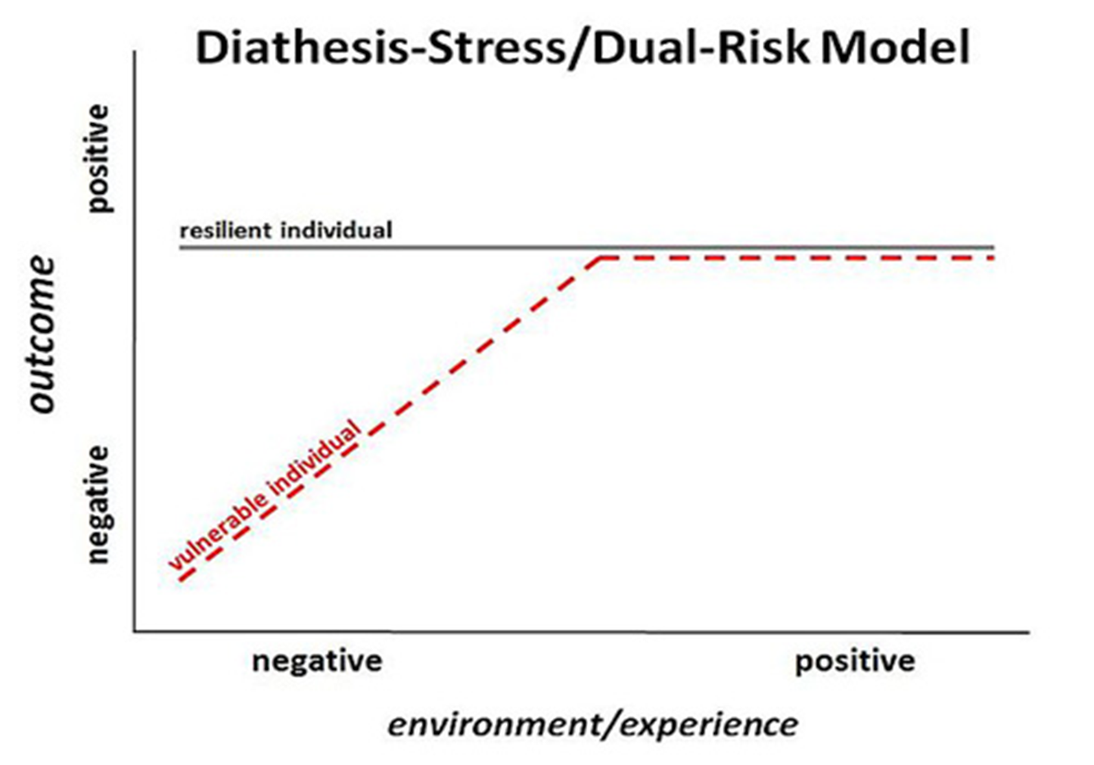
Diathesis Stress model
If an individual who is vulnerable to depression experiences a negative environment/experience they are more likely to experience a negative outcome.
If the person is a resilient individual, then they are going to be less effected by their environment or experiences.

Slide 58
Biological causes of depression- Diathesis Stress model
Protective factors:
These are things which will help prevent an individual from suffering from depression even if they are more susceptible and have experienced stressful situations in their life.
What do you think these factors could be?

Slide 59
Biological causes of depression- Diathesis Stress model
Protective factors:
These are things which will help prevent an individual from suffering from depression even if they are more susceptible and have experienced stressful situations in their life.
A supportive social group
Self-confidence
Self-esteem
Exercise
The more protective factors a person has the less likely they are to develop a mental illness.

Slide 61
Diathesis Stress model evaluation
Strengths
It is useful for understanding the interplay of nature and nurture, since there is evidence that both play a part (e.g McGuffin that we are about to look at)
It can help people because it promotes the idea of protective factors. Protective factors like positive social support and high self esteem can counteract the effect of stressors, which prevents mental ill health (e.g. adolescence and PSHE)
Can help identify people who might suffer from mental ill health and get extra support

Slide 62
Diathesis Stress model evaluation
Weakness
This model does not account for the influence of cognitive processes and there is a lot of evidence that distorted thinking must be present to cause depression

Slide 63
Task
Answer in your jotters
What do Psychologists think about serotonin and depression?
Explain one point in life that hormonal changes might cause depression
Identify one hormone thought to be involved in depression and why (what happens if it is low/high or whatever)
What does the diathesis-stress model say about depression?

Slide 64
Biological study
McGuffin et al (1996)

Slide 65
McGuffin et al (1996)
Mandatory study is a twin study.
Why do you think studying twins is useful when we are trying to work out if something is genetic based or not?
What is meant by monozygotic and dizygotic twins?
If something was genetically inherited, what would you expect to see in monozygotic twins?

Slide 66
McGuffin et al (1996) – Biological causes of Depression
Why a twin study?
Twins tend to share the same environment growing up, since they grow up in the same house at the same time. However, MZ twins share 100% of the same genes while DZ twins only share 50%. If there is a higher concordance between MZ twins than DZ twins, that suggests a genetic basis.
Aim: to investigate the contribution of genetics versus environment in depression

Slide 67
McGuffin et al (1996) – Biological causes of Depression
Method
177 people who suffered from depression but had a currently undiagnosed twin took part
They were all interviewed (both twins). The interviewer was ‘blind’ to their mental health history and was identifying how many symptoms of depression they had.

Slide 68
McGuffin et al (1996) – Biological causes of Depression
Results
The concordance rate for identical twins (46%) was higher than from non-identical (20%)
Conclusion
Suggests there is a genetic component of depression and that even when all environment is shared, genetics plays a part
Concordance Rate is a term that is used in statistics and by geneticists to describe the rate of probability that two people with shared genes will develop the same organic disease

Slide 69
In your jotter
Summarise McGuffin 1996 in your jotter
No more than one sentence for each part
Try and read it over once more just now and then fill it in from memory
Aim:
Method:
Results:
Conclusion:

Slide 70
McGuffin et al (1996) – Biological causes of Depression Evaluation
Weakness: Concordance rates aren’t very high. It would be 100% if it was PURELY genetic. Must be other factors at work too (maybe diathesis stress is a good idea?)
Strength: ‘Blind’ methodology – the researcher didn’t know if they were interviewing a twin diagnosed with depression or not, so couldn’t be biased
Strength/weakness: The low concordance rates might be explained by comorbidity. Maybe you don’t just inherit ‘depression’ but a vulnerability for different mental ill health. They only looked a depression but the twin could have had other related disorders.

Slide 71
McGuffin et al (1996) – Biological causes of Depression Link
Links to the idea of there being a biological cause – genes control our neurotransmitter and hormone development so it links to either of these
Links to diathesis stress – concordance was not very high. If it was ONLY genetics, surely it would be 100% for MZ twins. That suggests other factors are at play too – maybe you can be predisposed but need certain life events to trigger it

Slide 72
McGuffin et al (1996) – Biological causes of Depression Implications
If depression has a genetic basis, it should be possible to identify the genes involved and maybe treat depression more effectively (or identify when people are at risk)

Slide 73
McGuffin et al (1996) – Biological causes of Depression Compare
Adoption studies are also useful – when people share genes with parents but are then raised by someone else, do they have more in common (mental health wise) with their bio parents or adopted parents?
Tully (2008) – having a biological parent with depression caused increased risk of the child having it too, even if they were then adopted and grew up in a different household (suggests the same as McGuffin – there is a genetic factor)

Slide 74
Task
Pick a post-it note colour
On your post-it note write the following;
Purple – McGuffin aim and method
Green – McGuffin results and conclusion
Yellow – a strength and weakness of McGuffin

Slide 75
Show me (6 questions)
1. Explain the serotonin hypothesis of depression (at least 2 sentences)
End
1
2
3
4
5
6
7
8
9
10
11
12
13
14
15
16
17
18
19
20
21
22
23
24
25
26
27
28
29
30
31
32
33
34
35
36
37
38
39
40
41
42
43
44
45

Slide 76
Show me (6 questions)
Explain the serotonin hypothesis of depression (at least 2 sentences)
Serotonin is a neurotransmitter (a chemical messenger going between neurons). Abnormal levels could prevent messages being sent properly. The serotonin hypothesis states that low levels of serotonin are linked to depression.

Slide 77
Show me (6 questions)
2. What is a strength and a weakness of the serotonin hypothesis?
End
1
2
3
4
5
6
7
8
9
10
11
12
13
14
15
16
17
18
19
20
21
22
23
24
25
26
27
28
29
30
31
32
33
34
35
36
37
38
39
40
41
42
43
44
45

Slide 78
Show me (6 questions)
2. What is a strength and a weakness of the serotonin hypothesis?
Strength: SSRIs raise levels of serotonin and work 65% of the time
Weakness:
Cause v effect (maybe it’s just a symptom, not a cause?)
Just because a treatment works doesn’t mean it is the cause
Likely to be a mix of neurotransmitter imbalance, not just one

Slide 79
Show me (6 questions)
3. What does Diathesis Stress theory say about depression?
End
1
2
3
4
5
6
7
8
9
10
11
12
13
14
15
16
17
18
19
20
21
22
23
24
25
26
27
28
29
30
31
32
33
34
35
36
37
38
39
40
41
42
43
44
45

Slide 80
Show me (6 questions)
3. What does Diathesis Stress theory say about depression?
Says people can be genetically predisposed to depression so then will need different levels of stress (events that disrupt wellbeing) in their life to cross the threshold to having depression.

Slide 81
Show me (6 questions)
4. What is a strength and weakness of diathesis stress theory?
End
1
2
3
4
5
6
7
8
9
10
11
12
13
14
15
16
17
18
19
20
21
22
23
24
25
26
27
28
29
30
31
32
33
34
35
36
37
38
39
40
41
42
43
44
45

Slide 82
Show me (6 questions)
4. What is a strength and weakness of diathesis stress theory?
Strength: Takes into account both nature and nurture which both play a part in depression (e.g. McGuffin shows this). Has positive applications – protective factors that reduce impact of stress can be encouraged.
Weakness: Doesn’t take into account cognitive processes – how we look at life events

Slide 83
Show me (6 questions)
5. What were McGuffins results and then his conclusion?
End
1
2
3
4
5
6
7
8
9
10
11
12
13
14
15
16
17
18
19
20
21
22
23
24
25
26
27
28
29
30
31
32
33
34
35
36
37
38
39
40
41
42
43
44
45

Slide 84
Show me (6 questions)
5. What were McGuffins results and then his conclusion?
Results: Concordance 46% for MZ and 20% for DZ
Conclusion: Because there is higher concordance for MZ (who share all genes) there must be a genetic component to depression

Slide 85
Show me (6 questions)
6. Why does McGuffins study back up Diathesis Stress theory?
End
1
2
3
4
5
6
7
8
9
10
11
12
13
14
15
16
17
18
19
20
21
22
23
24
25
26
27
28
29
30
31
32
33
34
35
36
37
38
39
40
41
42
43
44
45

Slide 86
Show me (6 questions)
6. Why does McGuffins study back up Diathesis Stress theory?
‘Diathesis’ – showed genes are involved since MZ concordance was higher than DZ
‘Stress’ – concordance wasn’t 100% for MZ, so it cant JUST be to do with genes. Life events must play a role too.

Slide 87
Biological treatments
Antidepressants
Electroconvulsive therapy

Slide 88
Task
Answer in your jotters.
What do neurotransmitters do?
Which neurotransmitter might be involved in depression?

Slide 89
Task
Neurotransmitters send messages between neurons.
The three neurotransmitters which play the most dominant role in depression are;
Dopamine
Serotonin
Noradrenaline

Slide 90
Notes:
Drugs taboo – are people educated about what they actually do

Slide 91
Antidepressants SSRIs SNRIs TCAs MAOIs
Antidepressants are psychiatric drugs which are available on prescription and are licensed to treat depression.
The ones we will be looking at are;
1. Selective Serotonin Reuptake Inhibitors
2. Serotonin Norepinephrine Reuptake Inhibitors
3. Tricyclic Antidepressants
4. Monoamine Oxidase Inhibitors

Slide 92
Antidepressants SSRIs SNRIs TCAs MAOIs
Antidepressants work by boosting or prolonging the activity of particular brain chemicals, such as noradrenaline and serotonin, which are thought to be involved with regulating mood.
Noradrenaline and serotonin are neurotransmitters. This means that they pass messages between nerve cells in your brain, and between nerves and other target organs in the rest of your body.
By causing a change to your brain chemistry, antidepressants may lift your mood. However, antidepressants don't work for everyone, and there is no scientific evidence that depression is caused by a chemical imbalance which is corrected by antidepressants.

Slide 93
Antidepressants SSRIs SNRIs TCAs MAOIs
Quick neurochemistry reminder…
Serotonin relays messages from one area of the brain to another. Serotonin can impact the brain cells related to mood and it also seems to have a calming affect.
Noradrenaline is often referred to as norepinephrine it increases alertness and focuses attention. It also increases heart rate and blood pressure.

Slide 94
Antidepressants Selective serotonin reuptake inhibitors (SSRIs)
They were first developed in the 1970s to increase serotonin levels based on the serotonin hypothesis that depression is caused by low levels of the neurotransmitter serotonin.
They work by blocking the reuptake of serotonin into the nerve cell that released it, which prolongs its action in the brain.
Reuptake means to reabsorb neurotransmitters which haven’t made it to the next neuron back into the neurons that released it. Serotonin act to lighten mood, when it is reabsorbed it no longer can have an effect on mood

Slide 95
Antidepressants Selective serotonin reuptake inhibitors (SSRIs)
The side effects that SSRIs can cause are generally easier to cope with than those of other types of antidepressants.
Some of the side effects are
Nausea, vomiting or diarrhea.
Headache.
Drowsiness.
Dry mouth.
Insomnia.
Nervousness, agitation or restlessness.
Dizziness.
Sexual problems, such as reduced sexual desire
Even with these side effects they’re still the most commonly prescribed type of antidepressant in the UK.

Slide 96
Antidepressants Selective serotonin reuptake inhibitors (SSRIs)
Strength: 65% effectiveness (worth mentioning a placebo is 25%, so it is more effective)
Weakness: Can have some limited side effects e.g. erectile dyfunction and indigestion
For all biological treatments – not treating the thinking etc behind it

Slide 97
Antidepressants Serotonin norepinephrine reuptake inhibitors (SNRIs)
The first of these was developed in the early 1990s, so they're one of the newer types of antidepressant.
They're very similar in action to SSRIs, but they act on noradrenaline as well as serotonin.
They have a more selective action than tricyclics, which means they're better at targeting the brain chemicals which affect your mood, without causing unwanted side effects.
They're sometimes preferred for treating more severe depression and anxiety.

Slide 98
Antidepressants Serotonin norepinephrine reuptake inhibitors (SNRIs)
The side effects that SNRIs are similar to those of SRRIs
Some of the side effects are
Dizziness.
Nausea.
Dry mouth.
Sweating.
Tiredness.
Insomnia.
Anxiety or agitation.
Constipation.
SNRIs and SRRIs are generally used more commonly than TCAs and MAOIs.

Slide 99
Antidepressants Serotonin norepinephrine reuptake inhibitors (SNRIs)
Strength: improvement in pharmacology – targeting two different things
Weakness: Not necessarily any better than SSRIs, just work for different people

Slide 100
Antidepressants Tricyclic Antidepressants (TCAs)
They're the oldest type of antidepressant, first developed in the 1950s.
They work by prolonging the action of noradrenaline and serotonin in the brain.
They're called ‘tricyclic’ because of their chemical structure, which has three rings.
They tend to cause more unpleasant side effects compared with other types of antidepressants.

Slide 101
Antidepressants Tricyclic Antidepressants (TCAs)
The unpleasant side effects of TCAs are one of the reasons these antidepressants are less popular than SSRIS and SNRIS
tooth decay
decreased alertness
suicidal feelings
serotonin syndrome
diabetes
hypomania or mania

Slide 102
Antidepressants Tricyclic Antidepressants (TCAs)
Strength: Can sometimes work for severe depression when others aren’t
Weakness: a lot more side effects but also much more dangerous if overdosed

Slide 103
Antidepressants Monoamine Oxidase Inhibitors (MAOIs)
They work by making it harder for an enzyme (monoamine oxidase) that breaks down noradrenaline and serotonin to do its job, causing these chemicals to stay active in the body for longer.
They can have dangerous interactions with some kinds of food, so when taking MAOIs, you need to follow a careful diet.
Because of these interactions, you're not likely to be prescribed an MAOI unless you've tried all other types of antidepressant and none of them have worked for you.

Slide 104
Antidepressants Monoamine Oxidase Inhibitors (MAOIs)
The side effects associated with MAOIs are;
decreased alertness
SIADH (Syndrome of Inappropriate Antidiuretic Hormone Secretion)
serotonin syndrome
diabetes
suicidal feelings
Notes:
SIADH – Stops the kidneys ability to regulate how much water the body holds. Can result in brain injuries.
Serotonin syndrome - Serotonin syndrome occurs when the levels of a chemical called serotonin in your brain become too high. Symptoms are confusion, Agitation, muscle twitching, Sweating, Shivering, diarrhoea.

Slide 105
Antidepressants Monoamine Oxidase Inhibitors (MAOIs)
Strengths: They were an early treatment for a really wide range of disorders, like PTSD and depression
Weaknesses: They have serious side effects and people taking them normally need to change their diet e.g. not have any aged cheeses or alcohol.
Notes:
Can’t eat food or drinks which are aged because of the tyramine which are found in these foods can have an effect on your blood pressure and the MAOIs can also have an impact on the tyramine.

Slide 106
Antidepressants Evaluating antidepressants
Strengths: They have a very good record of helping with moderate to severe depression
They are also much more cost effective than psychotherapy sessions
Weaknesses: They don’t work for everyone
There were a lot of side effects but common to all types of antidepressant are those of decreased alertness and serotonin syndrome but you can also mention other common side effects like manic episodes and sexual problems

Slide 107
Task
You work for a pharmaceutical company and your task is to sell your particular antidepressant.
You will work with your team and develop a dragons den like pitch.
You must explain how your antidepressants work and why people should take your antidepressant over the other 3.
iPads are available to do more research.

Slide 108
Electroconvulsive therapy (ECT)
This is perhaps the most controversial treatment for depression
The National Institute for Clinical Excellence (NICE) states that ECT ‘should only be used when all other treatments have failed or when the condition is considered to be life threatening because of high suicide risk’
Under the Mental Health Act can be used without patient’s permission.

Slide 109
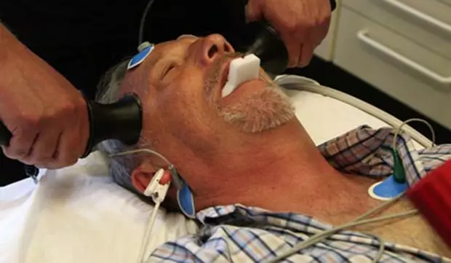
Electroconvulsive therapy
Two electrodes are attached to the scalp
A small electric shock is given (around 0.6amps)
This affects the entire brain causing a seizure which can last up to a minute long
The patient is anaesthetised and given a nerve blocking drug – this is so that when the patient ‘fits’ because of the seizure the muscle contraction doesn’t fracture any of their bones

Slide 110
Electroconvulsive therapy (ECT) How does it work?
No one really knows how electroconvulsive therapy works. However, one explanation is that ECT ‘tricks’ the brain into producing more noradrenaline.
Another explanation is that ECT affects the hormonal system and this helps with the depressed symptoms
It is known to change patterns of blood flow in the brain, and also change the way energy is used in parts of the brain that are thought to be involved in depression

Slide 111
Electroconvulsive therapy (ECT)
ECT has both short term and long term side effects which should be considered.
The short term side effects are;
drowsiness (you may sleep for a while)
confusion
headache
feeling sick
aching muscles
loss of appetite
injuries to their teeth or jaw, or other muscles, (but physical injury from the convulsions should be minimised by the muscle relaxant)

Slide 112
Electroconvulsive therapy (ECT)
ECT has both short term and long term side effects which should be considered.
The long term side effects are rarer;
apathy (loss of interest in things)
loss of creativity, drive and energy
difficulty concentrating
loss of emotional responses
difficulty learning new information

Slide 113
Electroconvulsive therapy (ECT)
Strength: Research indicates that 70% of patients improve from serious depression with ECT (Comer, 2001)
Weakness: Research also indicates 84% of patients then relapse within 6 months (Sakheim, 2002)
ECT is reported to be effective but there are concerns over side-effects (e.g. memory loss): NHS says 30% have anxiety after

Slide 114
Task
You are the developer of a biological treatment for depression. It is your job to develop a pitch which will make investors want to give you money.
You should com up with the following;
A catchy name (possible slogan)
USP
Description of what your treatment includes
History of it, if you know
Reason why they should choose your method over the others
Side effects but try and put a positive spin on them

Slide 115
Task
In your jotter.
How do anti depressants generally work?
Name 3 anti depressants
Explain how ECT works and why it isn’t prescribed often

Slide 116
Task
How do anti depressants generally work?
They tend to try and prolong the secretion of serotonin and noradrenaline into the brain.
2. Name 4 anti depressants
Selective Serotonin Reuptake Inhibitors
Sereotonin Norepinephrine Reuptake Inhibitors
Tricyclic Antidepressants
Monoamine Axidase Inhibitors
Explain how ECT works and why it isn’t prescribed often
Works by sending a small electric shock into the brain and thought to trick the brain into producing more noradrenaline. It isn’t prescribed often because it can cause memory loss and other significant side effects.

Slide 117
Task
Create a leaflet
NHS leaflets always provides lots of info about treatments
Include at least 3 treatments (one needs to be SSRIs)
40 minutes only – if you don’t have 3 explained you need to finish at home
Needs to include how it will work, any research about it, any side effects/issues
I should be able to ask you about your 3 and you can tell me

Slide 118
Evaluate Biological approach
How can we evaluate the biological approach to depression?
Strengths: Non-judgemental- any mental ill health based on biological factors. This means people can seek treatment without feeling judged.
Lots of successful treatments based on biological explanations, e.g. SSRIs.
Weaknesses: Focus on treating the symptoms and not the causes- patients can relapse again in the future.
Says mental health only comes down to biology. McGuffin (1996) showed that other factors must be at work too.

Slide 119
Exam Style Question
Dr Ahmed is considering treatments for a patient diagnosed with MDD. Explain ways of improving wellbeing using biological treatments, with reference to this scenario (6 marks)
Evaluate biological treatments of depression (4 marks)
We will go over how to answer the first question with one example before you get started on your own.

Slide 120
Dr Ahmed is considering treatments for a patient diagnosed with MDD. Explain ways of improving wellbeing using biological treatments, with reference to this scenario (6 marks)
SSRIs – Dr Ahmed could prescribe these as low serotonin levels are thought to be a cause of depression and this increases them (1). Serotonin is a type of neurotransmitter (chemical messenger) and so low levels are thought to impact how signals are sent in the brain (1). SSRIs stop serotonin from being reuptaken to increase levels in Dr Ahmeds patient (1). They are effective 65% of the time (1) (compared to placebos only working 25% of the time) (1). Dr Ahmed should tell his patient that symptoms should start to improve within 2 weeks, and to come back if there is no difference after 4 (1)

Slide 121
Dr Ahmed is considering treatments for a patient diagnosed with MDD. Explain ways of improving wellbeing using biological treatments, with reference to this scenario (6 marks)
SNRIs – SNRIs work by increasing the levels of 2 neurotransmitters (norepinephrine and serotonin (1)). These are thought to be low in patients like Dr Ahmed’s who have MDD, and so stopping the reuptake of them increases levels (1 – but not if already mentioned in SSRIs). As neurotransmitters are chemical messengers, this then helps messengers between neurons to be sent efficiently, increasing mood etc (1 – but not if already done). It has been shown that these work for some patients while SSRIs work for others, so Dr Ahmeds patient might respond to one better than the other (1).

Slide 122
Dr Ahmed is considering treatments for a patient diagnosed with MDD. Explain ways of improving wellbeing using biological treatments, with reference to this scenario (6 marks)
TCAs – TCAs work by increasing the levels of 2 neurotransmitters (norepinephrine and serotonin (1)). These are thought to be low in patients like Dr Ahmed’s who have MDD, and so stopping the reuptake of them increases levels (1 – but not if already done). As neurotransmitters are chemical messengers, this then helps messengers between neurons to be sent efficiently, increasing mood etc (1 – but not if already done). However, these antidepressants can be dangerous to overdose (1) on so Dr Ahemd might want to consider SNRIs which do the same thing but are safer (1).

Slide 123
Dr Ahmed is considering treatments for a patient diagnosed with MDD. Explain ways of improving wellbeing using biological treatments, with reference to this scenario (6 marks)
MAOIs stop the breakdown of a neurotransmitter (chemical messengers) called monoamine oxidase (1). This can increase the levels and help messages be sent between neurons more effectively (1). However, Dr Ahmed might have to get his patient to change his diet if he was on these (e.g. no alcohol) (1)

Slide 124
Dr Ahmed is considering treatments for a patient diagnosed with MDD. Explain ways of improving wellbeing using biological treatments, with reference to this scenario (6 marks)
ECT involves passing an electrical current through the brain, causing a seizure for around a minute (1). This is given 3 times a week for around 5 weeks (1). Dr Ahmed might want to consider this if the patients depression is severe, as it is shown to work in 70% of severe cases (1). However, it is rarely used because there is little understanding of why it works (1).

Slide 125
Evaluate biological treatments of depression (4 marks)
Biological treatments treat depression the same way as a physical illness, focusing on reducing the symptoms (1). However, this could be criticised for not tackling the thinking or social/life issues that have caused it in the first place (1). Antidepressants like SSRIs have been shown to be effective (65%) (1), but can also have side effects – e.g. insomnia for SSRIs (1). Other antidepressants like MAOIs require a change in lifestyle/diet (1) and some can be very dangerous to overdose on (e.g. TCAs) (1). Antidepressants tend to work relatively quickly but not instantly (e.g. two weeks to start) (1). ECT is an electro shock based treatment, and while it does help with severe depression (70% effective) (1), patients often then relapse within 6 months (84%) (1). It can also have side effects, e.g. the NHS say 30% of people suffer anxiety after it (1)

Slide 126
Cognitive causes of depression Becks theory
Negative self-schema
Faulty information processing
Cognitive triad

Slide 127
 |  | Totally Agree | Agree | Disagree | Totally Disagree
1. | If I don’t set the highest standards for myself, I am likely to end up a second-rate person. | 1 | 2 | 3 | 4
2. | My value as a person depends greatly on what others think of me. | 1 | 2 | 3 | 4
3. | People will probably think less of me if I make a mistake. | 1 | 2 | 3 | 4
4. | I am nothing if a person I love doesn’t love me. | 1 | 2 | 3 | 4
5. | If other people know what you are really like, they will think less of you. | 1 | 2 | 3 | 4
6. | If I fail at my work, then I am a failure as a person. | 1 | 2 | 3 | 4
7. | My happiness depends more on other people than it does me. | 1 | 2 | 3 | 4
8. | I cannot be happy unless most people I know admire me. | 1 | 2 | 3 | 4

Slide 128
 |  | Totally Agree | Agree | Disagree | Totally Disagree
9. | If I am to be a worthwhile person, I must be truly outstanding in at least one major respect | 1 | 2 | 3 | 4
10. | If you don’t have other people to lean on, you are bound to be sad. | 1 | 2 | 3 | 4
11. | I do not need the approval of other people in order to be happy. | 1 | 2 | 3 | 4
12. | If you cannot do something well, there is little point in doing it at all. | 1 | 2 | 3 | 4
13. | If I do not do well all the time, people will not respect me. | 1 | 2 | 3 | 4
14. | If others dislike you, you cannot be happy. | 1 | 2 | 3 | 4
15. | People who have good ideas are more worthy than those who do not. | 1 | 2 | 3 | 4
16. | If I do not do as well as other people, it means I am an inferior human being. | 1 | 2 | 3 | 4

Slide 129
What do you think about these statements?
“It is essential to be loved or approved of by everyone in the community”
“You must be perfectly competent, capable and achieving in order to consider yourself worthwhile”

Slide 130
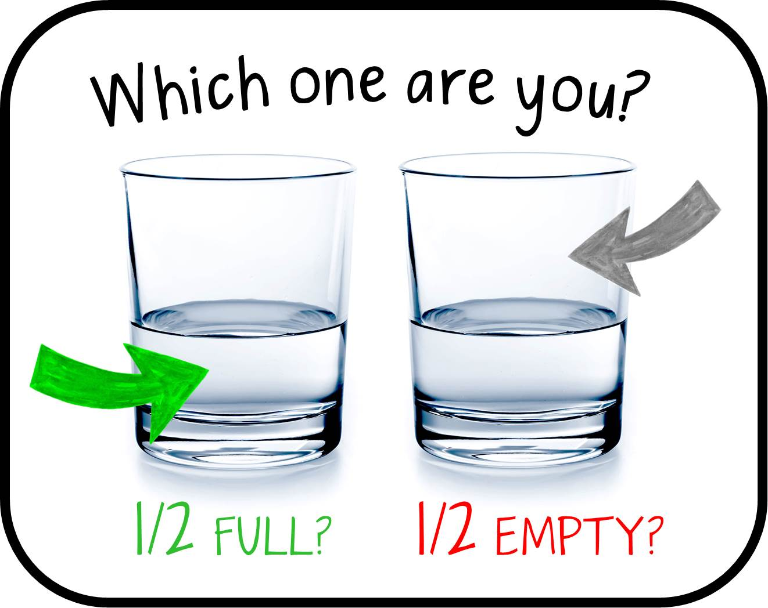
How people assess the same situation varies

Slide 131
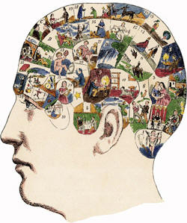
Remember from Sleep –
Cognitive psychologists compare humans to computers Input – Process – Output
So, the cognitive approach is saying there is a problem with the process (e.g. faulty information processing) and that is affecting our output (behaviour/emotion)
If we fix the process, we fix the output

Slide 132
Cognitive causes
Cognitive psychologists explain abnormalities like depression, schizophrenia and OCD in terms of irrational and negative thinking
They see the problem as being the way the individual is thinking so if you change the thinking the problem will disappear
Beck’s model of depression is probably the single most important advance in our understanding of the thought processes in depressed people.

Slide 133
Cognitive causes
Maladaptive behaviour is caused by faulty and irrational cognitions.
It is the way you think about a problem, rather than the problem itself that causes mental disorders.
Individuals can overcome mental disorders by learning to use more appropriate cognitions.
Aim to be positive and rational.

Slide 134
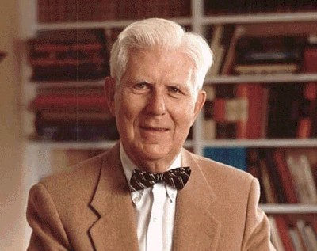
Aaron Beck
Beck suggested that there is a cognitive explanation as to why some people are more vulnerable to depression than others.
He suggested three parts to this cognitive vulnerability
negative self-schemas
faulty information processing
the negative cognitive triad
Notes:
Could link people being more vulnerable to depression with what the diathesis-stress model believes.

Slide 135
Beck’s theory Negative self-schemas
Remember back to sleep again. What are schemas?
A schema is a building block of knowledge, a ‘package’ of ideas and information that has developed with experience
A self-schema is a package of ideas that we have about ourselves
People who have become depressed have developed negative self-schemas and therefore they interpret all the information about themselves in a negative way

Slide 136
Beck’s theory Negative self-schemas
The basic idea of Beck’s model is that during early life we develop a set of schema based on our experience. Schemas refer to mental representations of the self and the world.
These schemas & belief systems, or assumptions, develop from early experiences – therefore, negative experiences during early life may result in negative schemas

Slide 137
Beck’s theory Negative self-schemas
Beck believes the cause of negative schemas can come from a variety of factors such as:
Parental rejection
Peer rejection
Teacher/parent criticism
Depressed parents
These schemas are then activated whenever a new situation arises that is like when the original schema was formed
For example sitting an exam may activate the schema formed when a teacher ridiculed you

Slide 138
Beck’s theory Negative self-schemas
These negative experiences lead to the development of dysfunctional beliefs about the world, which are triggered by critical incidents in the future.
So, for example, being dumped by your partner might trigger a set of beliefs such as “I am unlovable”, “people will always reject me”, “I am a worthless person”.
Once the negative schema is activated this leads to a stream of what Beck called negative automatic thoughts (NATs).
It is these negative automatic thoughts that lead to cognitive distortions or BIASES (an unfair or partial cognition, often based on limited information).

Slide 140
Task
Unfortunately Matilda has grown up and has developed depression. Use the video and what you know about negative self-schemas to explain why Matilda may feel this way.
Explain what self-schemas are.
Explain what might make self-schemas negative
Link the above directly to Matilda’s experience
(3 marks)

Slide 141
Beck’s theory Faulty information processing
Beck believed that people who are depressed make fundamental errors in logic – they tend to focus on the negative in a situation
Beck proposed that depressed people tend to selectively attend to the negative aspects of a situation and ignore the positive aspects
There is a tendency to blow small problems out of proportion with thinking in terms of black and white and ignoring the middle ground; you are a success or a failure, rather than not good at some things but OK at others.

Slide 142
Beck’s theory Faulty information processing
The thought patterns include;
Arbitrary Inference. Drawing a negative conclusion in the absence of supporting data.
Selective Abstraction. Focusing on the worst aspects of any situation.
Magnification and Minimisation. If they have a problem they make it appear bigger than it is. If they have a solution they make it smaller.
Personalization. Negative events are interpreted as their fault.
Dichotomous Thinking. Everything is seen as black and white. There is no in between.

Slide 143
Beck’s theory Faulty information processing
Hammen and Krantz (1976) found that depressed women made more logical errors when interpreting written material than non-depressed women.
Bates et al (1999) found that giving negative thought statements (like ‘I’ll never get this all done’) to depressed people increased their levels of depression.

Slide 144
Clip for faulty information processing
Catastrophizing

Slide 145
Beck’s theory The negative cognitive triad
Beck built on the idea of maladaptive responses, and suggested that people with depression become trapped in a cycle of negative thoughts
They have a tendency to view themselves, the world and the future in pessimistic ways – the triad of impairments
Negative view of the self (I am incompetent and undeserving)
Negative view of the world (it is a hostile place)
Negative view of the future (problems will not disappear, there will always be emotional pain)

Slide 147
3. The world is unfair!
2. I will never succeed.
2. I will never be happy.
1. I’m a rubbish news reporter!

Slide 148
Task
Negative view of the self (I am incompetent and undeserving)
Negative view of the world (it is a hostile place)
Negative view of the future (problems will not disappear, there will always be emotional pain)
Come up with your own personal experience of the negative triad – create a poster demonstrating this.
If you really struggle to this of a time you have felt this way, make up a scenario.

Slide 149
Beck’s theory Weissman and Beck (1978)
AIM: to investigate the thought processes of depressed people to establish if they make use of negative schemas
METHOD: thought processes were measured using the dysfunctional attitude scale (DAS). Participants were asked to fill in a questionnaire by ticking whether they agreed or disagreed with a set of statements. For example, ‘people will probably think less of me if I make a mistake’.
RESULT: they found that depressed participants made more negative assessments than non-depressed people. When given some therapy to challenge and change their negative schemas there was an improvement in their self-ratings
CONCLUSION: Depression involves the use of negative schemas

Slide 150
Task
In your jotter
1. Who’s theory of depression did we look at last time?
2. What were the three main parts of Beck’s theory?
3. What are the three key parts of the negative triad?
4. What were the names of the researchers who looked into cognitive causes of depression?
5. What was the aim of the study?
6. What were the results?
7. What scale did they use?
8. What can we conclude from the study?

Slide 151
Task
Who’s theory of depression did we look at last time? Beck
2. What were the three main parts of Beck’s theory? Negative self-schemas, faulty information procession and negative cognitive triad
3. What are the three key parts of the negative triad? Negative views of the world, Negative views of the future and Negative views of the self
4. What were the names of the researchers who looked into cognitive causes of depression? Weissman & Beck (1978)

Slide 152
Task
5. What was the aim of the study? To investigate the thought processes of depressed people to establish if they make use of negative schemas
6. What were the results? Depressed people made more negative assessments than non- depressed people
7. What scale did they use? Dysfunctional Attitude Scale (DAS)
8. What can we conclude from the study? Depression involves the use of faulty information processing – interpreting things in a negative way

Slide 153
Another cognitive theory Albert Elllis
You will never be asked directly on this theory. However, it is important to understand it so you can make comparisons with Beck’s theory.
Ellis proposed that good mental health is the result of rational thinking
Ellis argued that there are common irrational beliefs that underlie much depression (poor mental health), and sufferers have based their lives on these beliefs
For example: “I must be successful, competent and achieving in everything I do if I am to consider myself worthwhile”

Slide 154
Another cognitive theory Albert Elllis
Ellis suggested that …
(A) an action is affected by
(B) and individual’s beliefs which results in
(C) a consequence
If beliefs are subject to cognitive biases (in the same way as Beck’s) then they can cause irrational thinking which may produce undesirable behaviours.

Slide 155
Another cognitive theory Albert Elllis
(A) an action is affected by
(B) and individual’s beliefs which results in
(C) a consequence
Example-
“Emma overhears a remark made in class ‘she really gets on my nerves’. It could have referred to anyone but Emma believes that she is unworthy and people don’t want to be friends with her. She withdraws from the friendship group and becomes more and more isolated and depressed.”

Slide 156
A: Activating event
Mary and her boyfriend split up.
Rational Thoughts
Mary tells herself that although it is a sad situation they were not compatible and she may learn from the experience.
Irrational Thoughts
Mary tells herself that the break up is her fault and that she is not loveable, and so will always fail at relationships.
B: Beliefs
(about A)
Desirable Emotions
Mary feels sad, but is hopeful that she will have successful relationships in the future.
Undesirable Emotions
Mary feels guilty that she spoilt the relationship and that she is unlovable.
Desirable Behaviour
Mary looks forward to forming new healthy relationships and tries to learn from her experience.
Undesirable Behaviour
Mary resolves not to form new relationships as she will only fail and get hurt again.
C: Consequences
(of B)

Slide 157
Cognitive causes of depression
Depressed people undoubtedly have negative thoughts but do the negative thoughts help cause depression, or do they merely occur as a result of being depressed?
Cause or effect?

Slide 158
Cognitive causes of depression Evaluation
Strength: It has good supporting evidence
Much research has supported the proposal that depression is associated with faulty information processing, negative self-schemas and the triad of impairments
Strength: It has practical application in CBT
Beck’s cognitive explanation forms the basis of cognitive-behavioural therapy. All cognitive aspects of depression can be challenged in CBT.
Weakness: It does not explain all aspects of depression
The theory explains the basic symptoms of depression however it is a complex disorder with a range of symptoms, not all of which can be explained

Slide 159
SLICE
S ummarise: What is the cognitive approach? What are the main ideas?
L ink: Theory to research (Weissman and Beck (1978) and Giovanni when we look at it next)
I mplications: Fault thoughts cause depression -> CBT (we will look at this treatment more in depth next week)
C omparisons: Compare cognitive to biological (or make comparisons between Beck and Ellis)
E valuation: Strengths and weaknesses of the cognitive approach

Slide 160
Exam style question
Analyse the cognitive approach to explaining depression (10 marks)
5 marks max for summary and evaluation
Unlimited marks for links, implications and comparisons

Slide 161
Cognitive treatments of depression
Cognitive behavioural therapy (CBT)

Slide 162
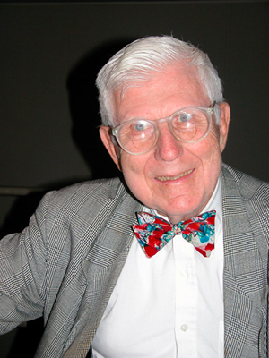
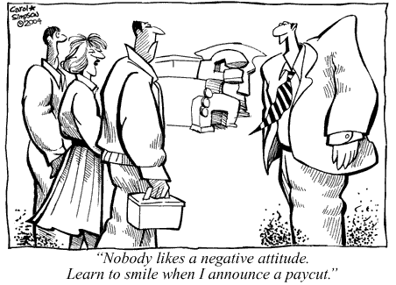
Cognitive behavioural therapy
CBT was developed by Beck with the aim of teaching ‘clients’ to rethink and challenge their faulty processing /negative schemas.

Slide 163
Notes:
https://www.youtube.com/watch?v=ub8HqFrAN2c

Slide 164
Eve’s experience
1. Why did Eve seek CBT treatment?
2. Where did she get CBT from? What was a slight negative of this?
3. How long did she wait to get CBT?
4. What does she highlight about the difference between CBT compared to other counselling she had?
5. What were some of the things Eve had to do on a weekly question?
6. Was CBT effective for Eve? What was some of the evidence for this?

Slide 165
Cognitive behavioural therapy
CBT wants to help people understand that we have: thoughts, emotions and behaviours. Our thinking can impact the other two parts.
CBT can help people to change how they think (‘cognitive') and what they do (‘behaviour'). These changes can help them to feel better (‘emotions’).

Slide 166
Cognitive behavioural therapy
It is a talking therapy, focused on:
how you think about yourself, the world and other people
how what you do affects your thoughts and feelings.
From the cognitive point of view therapy aims to deal with the thinking, such as challenging negative thoughts
The therapy also includes behavioural techniques such as behavioural activation (encouraging patients to engage in those activities they are avoiding)

Slide 167
Cognitive behavioural therapy
CBT aims to help you deal with overwhelming problems in a more positive way by breaking them down into smaller parts. You're shown how to change these negative patterns to improve the way you feel.
Unlike some other talking treatments, CBT deals with your current problems, rather than focusing on issues from your past. It looks for practical ways to improve your state of mind on a daily basis.

Slide 168
Cognitive behavioural therapy What happens?
Meet with a therapist one to one for between 5 and 20, weekly, or fortnightly sessions.
Each session will last around 60 minutes.
Patients work with a therapist to break down problems into their separate parts – such as thoughts, physical feelings and actions.
The patient and therapist will analyse these areas to work out if they're unrealistic or unhelpful and to determine the effect they have on each other and on the patient.
The therapist will then be able to help the patient work out how to change unhelpful thoughts and behaviours.

Slide 169
Cognitive behavioural therapy What happens?
After working out what can change, the therapist will ask the patient to practise these changes in daily life and discuss how they got on during the next session.
The eventual aim of therapy is to teach people to apply the skills they learn during treatment to daily life.
This should help patients manage their problems and stop them having a negative impact on life – even after the course of treatment finishes.

Slide 170
Cognitive behavioural therapy What happens?
During CBT the therapist would use a process of reality testing e.g. if the client says, ‘I’m useless, and I always fail’, they will be asked whether in reality, they have been successful at something.
The therapist might ask the client to do something to demonstrate their ability to succeed.
The therapist can also give homework e.g. if they believe no one is ever nice to them, they could be challenged to record any compliments they get this week

Slide 171
Cognitive behavioural therapy Evaluation
In your pairs, attempt to evaluate CBT as a treatment for depression.
Strengths: It may be helpful in cases where medication alone hasn't worked
It can be completed in a relatively short period of time compared to other talking therapies
The highly structured nature of CBT means it can be provided in different formats, including in groups, self-help books and computer programs
It teaches you useful and practical strategies that can be used in everyday life – even after the treatment has finished
Deals with the root cause and not just the symptoms like drug therapies.
No real side effects

Slide 172
Cognitive behavioural therapy Evaluation
In your pairs, attempt to evaluate CBT as a treatment for depression.
Weaknesses: It may not be suitable for people with more complex mental health needs or learning difficulties – as it requires structured sessions
It involves confronting your emotions and anxieties – you may experience initial periods where you're anxious or emotionally uncomfortable
It focuses on the individual’s capacity to change themselves (their thoughts, feelings and behaviours) – which doesn't address any wider problems in systems or families that often have a significant impact on an individual’s health and wellbeing
Can be expensive and time consuming
Could be considered as blaming the patient – they have depression due to their thinking and not their biology

Slide 173
Task
For each scenario you get, imagine you are the therapist
Can you think of any responses you might give to challenge the thinking?
Can you think of any homework tasks you might set?
App to try: Mindshift – the ‘thought journal’ section helps to do this

Slide 174
I just feel like I’m not wanted by my friends since my diagnosis. They don’t seem to invite me out anymore and I can understand why. It’s because I’m so boring and they have more fun without me.
Does assuming something make it true?
Are there any other explanations?
Notes:
Pair up and give one person the role of reading the scenario and the other person the role of giving a response to the scenario..

Slide 175
I often think people have ulterior motives and it makes me feel bad a lot of the time and not trust anyone. For example, this week my friend said my hair looked good. I know that isn’t true so she must either want something or feel the need to be polite.
Make a list of positive attributes, accept compliments with a thank you
If that doesn’t count, what does? Who decides? Why do you think good things can’t happen to you?

Slide 176
I often think about what others must think of me. For example, this week I forgot to send back my sons permission slip, so the teacher must think I’m so stupid. My friend didn’t text me back this morning, but I’m not sure why she is avoiding me.
Mind reading
Does assuming something make it true?
Can anyone please everyone all the time? What is a more realistic view?

Slide 177
I failed my driving test. I’m never going to pass and I’ll be stuck getting the bus the rest of my life.
Solution: List times in your life when a negative situation happened but it didn’t have a big long term outcome
Just because this happened once, does it guarantee it every time?
What other outcomes are possible?

Slide 178
I feel like I’ll never get another job because even the thought of putting my CV in somewhere makes me feel bad. I know they will just laugh at it and throw it away.
How do you know this?
What facts do you have that this is definitely the case?
What will happen if you continue thinking this way?
What is a worst case scenario? Is it that bad?

Slide 179
I always think that I am a failure if I don’t score perfectly on exams at school. I’m worried I’ll never get a job because I’m not the best at anything.
‘All or nothing thinking’
What other ways are there of looking at this situation?

Slide 180
Cognitive study
Giovanni (1998)

Slide 181
Giovanni (1998)
Mandatory study for cognitive approach to depression.
The aim of the study was to compare CBT v drug therapy in people with recurring depression

Slide 182
Giovanni (1998)
Method
40 patients with MDD that keeps coming back. They had been successfully treated with drug therapy, and then were randomly assigned to either continue with this or undertake CBT
They were followed up with 2 years on

Slide 183
Giovanni (1998)
Results
The CBT group had significantly lower levels of residual symptoms than the control group.
At the two year follow up, the CBT group had a lower relapse rate
25% v 80%

Slide 184
Giovanni (1998)
Evaluation
Strengths:
High level of control e.g. 2 year check up for all patients so that they gone the same length of time, measured on same checklist of symptoms
Practical application – shows CBT might be better for people with recurring depression

Slide 185
Giovanni (1998)
Evaluation
Weaknesses:
No info about patients lives during these 2 years – did they have any other treatment, stressful life events etc.
Only 40 people.
Completed in 1998 so lacks temporal validity, drug treatments have moved on a lot

Slide 186
Giovanni (1998)
Link
Can link both to the cognitive approach in general and how CBT is thought to work.

Slide 187
Giovanni (1998)
Implications
Remember SSRIs work 65% of the time – you could compare to this research and say since both seem to be effective, but CBT seems to have a lower relapse, maybe both should be offered at the same time to patients?
The World Health Organisation predicted that in 2020 depression will become the biggest costing disease (cost to individuals, families and the economy through lowered productivity, sickness etc). Therefore, if psychological research shows that people with a disorder such as depression are less likely to suffer a relapse after having CBT then, even though cognitive therapy might initially be more expensive than drug therapy, in the long-term it might be more economically sound to offer cognitive therapy as people would have less time off work and wouldn’t need further treatment.

Slide 188
Giovanni (1998)
Compare
Can compare with Weissman and Beck (1978) as they found depressed people have make more negative assessments than non depressed people. Can use these results to explain why the CBT may help with the reduction of relapse which occurred.

Slide 189
Ailsa has had recurring MDD for the past 8 years. She feels like this is how the rest of her life would be.
Explain what is meant by MDD (4 marks)
Explain a treatment you think Ailsa should consider, using evidence to back this up (6 marks)

Slide 190
Exam style question
Ailsa has had recurring MDD for the past 8 years. She feels like this is how the rest of her like would be
Explain what is meant by MDD (4 marks)
Explain a treatment you think Ailsa should consider, using evidence to back this up (6 marks)

Slide 191
Explain a treatment you think Ailsa should consider, using evidence to back this up (6 marks)
Ailsa should consider CBT, a talking therapy based on cognitive theories of depression which say that faulty thinking is the cause of depression (1). CBT would involve her seeing a therapist 5-20 times for one hour one to one (1). The therapist would teach her about how her thoughts affect her behaviour and emotions (1), and try and challenge her faulty information processing (1). The therapist would set challenges/homework to allow this to be continued in between sessions so that ailsa could eventually do it herself (1). 1 mark for explaining any element of Beck’s or Ellis’ theory that it is based on. 1 mark for an example of how the therapist might challenge.
Giovanni (1998) compared CBT v drug therapy in people with recurring MDD (1) and found that after 2 years 80% of those on antidepressants had relapsed compared to only 25% of those getting CBT (2). Since Ailsa has recurring MDD, this might be more effective for her in the long term (1).

Slide 192
Exam style question
Explain biological and cognitive treatments for depression (10 marks)

Slide 193
Explain biological and cognitive treatments for depression (10 marks)
One biological treatment for depression is SSRIs. These are used because serotonin (neurotransmitters / chemical messengers that send signals) levels are thought to be low in people with depression (1) and so these blocks the reuptake of serotonin to increase levels (1). These are the most common antidepressant and have different brand names like Prozac (1). They are effective around 65% of the time (1). Another biological treatment for depression is SNRIs. These block the reuptake of both serotonin and norepinephrine (1) increasing the overall levels of these neurotransmitters. They were developed to address both of these as it would be more effective, but actually the NHS says that SSRIs and SNRIs are no more effective than each other and just work for different people (1)

Slide 194
Explain biological and cognitive treatments for depression (10 marks)
Another biological treatment for depression is TCAs. These increase the levels of both norepinephrine and serotonin (chemical messengers) (1). However, they are dangerous if they are overdosed on and have serious side effects (1) so SSRIs and SNRIs now tend to be prescribed more often (1).
A final biological drug treatment for depression is MAOIs. These stop the breakdown of a neurotransmitter called monoamine oxidase to increase its levels in the brain (1). This type of antidepressant require a change of diet e.g. no aged cheeses or alcohol (1)
ECT is another biological treatment for depression which involves passing an electrical current through the brain to produce a seizure which lasts around a minute (2). ECT seems to cause a release of chemicals that improve the symptoms of depression, but it is unclear exactly how this works (1). While ECT does work for severe depression around 70% of the time (1), lots of people then relapse (86%) (1). It also has serious side effects e.g. memory loss (1) or the NHS estimate 30% go on to have anxiety.

Slide 195
Explain biological and cognitive treatments for depression (10 marks)
One cognitive therapy for depression is CBT, a talking therapy based on cognitive theories of depression which say that faulty thinking is the cause of depression (1). CBT would involve an individual seeing a therapist 5-20 times for one hour one to one (1). The therapist would teach the individual about how her thoughts affect her behaviour and emotions (1), and try and challenge her faulty information processing (1). The therapist would set challenges/homework to allow this to be continued in between sessions s (1).
Marks for explaining any element of Beck’s or Ellis’ theory that it is based on e.g. CBT aims to address depressed people’s negative self schemas + explanation + examples or triad + explanation + examples (2) .
1 mark for an example of how the therapist might challenge a negative thought.

Slide 196
Explain biological and cognitive treatments for depression (10 marks)
Giovanni (1998) compared CBT v drug therapy in people with recurring MDD (1) and found that after 2 years 80% of those on antidepressants had relapsed compared to only 25% of those getting CBT (2). This shows that both biological treatments and cognitive treatments can be effective, but cognitive treatments might be better for recurring depression.

Slide 197
What you should know
Definitions + Diagnosis of depression (MDD and PDD)
Biological Causes of Depression
Neurochemistry
Hormones
Diathesis-Stress model
Biological Treatments of Depression
4 antidepressants
Electroconvulsive therapy
Cognitive Causes of Depression – Beck’s theory
Negative self-schema
Faulty information processing
Negative cognitive triad
Cognitive Treatments of Depression
CBT
Cognitive study - Giovanni (1998)
Biological study - McGuffin et al (1996)
Notes:
Copy all of what we need to know…… Then take title first point as title.

