Slide 1
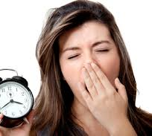
Sleep Higher Psychology

Slide 2
What you need to know
Biological processes relating to sleep and dreams, which must include:
The role of the brain in sleep
Circadian rhythms
Non-REM and REM sleep and dreaming
Oswald’s (1966) Restoration theory of sleep
The aims, methods, results and conclusions of Dement, W. and Kleitman, N. (1957
Cognitive processes relating to sleep and dreams, which must include:
Sleep to facilitate information processing
Crick and Mitchison’s (1986) Reorganisational theory of dreaming
The aims, methods, results and conclusions of Czeisler, et al. (1990).
Psychodynamic processes relating to sleep and dreams, which must include:
Conscious and unconscious processes
Manifest and latent content of dreams
Defence mechanisms
Factors affecting sleep, which must include:
Impact of drugs
Impact of light
Notes:
Think of the different processes as different sides of an argument
https://www.ninds.nih.gov/Disorders/Patient-Caregiver-Education/Understanding-Sleep#1 ---- role of the brain in sleep

Slide 3
Introduction to sleep

Slide 4
True or False?
People who become blind after birth can see images in their dreams
True
Naps can help you catch up with sleep
True
Ants do not sleep
False
If you die in your dreams, you will die in real life
False
The elderly need more sleep
False
Teens need more sleep than older adults
True
Notes:
Show me boards,

Slide 5
True or False?
Everyone needs eight hours of sleep
False
A big meal before bed will trigger nightmares
False
Some people do not dream
False
We become paralysed during sleep
True
Elephants lie down at night to sleep
True
On average, we spend about 30% of our lives asleep
True

Slide 6
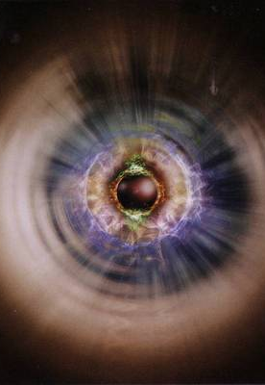
Definition: ‘A reduced state of consciousness’…
What is consciousness?
Consciousness is our subjective awareness of thoughts, feelings and sensations.
When we sleep, meditate, or are under the influence of psychoactive drugs we are in an altered state of consciousness

Slide 7
Definition (cont’d): …where an organism is less active and less responsive to the outside world.
We move less during sleep, and are entirely paralysed during one sleep stage (REM).
When in a deep sleep, we hear little or nothing of the world around us… Though in lighter sleep, we are responsive to sounds.

Slide 8
Simpler definition
Sleep can be defined as a state of reduced conscious awareness during which the body is less active and less responsive. We spend about 30% of our lives asleep.

Slide 9
What is sleep for?
As an evolved behaviour that exists in all animals, sleep must serve an essential purpose…
Restoration Theory is based on idea that sleep provides an opportunity for the body to repair and refresh itself
(Biological process theory)
Reorganisation theory states that sleep helps the mind to reorganise, removing useless memories and consolidating important ones.
(Cognitive process theory)

Slide 10
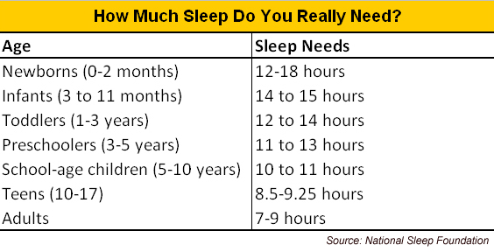
How much do you sleep?
Are you getting enough sleep according to the National Sleep Foundation?

Slide 11
Biological processes

Slide 12
What you need to know
Biological processes relating to sleep and dreams, which must include:
Circadian rhythms
Non-REM and REM sleep and dreaming
The role of the brain in sleep
Oswald’s (1966) Restoration theory of sleep
The aims, methods, results and conclusions of Dement, W. and Kleitman, N. (1957)

Slide 13
Circadian Rhythms
Humans, and many other animals, have an internal biological clock. This clock operates on a cycle of just over 24 hours. Environmental cues, especially light, reset the clock, keeping it in time with the day/night cycles.
The clock directs the rhythmic secretion of hormones, such as melatonin, that influence our sleep cycle. If the biological clock becomes out of phase with the environment, various types of sleep problems can result.

Slide 14
Circadian Rhythms
Our energy levels and mental alertness are controlled by the “circadian rhythm” – our innate biological clock, which regulates our sleep and waking cycle. Having different circadian rhythms is what makes an early bird and night owl so different.
Look at the differences between an owl and a lark.
You are going to find out who in the class is a night owl and who is a morning lark.

Slide 15
Night owl or morning lark
When do you go to bed during the week? What time do you wake up? Do you need an alarm clock to wake up?
When do you go to bed on the weekend? When do you get up? Do you get up with or without an alarm clock?
Do you go to bed early on Sunday? Do you find it easy to wake up on Monday mornings?
How many hours of sleep do you get on the weekend compared to during the week?
What are your parents’ sleep habits like? Do they go to bed early (or earlier than you)? When do they wake up? How many hours of sleep do they get?

Slide 16
Night owl or morning lark
Are there more larks or more owls in the classroom?
Why do you think this is?
What do you think your parents are? Owls or larks? Why?
How do you think it may be helpful to know whether you are an owl or a lark?

Slide 17
Circadian Rhythms
Studies have found that we all have one thing in common – our sleep pattern shifts a few hours later during adolescence. This means that it is harder for teenagers to fall asleep and wake early.
Many studies on circadian rhythms and education have looked at how students’ performance and health is affected by changing the school start time. For example, a study by Kelley et al (2017) found that if teenagers are usually required to be at school by 8:30am, but for a number of years they are allowed to arrive at 10am, sick days decrease and academic performance improves.

Slide 18
Latest chronotypes: at age 18

Slide 20
Too simple?
Hummingbirds are in the middle and they may be ready for action both early in the morning and late at night. Some hummingbirds are more larkish, and others, more owlish. For instance, a hummingbird could wake up at dawn for camping or other occasions and stay up later than usual bedtime to complete an assignment.

Slide 21
In your own words
“The difference in our circadian rhythms dictates whether we would be classed as a morning lark or a night owl.
A night owl can be described as….
A morning lark can be described as…
However, some people may feel they are neither a morning lark or a night owl. These people may be described as hummingbirds. This means…”

Slide 22
Circadian Rhythms
A circadian rhythm is a body cycle that lasts 24 hours (or, literally translated, about a day). The sleep-wake cycle is an example of a circadian rhythm, although it only lasts 24 hours because it is reset by exogenous zeitgebers (such as day light, meal times, and the clock).

Slide 23
Michel Siffre
Siffre conducted a study which involved him going into a cave for 63 days with only a torch for light and no access to time. He found that when given the opportunity his body naturally fell into a 24-25 hour sleep-wake cycle. However, when this was repeated with other participants some of them feel into a 48 hour sleep-wake cycle showing that exogenous zeitgebers may be different roles for different individuals

Slide 24
N-REM and REM sleep

Slide 25
REM and NREM sleep
The cycle starts at light sleep, progressing to deep sleep and then REM sleep, where brain waves speed up and dreaming occurs. This repeats itself about every 90 minutes throughout the night.
A complete sleep cycle goes through the four stages of NREM sleep before entering REM (Stage 5) and then repeating. Research using EEG has highlighted distinct brain waves patterns during the different stages of sleep.

Slide 26
What do the brain waves mean?
If our physiology, diet or environment causes an overproduction or underproduction of a certain brainwave, it can alter the balance of our bodies and induce many negative effects such as insomnia, anger, stress, learning difficulties or anxiety.
In sleep and dreams we are interested in alpha waves, theta waves and delta waves

Slide 27
Alpha and Theta waves
Both alpha and theta brainwaves are found in stages 1 and 2. Starting with alpha brainwaves as we fall asleep and progressing into theta waves.
Alpha waves are known to help calm you down and promote feelings of deeper relaxation and content. However, high levels of alpha waves can result in daydreaming.

Slide 28
Alpha and Theta waves
Theta waves are involved in restorative sleep. They are often classed as the ‘suggestible waves’ because they are the waves which are seen when someone is being hypnotised. If an excess of theta waves are produced during the day the individual might be prone to bouts of depression, as theta waves are also linked to us experiencing and feeling deep and raw emotions

Slide 29
Delta waves
Delta waves are associated with deep levels of relaxation and restorative sleep, to remember this simply think of ‘Delta’ for ‘Deep’.
Healthy levels of Delta waves can contribute to a more restful sleep, allowing us to wake up refreshed.
These brainwaves are thought to occur in stages 3&4 as this is the deepest of our Non REM sleep. It is suggested that the delta waves help with the restoration of any minor injuries and help to remove waste chemicals from our muscles.

Slide 30
Sleep cycle
Stages 1 and 2 are ‘light sleep’ stages. During these stages brainwave patterns become slower and more rhythmic, starting with alpha waves progress to theta waves.
Stages 3 and 4 are ‘deep sleep’ or slow wave sleep stages, where it is difficult to wake someone up. This stage is associated with slower delta waves.
Finally, Stage 5 is REM (or dream) sleep. Here is the body is paralysed (to stop the person acting out their dream) and brain activity resembles that of an awake person.
On average, the entire cycle repeats every 90 minutes and a person can experience up to five full cycles in a night.

Slide 32
Role of the brain in sleep – Important words
Basal forebrain
Adenosine
Glycogen
Hypothalamus
SCN
The brain stem
GABA
The thalamus
Cerebral cortex
The amygdala
Notes:
Each pair/3 takes an area of the brain and does something with it.

Slide 33
Role of the brain in sleep – Homeostatic process.
Our body goes through homeostatic processes – this is basically a self regulating process which the body does to maintain balance.
The hypothalamus is responsible for the homeostatic process.
An example of a homeostatic process is the body shivering when we are cold or sweating when we are warm. It does this to try and regulate our body temperature.
It also happens in relation to sleep and this is how the above process occurs

Slide 34
Cerebral cortex
Basal forebrain
Brain stem
Amygdala

Slide 35
Role of the brain in sleep – Homeostatic process.
Adenosine builds up in the cells of the basal forebrain as a natural by product of being awake. This adenosine build up is thought to play a role in making us sleepy. When we sleep this is cleared and is replaced with glycogen which is used as our energy for the next day.
We know this to be true as it has been discovered that caffeine blocks adenosine – stopping the feeling of sleepiness.

Slide 36
Role of the brain in sleep – What happens when we are awake
The hypothalamus is responsible for the homeostasis.
Within the hypothalamus the SCN is found. This controls our circadian rhythms, which in turn plays a role in the homeostatic process.
The SCN gets info from the nerve cells in the eyes which tells them whether its light or dark. If the cells indicate that it is dark then the SCN will send this information to the pineal gland which will then produce melatonin.
Side fact – Blind people some times take melatonin tablets at the same time each night to regulate sleep.

Slide 37
Role of the brain in sleep – What happens when we are asleep
Different areas of the brain play different roles when we are actually asleep.
The brain stem helps to produce a chemical called GABA. GABA enables the body to relax and fall asleep. When we are asleep it allows us to sleep soundly throughout the night.
Low GABA levels are linking to insomnia – one study showed people with insomnia had GABA levels 30% lower than those without the disorder.
GABA also plays a role in REM sleep as it makes sure muscles are relaxed and limbs aren’t moving.

Slide 38
Role of the brain in sleep – What happens when we are asleep
The thalamus acts as a messenger between the senses in the brain and the cerebral cortex. This allows the cerebral cortex to be aware of things we are seeing, hearing, smelling, feeling or tasting.
The cerebral cortex processes information from the short-to-long term memory. During most stages of sleep the thalamus stays quiet meaning we can tune out the world. However during REM sleep the thalamus is very active! It sends the cortex images, sounds and other sensations which fill up our dreams.
The amygdala is also very active during REM. This area of our brain is responsible for processing emotions – This could explain why we sometimes wake up feeling scared after a nightmare.
Notes:
Colour in the brain writing what it does as we go on.

Slide 39
Cerebral cortex
Basal forebrain
Brain stem
Amygdala

Slide 40
Role of the brain in sleep – Important words
Basal forebrain
Adenosine
Glycogen
Hypothalamus
SCN
The brain stem
GABA
The thalamus
Cerebral cortex
The amygdala
Pineal Gland
Melatonin
Notes:
Make up a match up the definitions game

Slide 41
Restoration theory of sleep
There must be some benefits or why would we sleep at all?
It is found in virtually ALL animals so must be adaptive, and different species have different patterns.

Slide 42
Restoration theory of sleep
Oswald (1966) proposed that sleep is the period of inactivity necessary for the body and brain to replenish (heal) themselves, to repair any deterioration and damage sustained during the day.
Oswald said that short-wave sleep (SWS) is for restoring the body in terms of physical activity, whilst REM sleep is for resting the brain functions.

Slide 43
Restoration theory of sleep
You are going to watch a video describing the restoration theory.
It is 10 minutes long, to make sure you are listening through out you will answer questions as you go.
Notes:
https://www.youtube.com/watch?v=Fjn6OjOp-d4&list=PLhE471QKETma1F_6znkBGV3QsXWBvFj_Q&index=5&t=0s
Glue answers into jotters

Slide 44
Restoration theory of sleep
The video briefly mentioned Peter Tripp, he is important as he can provide both evidence for and against the restoration theory.
Notes:
https://www.youtube.com/watch?v=Fjn6OjOp-d4&list=PLhE471QKETma1F_6znkBGV3QsXWBvFj_Q&index=5&t=0s
Glue answers into jotters

Slide 45
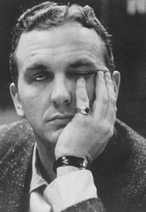
Case of Peter Tripp
New York DJ, Peter Tripp, set a world record for sleep deprivation in 1959.
He went for 201 hours (8.4 days) without sleep.
His behaviour became psychotic: he hallucinated that he could see spiders, became paranoid, and finally claimed he was not Peter Tripp but an imposter.

Slide 46
Peter Tripp
By 100 hours, he could only perform one or two of the daily battery tests,.
By 110 hours there were signs of delirium. A doctor walked into the booth in a tweed suit that Tripp saw as a suit of furry worms.
Around 120 hours, he opened a drawer and rushed out calling for help as it appeared to be spurting flames. Tripp grew angry at these points believing it was a masquerade or a set up to test him.
By 170 hours the tests were torture, a simple algebraic problem that Tripp had earlier solved with ease took such superhuman effort
Notes:
Pupils should take notes and summarise the case of Peter Tripp using page 66 of the textbook.

Slide 47
Peter Tripp
How does this case study provide evidence for the restoration theory?
How does it produce evidence against the restoration theory?
The increase in difficulty completing the tasks could be because his neurotransmitters were not being replenished
If we need sleep to restore our body then Peter Tripp’s body should have started to deteriorate but this did not happen.
Notes:
Pupils should take notes and summarise the case of Peter Tripp using page 66 of the textbook.

Slide 48
Lavie et al (1984)
Another study which wasn’t mentioned in the video was Lavie et al (1984)
They conducted a study on a young 20 year old man who got hit in the head with a bit of shrapnel. His injuries resulted in him not being able to enter REM sleep – This should essentially stop him being able to replenish his neurotransmitters and result in him having poorer cognitive performance.
He went on to study law with no issues at all.
Notes:
Pupils should take notes and summarise the case of Peter Tripp using page 66 of the textbook.

Slide 49
Restoration theory of sleep
In summary this theory suggests that the function of sleep is for:
N-REM SLEEP
New tissue growth
Muscle repair
Remove waste chemicals
REM SLEEP
Replenish neurotransmitters – which keeps us alert
Notes:
Print these out and get them to copy it in then write an analyse question with the exception of Compare when they are finished

Slide 50
Restoration theory of sleep
It can be linked with different studies which either provide evidence for the theory or dispute it.
Shapiro et al (1981) – Ultramarathon runners
Rat study – Healing process
Horne & Harley (1988) – Hair dryer method
Lavie et al (1984) – Law student
Peter Tripp – American DJ, 201 hours awake

Slide 51
Restoration theory of sleep
Oswald implies predicts that more active species will sleep longer. However, this may not be applicable in real life.
Think about sloths. Oone of the least active creatures, sleeps for about 20 hours a day. At the other end of the scale, shrews are very active and presumably would need plenty of restoration, but only sleep a couple of hours a day.

Slide 52
Restoration theory of sleep
We have all experienced situations where we do not get enough sleep. Oswald implies when this happens we will have memory and attention problems due to the lack of neurotransmitters being replenished.
Think about when this might become problematic in real life.

Slide 53
Restoration theory of sleep
Oswald also implies that growth hormones are secreted during NREM sleep. He states during stage 4 sleep that the production of growth hormones is increased.
What could this explain in real life?

Slide 54
Restoration theory of sleep
The restoration theory could be compared with the reorganisational theory.
This theory contradicts the restoration theory and instead believes that we sleep in order to organise our thoughts and strengthen our memories.
We will learn more about this later.

Slide 55
Restoration theory of sleep
The restoration theory can be evaluated in many different ways.
Strengths
Explains why all mammals sleep
Explains poorer performance after lack of sleep
Backed up by evidence from Shapiro et al (1981), rat studies and Peter Tripp
Backed up by real life – babies sleeping longer

Slide 56
Restoration theory of sleep
The restoration theory can be evaluated in many different ways.
Weaknesses
Too simplistic – It doesn’t explain why we need several different stages of sleep.
Resting is believed to be enough to restore the body.
Duration of sleep does not always increase as day time activity increases.
The brain is very active during sleep which may contradict the idea that it is the ideal time for repair.

Slide 57
Restoration theory of sleep
Once you have copied all the notes which you need for the restoration theory I want you to attempt the following question.
“Analyse one theory which explains why we sleep” (12 marks)
You won’t be able to compare to another theory yet, but you should have enough points which you can expand on to gain the 12 marks.

Slide 58
Activation-Synthesis theory
The Biological process believes the Restoration theory explains why we sleep, but it looks to the Activation-Synthesis theory for an explanation for why we dream. This will be needed later to compare to the Psychoanalytic theory.
This theory sees dreams as essentially random and meaningless.
During REM, the cerebral cortex is activated. This causes certain memories to be recalled, which we then synthesise into a story (Hobson & McCarley, 1977).

Slide 59
Activation-Synthesis theory
Simply put…
Hobson & McCarley (1977) believe that dreams are just randomly activated messages. Which are then synthesised (put together & interpreted) into a story.
Take 3 post-it notes.
Name:
Place:
Verb:
Bring all the post-it notes to the front, we are going to synthesise our memories (post-its) into a dream (story)

Slide 60
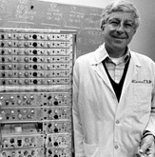
Dement and Kleitman (1957)
Research questions:
Does dream recall correlate to REM?
Is there a correlation between REM duration and estimates of dream length?
Are rapid eye movements connected to content of dreams?
Design: Lab experiment
Procedure: 9 participants (7m, 2f), 5 studied intensively
Method: Participants came to the lab just before their usual bedtime. Asked to avoid caffeine and alcohol on the day of the study. They went to bed in a dark, quiet room.
An EEG (electrodes attached to participant’s face and scalp) was used to record signals
woken at various times to test dream recall
Notes:
Fill in study summary

Slide 61
Findings
Notes:
If woken during REM sleep participants were more likely to say they had been dreaming There appeared to be a link between eye movement and dreaming.

Slide 62
Evaluation
Lacks ecological validity; unnatural sleeping location which could have affected their sleeping patterns
Waking participants during the night…!?
Sample size!! male-female ratio!! Generalisation!?
Later studies didn’t find a connection between eye movements and dream-contents
Notes:
well controlled lab experiment
small sample
(may be less important because study of physiological condition rather than psychological)
breakthrough in dream research
close correlation REM - dreams
nature of relationship remains unclear

Slide 63
What you should know
Biological processes relating to sleep and dreams, which must include:
Circadian rhythms
Non-REM and REM sleep and dreaming
The role of the brain in sleep
Oswald’s (1966) Restoration theory of sleep
The aims, methods, results and conclusions of Dement, W. and Kleitman, N. (1957)
You must now choose 1 way to show your knowledge on the above 5 areas.

Slide 64
Cognitive processes relating to sleep and dreams

Slide 65
What you need to know
Cognitive processes relating to sleep and dreams, which must include:
Sleep to facilitate information processing
Crick and Mitchison’s (1986) Reorganisational theory of dreaming
The aims, methods, results and conclusions of Czeisler, et al. (1990).

Slide 66
Sleep to facilitate information processing
The cognitive approach focuses on the role of sleep in memory and thinking.
According to this viewpoint, the mind is a processor of information and sleep largely exists in order to facilitate this information processing.
During sleep the mind can clean up the files, pruning out unnecessary items and strengthening links between memories.

Slide 67
Sleep to facilitate information processing
Strickgold (2009) has investigated the processes by which memories develop during sleep. According to his research, sleep can be of benefit to every type of memory, but he suggests that those that have a medium (rather than strong or weak) memory trace gain the biggest benefit.

Slide 68
Sleep to facilitate information processing
Sometimes a nap is just as good as an overnight sleep when it comes to consolidating learning through sleep.
Mednick et al (2003) found that for a perception task, the same benefit was found after a 90 minute nap (containing all sleep stages) as from a full night’s sleep. This idea has been supported by research into infants – Seehagen et al (2015), found that when babies were learning a new action, those who had taken a nap showed a better recall of the skill than those who had not.

Slide 69
Sleep to facilitate information processing
Use the 3 studies below to “explain how sleep helps with processing information”
Strickgold (2009) – Medium memory gaining the most benefit
Mednick et al (2003) – 90 minute nap and then a perception task
Seehagen et al (2015) – Babies learning a new action, comparing those who have napped and those who haven’t.

Slide 70
Reorganisational theory of dreaming (Crick & Mitchison, 1983)
“We dream in order to forget”
Crick & Mitchison (1983)
The reorganisation theory suggests that the role of dreaming is to delete unwanted memories – ‘reverse learning’.
Similar to the activation-synthesis theory, dreams are seen as random by-products of this process.

Slide 71
Reorganisational theory of dreaming (Crick & Mitchison, 1983)
The reorganisational theory of dreaming would predict links between what we think about during the day and what appears in our dreams. This is partly supported by evidence that dreams usually have a story that makes sense, rather than being a random mixture of memories.
The idea that dream content is based on what we have been thinking about when awake is called the continuity hypothesis of dreams.

Slide 72
Reorganisational theory of dreaming (Crick & Mitchison, 1983)
Crick & Mitchison state there are two types of memories.
Parasitic memories = bad (like parasites)
Adaptive memories = good (help survival)
During our sleep we make our way through all these memories and keep the adaptive ones and throw away the parasitic memories.

Slide 73
Reorganisational theory of dreaming (Crick & Mitchison, 1983)
You are going to watch another video this time describing the Reorganisational theory.
It is again 10 minutes long and will be answering questions as you go.
Notes:
https://www.youtube.com/watch?v=CQn-kH6LSsw

Slide 74
Reorganisational theory of dreaming
In summary the reorganisational theory suggests that dreaming is purely to unlearn useless information.
Crick and Mitchison believe that we do this in order to solidify our adaptive memories and make room for more.

Slide 75
Reorganisational theory of dreaming
This theory can be linked with different studies which either provide evidence for or against.
Strickgold (2009) – Medium memory gaining the most benefit
Mednick et al (2003) – 90 minute nap and then a perception task
Seehagen et al (2015) – Babies learning a new action, comparing those who have napped and those who haven’t.
Spiny anteaters and dolphins – No REM, big cortex
Neural networks – Unlearning information when it gets too full

Slide 76
Reorganisational theory of dreaming
The Reorganisational theory implies that our dreams are random and meaningless. Crick & Mitchison state it is just random stimuli from the brain stem breaking memory connections with the cortex.
This could explain why we dream about seemingly useless things which we have seen or experienced that day, as the brain now considers them to be parasitic memories. However, it can’t explain lucid dreaming.

Slide 77
Reorganisational theory of dreaming
The Reorganisational theory implies that dreaming allows adaptive memories to be stored long term. This would suggest after studying new information we should sleep so that these useful/adaptive memories can be stored.

Slide 78
Reorganisational theory of dreaming
This theory can be compared with either/both theories from the biological process.
Reorganisational theory – Doesn’t give a reason for dreaming
Activation-synthesis theory – Dreams are random and meaningless
It could also be compared with idea that dreams have manifest and latent content which you will learn more about later.

Slide 79
Reorganisational theory of dreaming
This theory can be evaluated in many different ways, however appears to be lacking in many strengths.
Strength
Unlike the restoration theory this gives a clear reason for why we dream.
Weakness
How does the brain decide what is useful and what isn’t
If the brain stem stimuli is truly random why do steams have a narrative
Not enough evidence on humans only computers, can’t generalise.

Slide 80
Restoration theory of sleep
Once you have copied all the notes which you need for the Reorganisational theory I want you to attempt the following question.
“Analyse one theory which explains why we sleep” (12 marks)
You should be able to fully complete this question with the notes you have just taken.

Slide 81
Shift work
It has been suggested that humans have evolved to sleep at night because we can’t see in the dark.
However, as businesses and work forces grow and start to work over multiple time-zones more and more people are working shifts.
What are the negative effects of shift work?

Slide 82
Shift work
What are the negative effects of shift work?
Sleep deprivation
Poor quality sleep
Poor alertness
Mistakes at work
Risk of Heart disease for night shift workers – the longer the duration of shift work the greater chance there is of CHD
Job stress & emotional problems (anxiety & depression)

Slide 83
Czeisler et al (1990)
Czeisler et al (1990) believes that shift work environments that are warm and dimly lit are counter productive
They believed that exposure to bright light at night and darkness during the day could help shift workers resynchronise better.

Slide 84
Czeisler et al (1990)
Nightshifts are associated with poor sleep and health problems.
However, previous research had shown that the presence of light or darkness regulates the circadian rhythm and it can ‘reset’ the suprachiasmatic nucleus by up to 12 hours

Slide 85
Czeisler et al (1990)
Nightshifts are associated with poor sleep and health problems.
However, previous research had shown that the presence of light or darkness regulates the circadian rhythm and it can ‘reset’ the suprachiasmatic nucleus by up to 12 hours

Slide 86
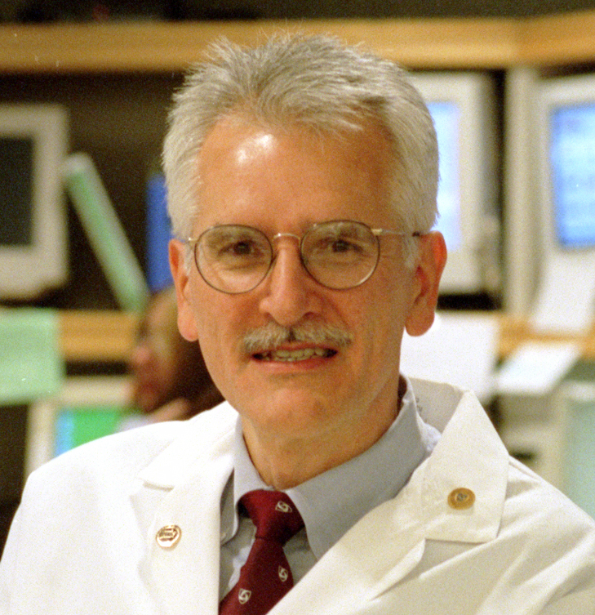
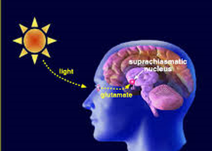
Czeisler et al (1990)
Aim - To evaluate if exposure to bright light at night and darkness in day can treat maladaptation due to night work.
Method – 8 males. 2 conditions, control and treatment. 2 weeks of nightshift. Treatment group with extremely bright lights, control group with normal lights.
Results – Treatment group slept 2 hours longer and treatment were more alert than control by the end of week 2.
Notes:
Fill in study summary

Slide 87
Boivin et al (1996) for comparison with Czeisler
Boivin et al (1996) put 31 male participants on an inverted sleep pattern (so they were awake at night and slept during the day) for three days.
Each day when they woke they were sat in front of dim lights for 5 hours and then placed in one of four conditions:
1.Very bright light, 2.Bright light ,3.Ordinary room light , 4. Continued dim light.
Core body temperature was recorded and used as a measure of how well they were adapting to the new rhythm. After three days:

Slide 88
Boivin et al (1996)
1.Very bright light, 2.Bright light ,3.Ordinary room light , 4. Continued dim light.
Group 1 had advanced by five hours (they were adapting to the new pattern best)
Group 2 had advanced by three hours.
Group 3 had advanced by one hour.
Group 4 had drifted backwards by one hour (were failing to show any signs of adapting).

Slide 89
What you should know
Cognitive processes relating to sleep and dreams, which must include:
Sleep to facilitate information processing
Crick and Mitchison’s (1986) Reorganisational theory of dreaming
The aims, methods, results and conclusions of Czeisler, et al. (1990).
You must now choose 1 way to show your knowledge on the above 3 areas.

Slide 90
Psychoanalytic processes relating to sleep and dreams

Slide 91
What you need to know
Psychodynamic processes relating to sleep and dreams, which must include:
Conscious and unconscious processes
Manifest and latent content of dreams
Defence mechanisms

Slide 92
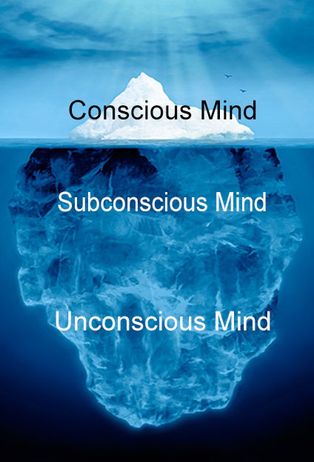
Conscious and unconscious processes
Sigmund Freud didn’t invent the idea of the conscious versus unconscious mind, but he was responsible for making it popular and this was one of his main contributions to psychology.
He believed the mind was split into 3 different areas and that these all influence our behaviours.

Slide 93
Conscious and unconscious processes
Freud described the conscious mind as things we are aware of and this is seen as the tip of the iceberg.

Slide 94
Conscious and unconscious processes
The subconscious contains thoughts and feelings that a person is not currently aware of, but which can easily be brought to consciousness
Freud describes the subconscious (preconscious)as a mental waiting room, in which thoughts remain until they 'succeed in attracting the eye of the conscious'

Slide 95
Conscious and unconscious processes
The unconscious mind is filled with mental processes that can’t be accessed by consciousness but that influence judgements, feelings, or behaviour
Our feelings, motives and decisions are powerfully influenced by our past experiences and stored in the unconscious.

Slide 96
Conscious and unconscious processes
Remembering a friend’s mobile number.
Hating a family member
Feeling thirsty

Slide 97
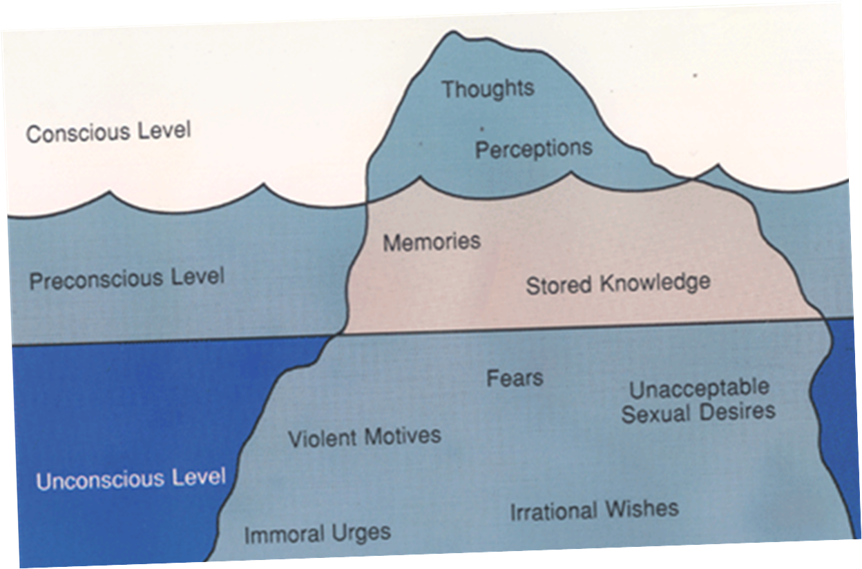
Conscious and unconscious processes
What part of the mind do you think dreams represent?
How could Psychologists use dreams to examine the mind?

Slide 98
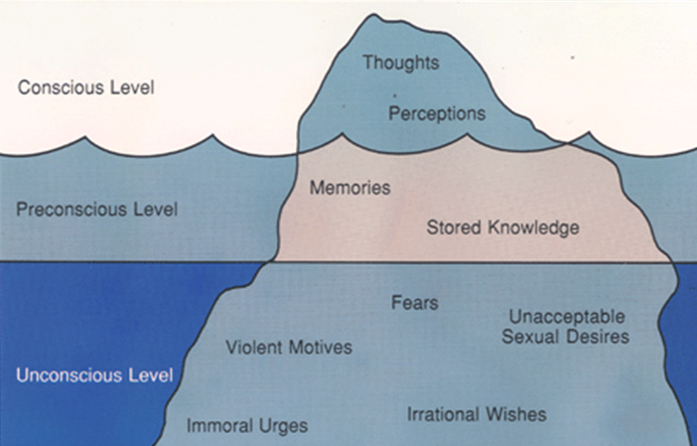

Slide 99
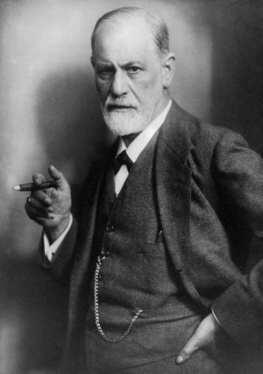
Conscious and unconscious processes in dreams
Freud explained dreams as a window into our unconscious and a manifestation of our deepest desires and anxieties (mostly of a sexual nature).
He said dreams express repressed childhood memories or obsessions. According to Freud, through our dreams, our subconscious can uncover the wishes that our conscious mind has learned to repress, and we use dreams to live out our deepest wishes and desires

Slide 100
Manifest and Latent content
Freud (1915) found that some events and desires were often too frightening or painful for his patients to acknowledge, and believed such information was locked away in the unconscious mind.
Freud believes that although we use our dreams to live out our unconscious thoughts, our mind still has to protect itself so creates two different layers to the dreams.
Dreams contain:
Manifest content – the story of the dream, often based on the events of the day
Latent content – the underlying meaning of the dream

Slide 101
Manifest and Latent content
The process whereby the underlying wish is translated into the manifest content is called dreamwork.
The purpose of dreamwork is to transform the forbidden wish into a non-threatening form, thus reducing anxiety and allowing us to continue sleeping.
For example, one of Freud’s patients was extremely resentful of his sister-in-law and used to refer to her as a dog, dreamed of strangling a small white dog. If the patient would have really dreamed of killing his sister-in-law, he would have felt guilty. The unconscious mind transformed her into a dog to protect him.

Slide 102
For example:
Freud also thought that dreams contain a series of symbols, with the true meaning of the dream hidden from the conscious mind. Anything that is disturbing, or embarrassing can be hidden by the unconscious mind using symbolic image.
These symbols may be based on the psychosexual obsessions of the person’s psychological stage of development – for example, Little Hans dreamed about his penis during the phallic stage.
Manifest Content | Latent Content
School | Learning or being judged
A storm | Emotional turmoil
Teeth falling out | Worries or lack of control
Pregnancy | A new aspect of self
Notes:
Copy out the table of manifest and latent content

Slide 103
Manifest and Latent content
Notes:
https://www.youtube.com/watch?v=g3QTV8MjAuM

Slide 104
Manifest and Latent content
Write down any dream which you have had in the past (if you can’t remember any make one up) on the blank piece of paper.
These dreams will be anonymous and are going to be swapped with someone else in the class.
You will all then try and discover the latent meaning behind these dreams using books/iPads/phones.

Slide 105
Example of manifest and latent content
In the case study of Little Hans Freud analysed Hans’ dreams through letters with Herb, Hans father.
Herb reported the manifest content of 3 different dreams in particular.
Hans was married to his mother and they had their own family.
There was a big giraffe in the room and a crumpled giraffe. The big giraffe called out because Hans took the crumpled one away. Hans then sat on the crumpled giraffe
A plumber came to the house and removed his ‘widdler’ and then replaced it with a bigger one.

Slide 106
Example of manifest and latent content
Herb reported the manifest content of 3 different dreams in particular.
Hans was married to his mother and they had their own family.
There was a big giraffe in the room and a crumpled giraffe. The big giraffe called out because Hans took the crumpled one away. Hans then sat on the crumpled giraffe
A plumber came to the house and removed his ‘widdler’ and then replaced it with a bigger one.
What do you think the latent content of these 3 dreams could be?

Slide 107
Example of manifest and latent content
Hans was married to his mother and they had their own family.
Freud claimed that Hans had a romantic desire for his mother and because of this wanted to get rid of his father.

Slide 108
Example of manifest and latent content
2. There was a big giraffe in the room and a crumpled giraffe. The big giraffe called out because Hans took the crumpled one away. Hans then sat on the crumpled giraffe.
Hans enjoyed getting into his parents bed in a morning but his father often objected (the big giraffe calling out because he had taken the crumpled giraffe - mother - away). Both Freud and the father believed that the long neck of the giraffe was a symbol for the large adult penis.

Slide 109
Example of manifest and latent content
3. A plumber came to the house and removed his ‘widdler’ and then replaced it with a bigger one.
Freud again linked this back to his romantic desire for his mother. He said that Hans wanted to be a grown up man and perceived having a larger penis as a representation of being a grown up.

Slide 110
Manifest and Latent content
Freud claimed that we cannot discover the latent content of someone’s dreams without knowing them personally.
'Dream dictionaries', which are still popular now, were a source of irritation to Freud. In an amusing example of the limitations of universal symbols, one of Freud's patients, after dreaming about holding a wriggling fish, said to him 'that's a Freudian symbol - it must be a penis!'
Freud explored further, and it turned out that the woman's mother, who was a passionate astrologer and a Pisces, was on the patient's mind because she disapproved of her daughter being in analysis.

Slide 111
Defence Mechanisms
Defence mechanisms are psychological strategies that are unconsciously used to protect a person from anxiety arising from unacceptable thoughts or feelings.

Slide 112
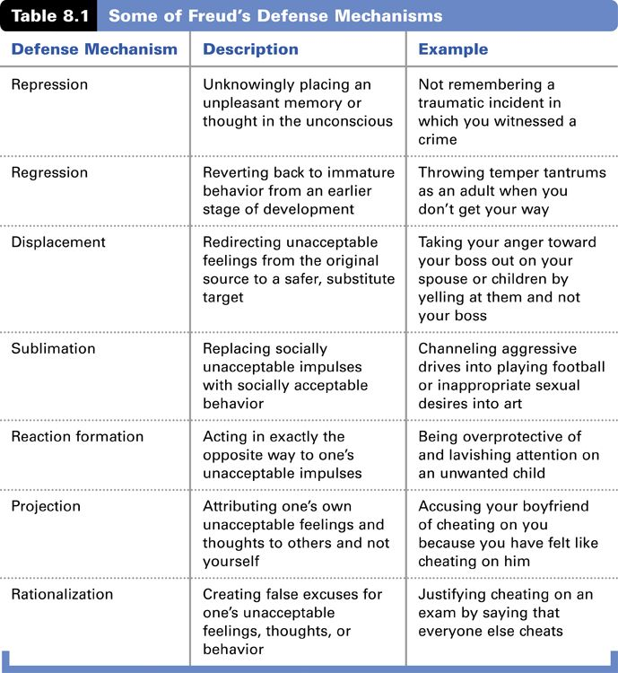
Notes:
Freud claims that we all unconsciously have at least some of these defence mechanisms. Which ones do you think occur during dreams.

Slide 113
Defence Mechanisms - Repression
Sometimes thoughts and memories are thought to have been repressed, meaning they have apparently been forgotten, but in reality have been pushed out of the conscious and into the unconscious.
These repressed thoughts and memories can according to psychoanalysts, be accessed through our dreams.
This is where Freudian slips come from. E.g, calling your boyfriend/girlfriend your exes name.

Slide 114
Defence Mechanisms - Displacement
Displacement means focussing the emotions we feel towards another we cannot confront onto a more accessible target.
This is seen in day to day life when someone may come home from work and argue with their partner when their real frustration is at their boss.
This also happens in dreams when the manifest content changes the true meaning of the dream in order to protect ourselves from the stress/guilt which may occur.

Slide 115
Defence Mechanisms - Sublimation
Sublimation means replacing socially unacceptable impulses with socially acceptable behaviours.
We again can see this when our dreams change our true desires into more acceptable manifest stories.

Slide 116
Evaluation of Psychodynamic
Strengths ·
Freud is a very influential psychologist, especially in the field of personality- he continues to have an influence on everyday language and culture ·
The theory suggests a link between dreaming and desire and has generated research, speculation and controversy in relation to the topic of dreaming ·
A study of patients suffering from strokes reveals that they lose their capacity to dream if there is damage to areas of higher forebrain governing desires (Solms, 1999). This supports the claim that there may be a link between dreaming and desire.

Slide 117
Evaluation of Psychodynamic
Weaknesses ·
It is based on the interpretation of dreams and it is not possible to gather evidence to support the theory
The content of dreams may mirror events during a person’s waking hours and may not be symbolic in any way
Poor research evidence/unscientific
Biased sample - Freud used mainly middle class women from Vienna for his research
Case study method cannot be generalised to the wider population
Emphasis on sexual factors

Slide 118
What you should know
Psychodynamic processes relating to sleep and dreams, which must include:
Conscious and unconscious processes
Manifest and latent content of dreams
Defence mechanisms
You must now choose 1 way to show your knowledge on the above 3 areas.

Slide 119
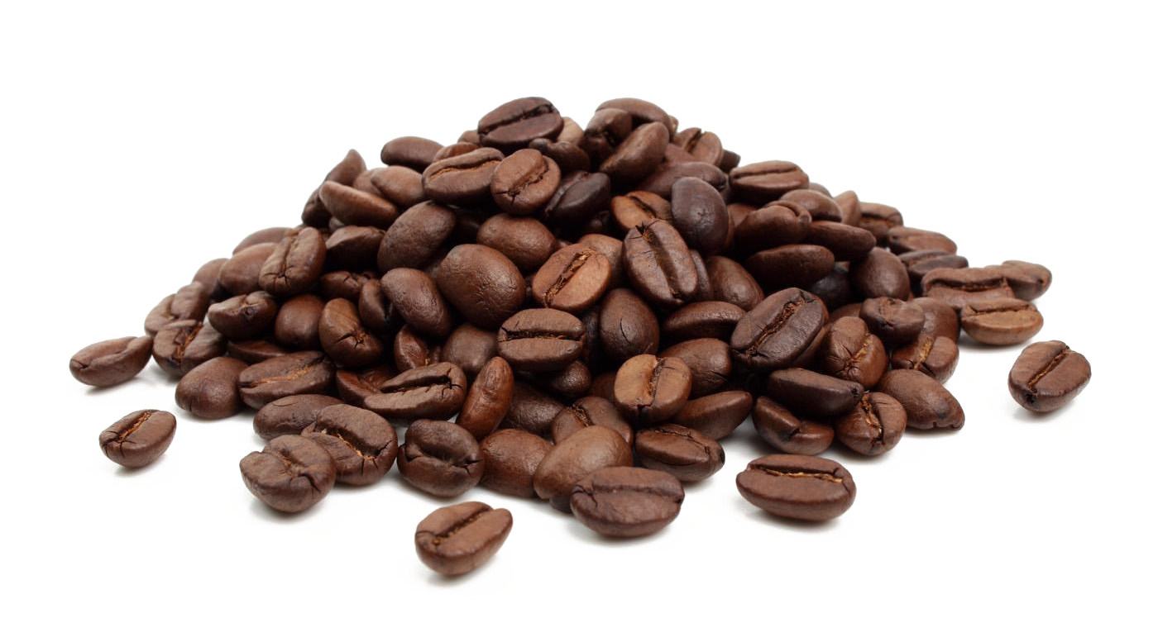
What factors affect sleep?

Slide 120
What you need to know
Factors affecting sleep, which must include:
Impact of drugs
Impact of light

Slide 121
Poor quality of sleep
Czeisler linked poor quality sleep and not sleeping enough to a raft of illnesses
These include:
Coronary heart disease
Digestive illnesses
Reproductive problems

Slide 122
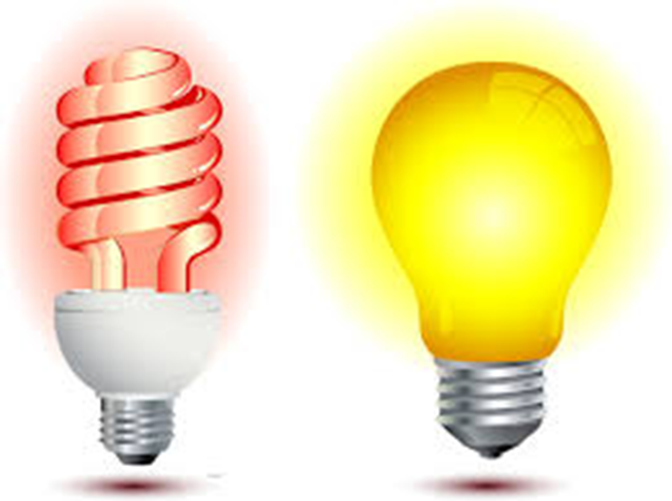
Returning to zeitgebers…
The main zeitgeber that affects our sleep is light
Darkness and light are zeitgebers
In the past we’d get sleepy as it started to get dark
Nowadays we have artificial light
We often stay awake or get in when it is still dark

Slide 123
Research
There is growing evidence that artificial light can upset out circadian rhythms and affect sleep quality
The worst wavelength of artificial light for disturbing our sleep pattern is blue wavelength
This wavelength really upsets the production of sleep hormones
It drastically disrupts the production of melatonin, the main sleep hormone
What do you think emits this type of light?

Slide 124
The worst culprits

Slide 125
Research
Unfortunately….
Before we found out that this light was so disruptive to our sleep many of us had started using phones and tablets as an alarm
One of the best things you can do for your sleep pattern is to ban these from your bedroom

Slide 126
Drugs
Prescription and recreational drugs can severely affect our sleep patterns
We’ll look briefly at stimulants, depressants and side effects of prescription drugs

Slide 127
Drugs - Caffeine
The most popular psychoactive drug in the world
In coffee, energy drinks, colas, tablets
It has a half life of around 5 hours in the human body

Slide 128
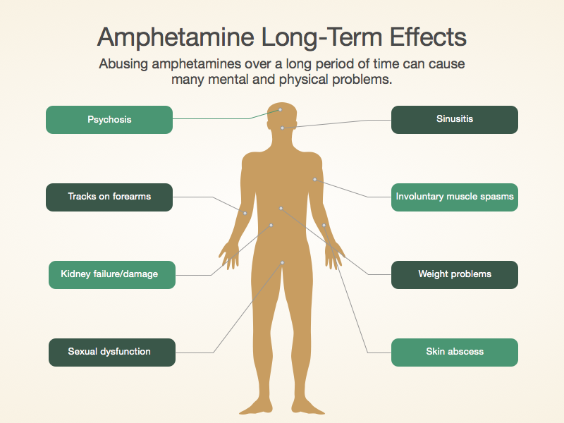
Drugs - Ampheamine
Often called speed
Class B drug
Taken as a recreational drug
Severely affects sleep patterns

Slide 129
Drugs - Prescription
Often have unwanted side effect and affecting sleep
Anti depressants often cause drowsiness or insomnia
Anti-histamines are an example of a drug that causes daytime drowsiness and can affect sleep later

Slide 130
Drugs - Alcohol
Alcohol acts as a depressant making us drowsy
This can have the effect of us getting off to sleep easily
However, it affects later parts of the sleep cycle particularly disrupting the balance of REM to non-REM sleep

Slide 131
Sleep hygiene
Simply put sleep hygiene refers to the rituals and behaviours you follow around sleep
The most important are:
Temperature – neither too hot nor too cold
Darkness – the darker, the better
Quiet – the quieter, the better
A comfortable place to lie down and stretch out

Slide 132
Sleep hygiene
Go to bed the same time every night
Keep your bedroom dark and cool
Dedicate your bed to sleep and nothing else
Limit screen time before going to bed
Don’t eat a huge meal soon to bedtime
Exercise – but not within two hours of bedtime
Get some sunshine, it will help reset your circadian rhythms (the absolute best way to do this is to sleep in a tent now and again!)

Slide 133
Sleep hygiene
If you can’t fall asleep after 20 minutes, leave your bedroom and do something relaxing somewhere else. You don’t want your mind to associate your bed with frustration
Don’t focus on the time, as it will just cause unhelpful anxiety
Do not (under any circumstances) check messages/social media etc on your mobile phone/tablet

Slide 134
What you should now know
Biological processes relating to sleep and dreams, which must include:
The role of the brain in sleep
Circadian rhythms
Non-REM and REM sleep and dreaming
Oswald’s (1966) Restoration theory of sleep
The aims, methods, results and conclusions of Dement, W. and Kleitman, N. (1957)
Cognitive processes relating to sleep and dreams, which must include:
Sleep to facilitate information processing
Crick and Mitchison’s (1986) Reorganisational theory of dreaming
The aims, methods, results and conclusions of Czeisler, et al. (1990).
Psychodynamic processes relating to sleep and dreams, which must include:
Conscious and unconscious processes
Manifest and latent content of dreams
Defence mechanisms
Factors affecting sleep, which must include:
Impact of drugs
Impact of light

